Slide 1
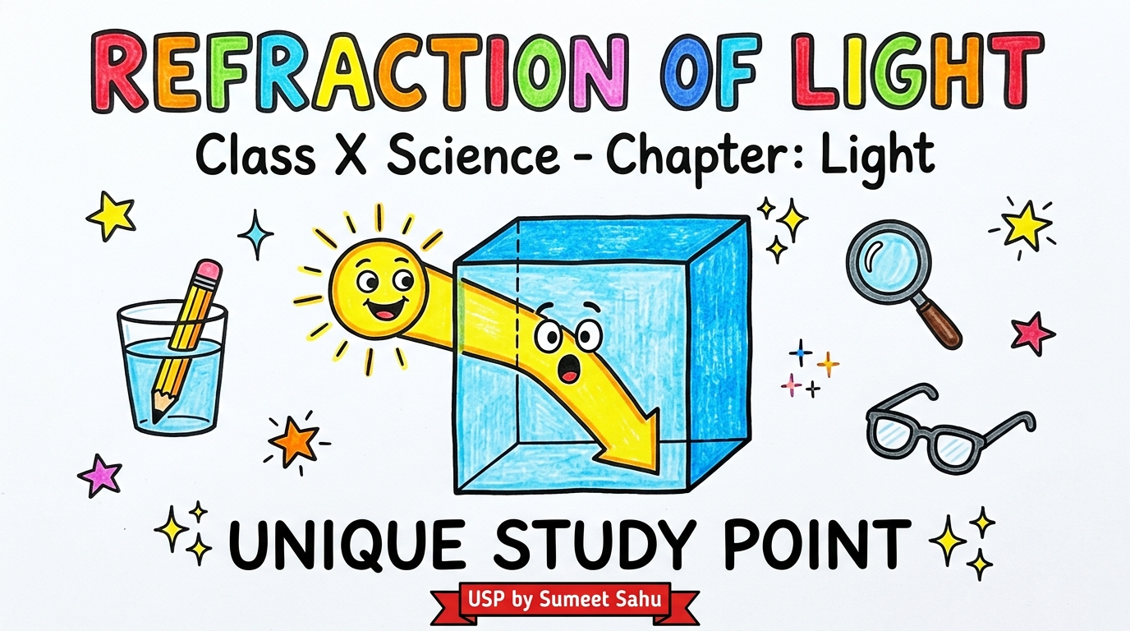
Notes:
Slide 1: Cover - Refraction of Light | Unique Study Point - Session 2026-27

Slide 2
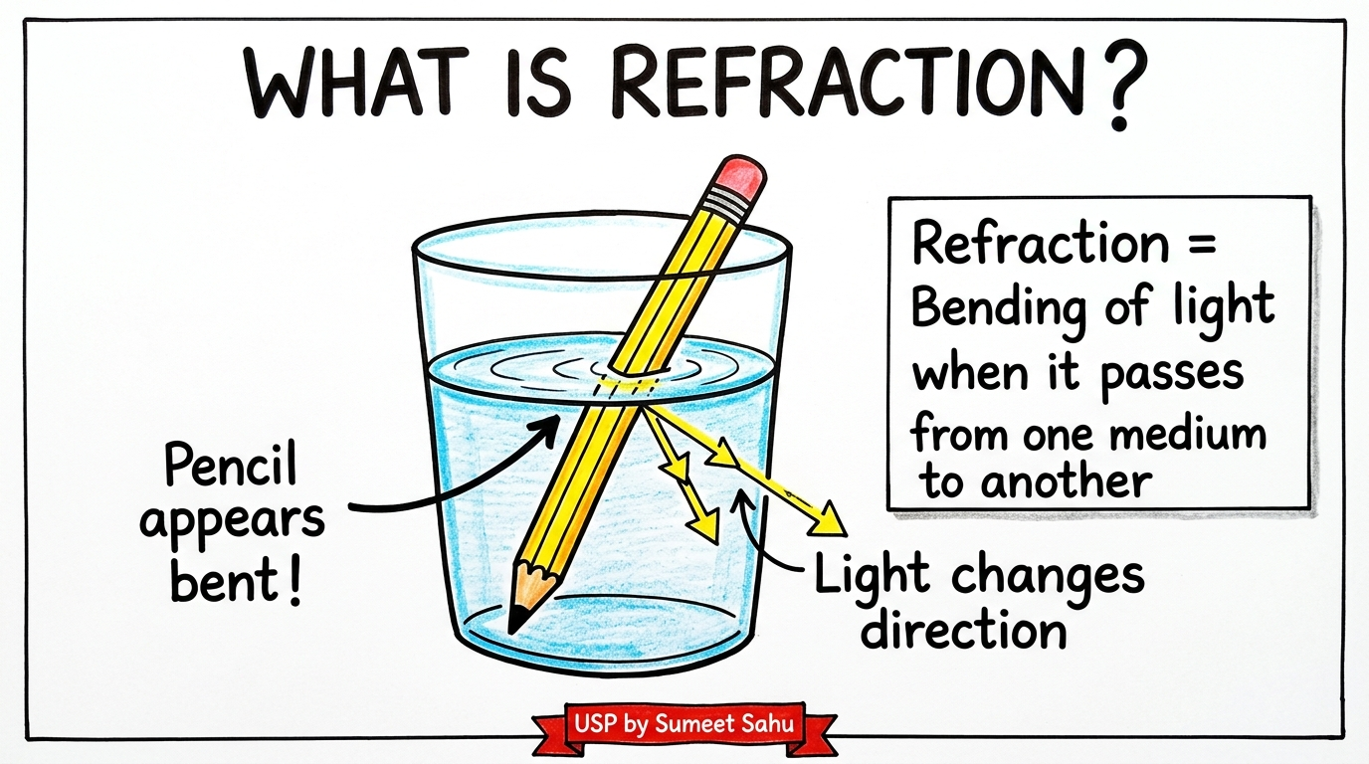
Notes:
Slide 2: What is refraction? | Unique Study Point - Session 2026-27

Slide 3
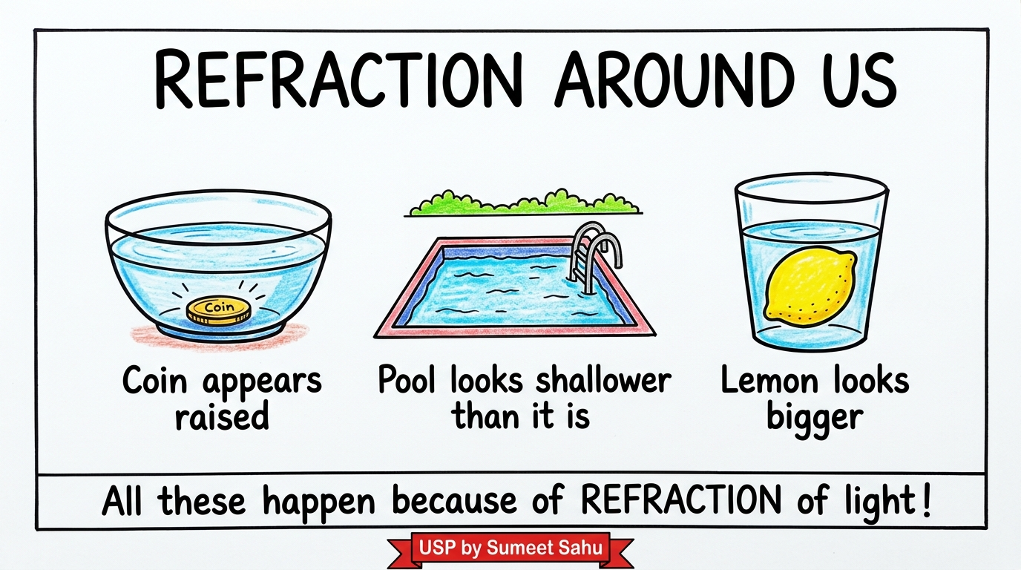
Notes:
Slide 3: Refraction around us (daily life) | Unique Study Point - Session 2026-27

Slide 4
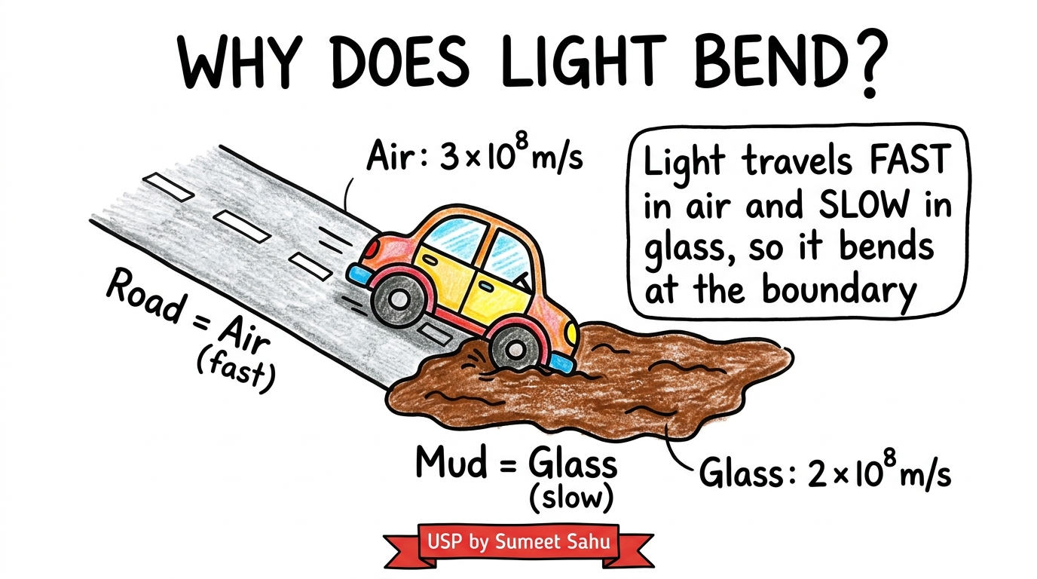
Notes:
Slide 4: Why does light bend? (speed change) | Unique Study Point - Session 2026-27

Slide 5
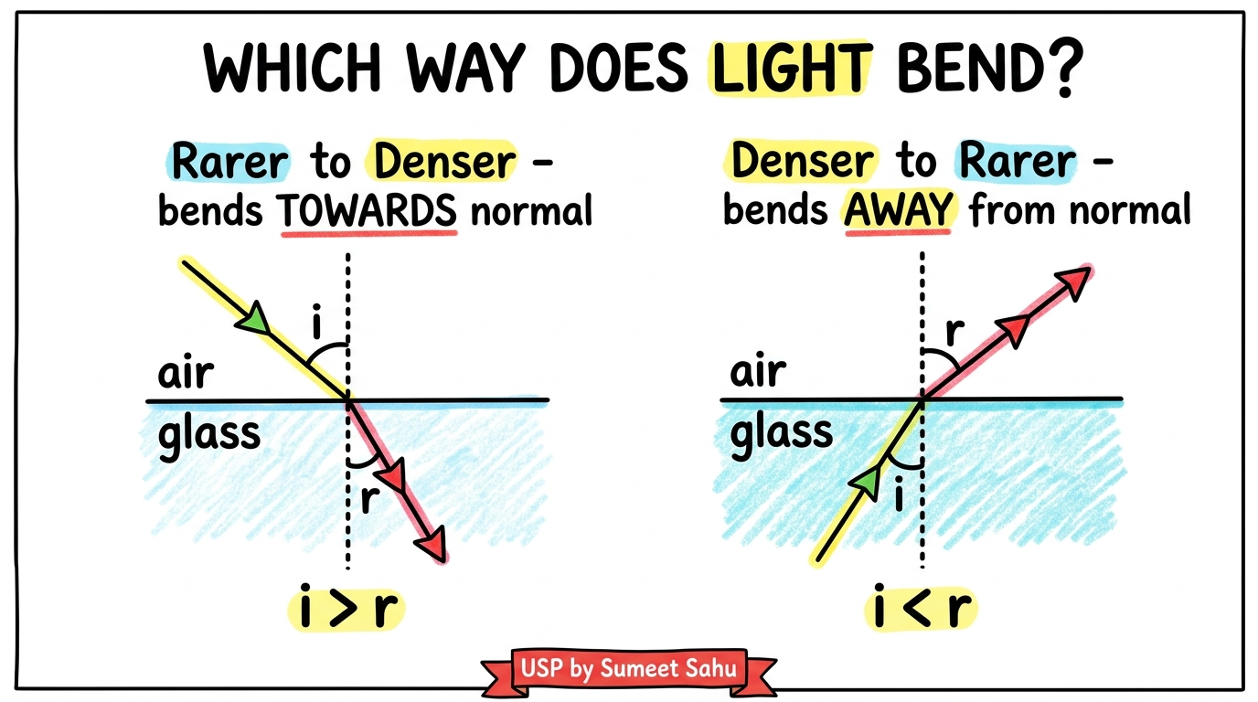
Notes:
Slide 5: Which way does light bend? (towards/away from normal) | Unique Study Point - Session 2026-27

Slide 6
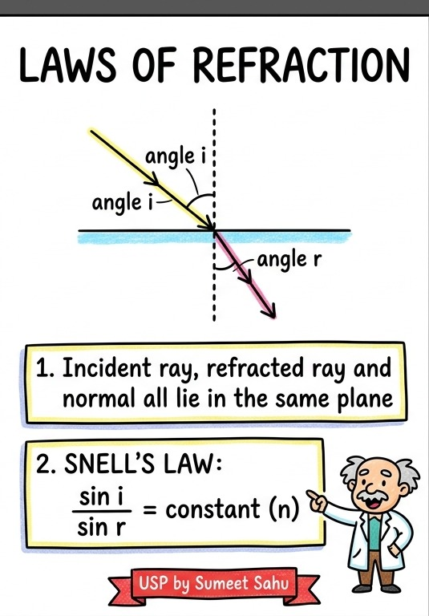
Notes:
Slide 6: Laws of refraction and Snell's law | Unique Study Point - Session 2026-27

Slide 7
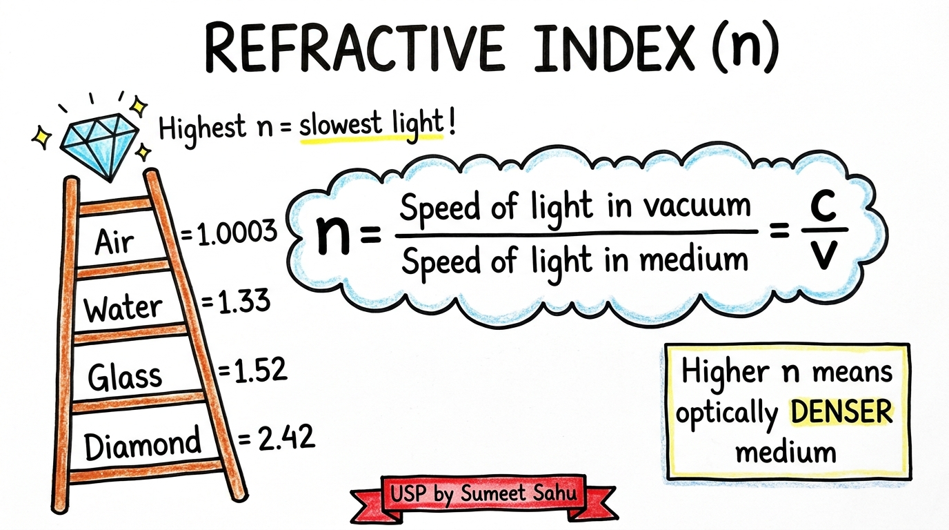
Notes:
Slide 7: Refractive index (n) | Unique Study Point - Session 2026-27

Slide 8
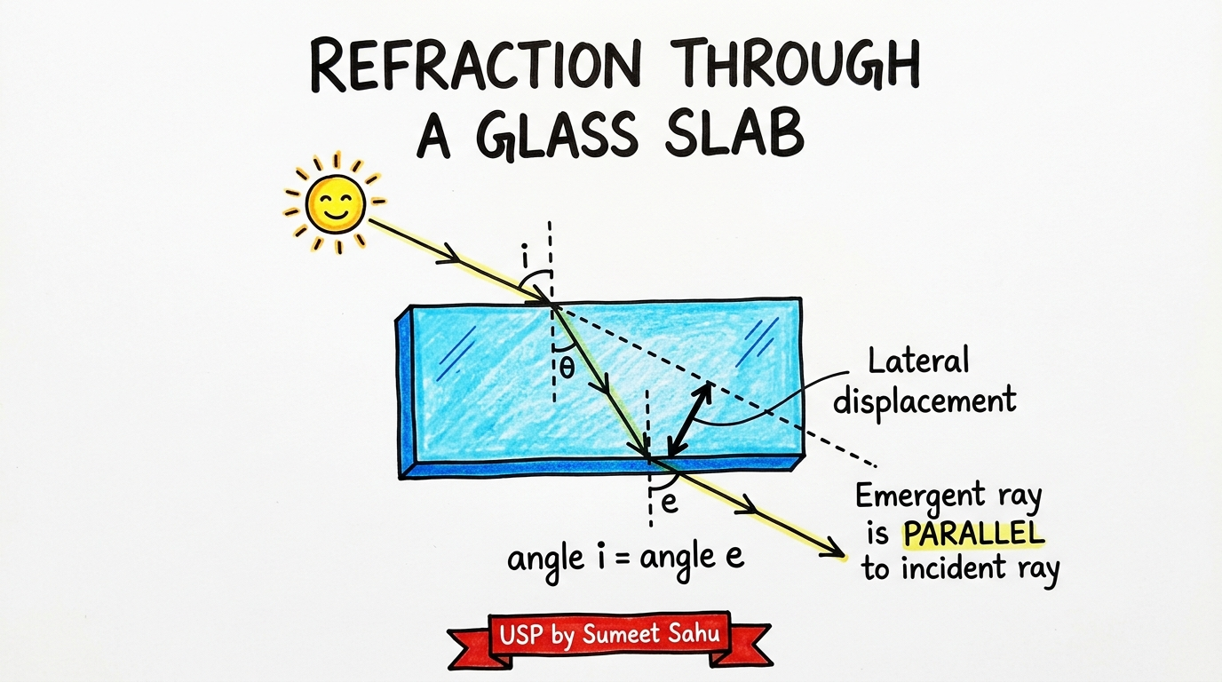
Notes:
Slide 8: Refraction through a glass slab | Unique Study Point - Session 2026-27

Slide 9
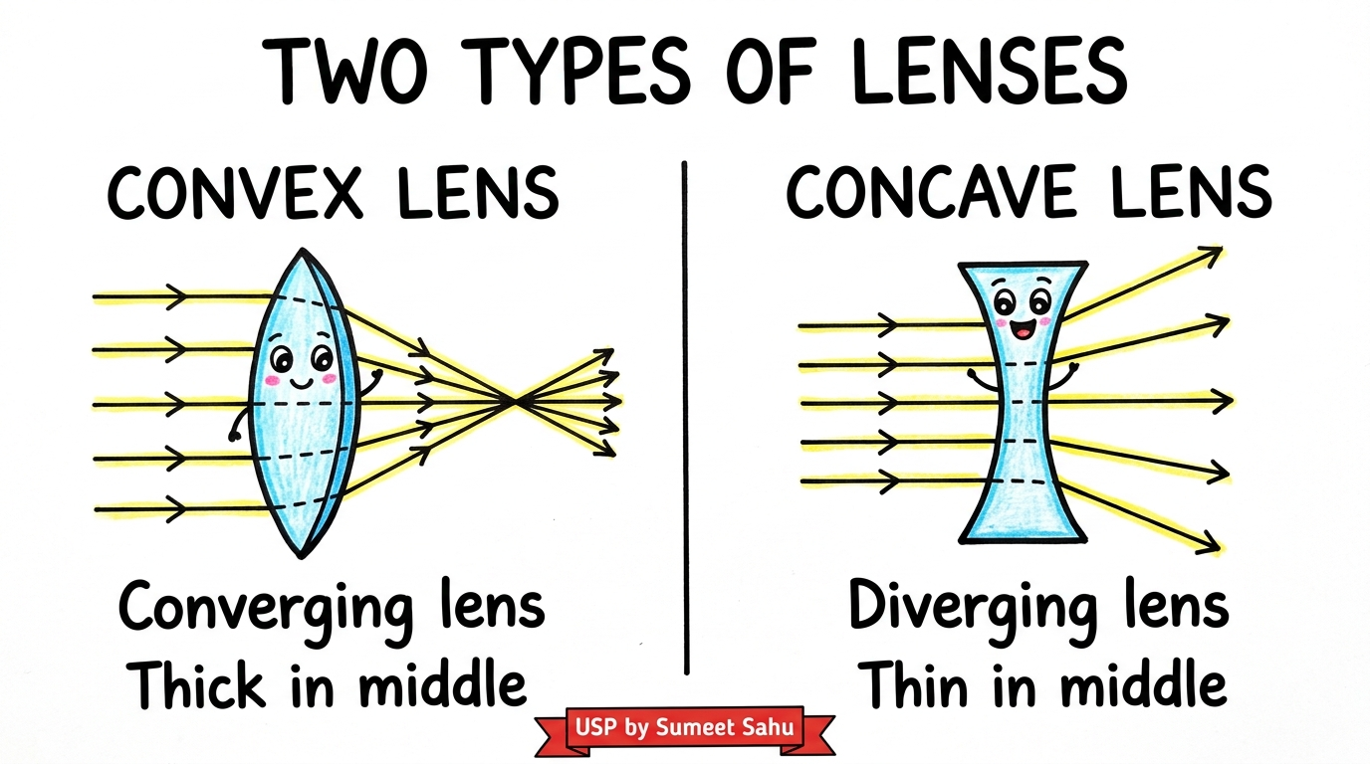
Notes:
Slide 9: Two types of lenses | Unique Study Point - Session 2026-27

Slide 10
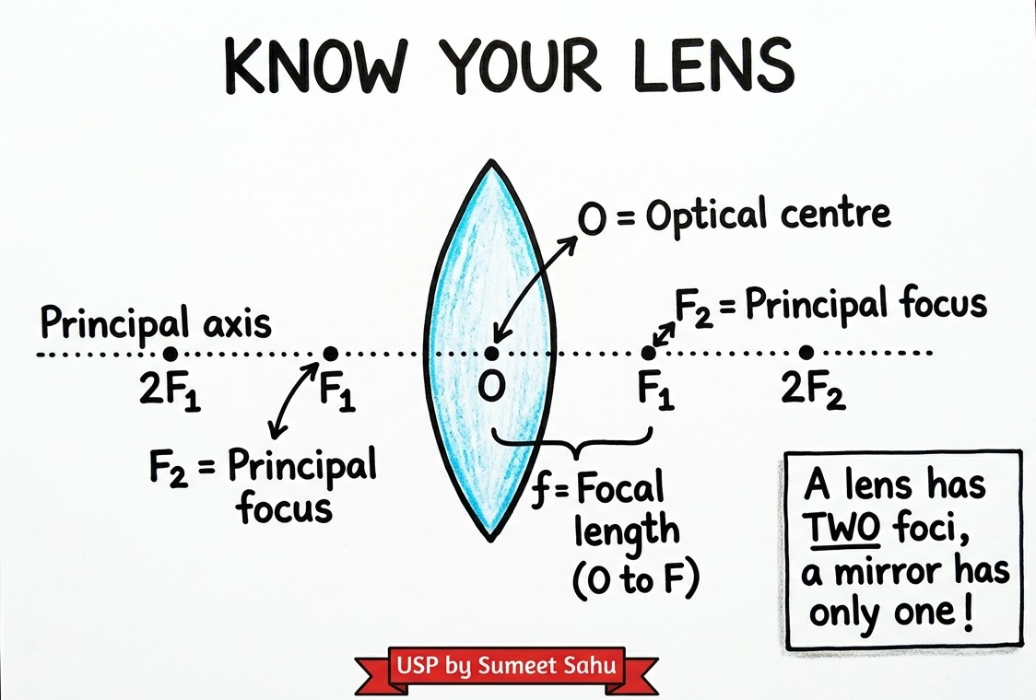
Notes:
Slide 10: Know your lens (terminology) | Unique Study Point - Session 2026-27

Slide 11
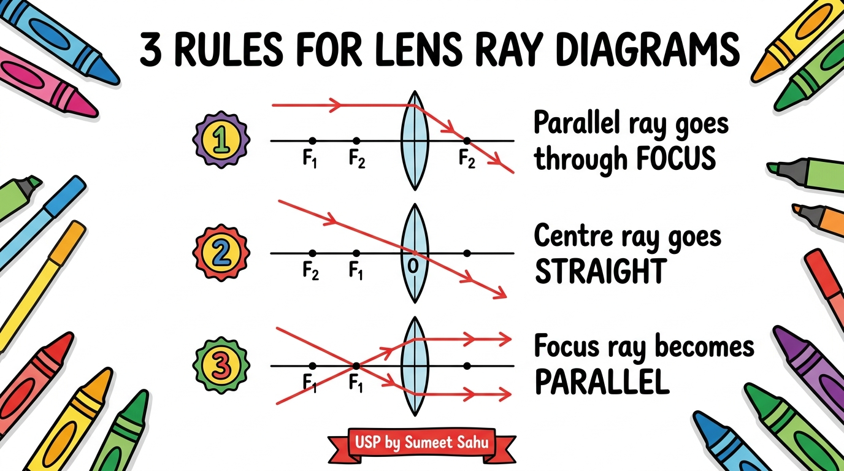
Notes:
Slide 11: 3 rules for lens ray diagrams | Unique Study Point - Session 2026-27

Slide 12
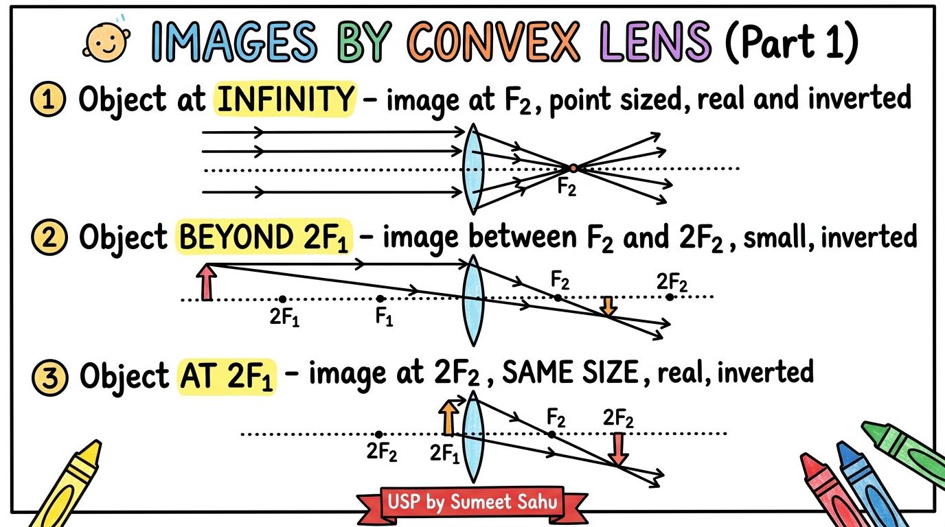
Notes:
Slide 12: Images by convex lens - Part 1 | Unique Study Point - Session 2026-27

Slide 13
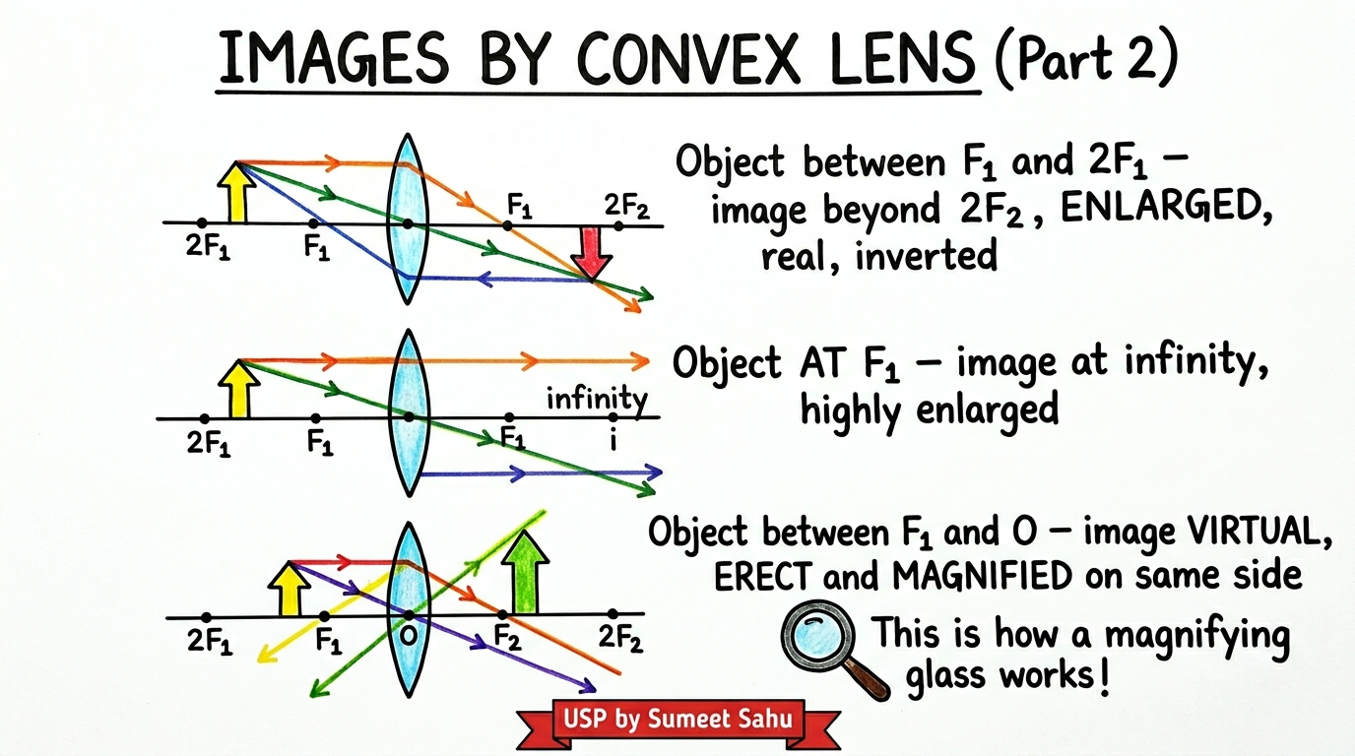
Notes:
Slide 13: Images by convex lens - Part 2 | Unique Study Point - Session 2026-27

Slide 14
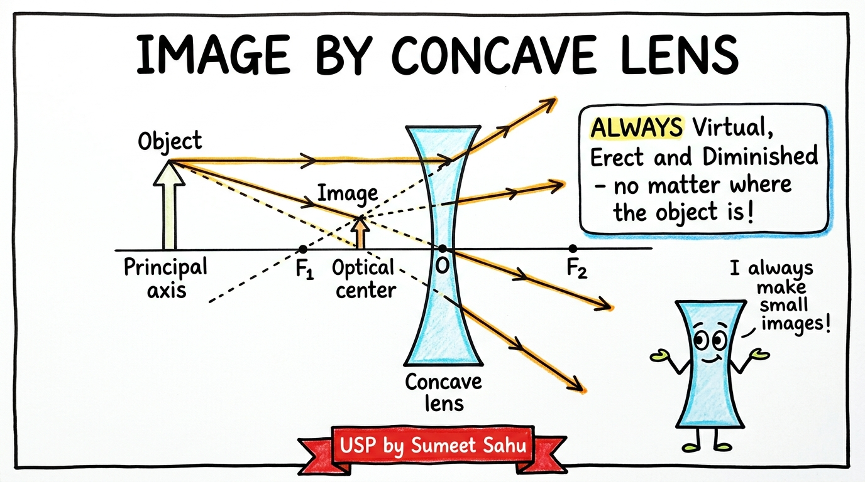
Notes:
Slide 14: Image by concave lens | Unique Study Point - Session 2026-27

Slide 15
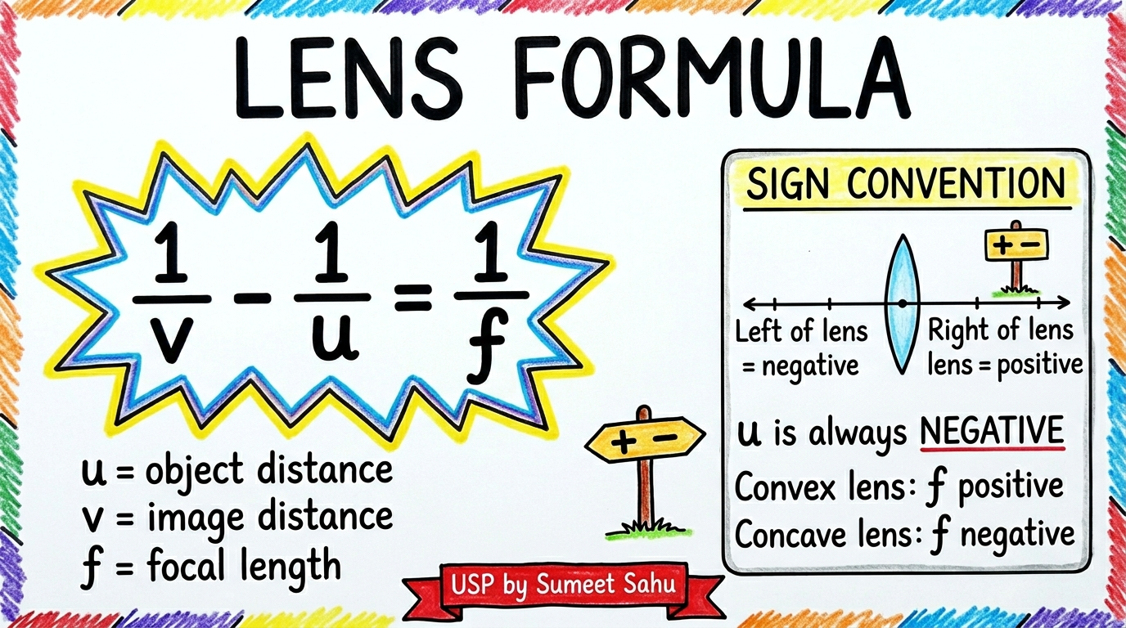
Notes:
Slide 15: Lens formula and sign convention | Unique Study Point - Session 2026-27

Slide 16
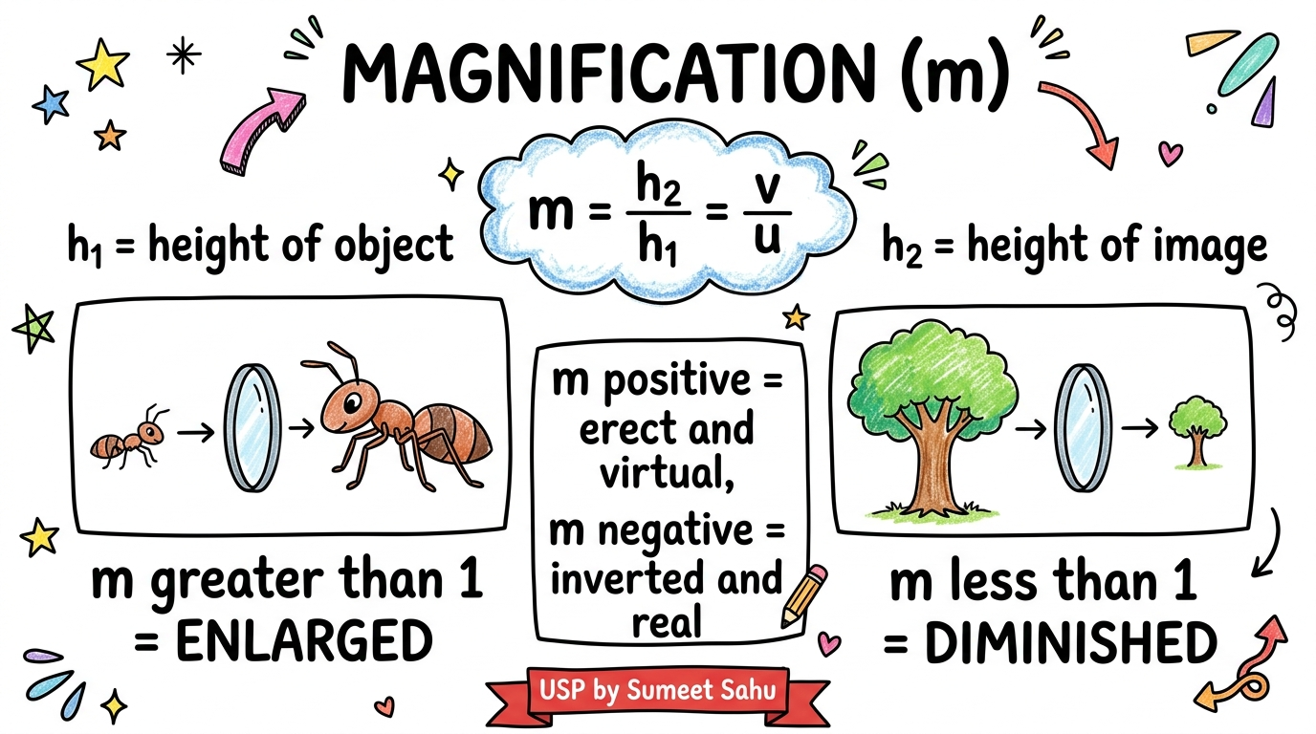
Notes:
Slide 16: Magnification (m) | Unique Study Point - Session 2026-27

Slide 17
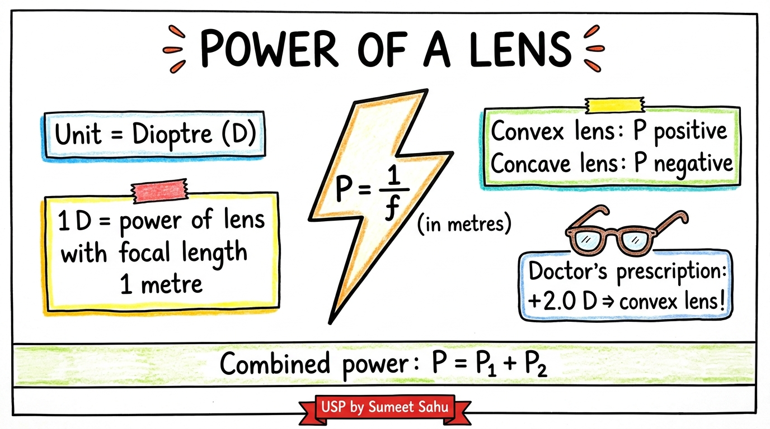
Notes:
Slide 17: Power of a lens | Unique Study Point - Session 2026-27

Slide 18
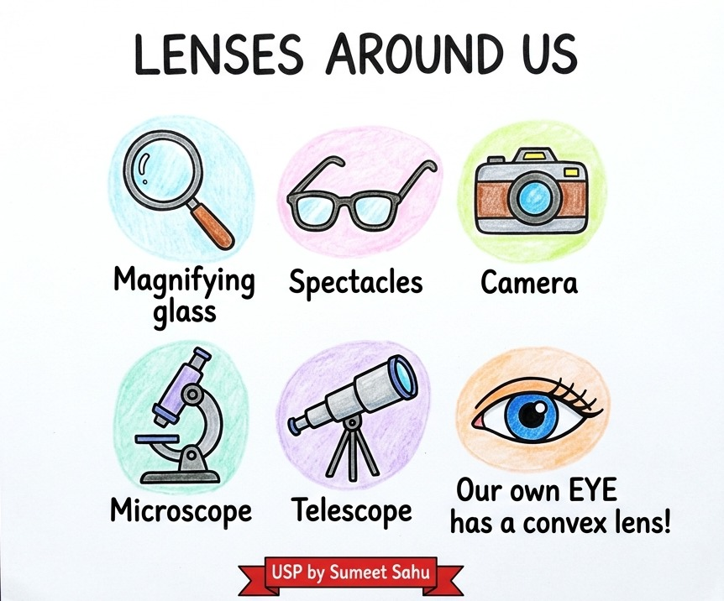
Notes:
Slide 18: Lenses around us | Unique Study Point - Session 2026-27

Slide 19
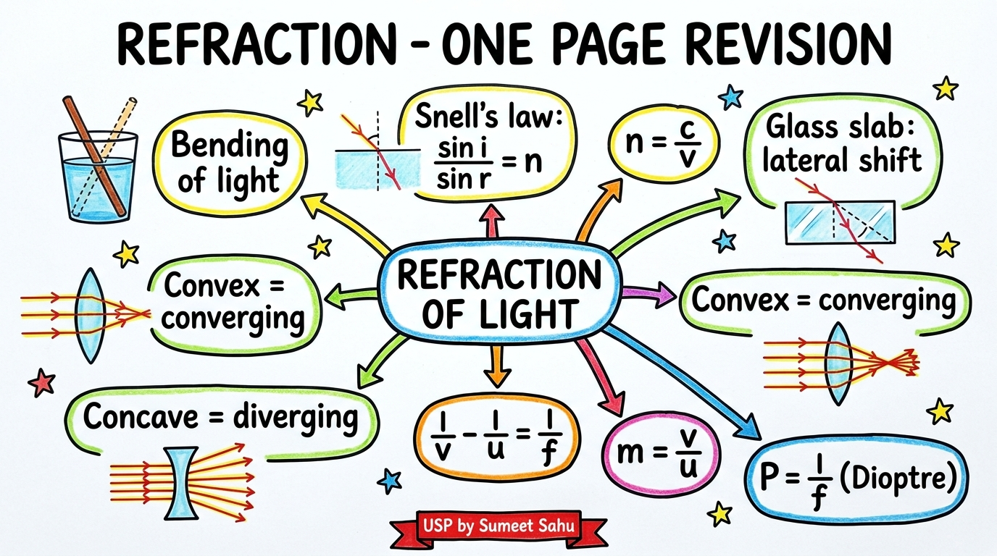
Notes:
Slide 19: One page revision (mind map) | Unique Study Point - Session 2026-27

Slide 20
Keep Practicing!
Refraction of Light - Class X Science
UNIQUE STUDY POINT
uniquestudyonline.com | App on Google Play Store | Ph: 8103405051
USP by Sumeet Sahu
Notes:
Closing slide with USP branding and contact details

