Slide 1
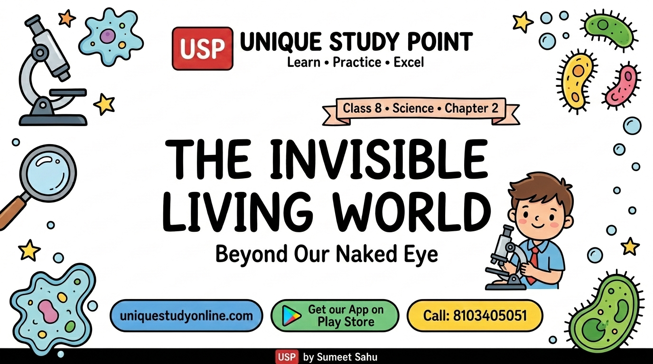

Slide 2
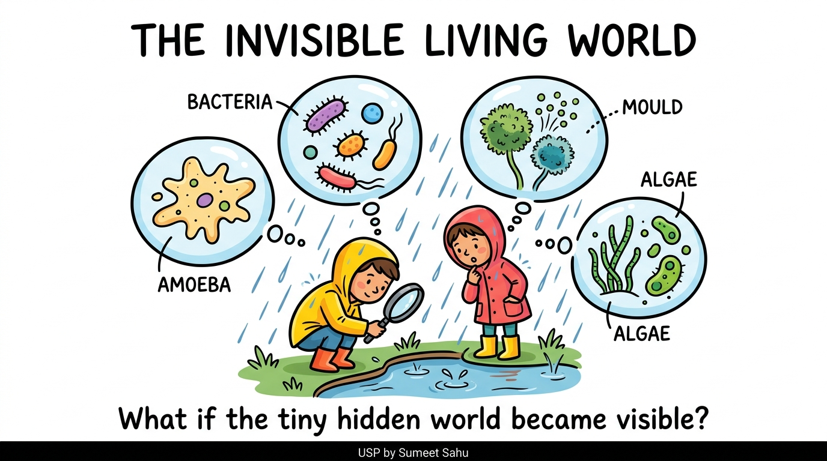
1
The Invisible Living World

Slide 3
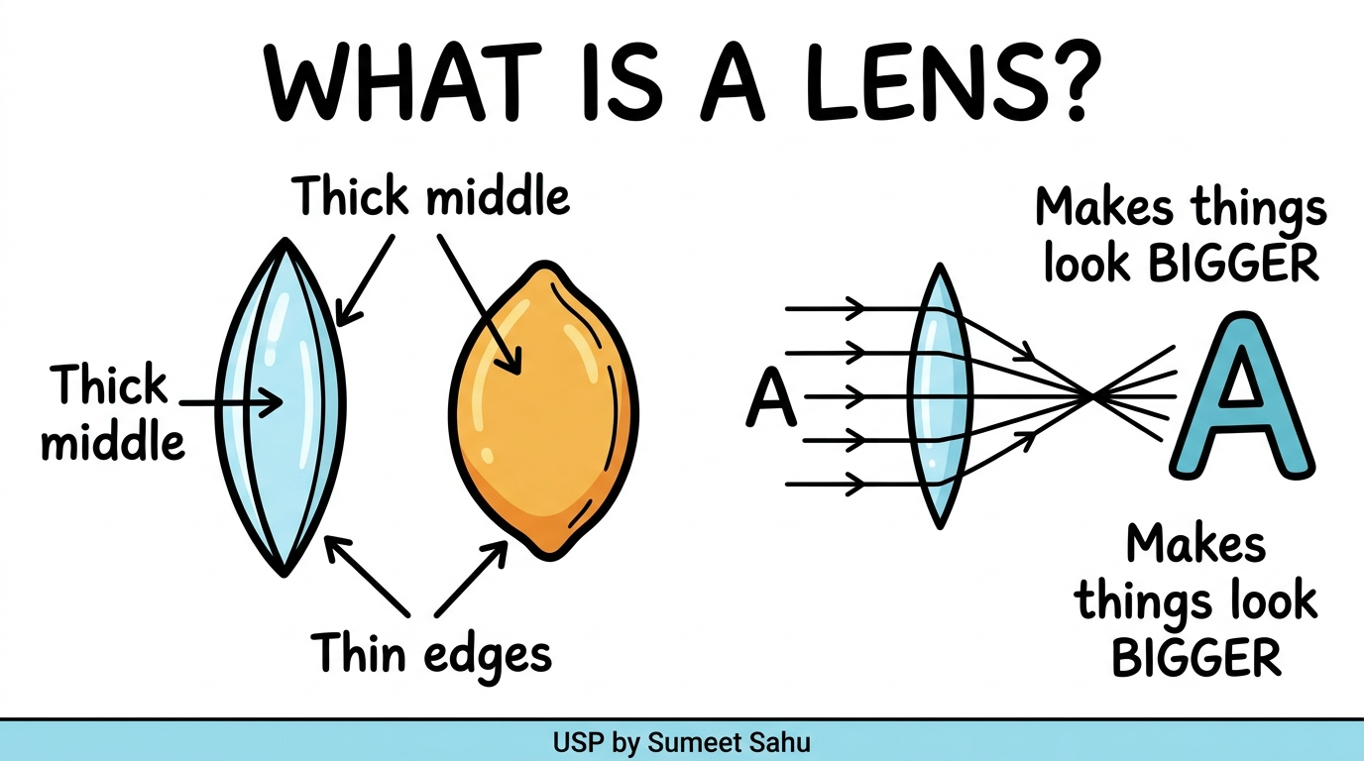
2
What is a Lens?

Slide 4
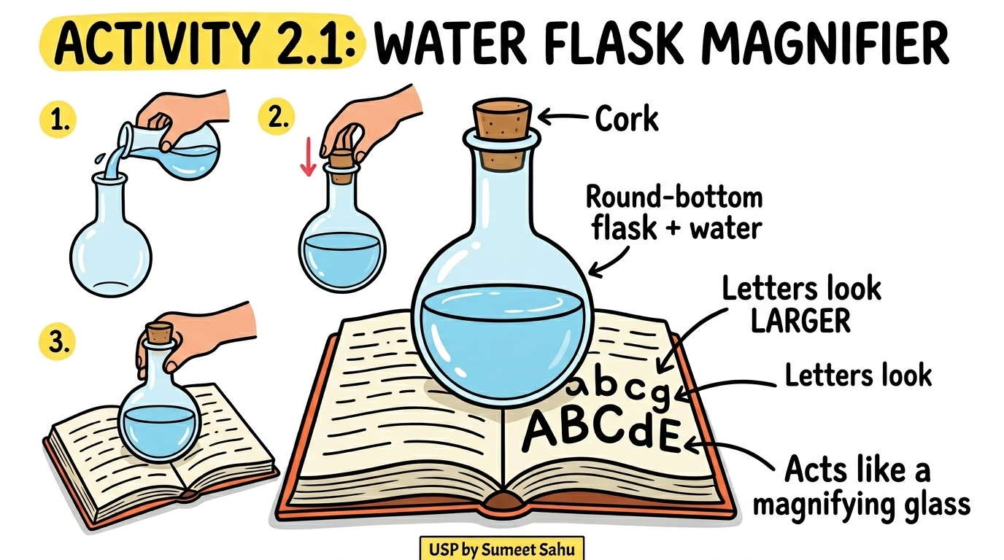
3
Activity 2.1 — Water Flask Magnifier

Slide 5
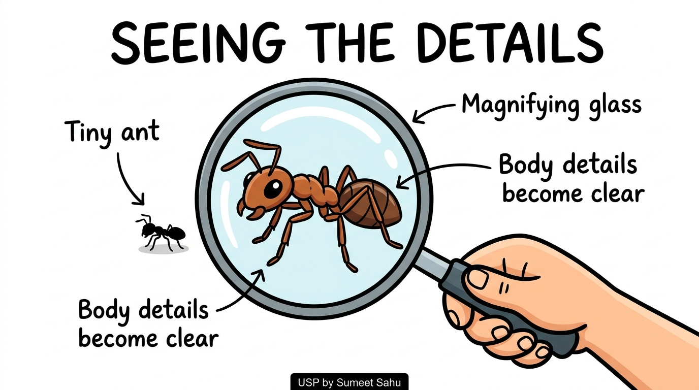
4
Seeing the Details — Magnifying Glass

Slide 6
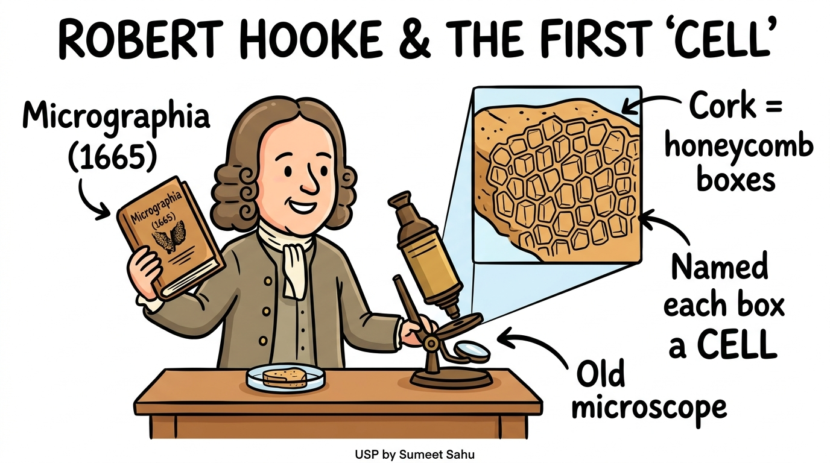
5
Robert Hooke & the First 'Cell'

Slide 7
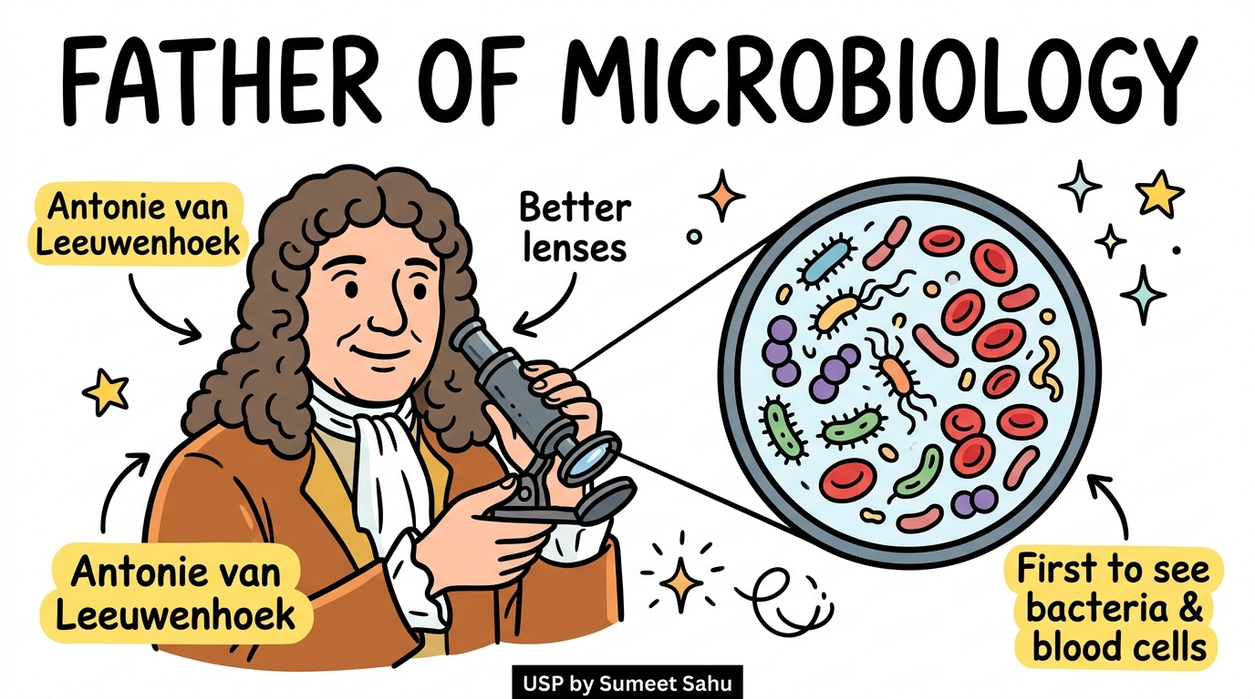
6
Father of Microbiology — Leeuwenhoek

Slide 8
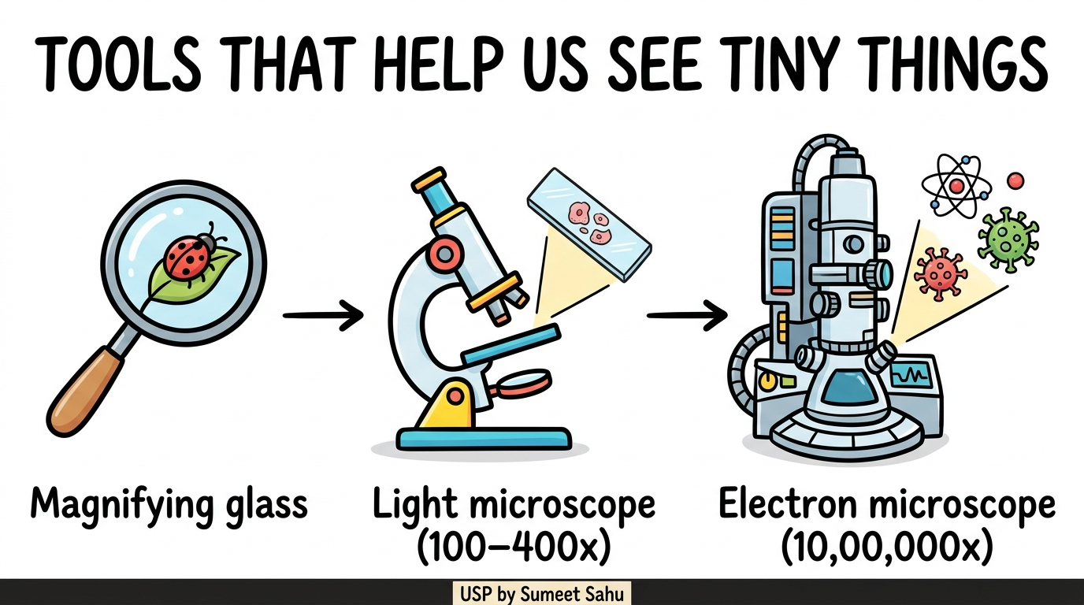
7
Tools That Help Us See Tiny Things

Slide 9
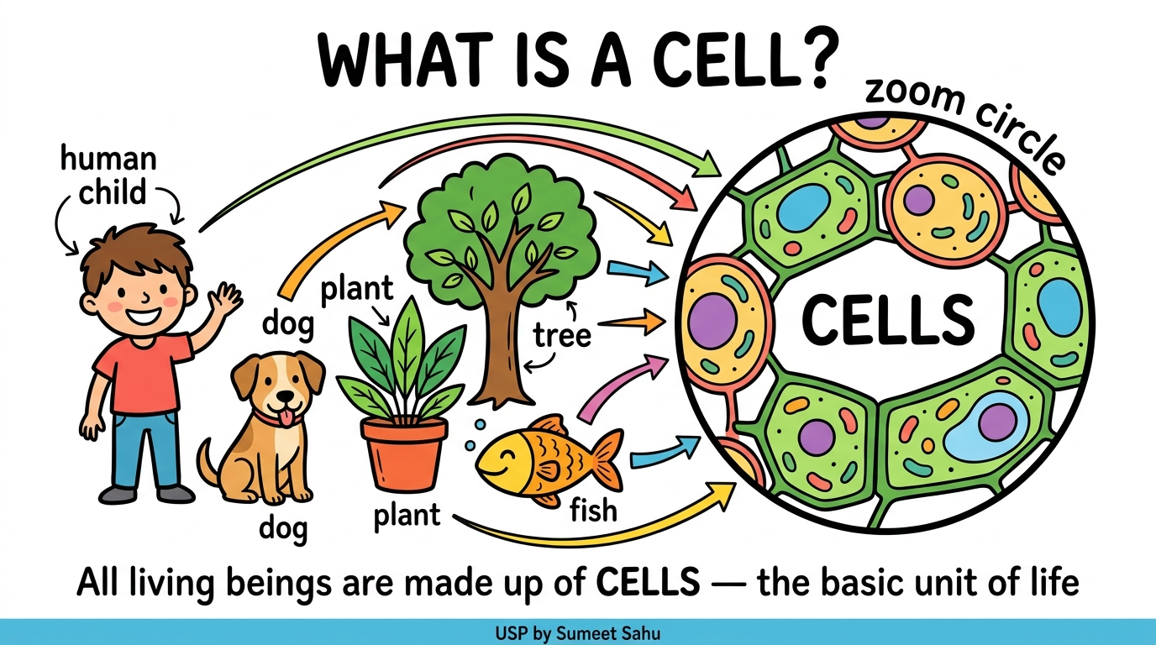
8
What is a Cell?

Slide 10
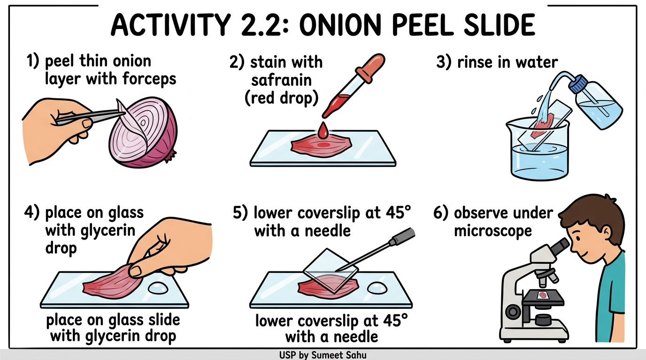
9
Activity 2.2 — Onion Peel Slide

Slide 11
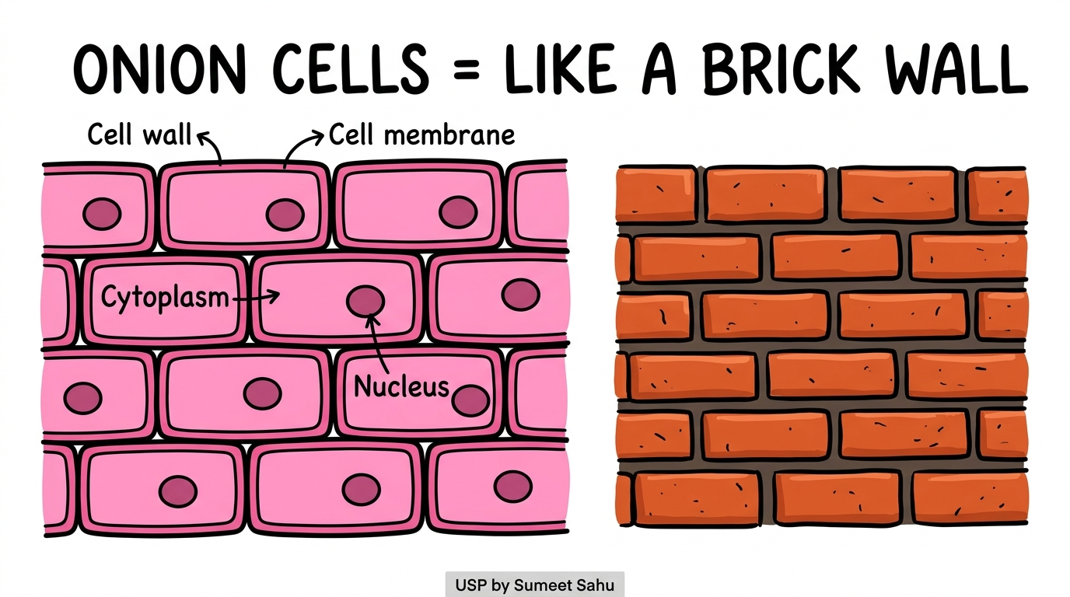
10
Onion Cells = Like a Brick Wall

Slide 12
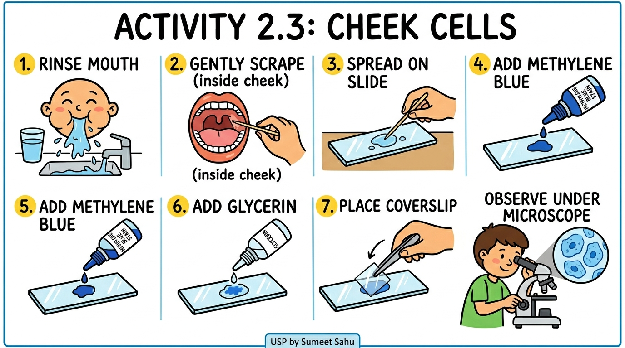
11
Activity 2.3 — Cheek Cell Slide

Slide 13
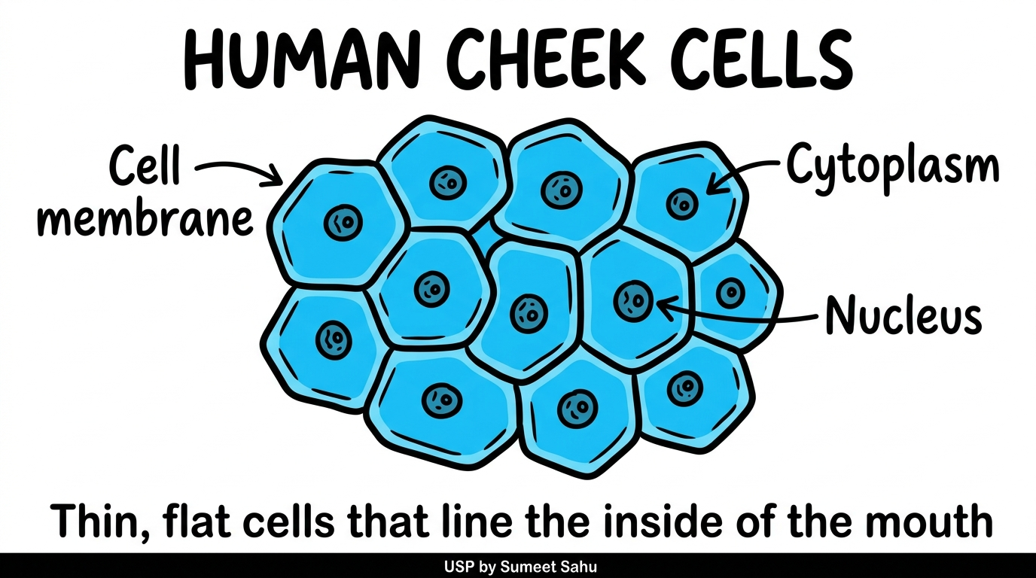
12
Human Cheek Cells

Slide 14
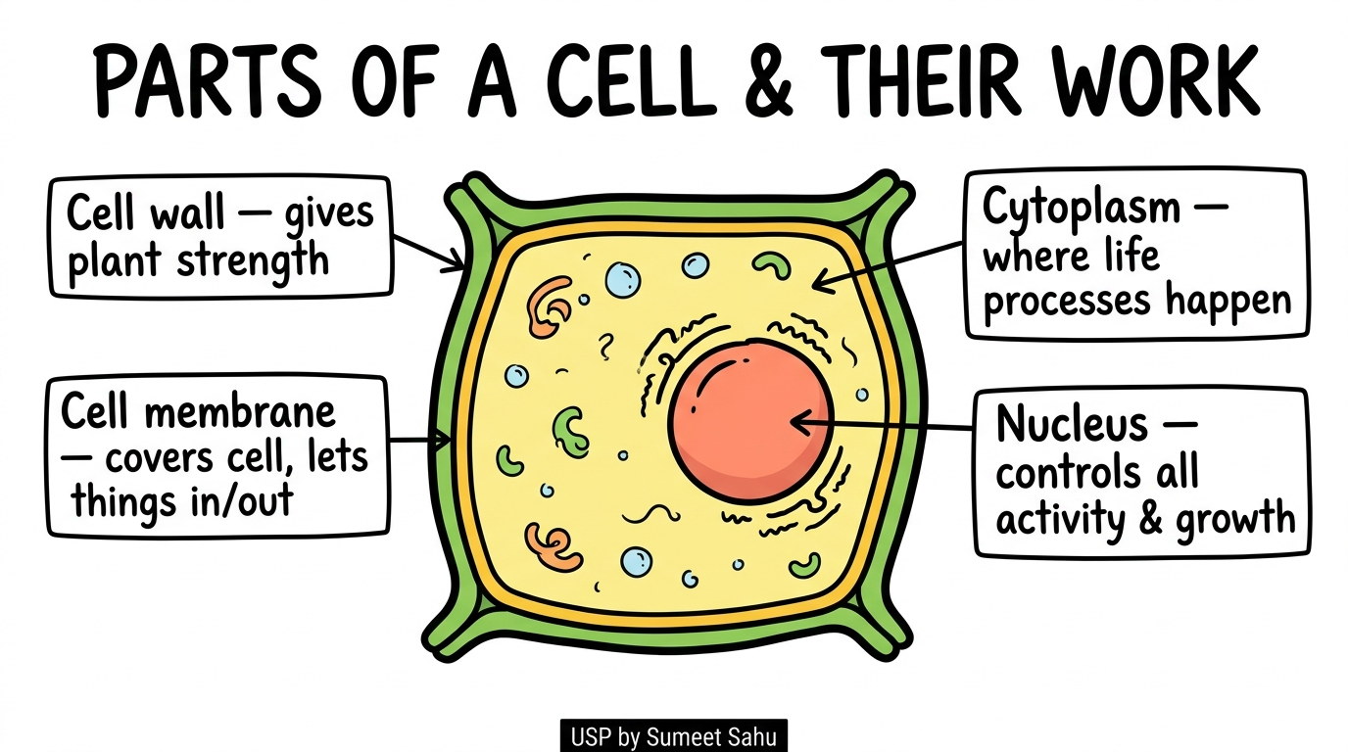
13
Parts of a Cell & Their Work

Slide 15
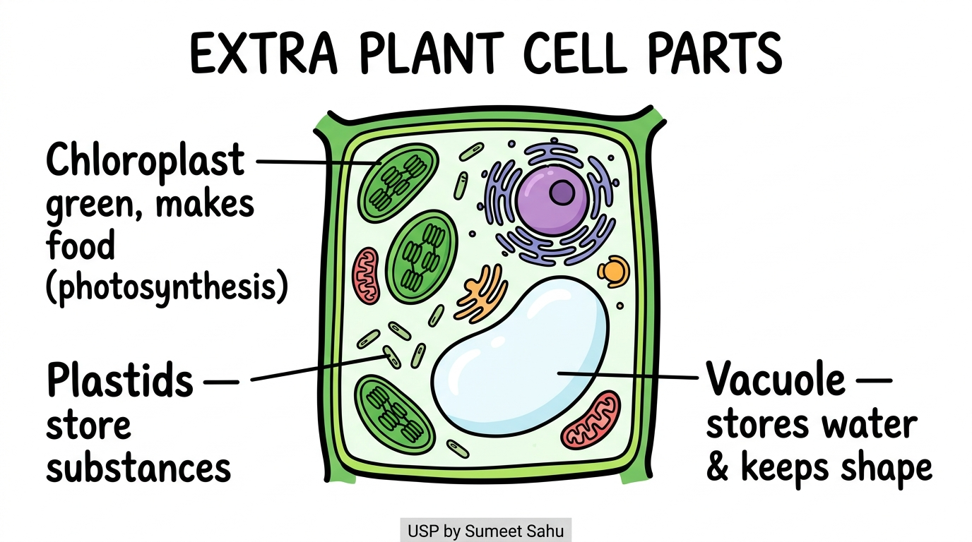
14
Extra Plant Cell Parts

Slide 16
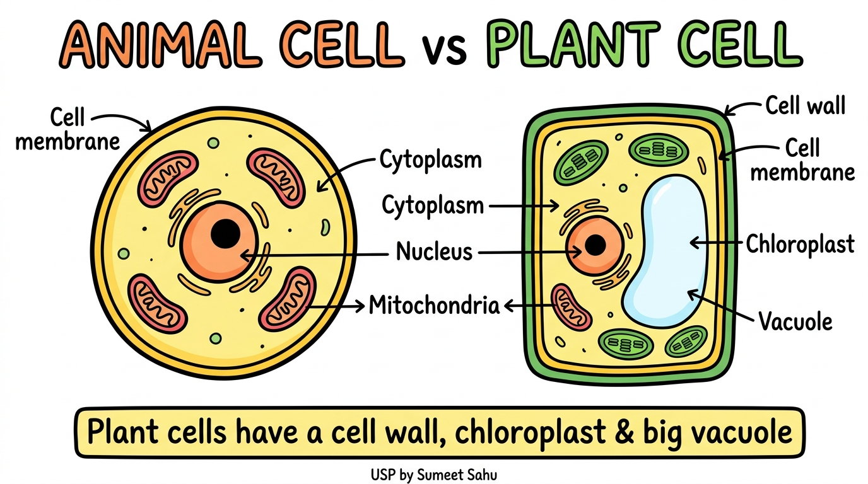
15
Animal Cell vs Plant Cell

Slide 17
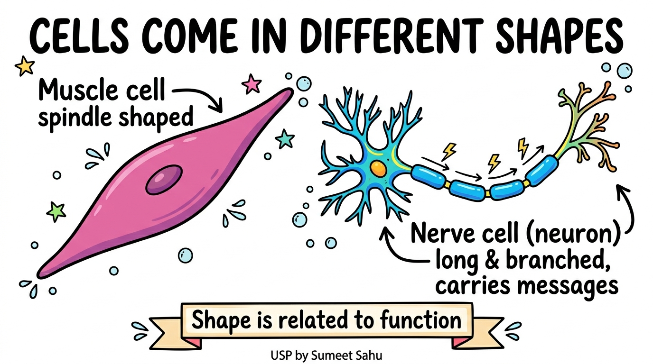
16
Cells Come in Different Shapes

Slide 18
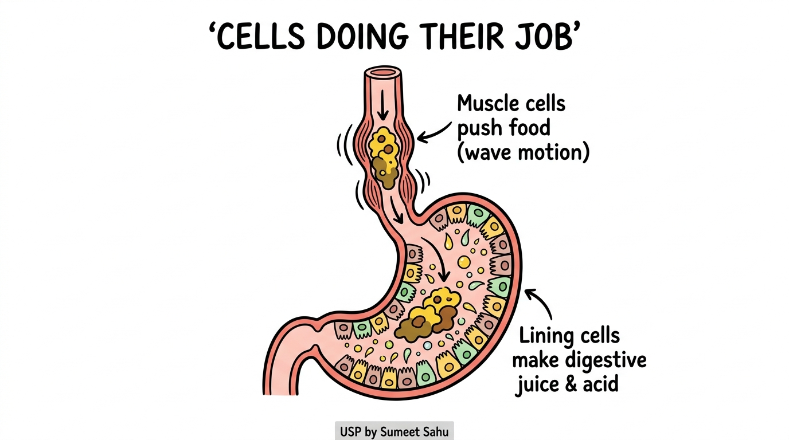
17
Cells Doing Their Job (Digestion)

Slide 19
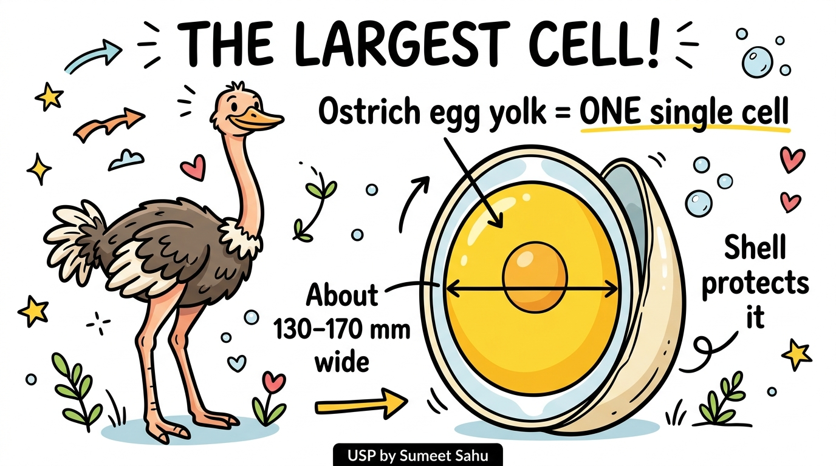
18
The Largest Cell — Ostrich Egg

Slide 20
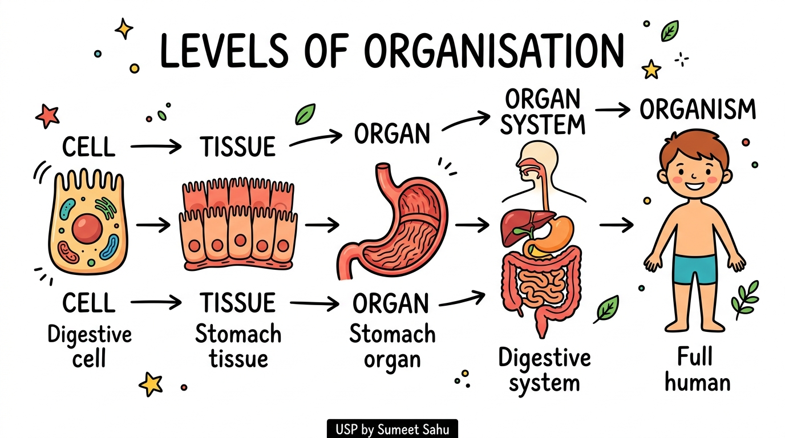
19
Levels of Organisation: Cell to Organism

Slide 21
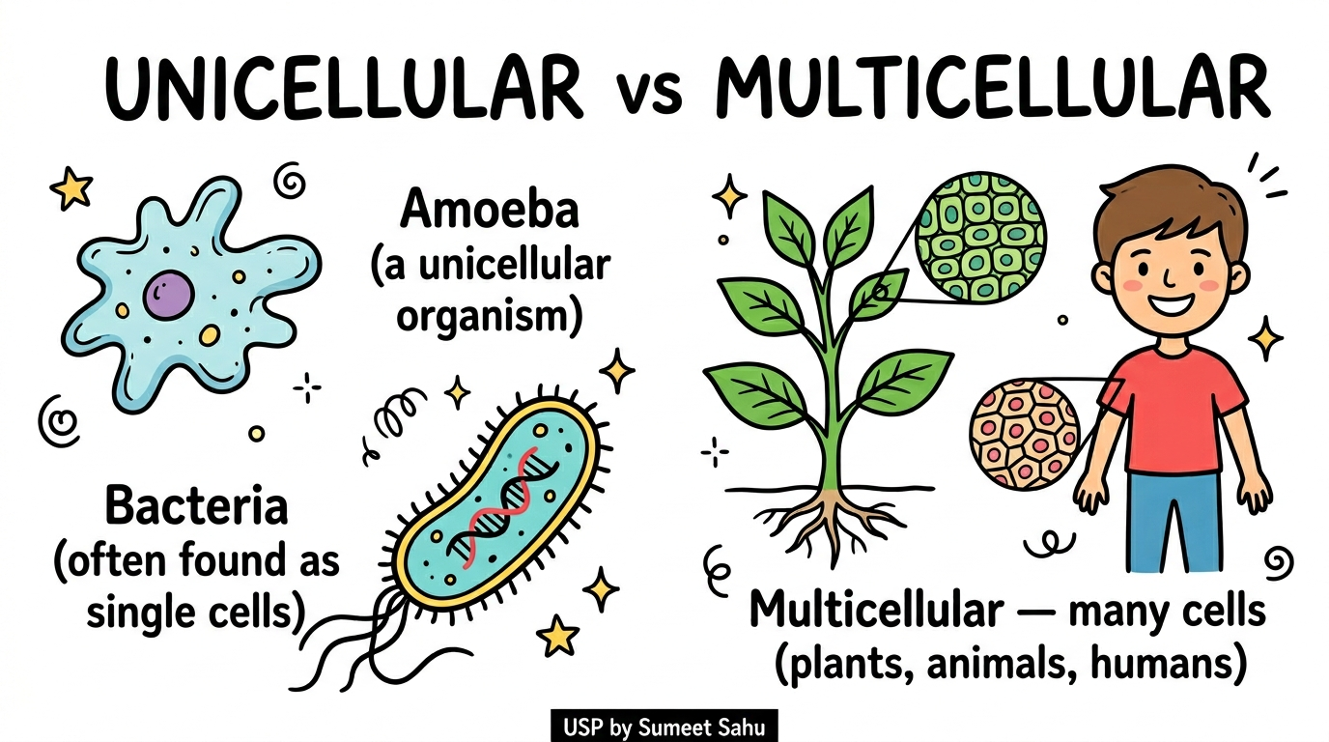
20
Unicellular vs Multicellular Organisms

Slide 22
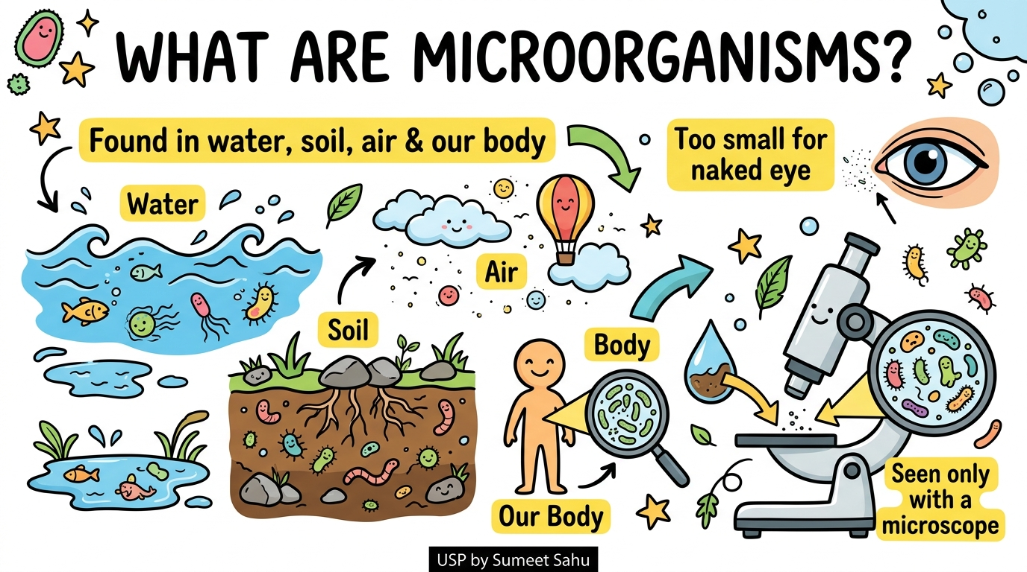
21
What Are Microorganisms?

Slide 23
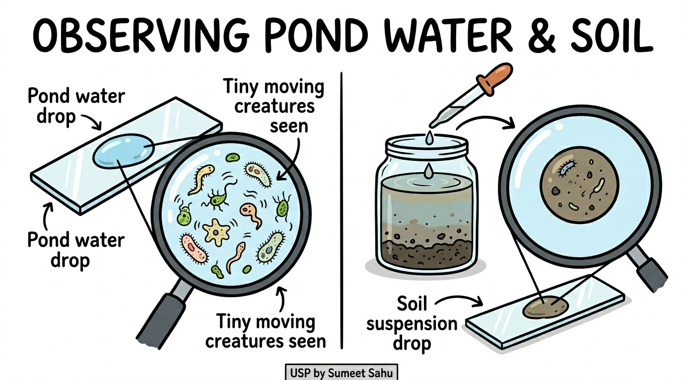
22
Activity 2.4 & 2.5 — Observing Pond Water & Soil

Slide 24
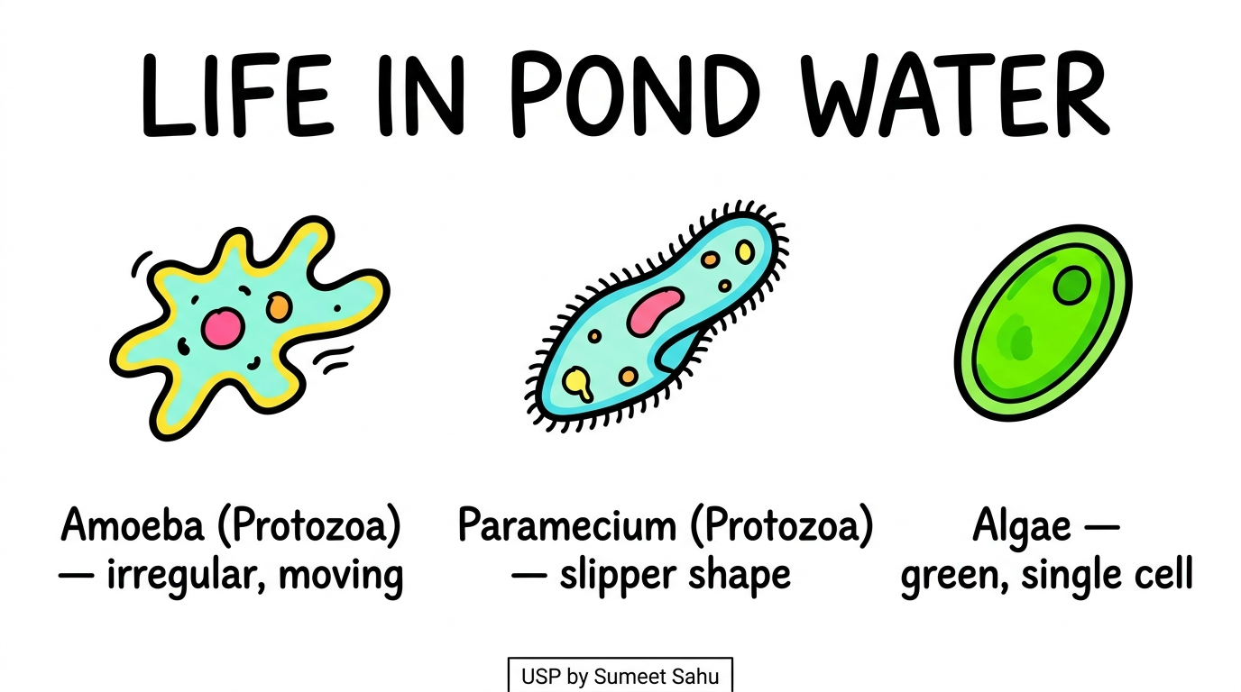
23
Life in Pond Water

Slide 25
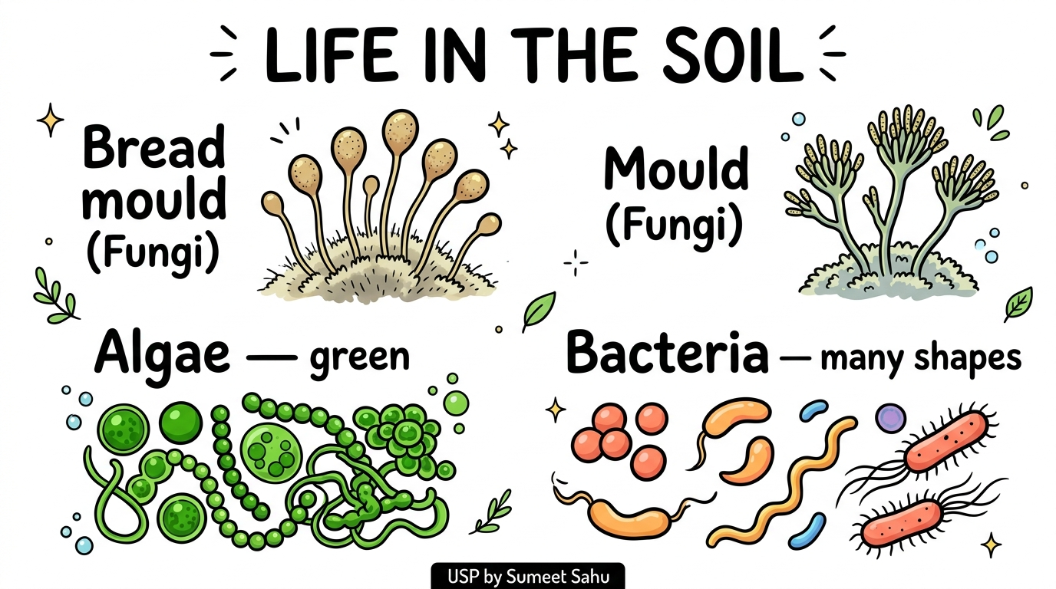
24
Life in the Soil

Slide 26
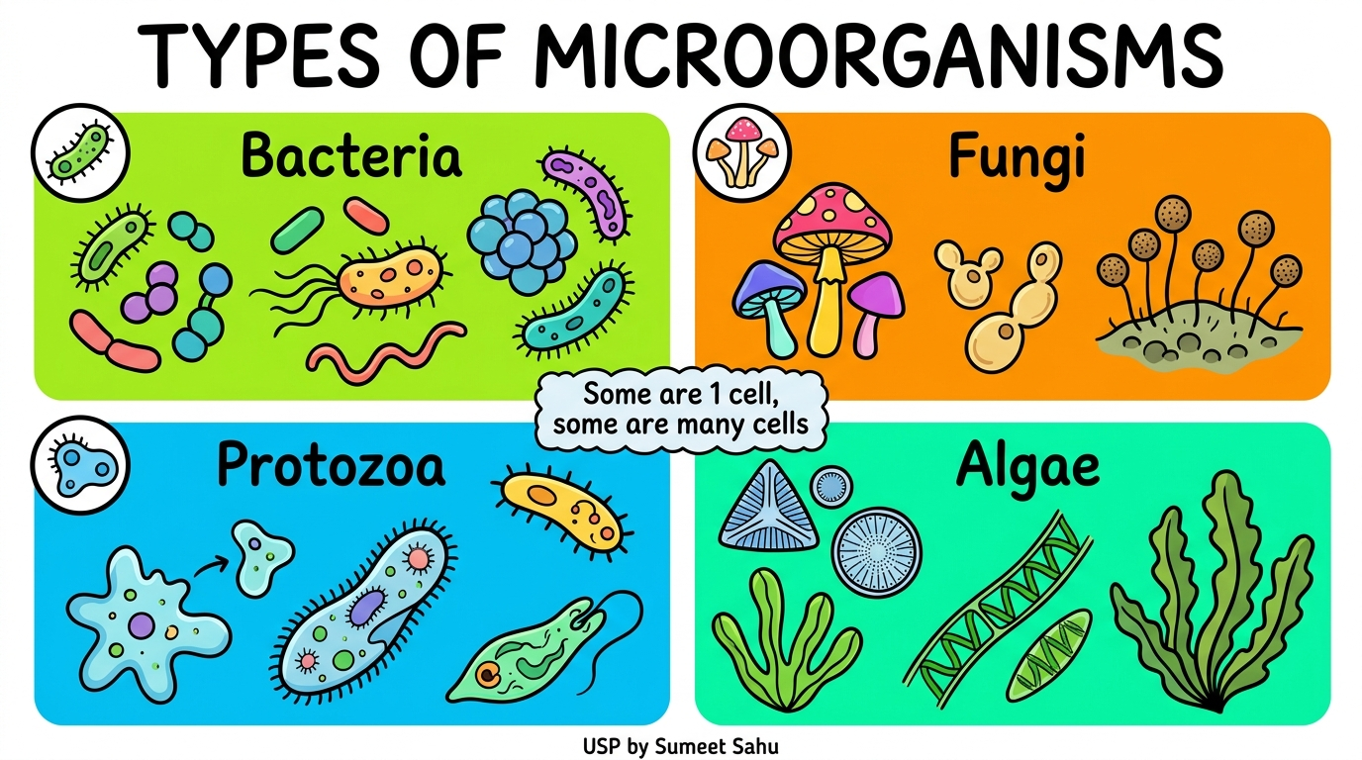
25
Types of Microorganisms

Slide 27
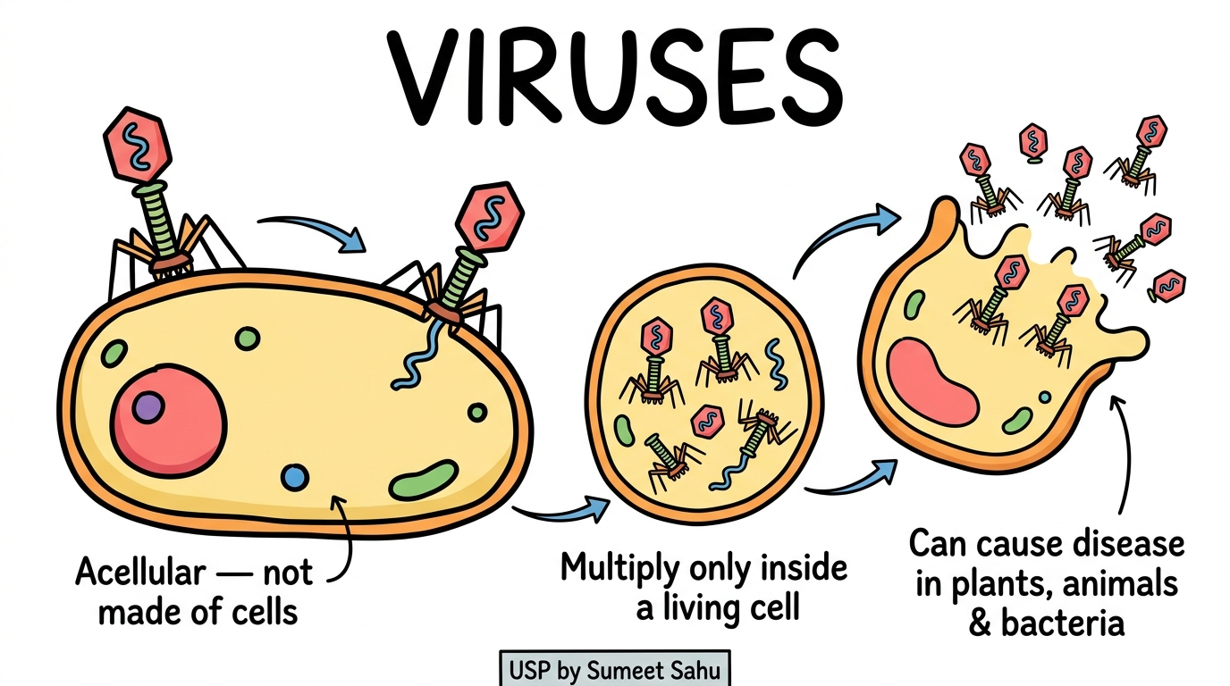
26
Viruses

Slide 28
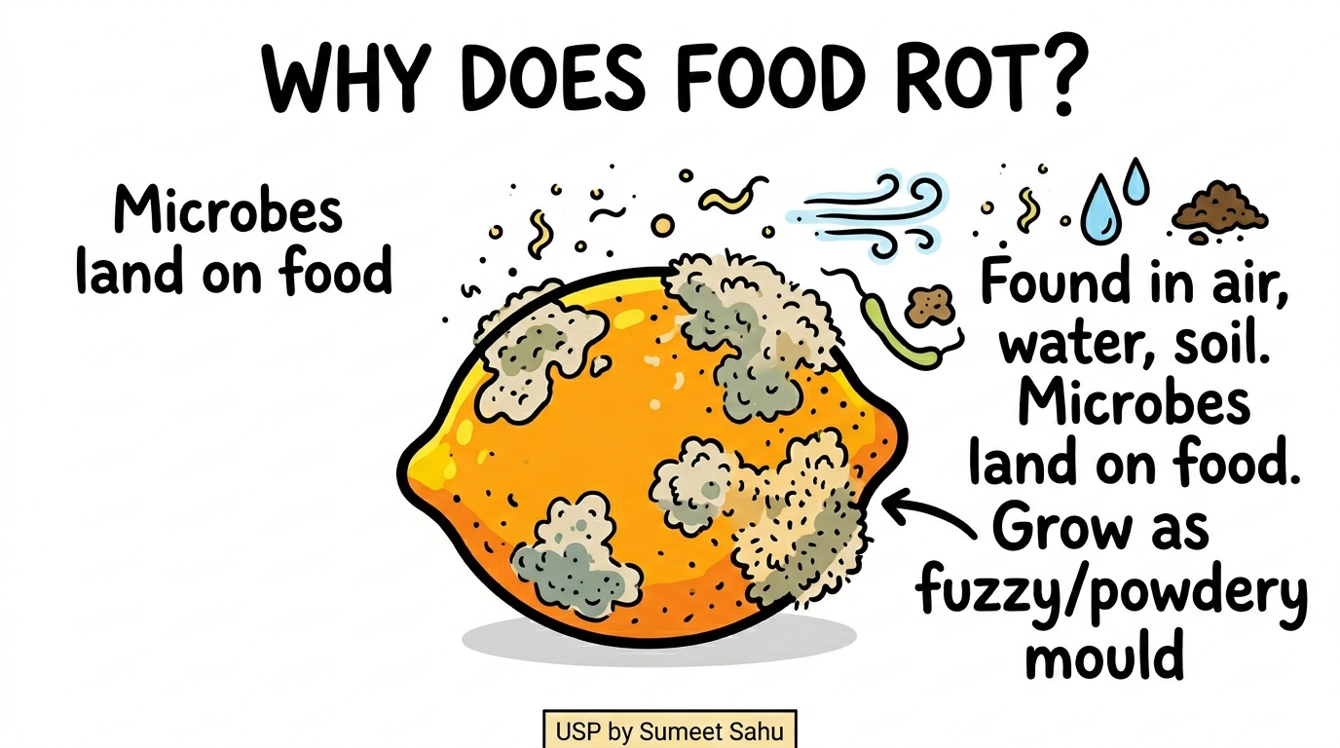
27
Why Does Food Rot?

Slide 29
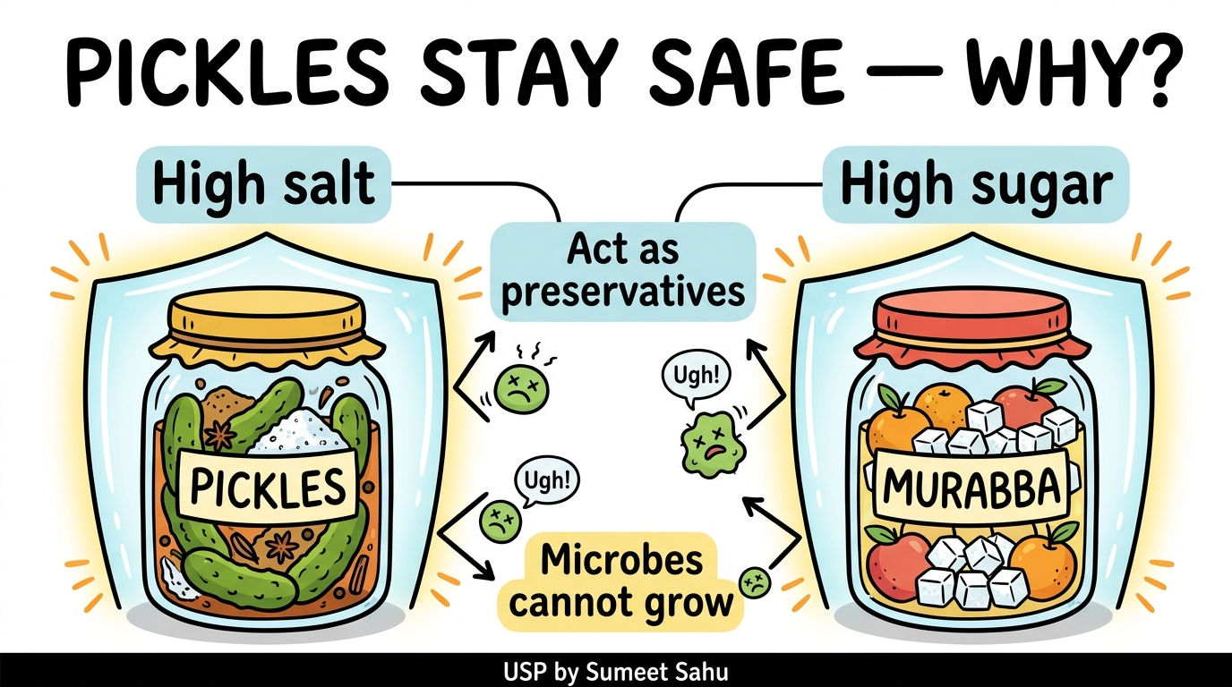
28
Pickles Stay Safe — Why?

Slide 30
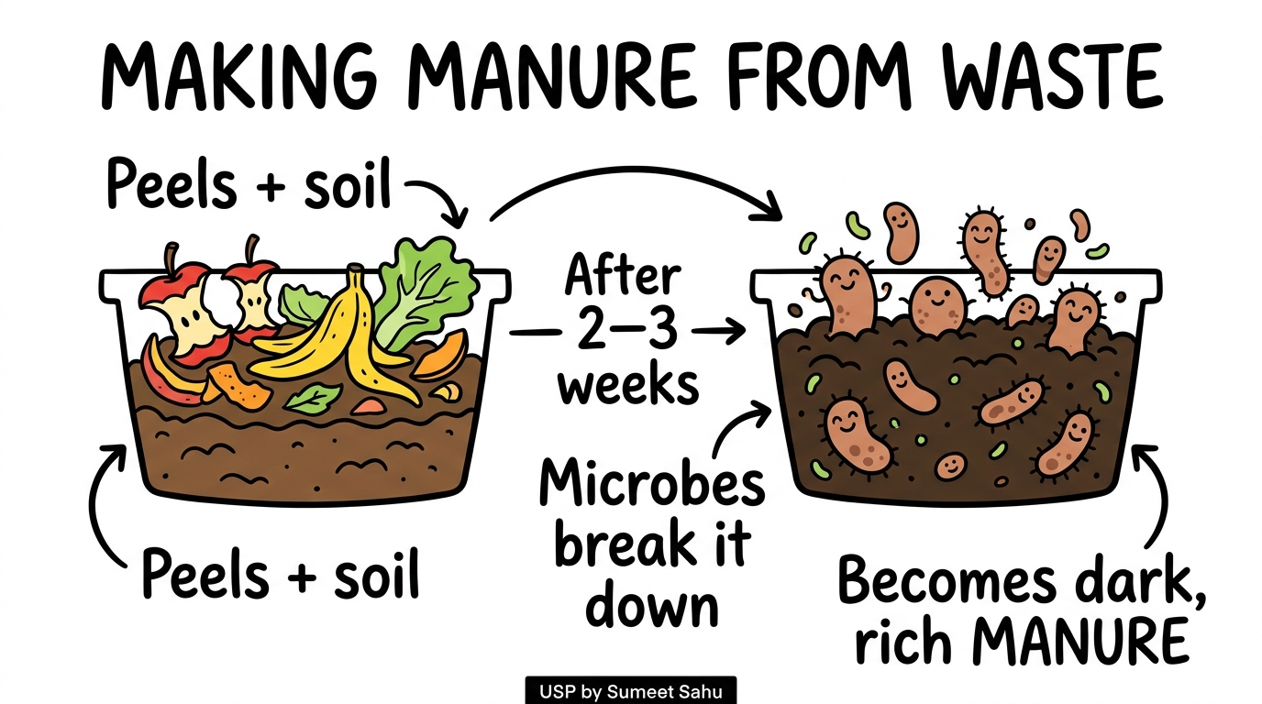
29
Activity 2.7 — Making Manure from Waste

Slide 31
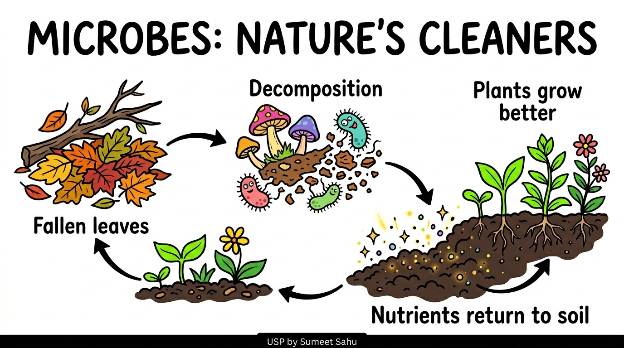
30
Microbes: Nature's Cleaners (Decomposition)

Slide 32
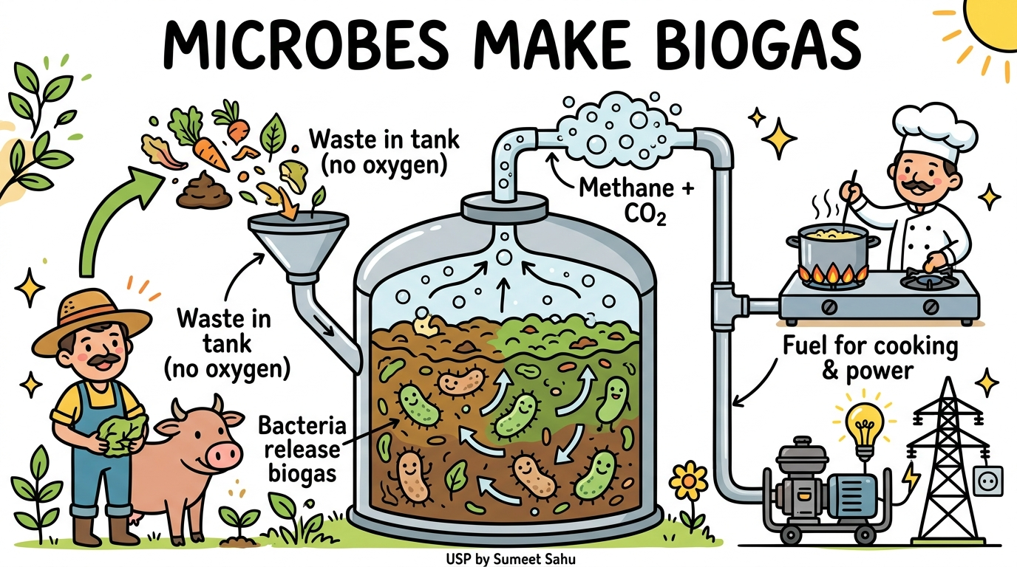
31
Microbes Make Biogas

Slide 33
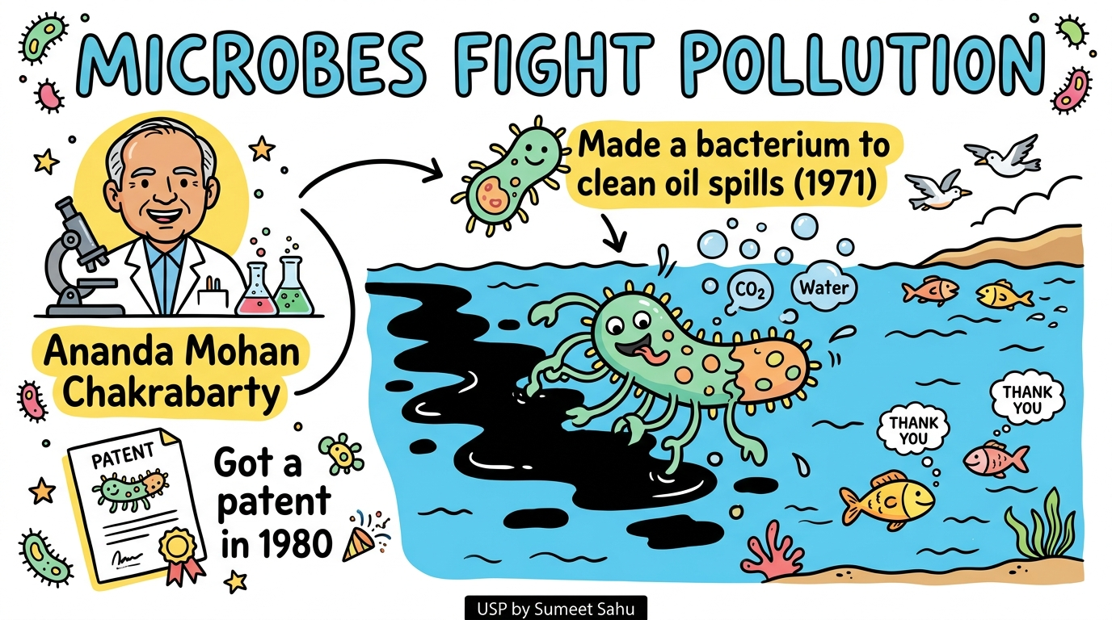
32
Microbes Fight Pollution — Chakrabarty

Slide 34
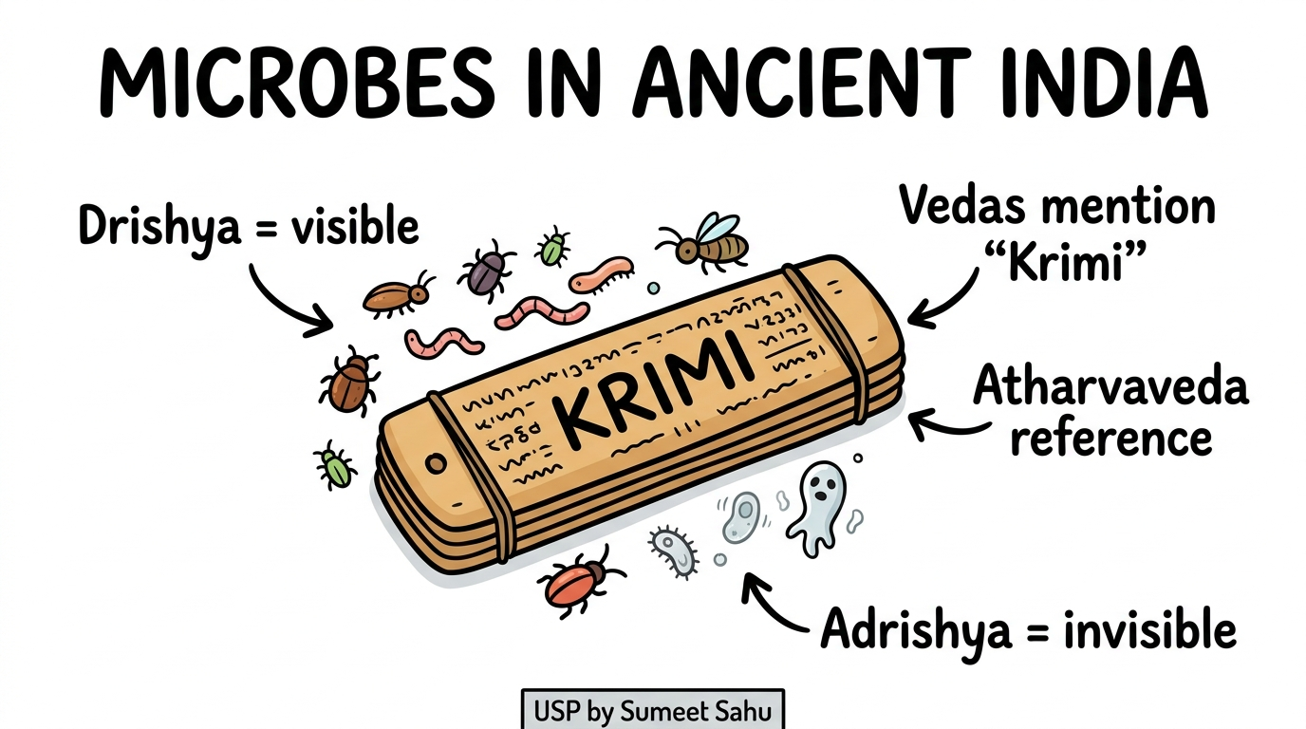
33
Microbes in Ancient India (Krimi)

Slide 35
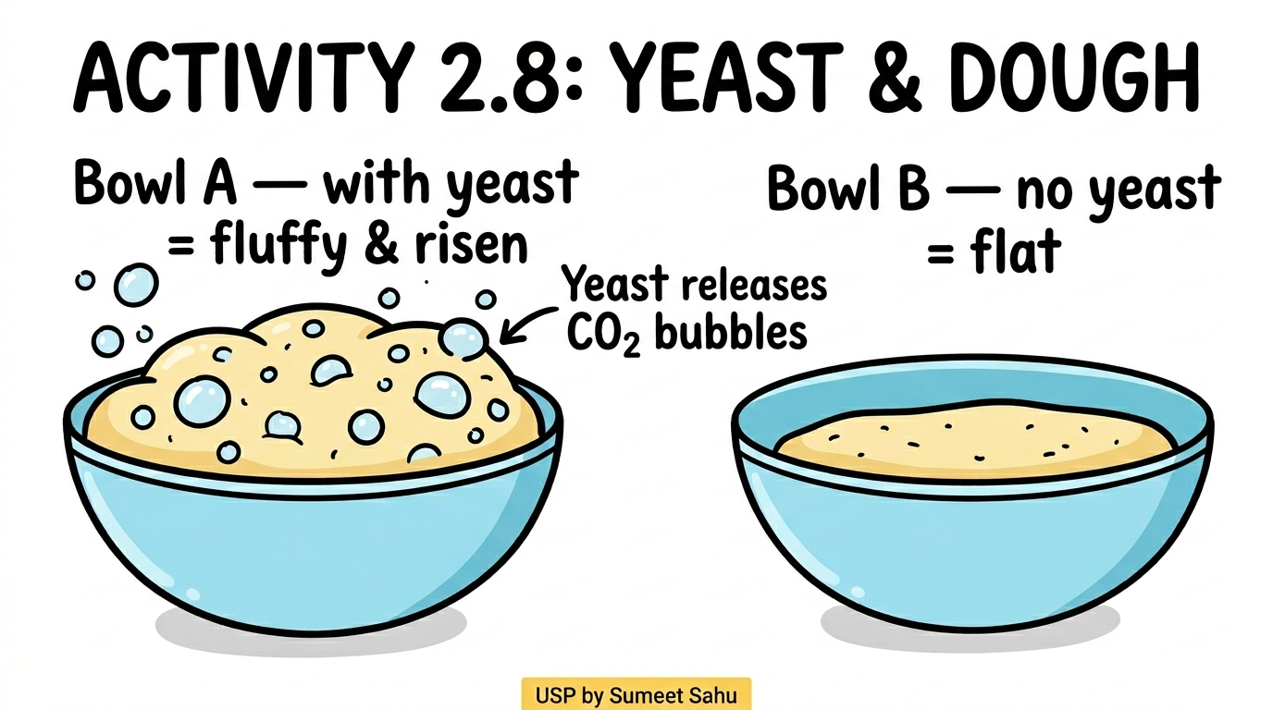
34
Activity 2.8 — Yeast & Dough

Slide 36
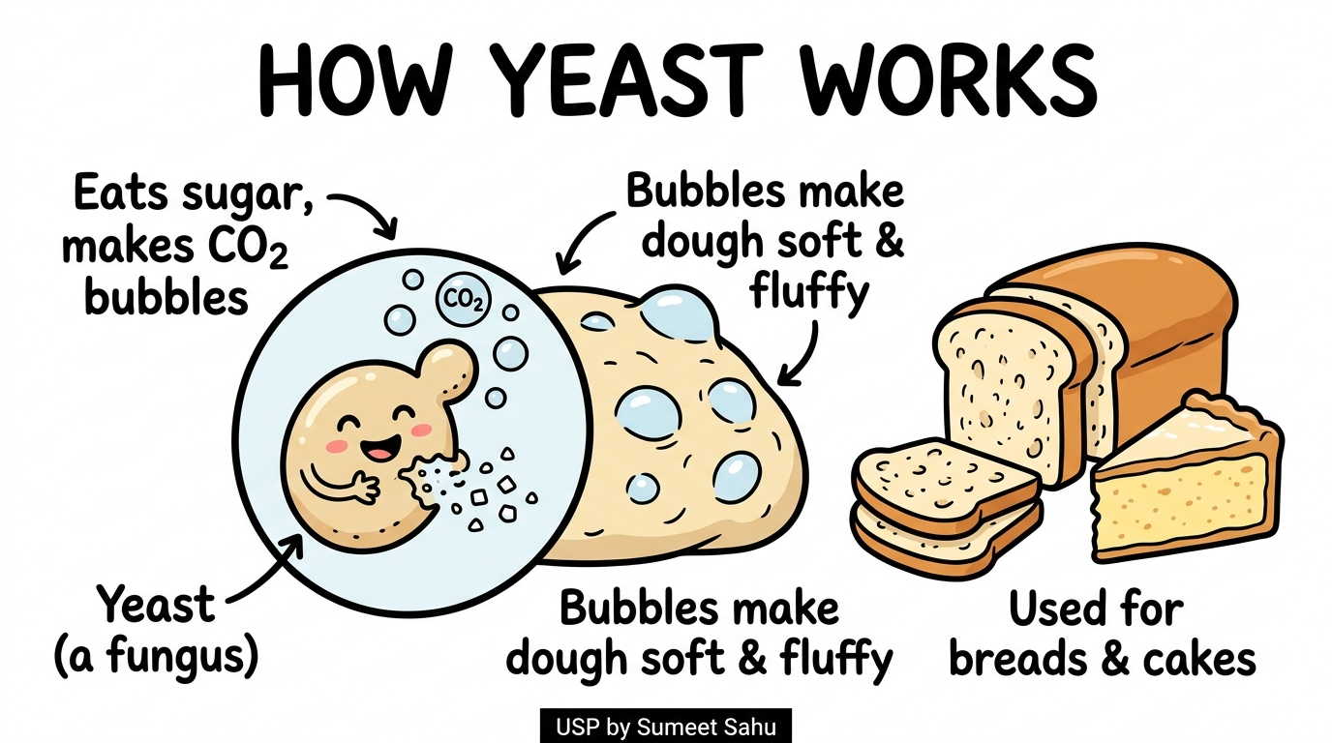
35
How Yeast Works

Slide 37
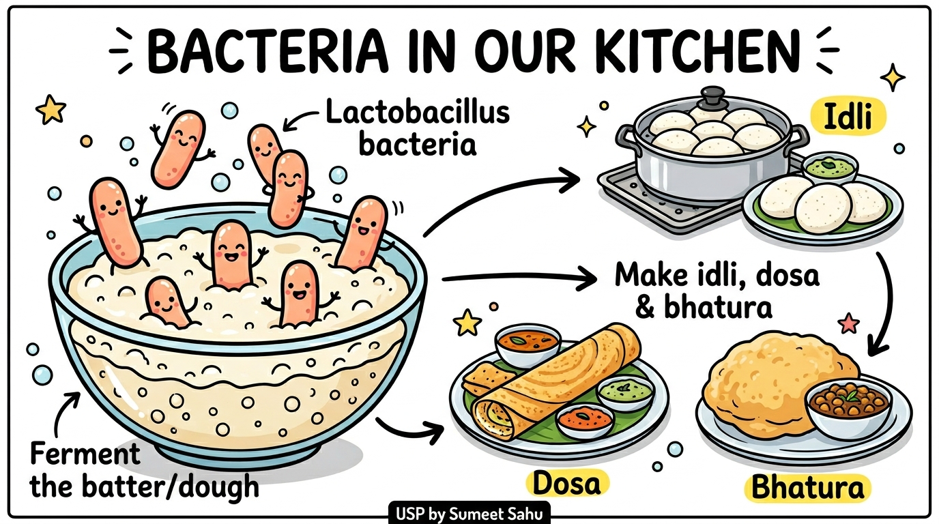
36
Bacteria in Our Kitchen

Slide 38
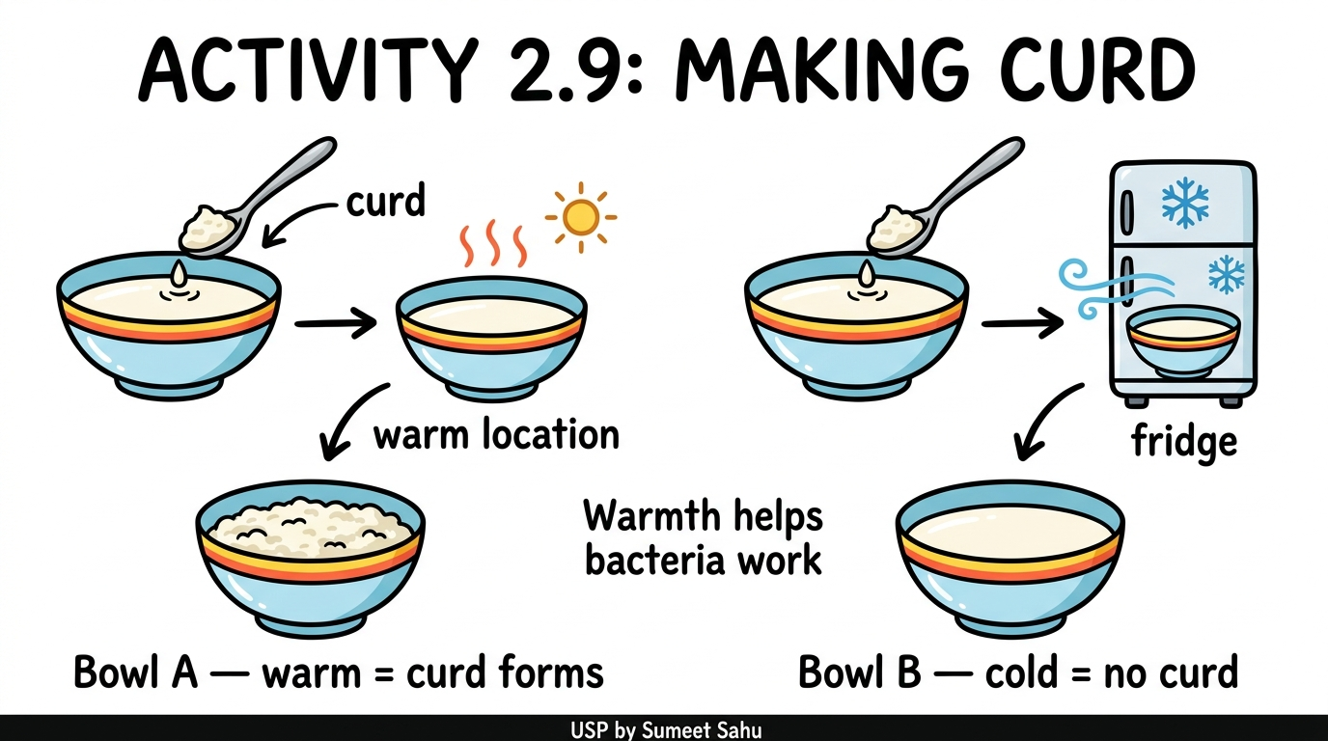
37
Activity 2.9 — Making Curd

Slide 39
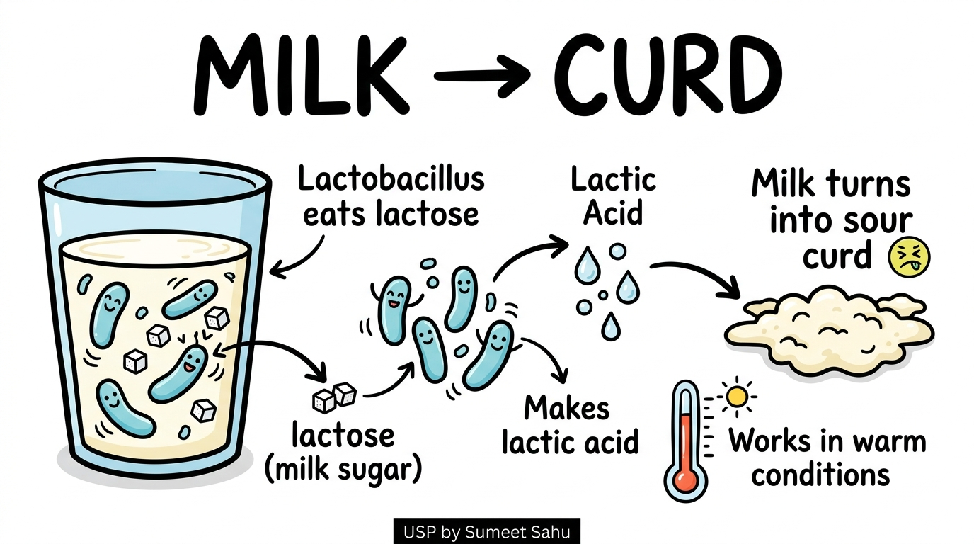
38
Milk to Curd — Lactobacillus

Slide 40
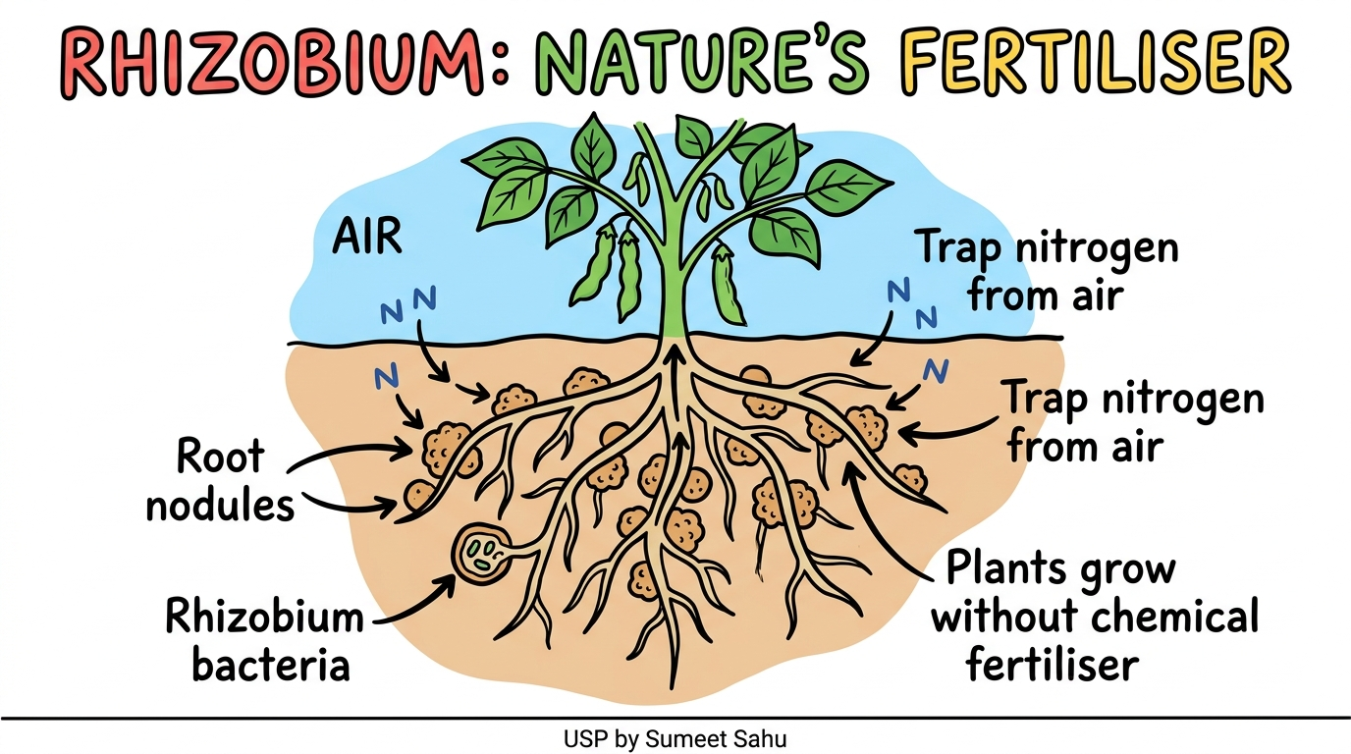
39
Rhizobium: Nature's Fertiliser

Slide 41
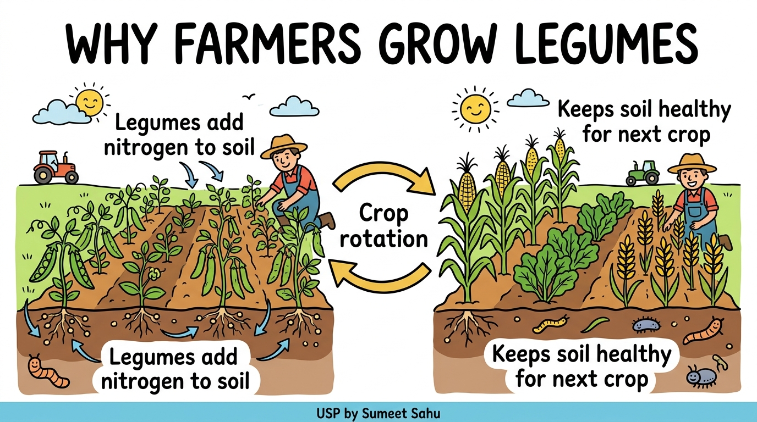
40
Why Farmers Grow Legumes

Slide 42
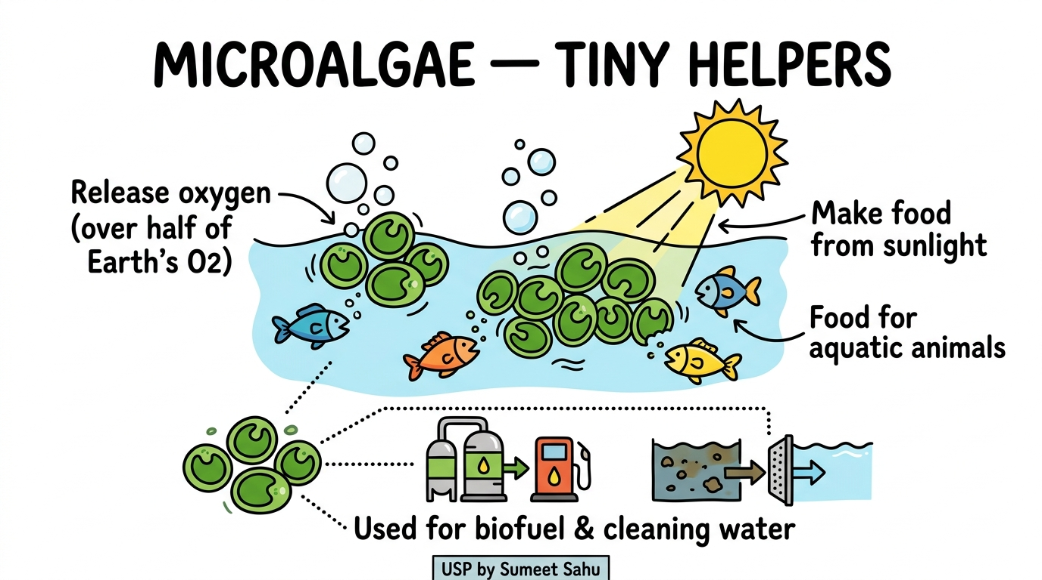
41
Microalgae — Tiny Helpers in Water

Slide 43
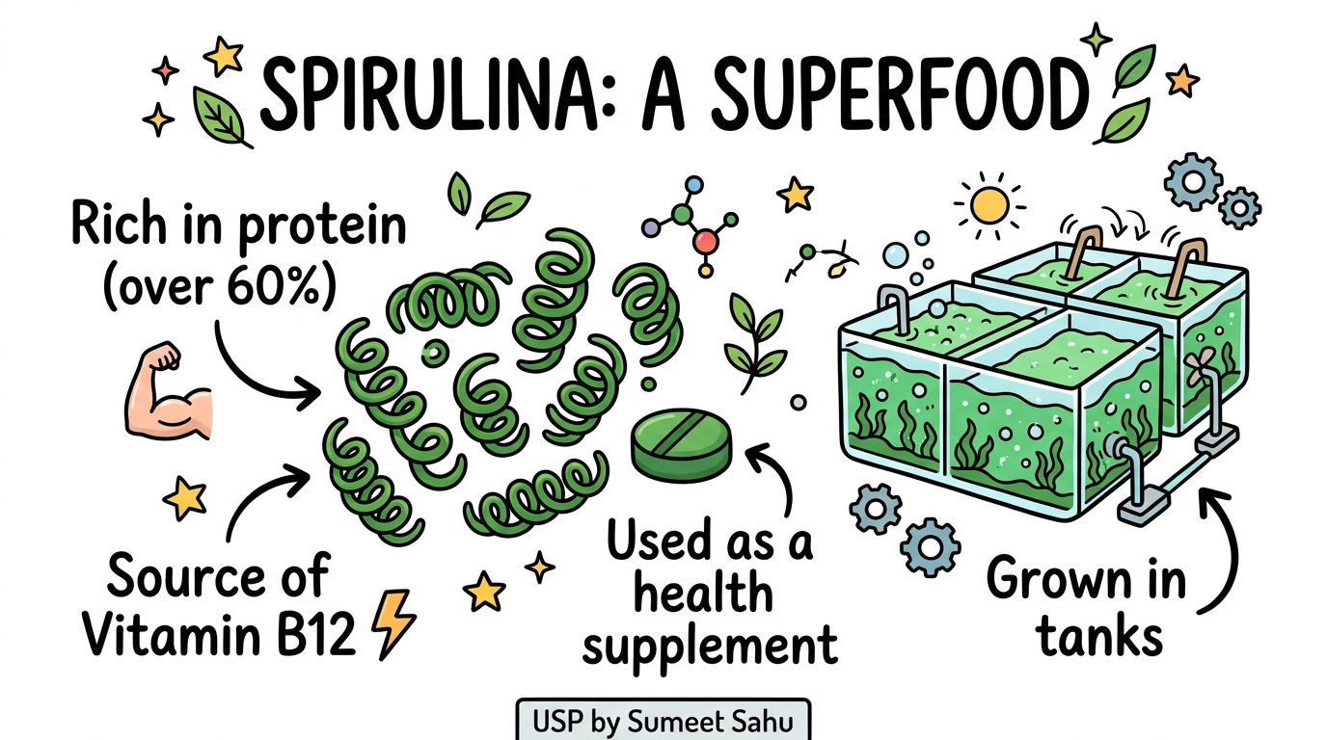
42
Spirulina: The Superfood

Slide 44
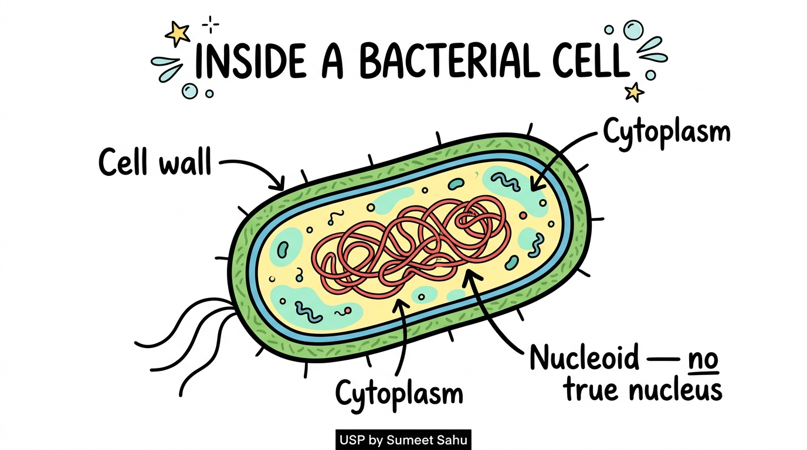
43
Inside a Bacterial Cell — Nucleoid

Slide 45
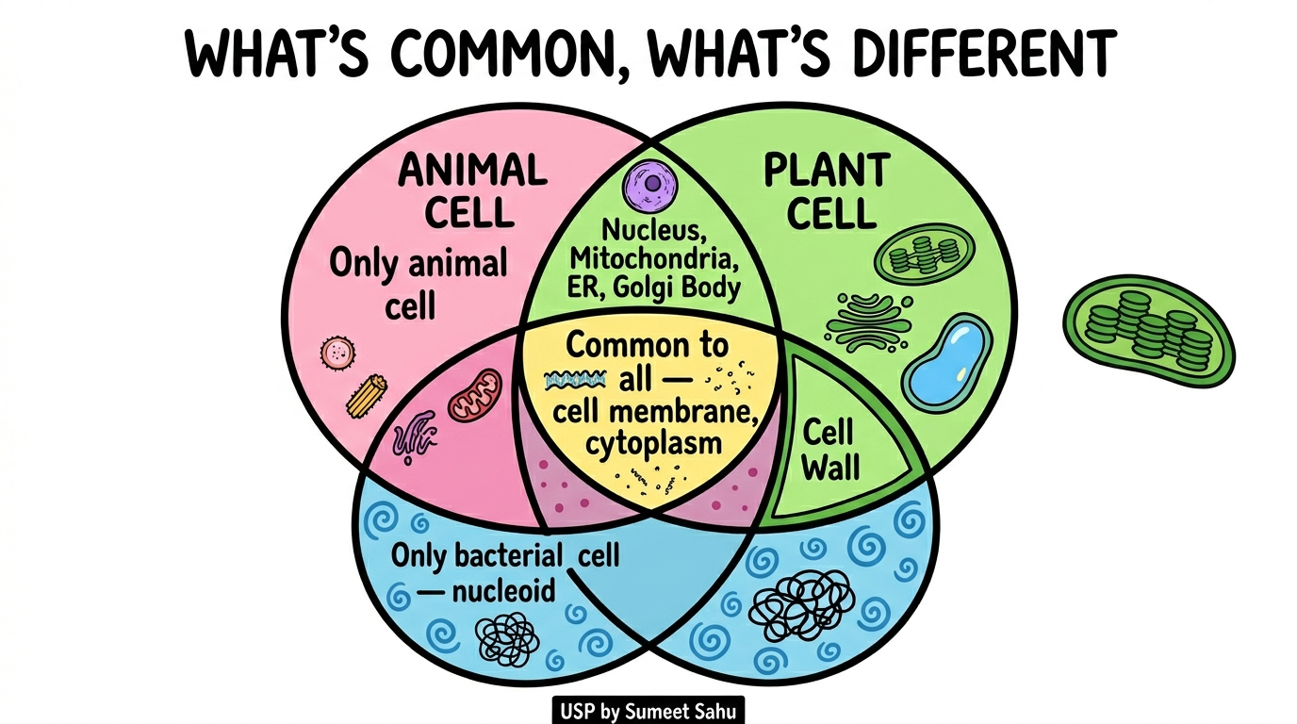
44
Animal, Plant & Bacterial Cells Compared

Slide 46
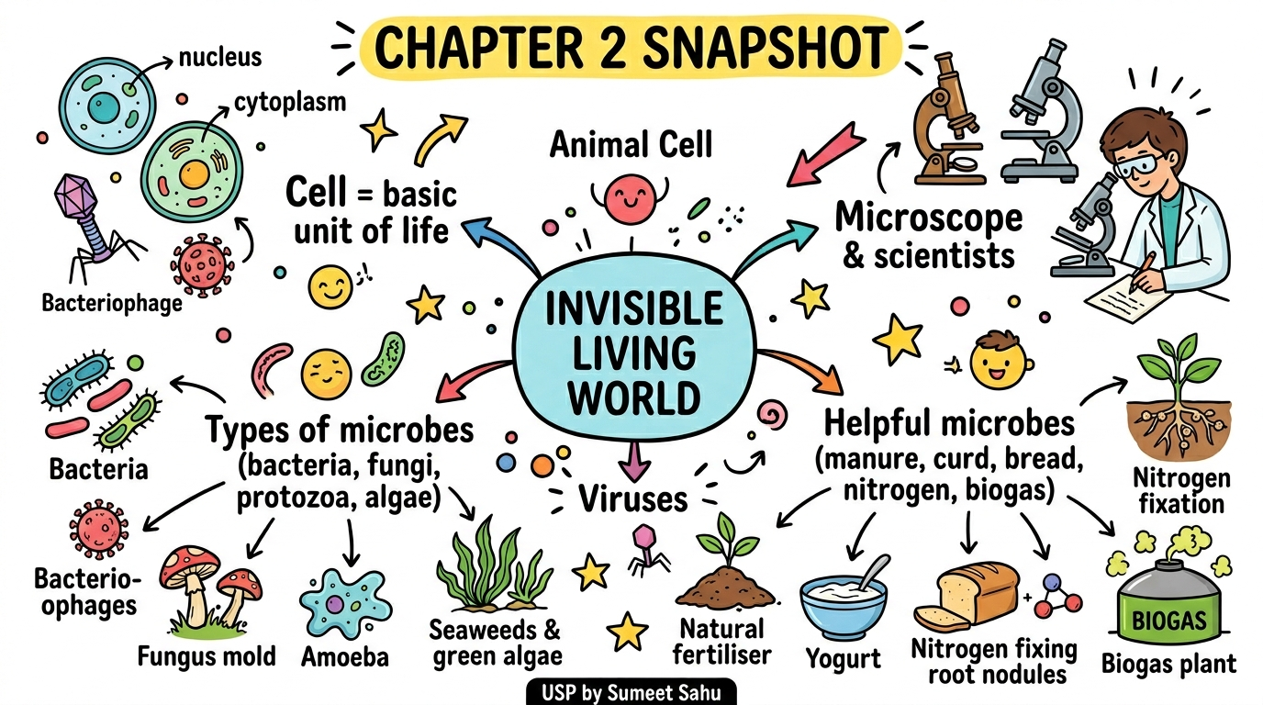
45
Chapter 2 Snapshot — Mind Map

