Slide 1
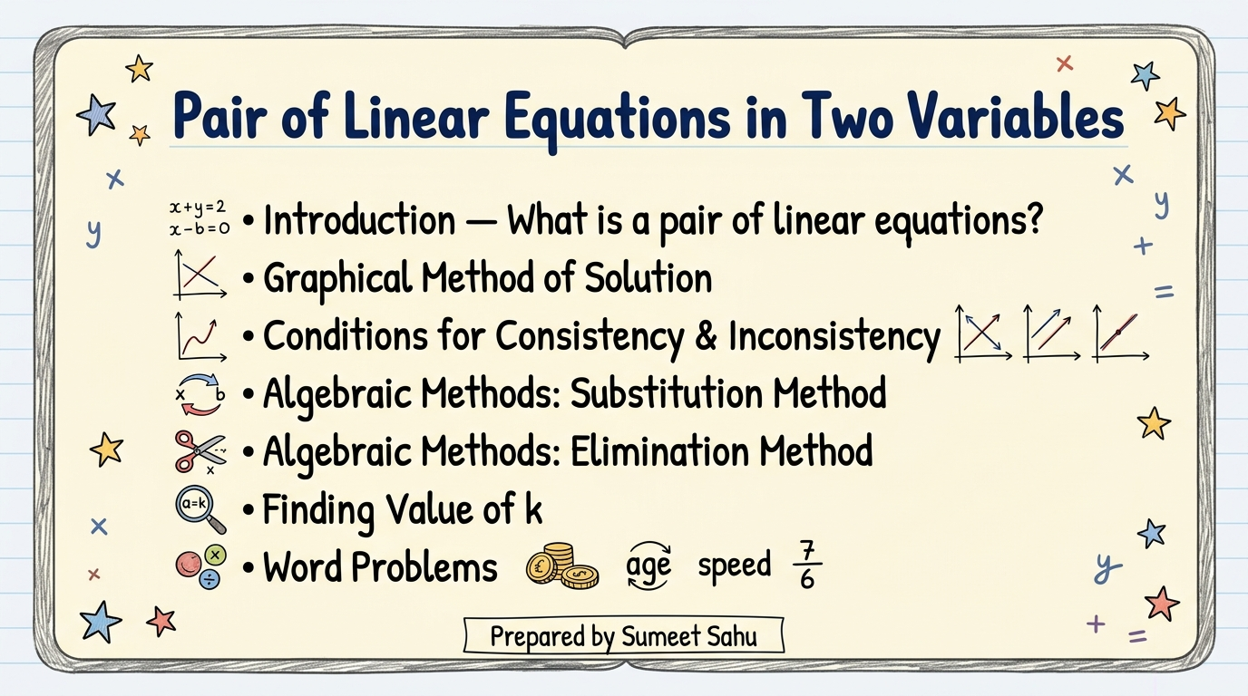
Notes:
Slide 1: Title slide — Pair of Linear Equations in Two Variables

Slide 2
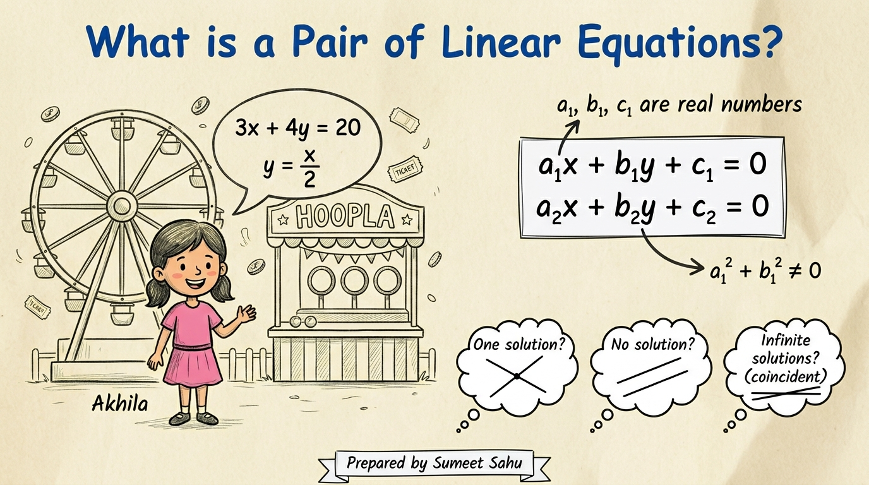
Notes:
Slide 2: Introduction — What is a Pair of Linear Equations? (Akhila and Giant Wheel example)

Slide 3
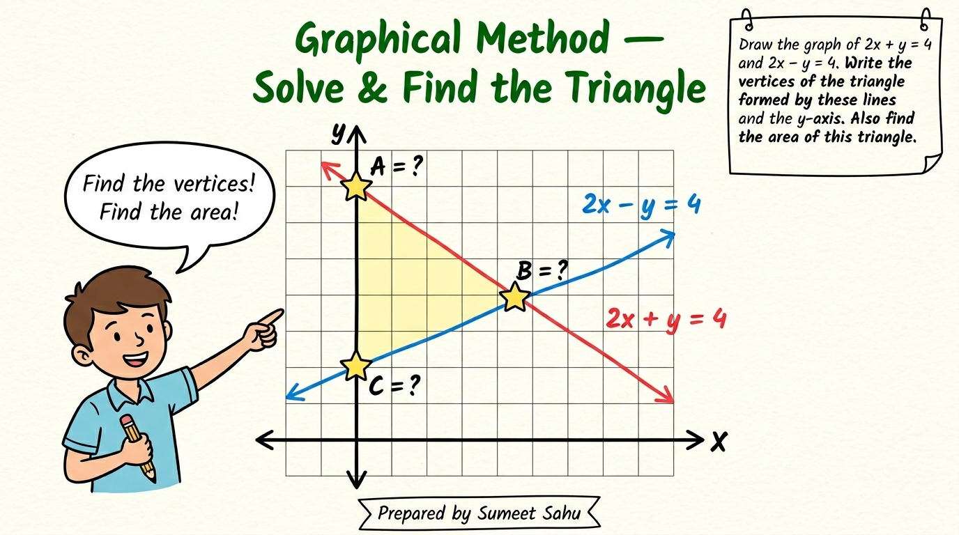
Notes:
Slide 3: Graphical Method — Solve & Find the Triangle (2x+y=4 and 2x-y=4)

Slide 4
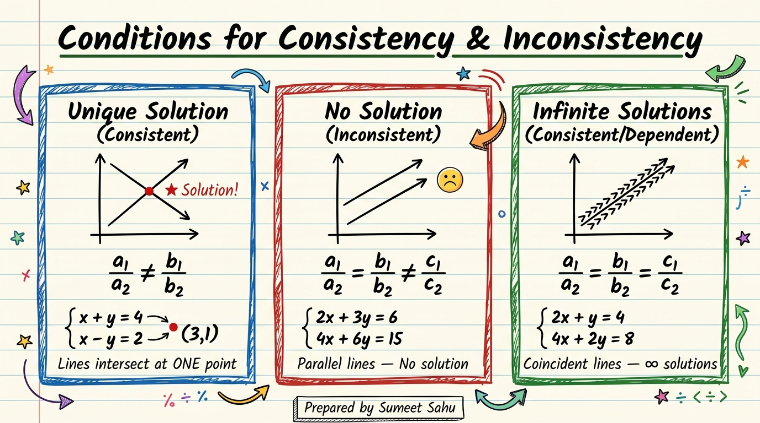
Notes:
Slide 4: Conditions for Consistency & Inconsistency — All three cases with graphs

Slide 5
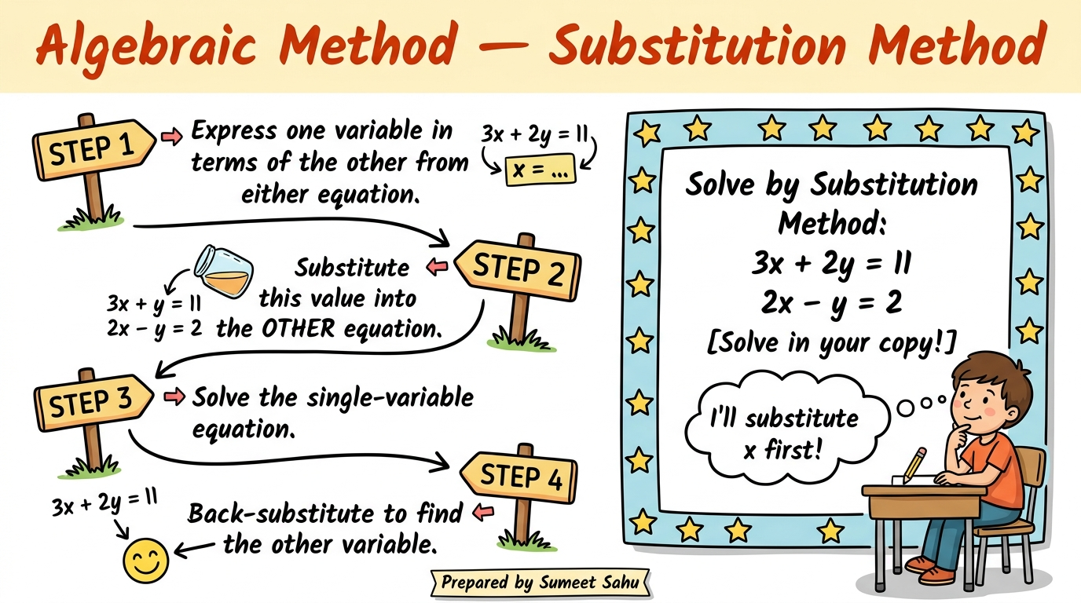
Notes:
Slide 5: Algebraic Method — Substitution Method (Steps + Question)

Slide 6
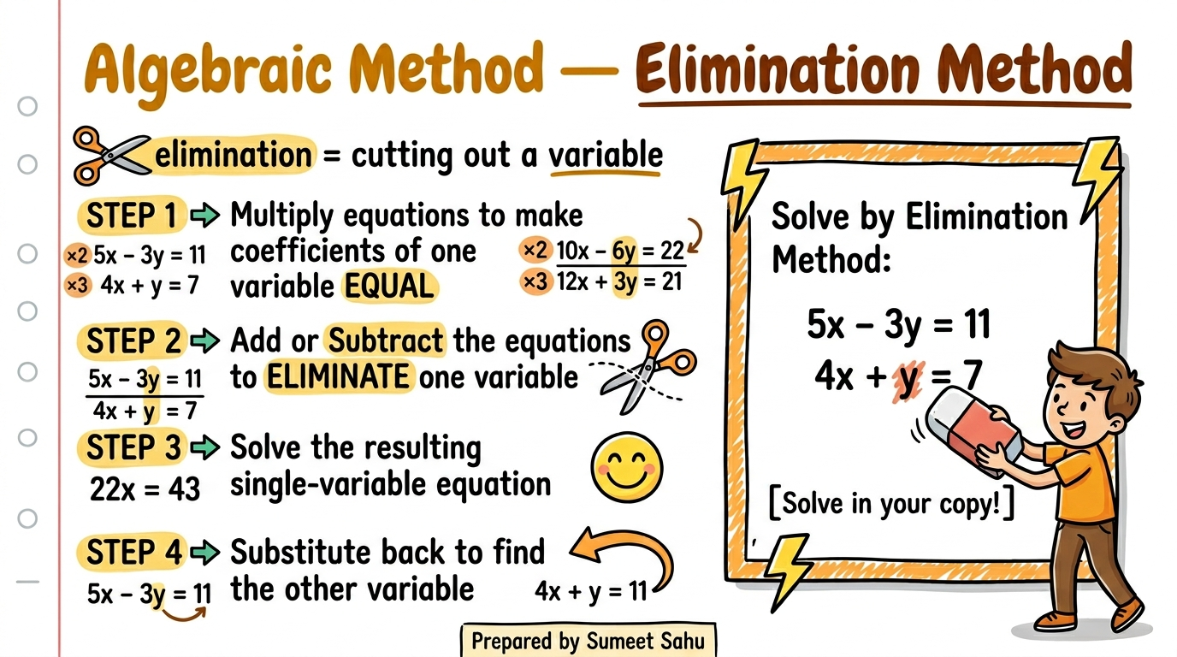
Notes:
Slide 6: Algebraic Method — Elimination Method (Steps + Question)

Slide 7
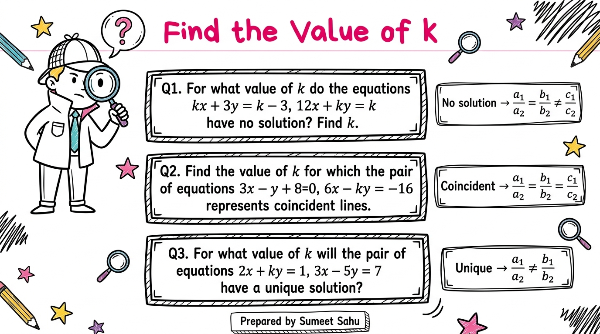
Notes:
Slide 7: Find Value of k — Three condition-based questions

Slide 8
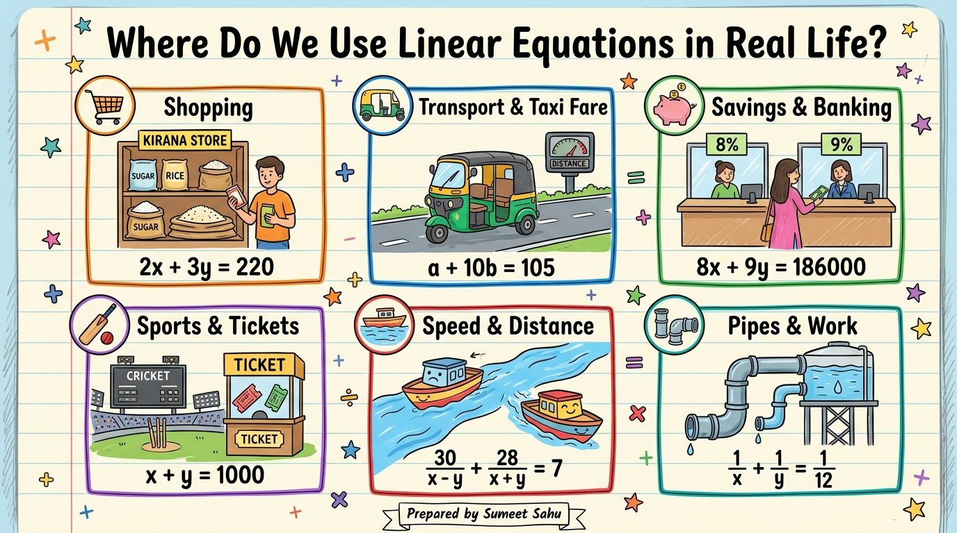
Notes:
Slide 20: Real-Life Uses — Where Do We Use Linear Equations?

Slide 9
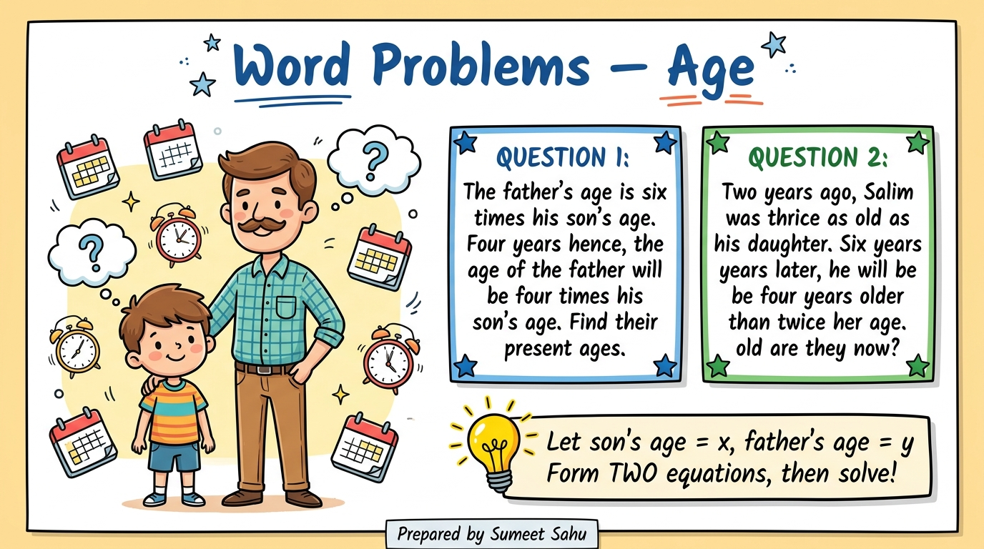
Notes:
Slide 8: Word Problems — Profit & Pipes

Slide 10
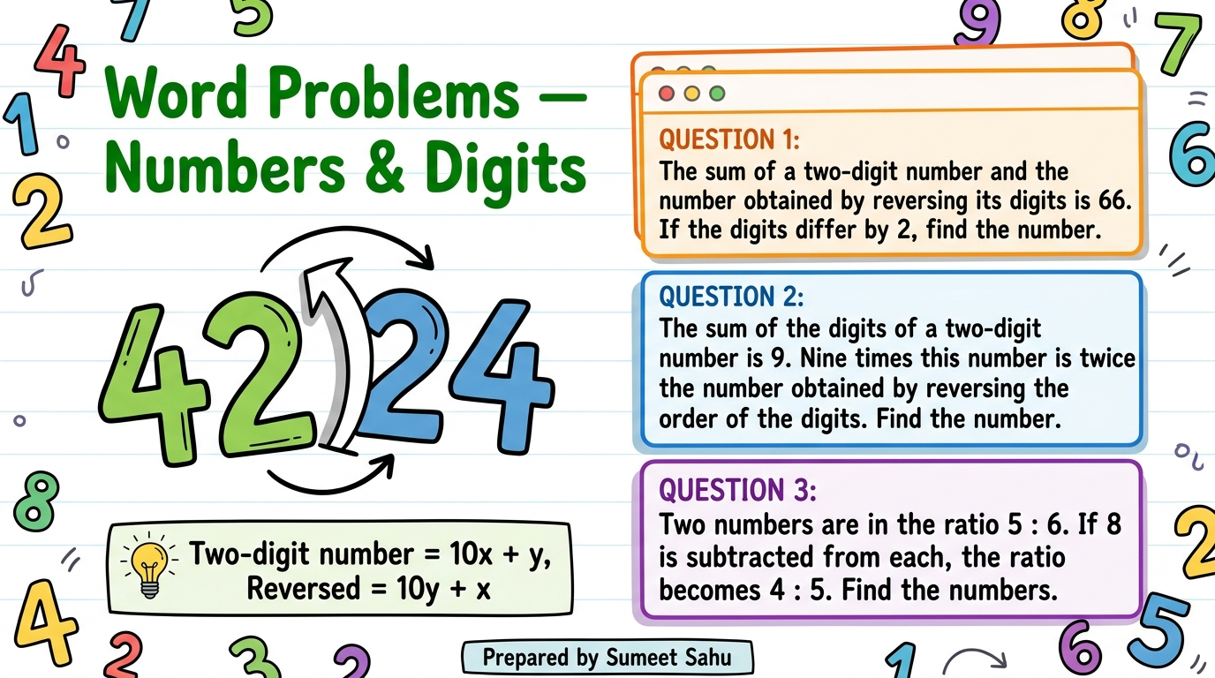
Notes:
Slide 9: Word Problems — Fractions & Angles

Slide 11
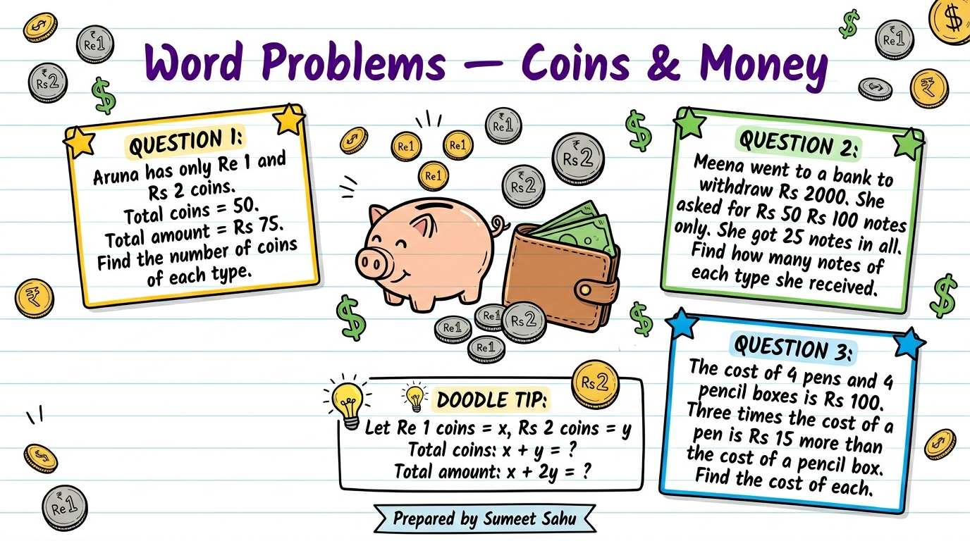
Notes:
Slide 10: Word Problems — Speed, Distance & Time

Slide 12
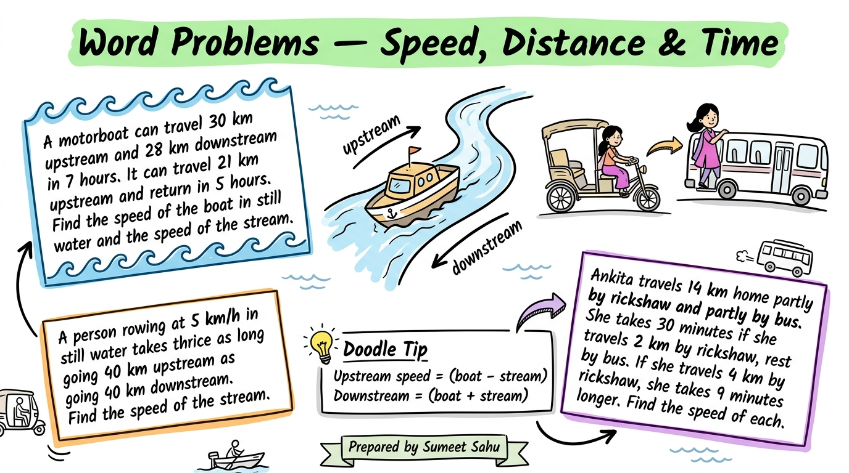
Notes:
Slide 11: Word Problems — Coins & Money

Slide 13
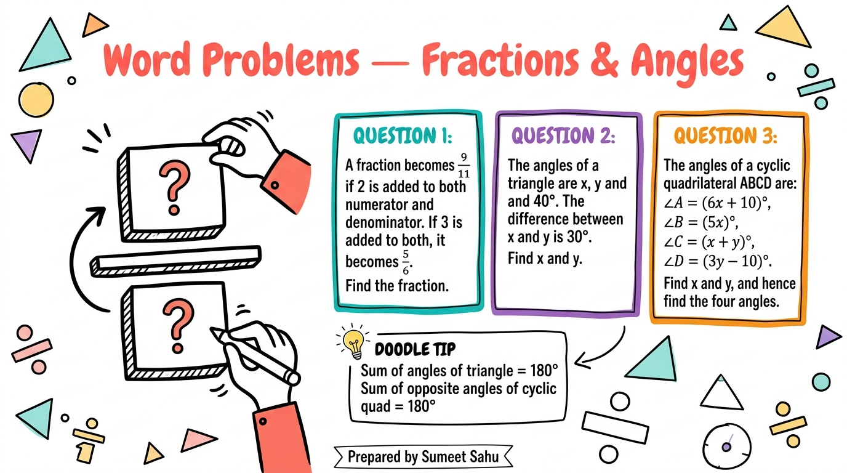
Notes:
Slide 12: Word Problems — Numbers & Digits

Slide 14
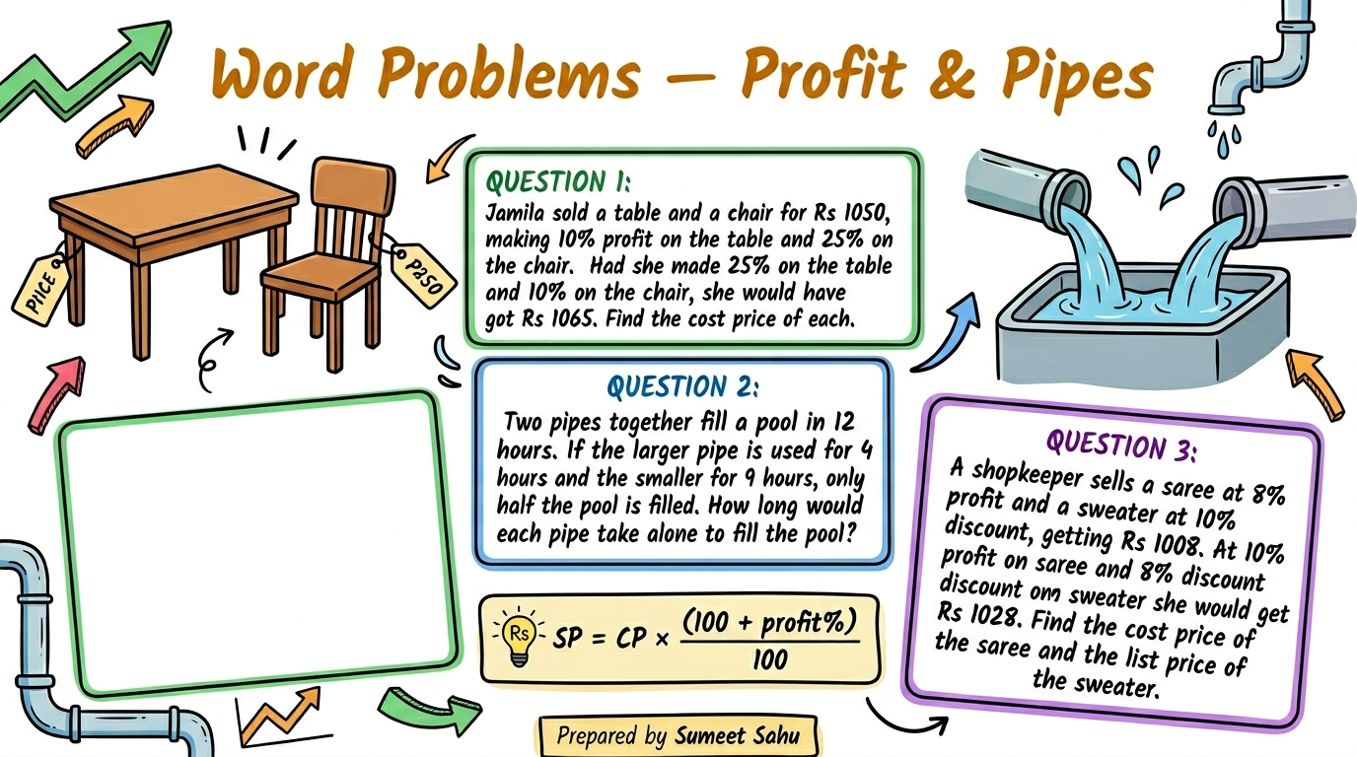
Notes:
Slide 13: Word Problems — Age Problems

Slide 15
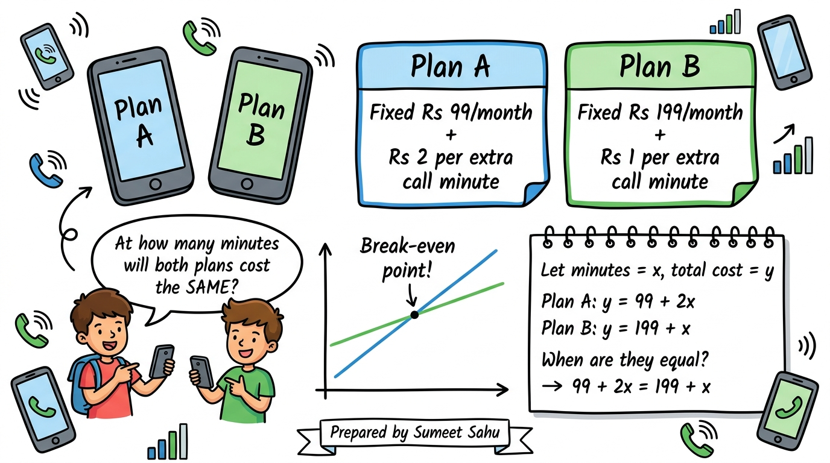
Notes:
Slide 15: Algebraic Method — Elimination Method detailed

Slide 16
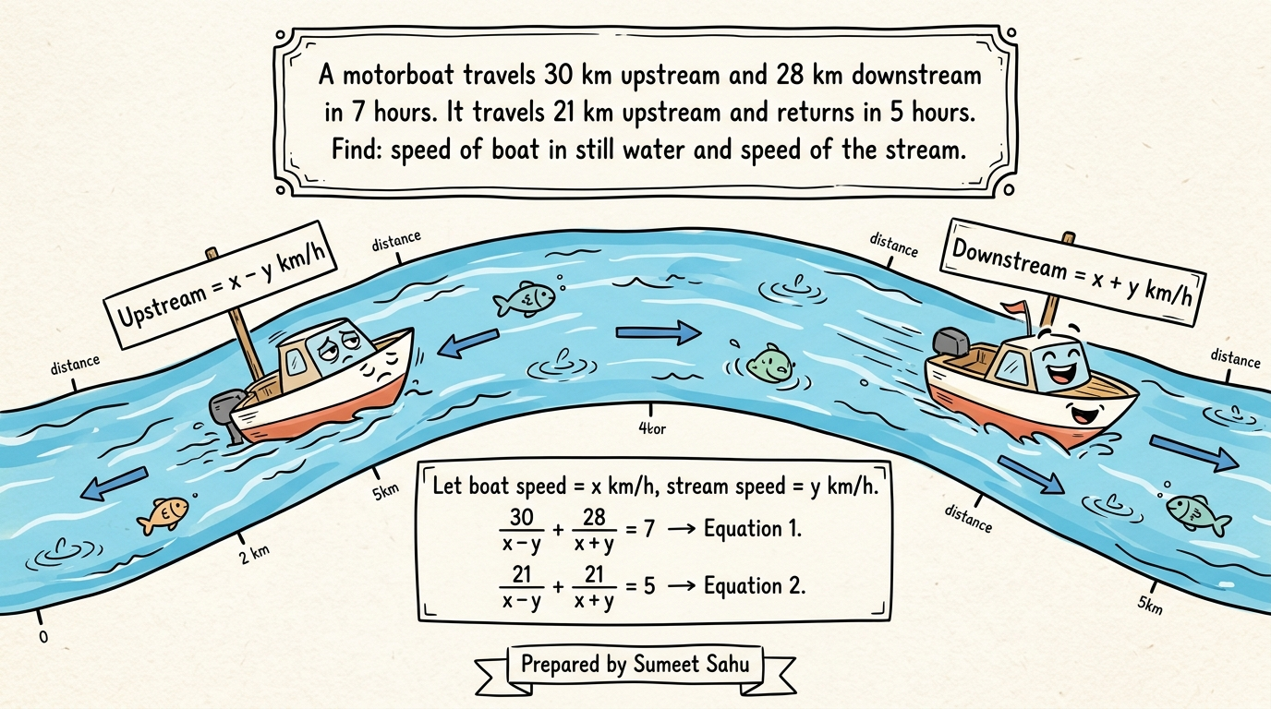
Notes:
Slide 18: Graphical Method — Solve & Find Triangle detailed

Slide 17
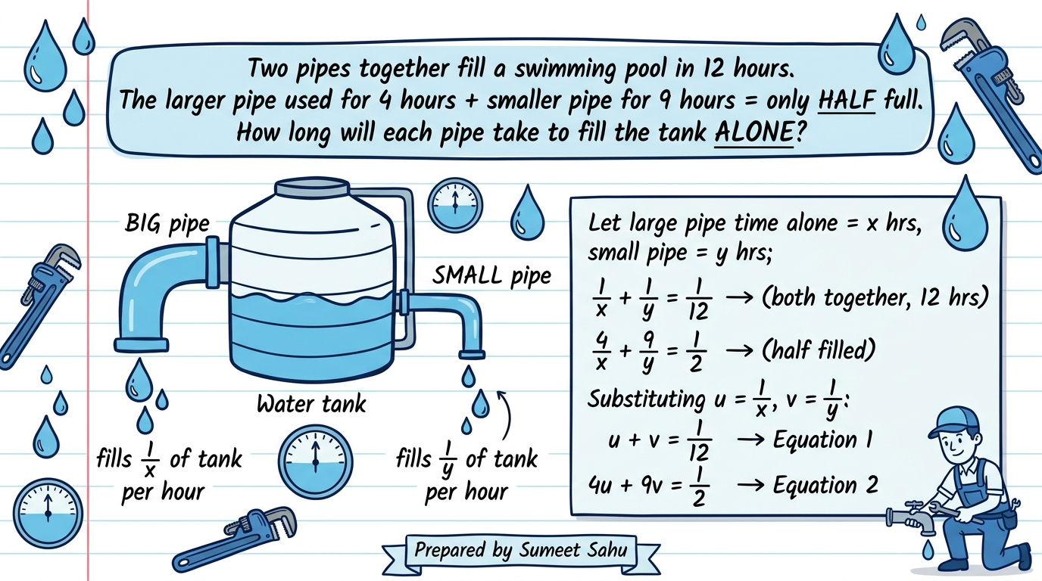
Notes:
Slide 16: Algebraic Method — Substitution Method detailed

Slide 18
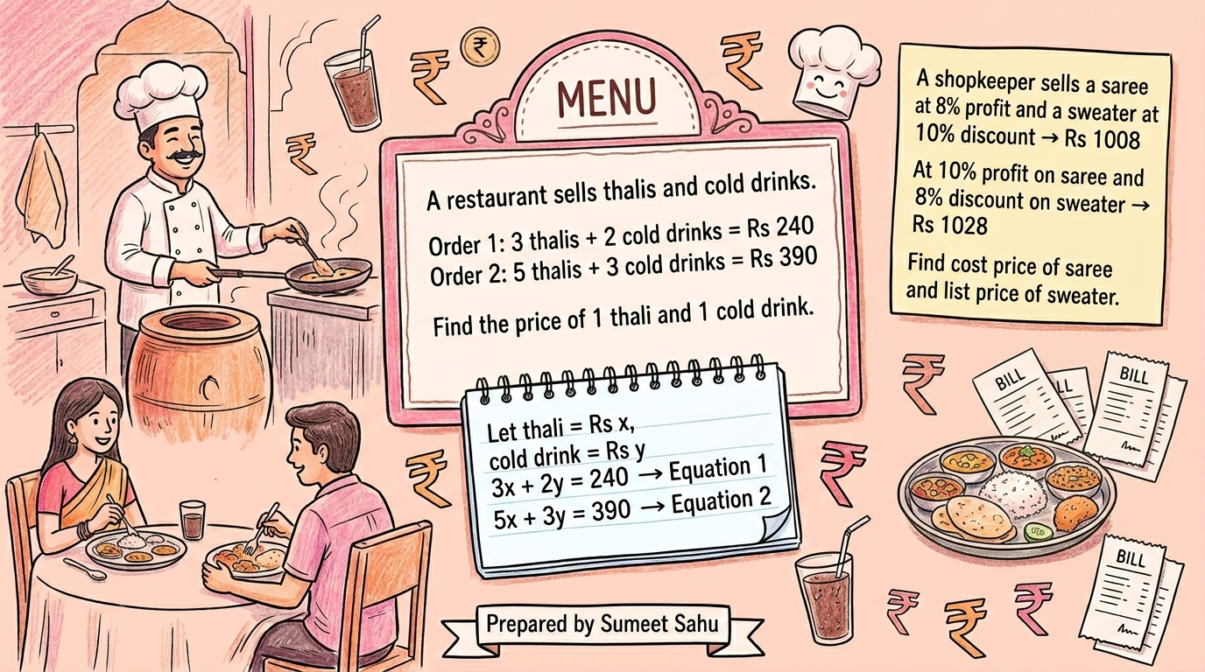
Notes:
Slide 17: Conditions for Consistency & Inconsistency — Visual

Slide 19
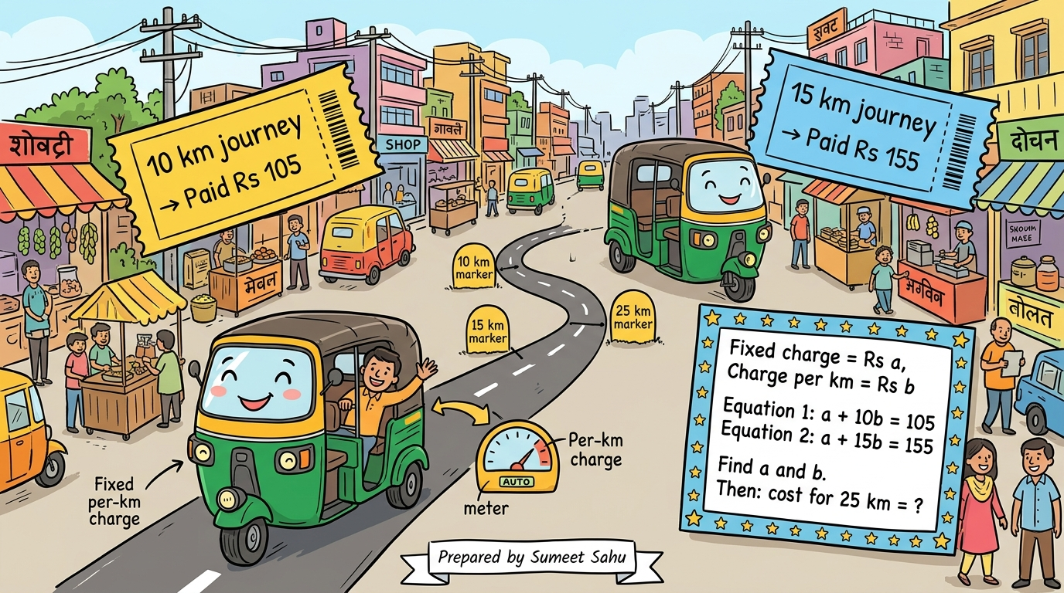
Notes:
Slide 19: What is a Pair of Linear Equations?

Slide 20
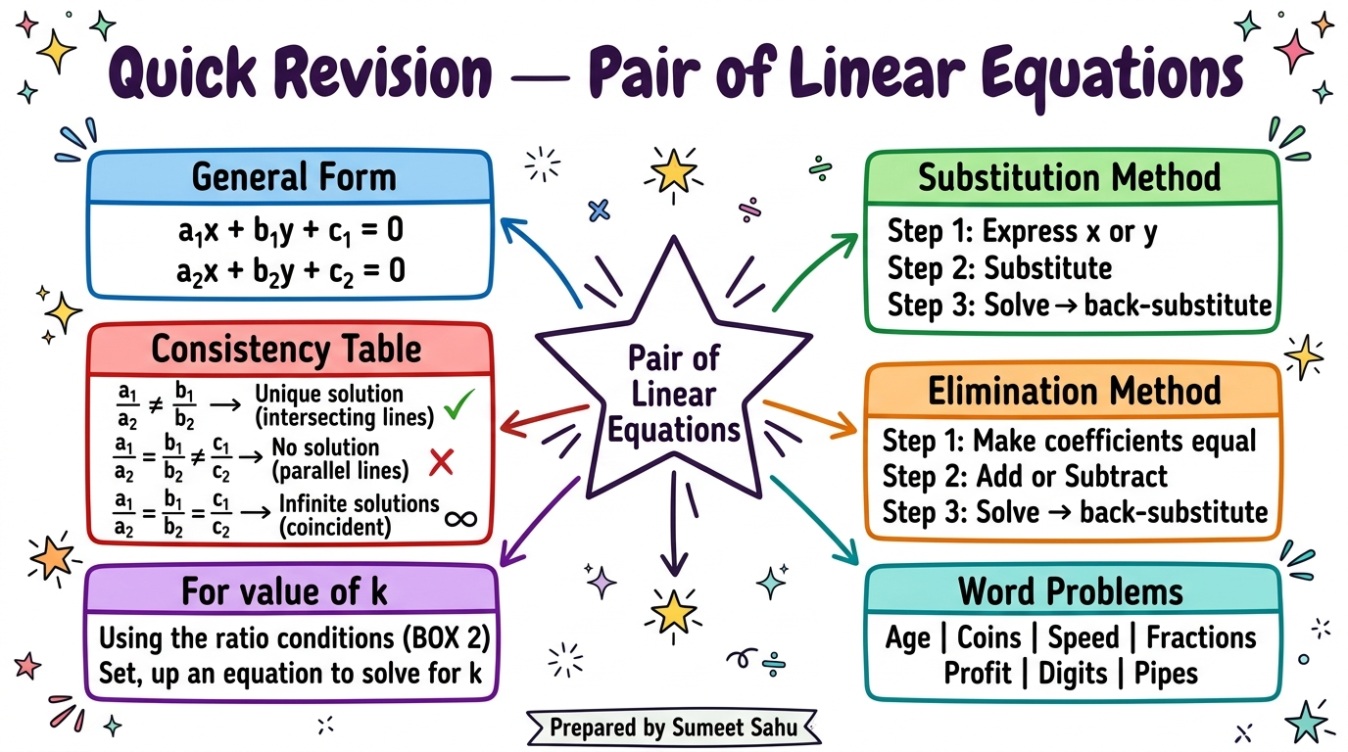
Notes:
Slide 14: Find the Value of k — Detective questions

