Slide 1
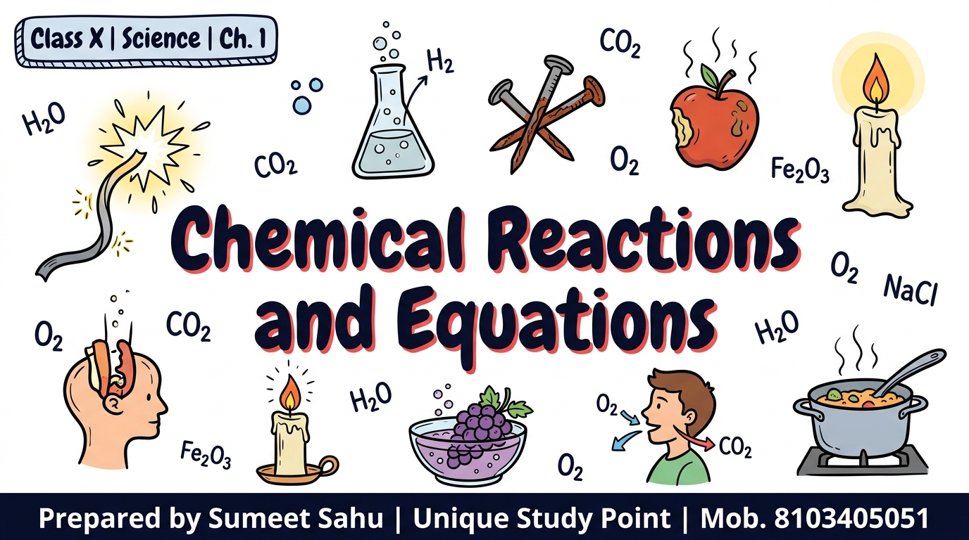
Notes:
Slide 1 of 46: Title — Chemical Reactions and Equations

Slide 2
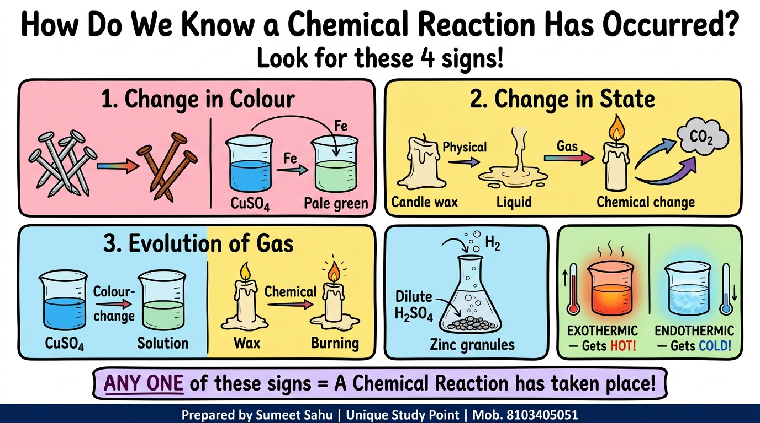
Notes:
Slide 2 of 46: Signs of a Chemical Reaction (4 Indicators)

Slide 3
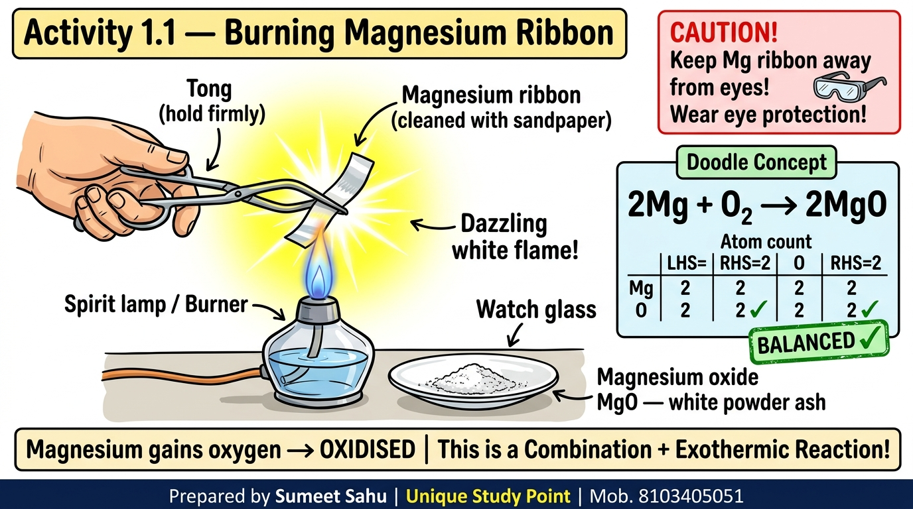
Notes:
Slide 3 of 46: Activity 1.1 — Burning Magnesium Ribbon

Slide 4
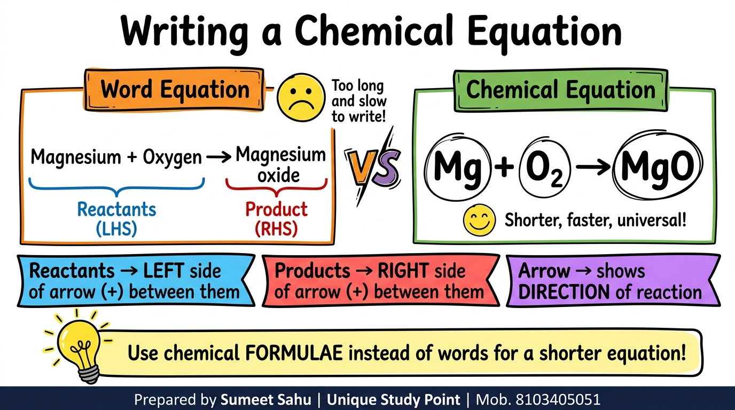
Notes:
Slide 4 of 46: Word Equation vs Chemical Equation

Slide 5
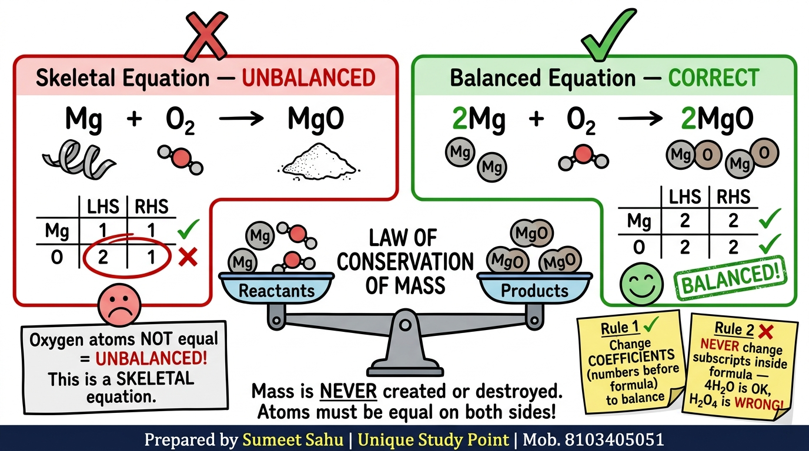
Notes:
Slide 5 of 46: Skeletal vs Balanced Equation

Slide 6
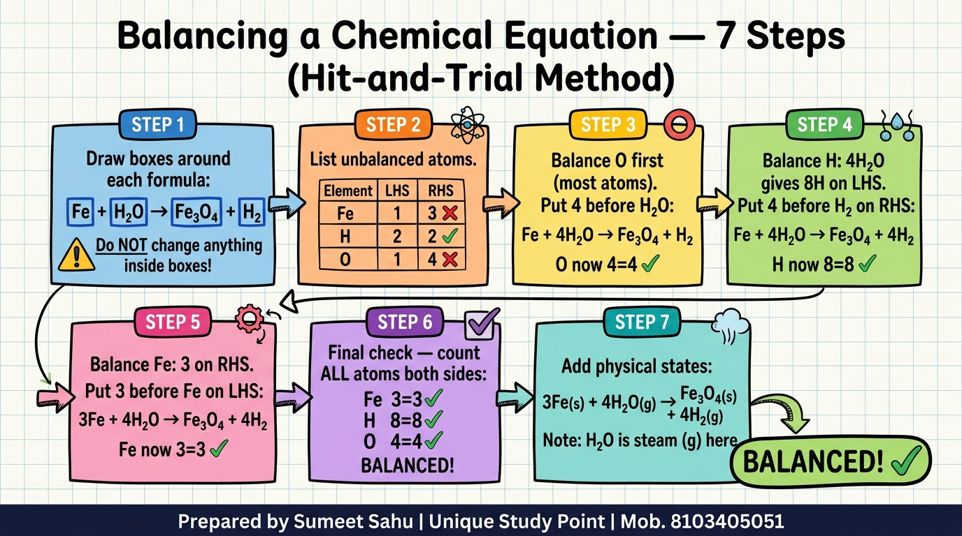
Notes:
Slide 6 of 46: Balancing — 7 Steps (Hit-and-Trial Method)

Slide 7
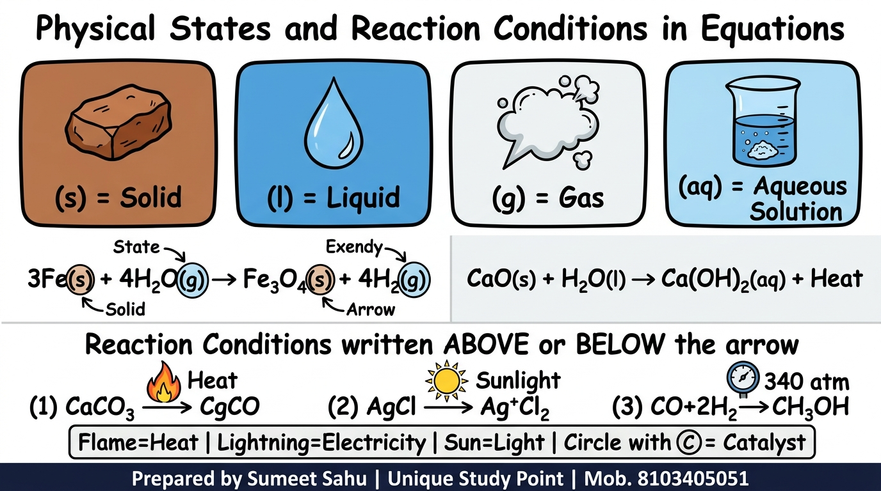
Notes:
Slide 7 of 46: Physical States and Reaction Conditions

Slide 8
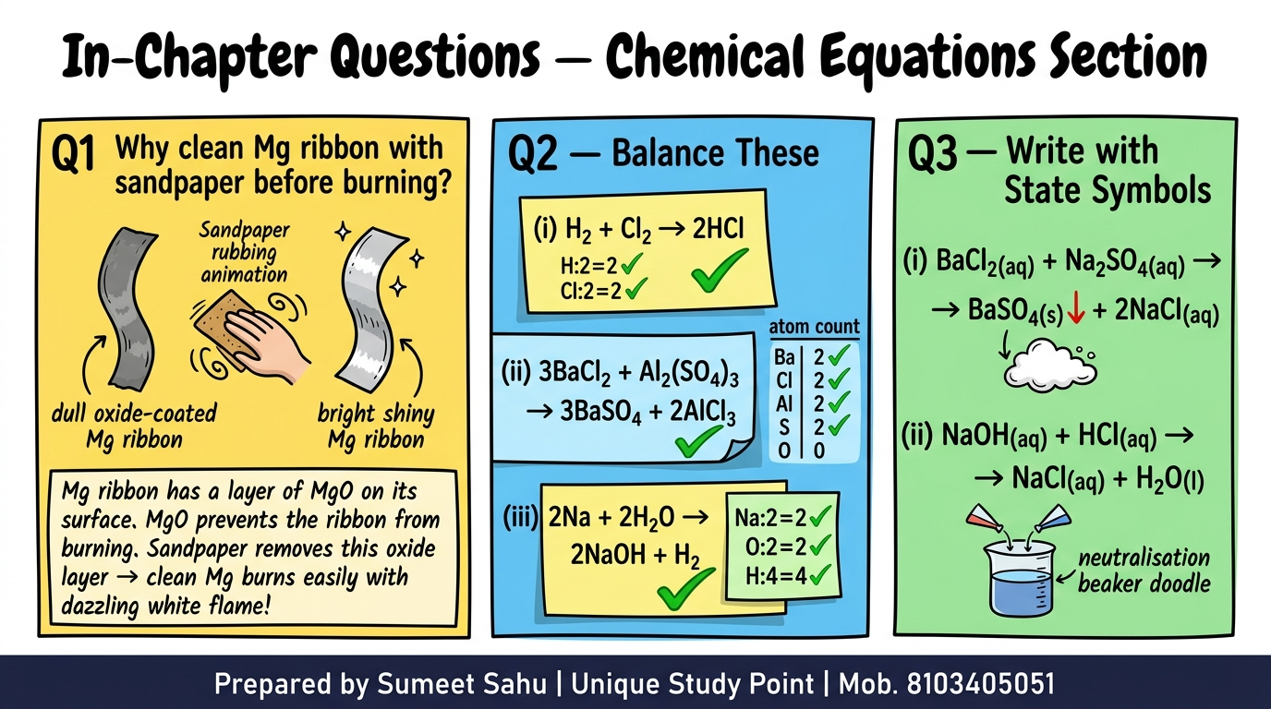
Notes:
Slide 8 of 46: In-Chapter Questions — Chemical Equations Section

Slide 9
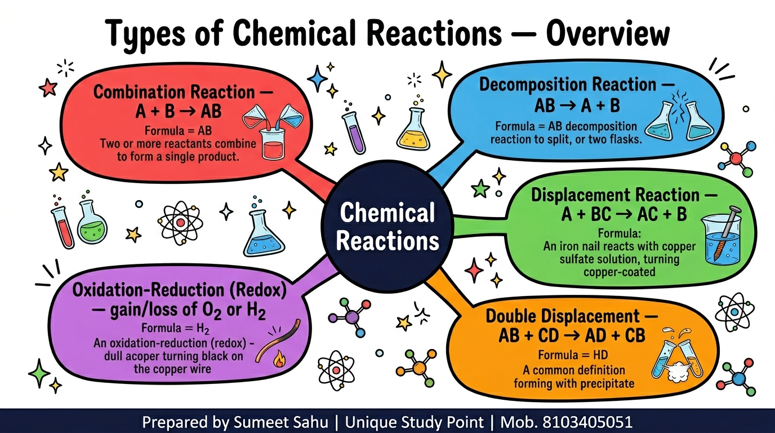
Notes:
Slide 9 of 46: Types of Chemical Reactions — Overview (Mind Map)

Slide 10
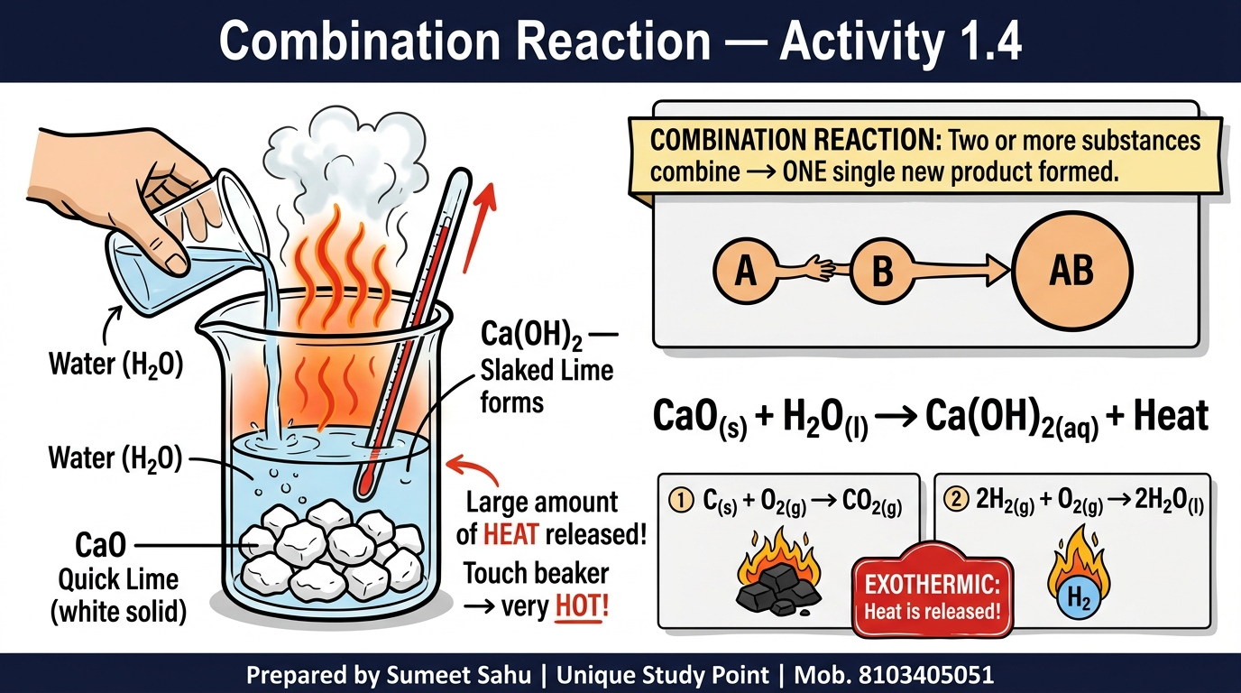
Notes:
Slide 10 of 46: Combination Reaction — Activity 1.4 (CaO + H₂O)

Slide 11
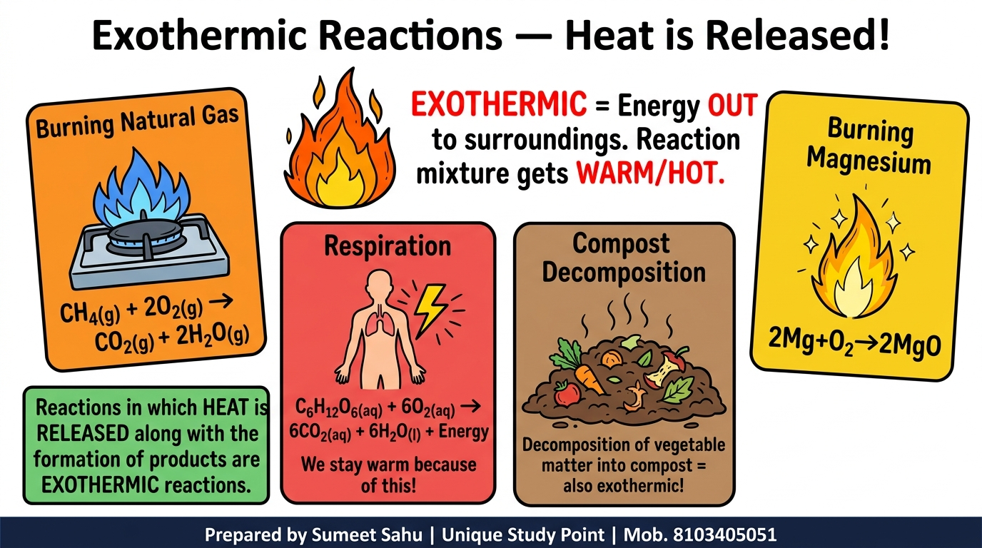
Notes:
Slide 11 of 46: Exothermic Reactions — Heat is Released

Slide 12
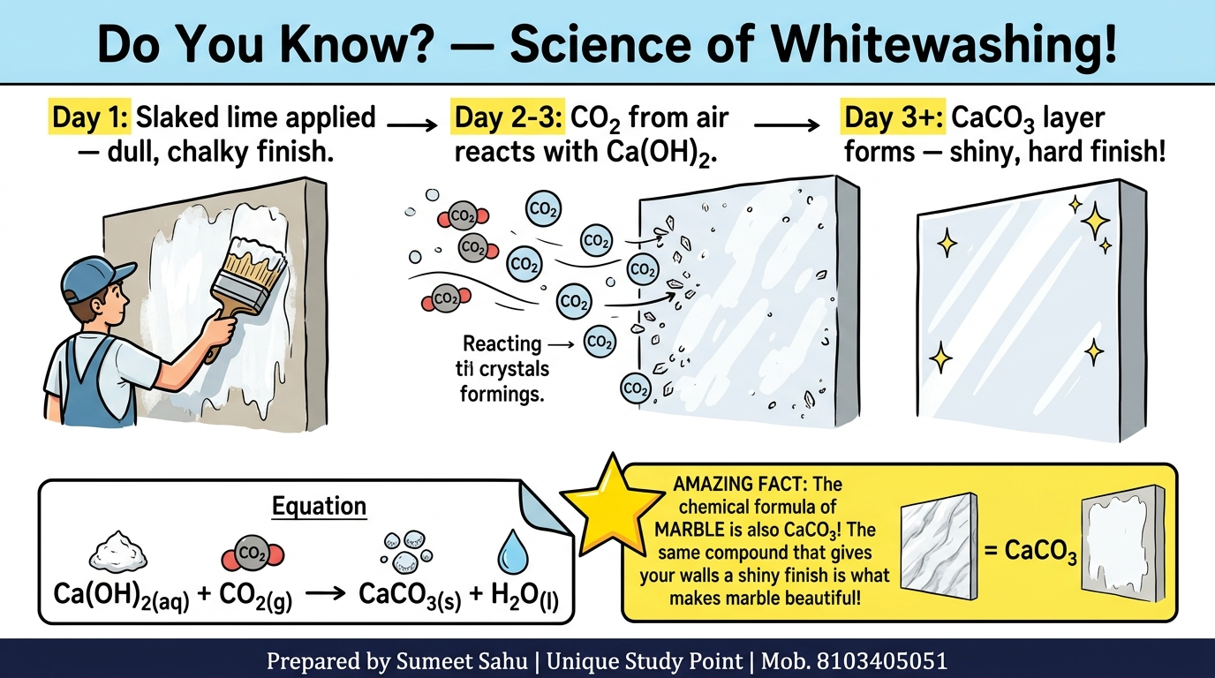
Notes:
Slide 12 of 46: Do You Know? — Science of Whitewashing

Slide 13
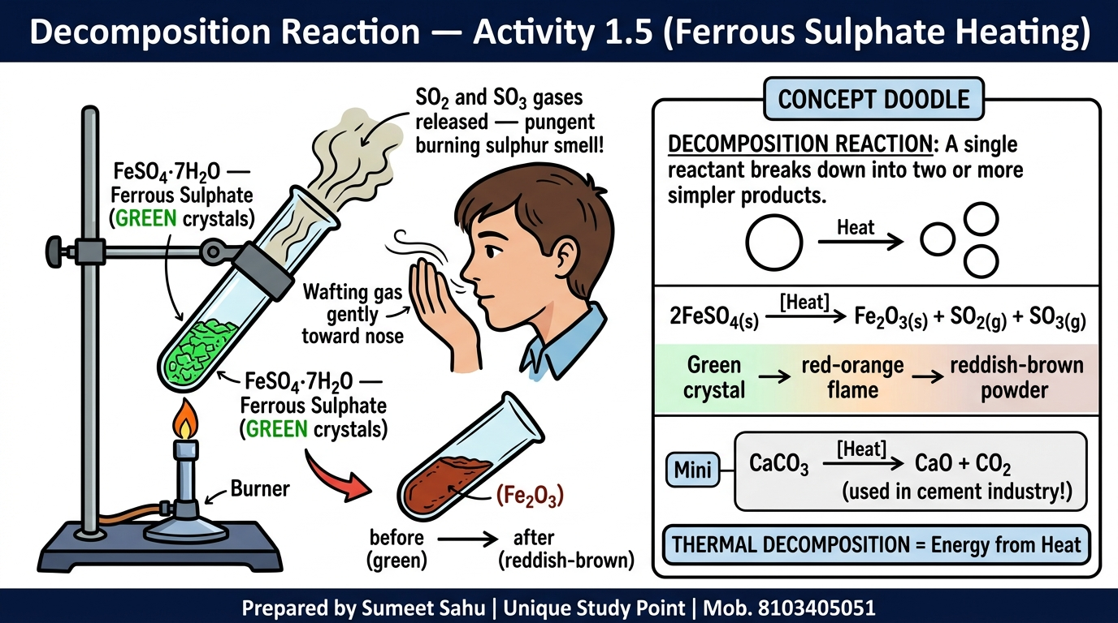
Notes:
Slide 13 of 46: Decomposition Reaction — Activity 1.5 (FeSO₄ Heating)

Slide 14
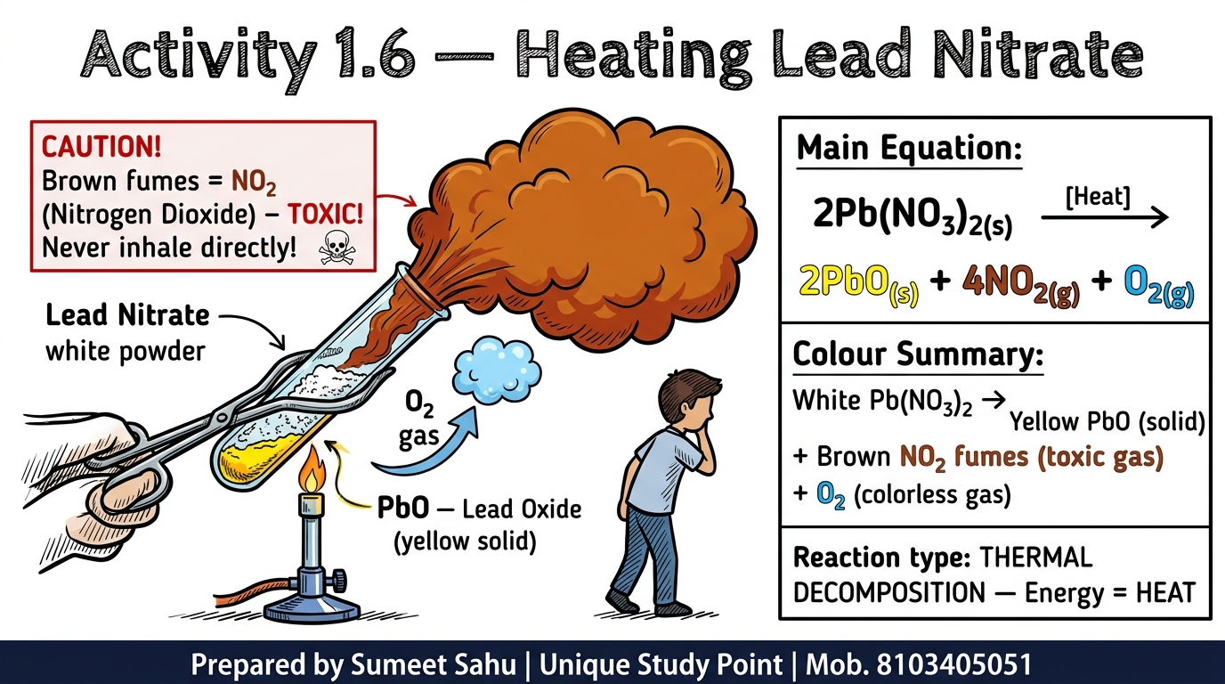
Notes:
Slide 14 of 46: Activity 1.6 — Heating Lead Nitrate (Brown NO₂ Fumes)

Slide 15
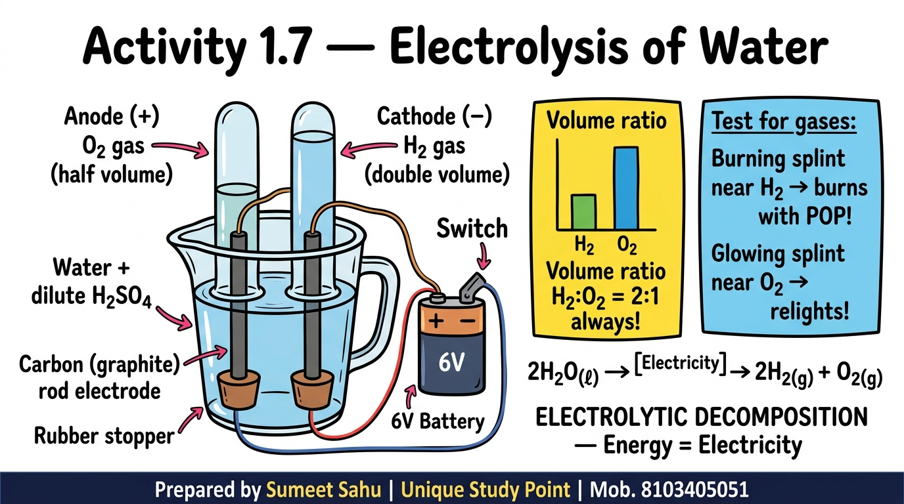
Notes:
Slide 15 of 46: Activity 1.7 — Electrolysis of Water

Slide 16
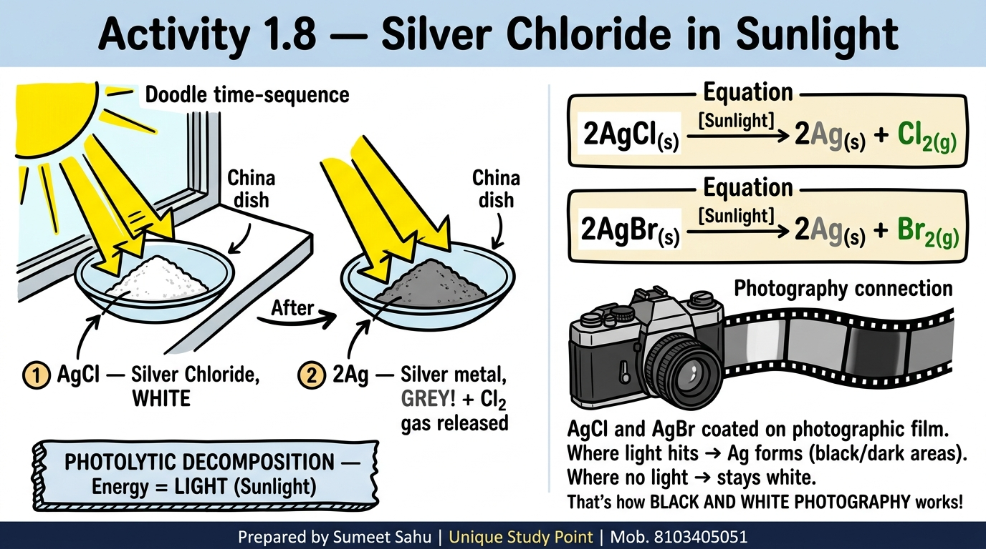
Notes:
Slide 16 of 46: Activity 1.8 — Silver Chloride in Sunlight + Photography

Slide 17
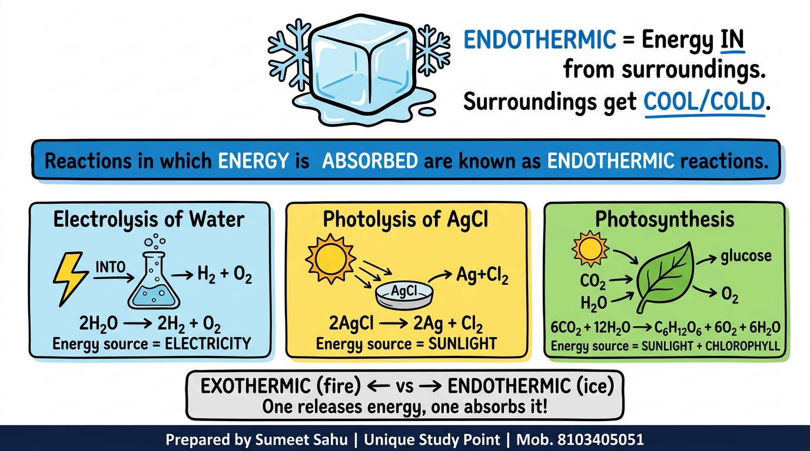
Notes:
Slide 17 of 46: Endothermic Reactions — Energy Absorbed

Slide 18
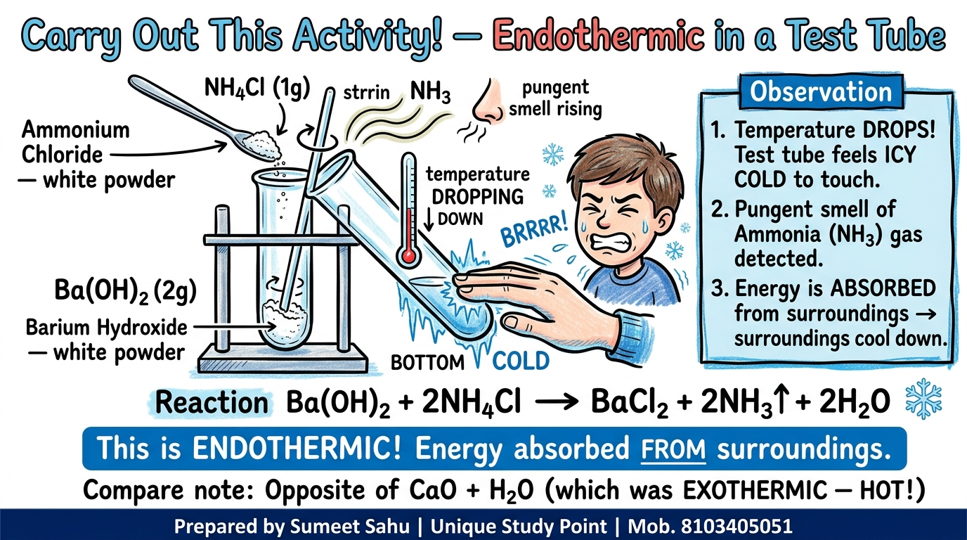
Notes:
Slide 18 of 46: Ba(OH)₂ + NH₄Cl — Endothermic Activity (Feel the Cold!)

Slide 19
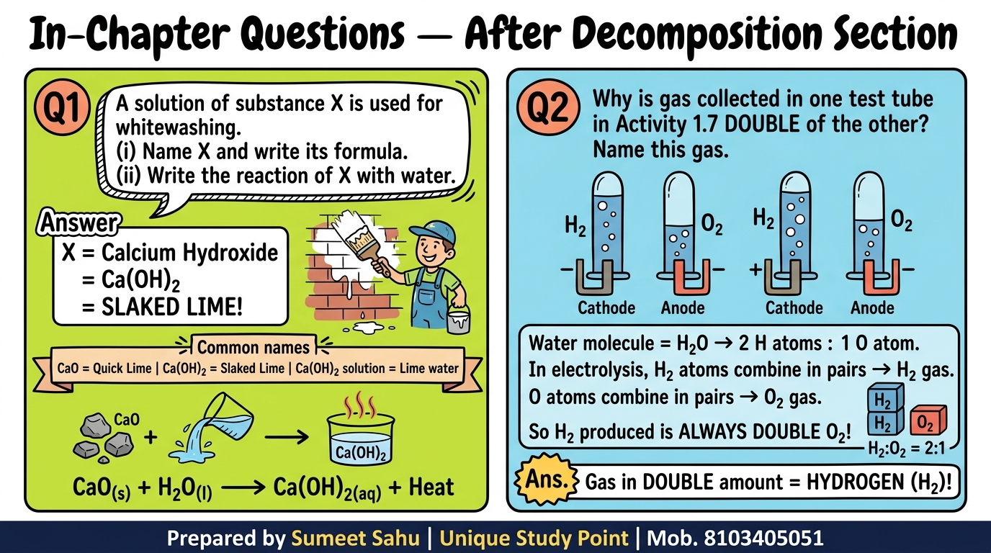
Notes:
Slide 19 of 46: In-Chapter Questions — After Decomposition Section

Slide 20
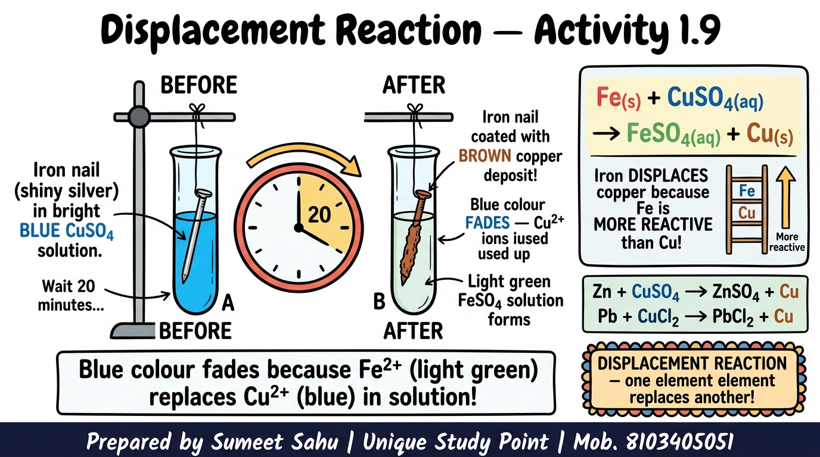
Notes:
Slide 20 of 46: Displacement Reaction — Activity 1.9 (Iron Nail in CuSO₄)

Slide 21
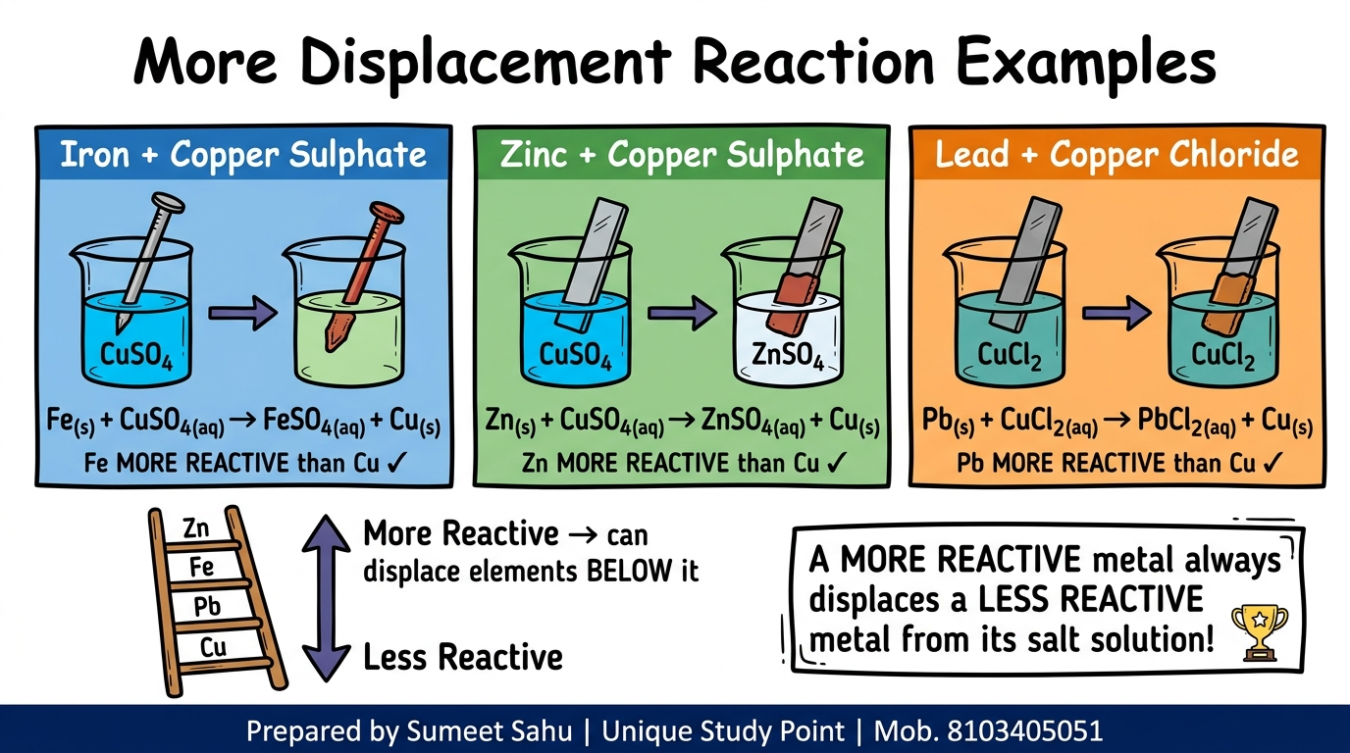
Notes:
Slide 21 of 46: More Displacement Reaction Examples (Zn, Pb, Fe + Reactivity Ladder)

Slide 22
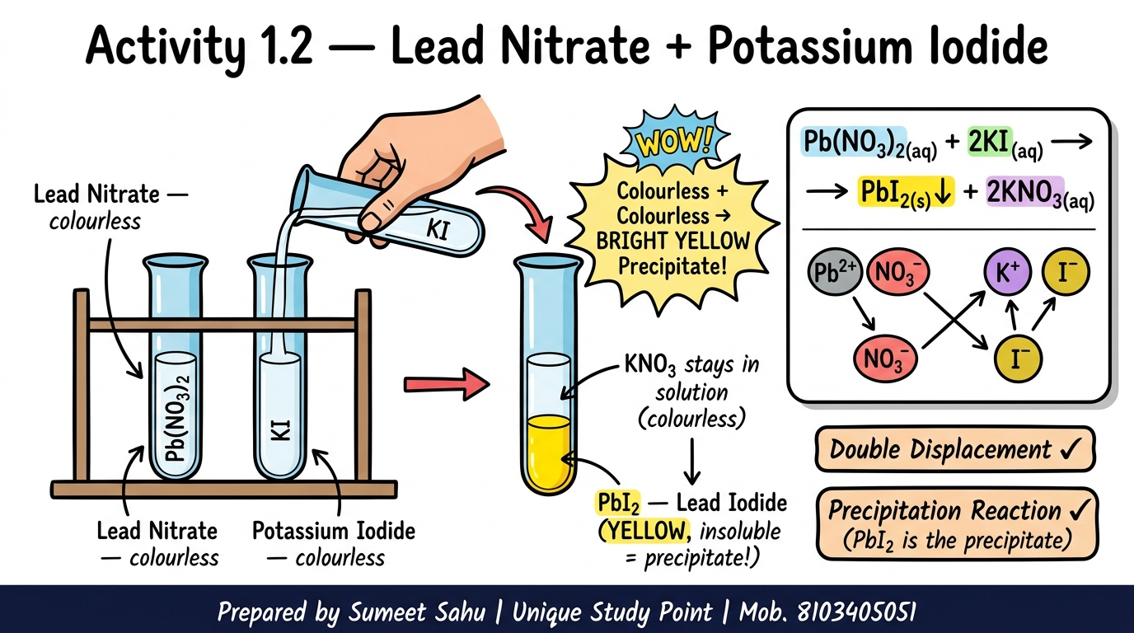
Notes:
Slide 22 of 46: Activity 1.2 — Lead Nitrate + Potassium Iodide (Yellow PbI₂ Precipitate)

Slide 23
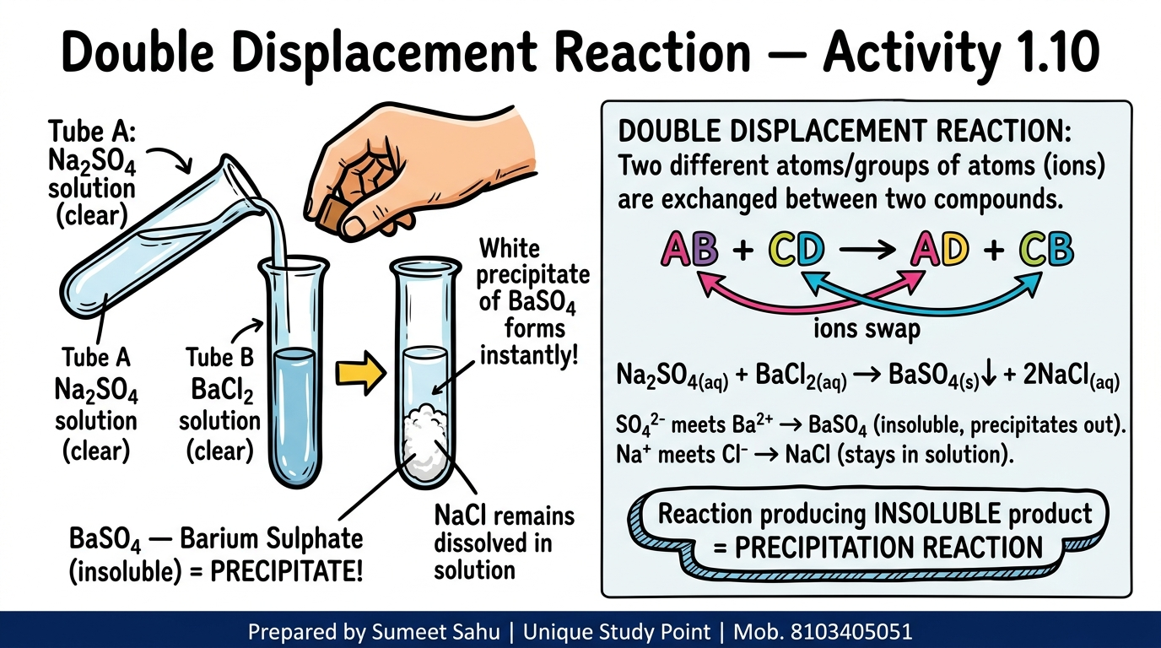
Notes:
Slide 23 of 46: Double Displacement Reaction — Activity 1.10 (BaSO₄ White Precipitate)

Slide 24
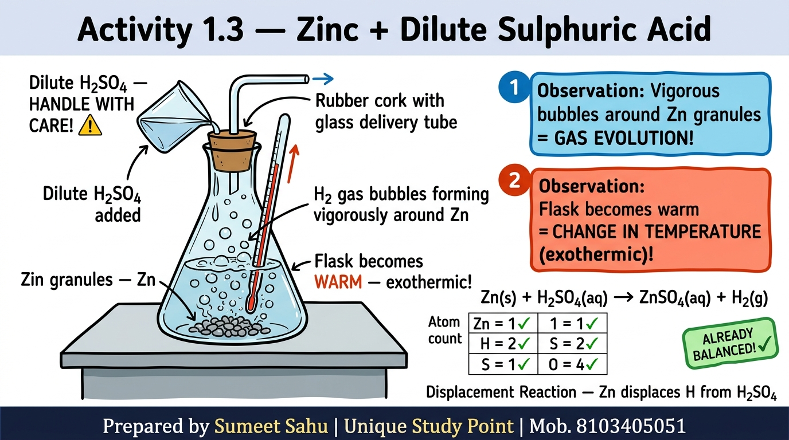
Notes:
Slide 24 of 46: Activity 1.3 — Zinc + Dilute Sulphuric Acid (Gas Evolution + Temp Change)

Slide 25
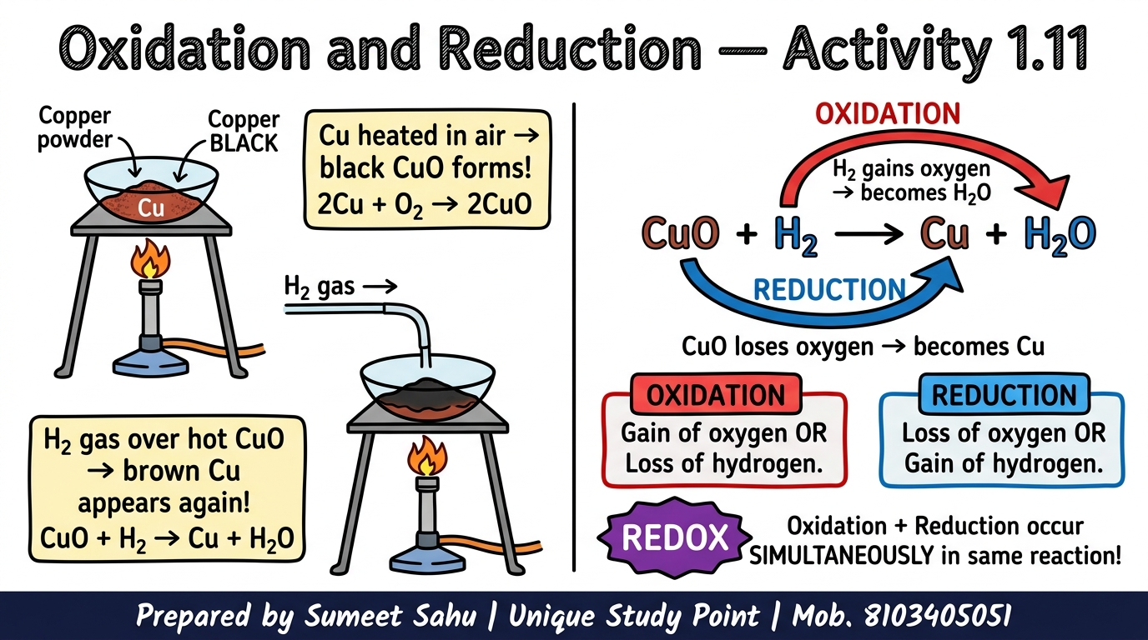
Notes:
Slide 25 of 46: Oxidation and Reduction — Activity 1.11 (Copper Powder)

Slide 26
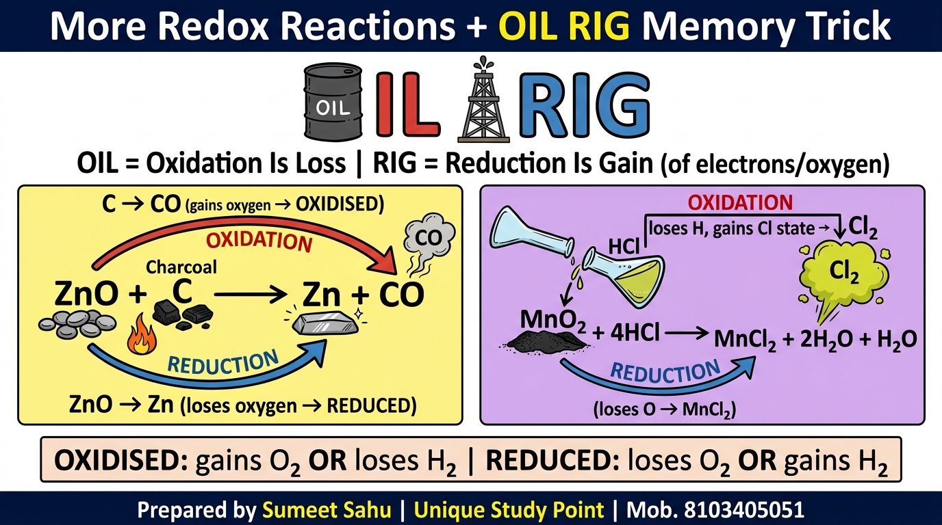
Notes:
Slide 26 of 46: More Redox Reactions + OIL RIG Memory Trick

Slide 27
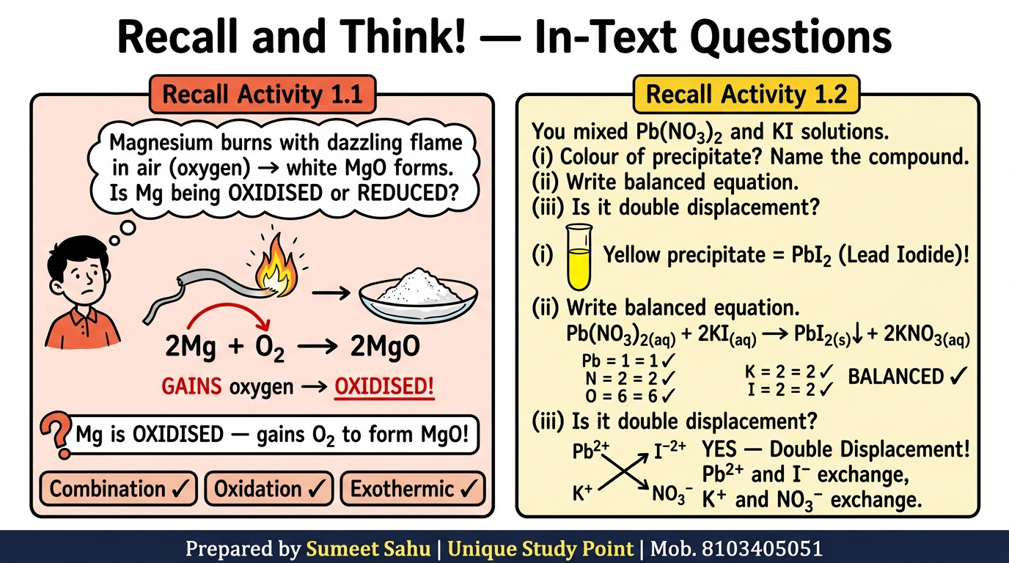
Notes:
Slide 27 of 46: Recall and Think! — In-Text Questions (Mg Oxidised? + Activity 1.2 Revisit)

Slide 28
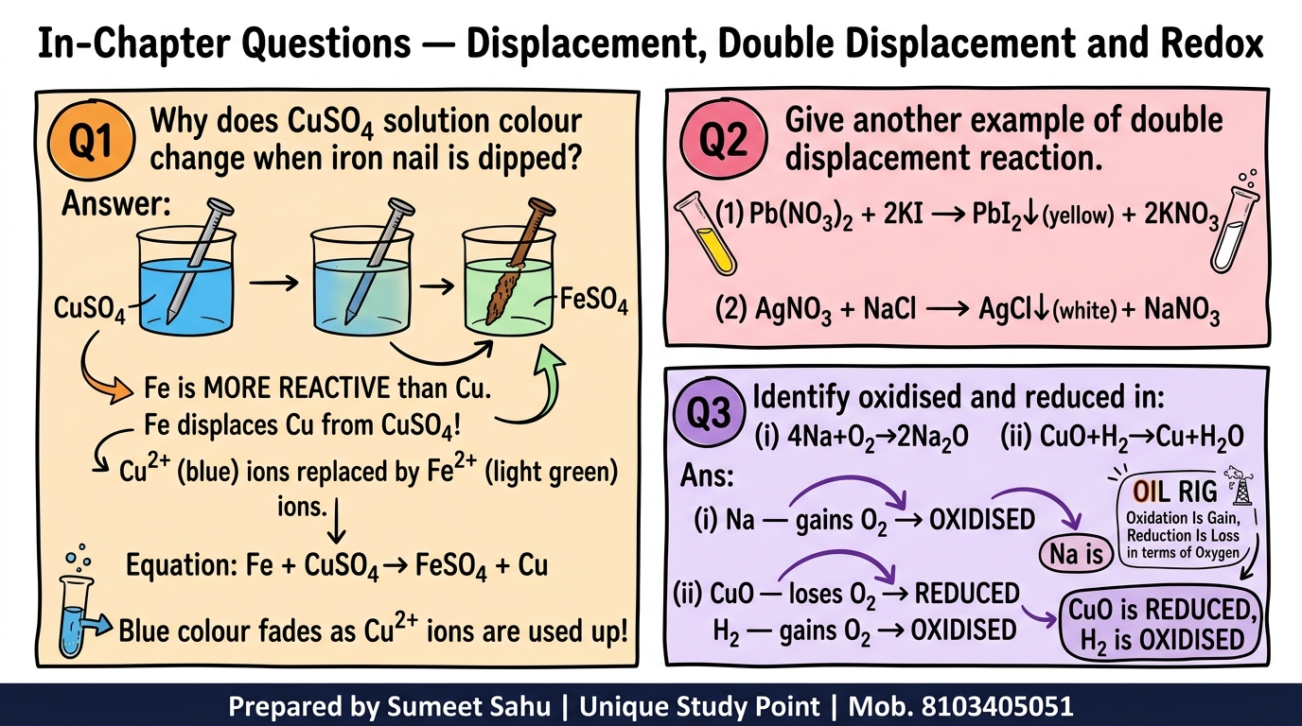
Notes:
Slide 28 of 46: In-Chapter Questions — Displacement, Double Displacement and Redox

Slide 29
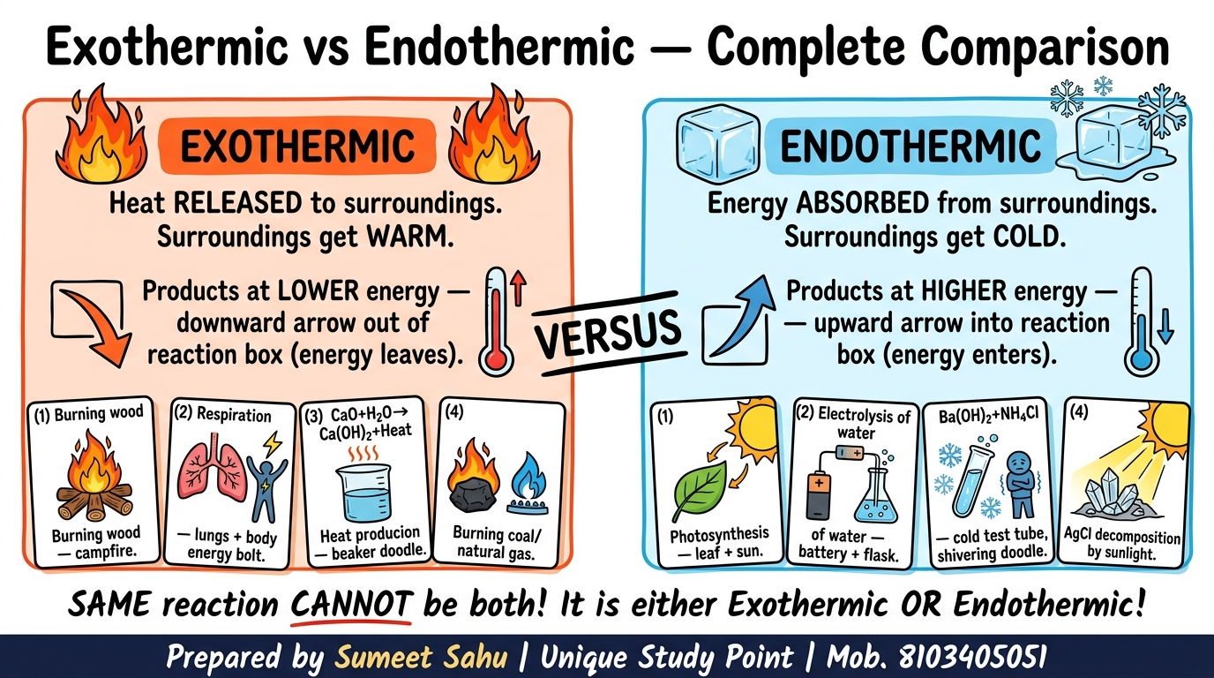
Notes:
Slide 29 of 46: Exothermic vs Endothermic — Complete Comparison

Slide 30
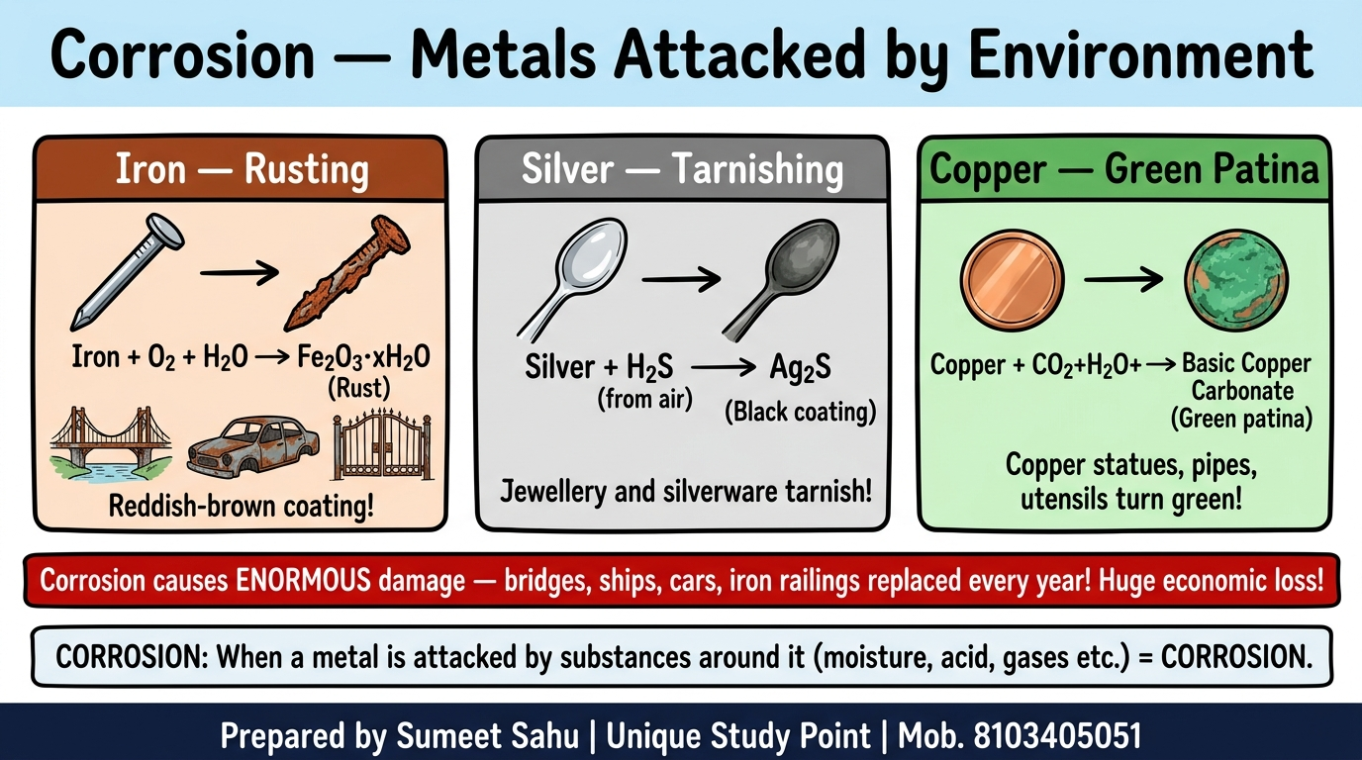
Notes:
Slide 30 of 46: Corrosion — Metals Attacked by Environment

Slide 31
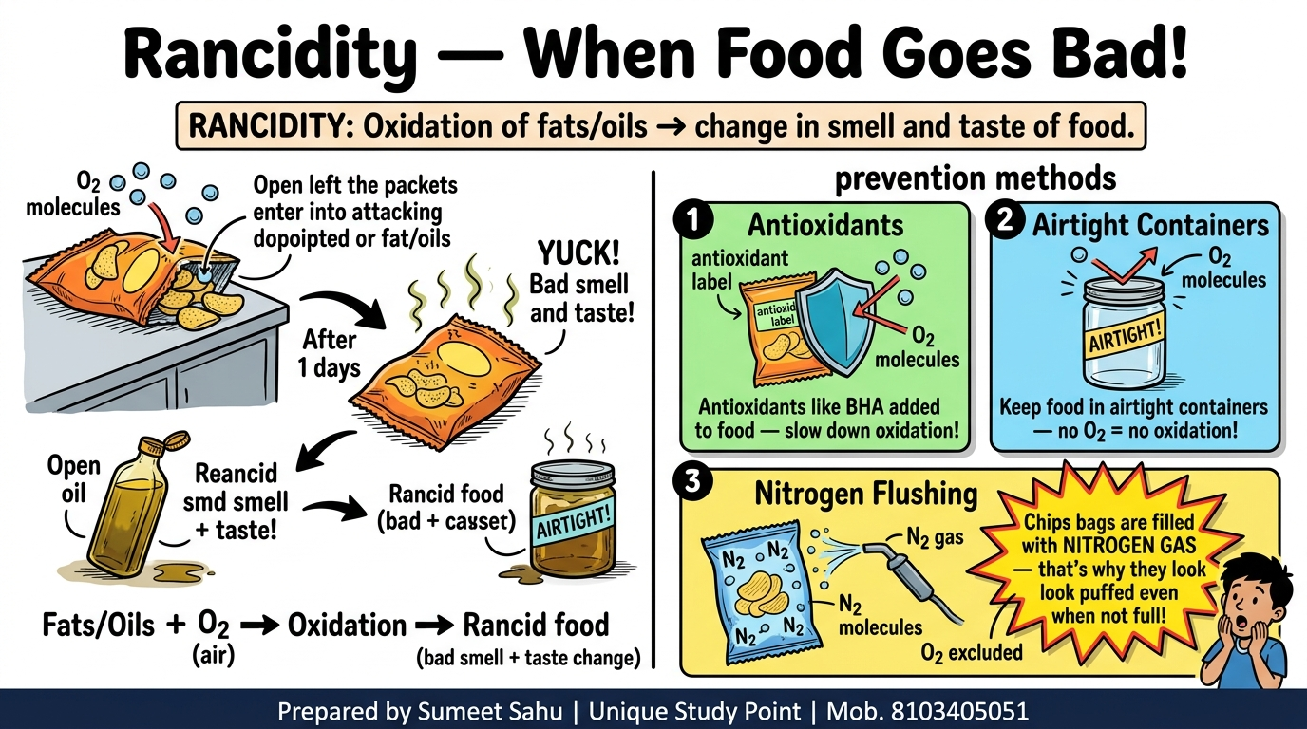
Notes:
Slide 31 of 46: Rancidity — When Food Goes Bad! (Prevention Methods)

Slide 32
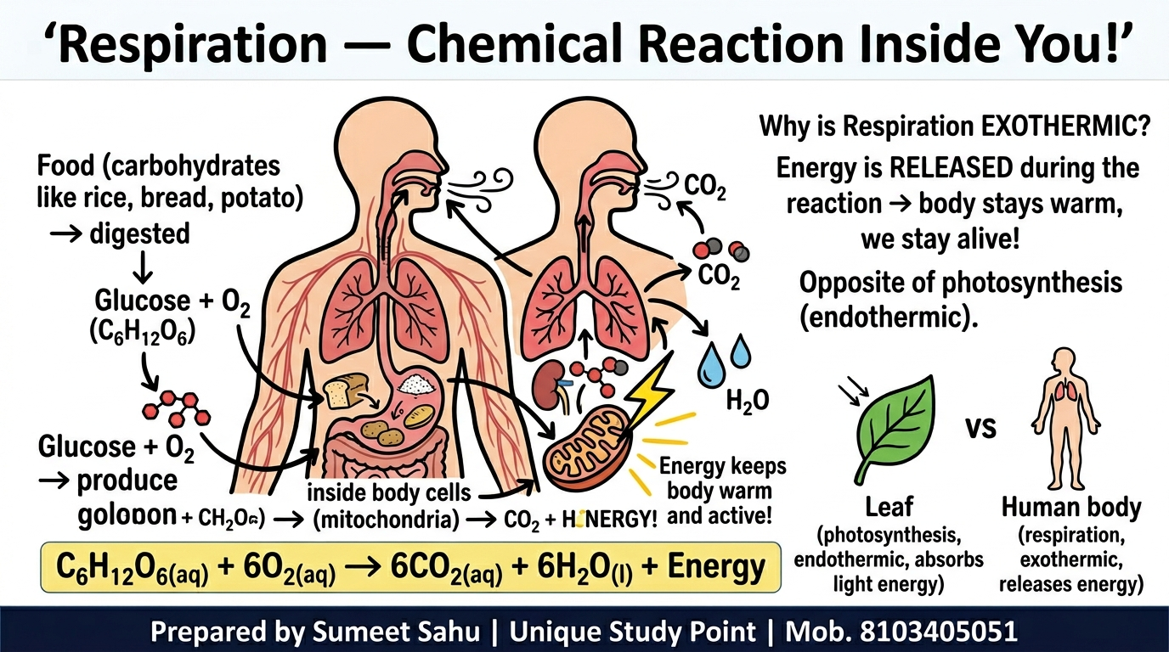
Notes:
Slide 32 of 46: Respiration — Chemical Reaction Inside You! (Exothermic)

Slide 33
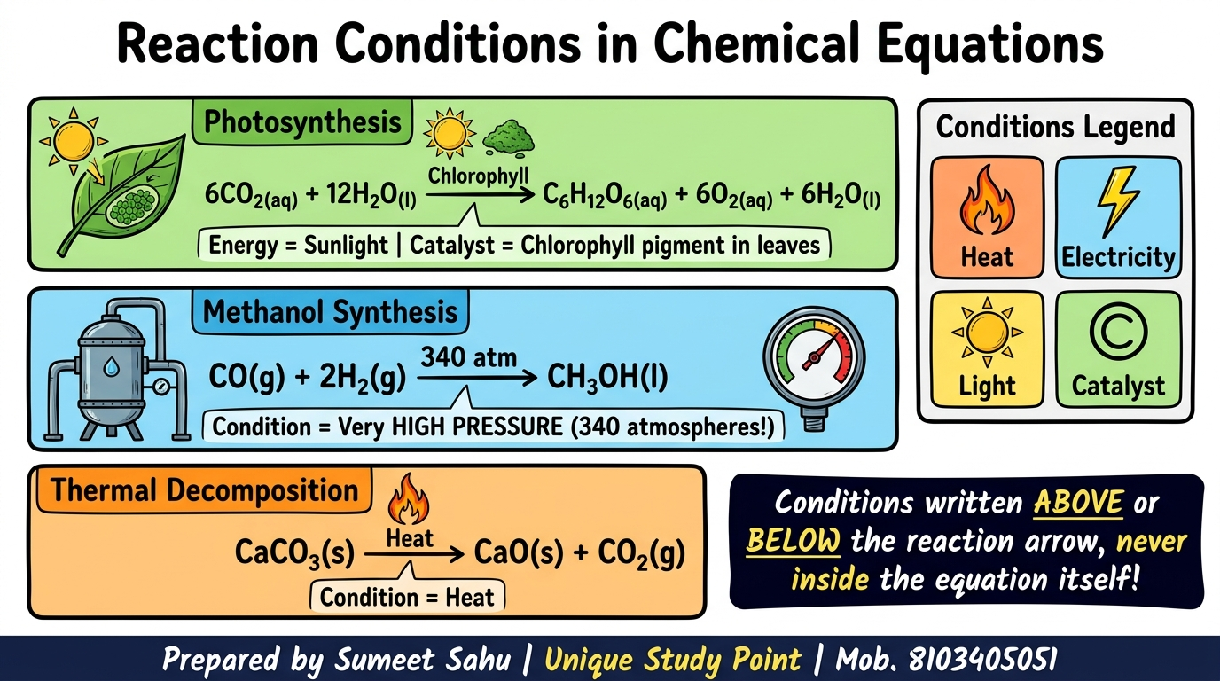
Notes:
Slide 33 of 46: Reaction Conditions in Chemical Equations (Photosynthesis, Methanol)

Slide 34
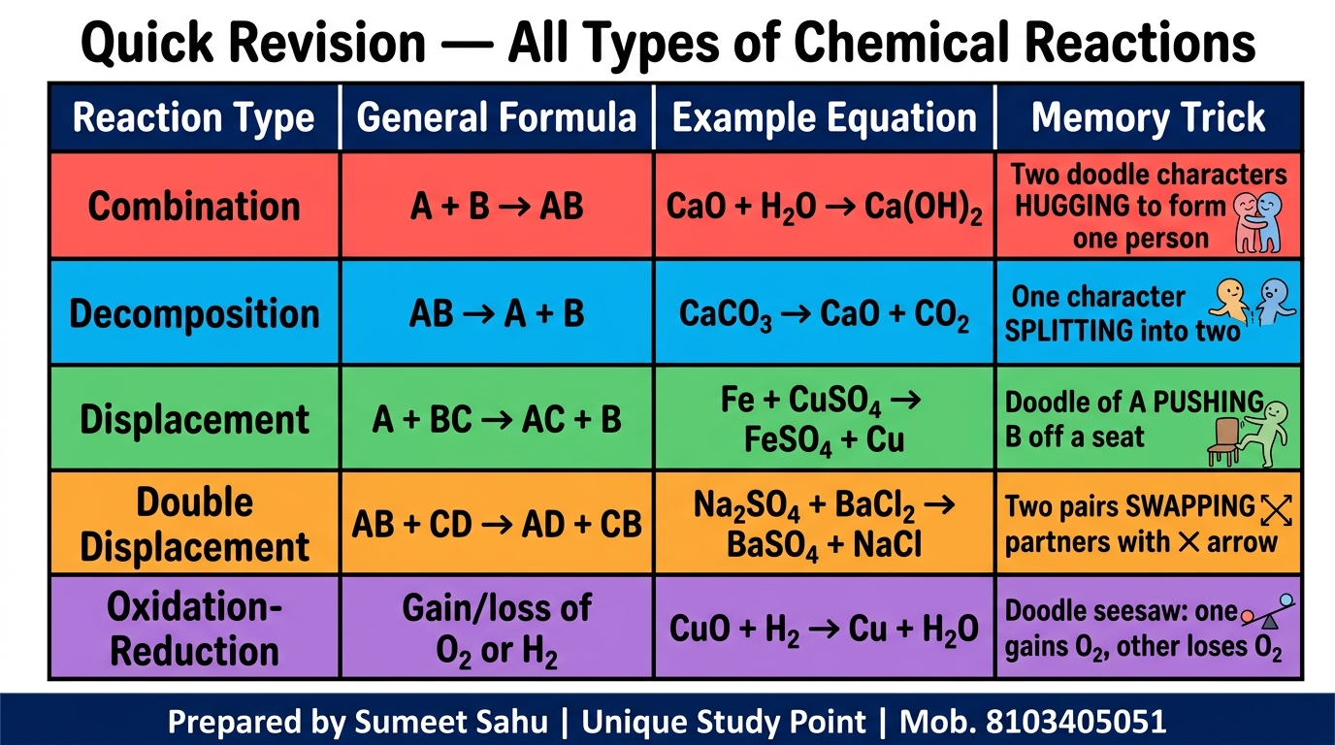
Notes:
Slide 34 of 46: Quick Revision — All Types of Chemical Reactions (Summary Table)

Slide 35
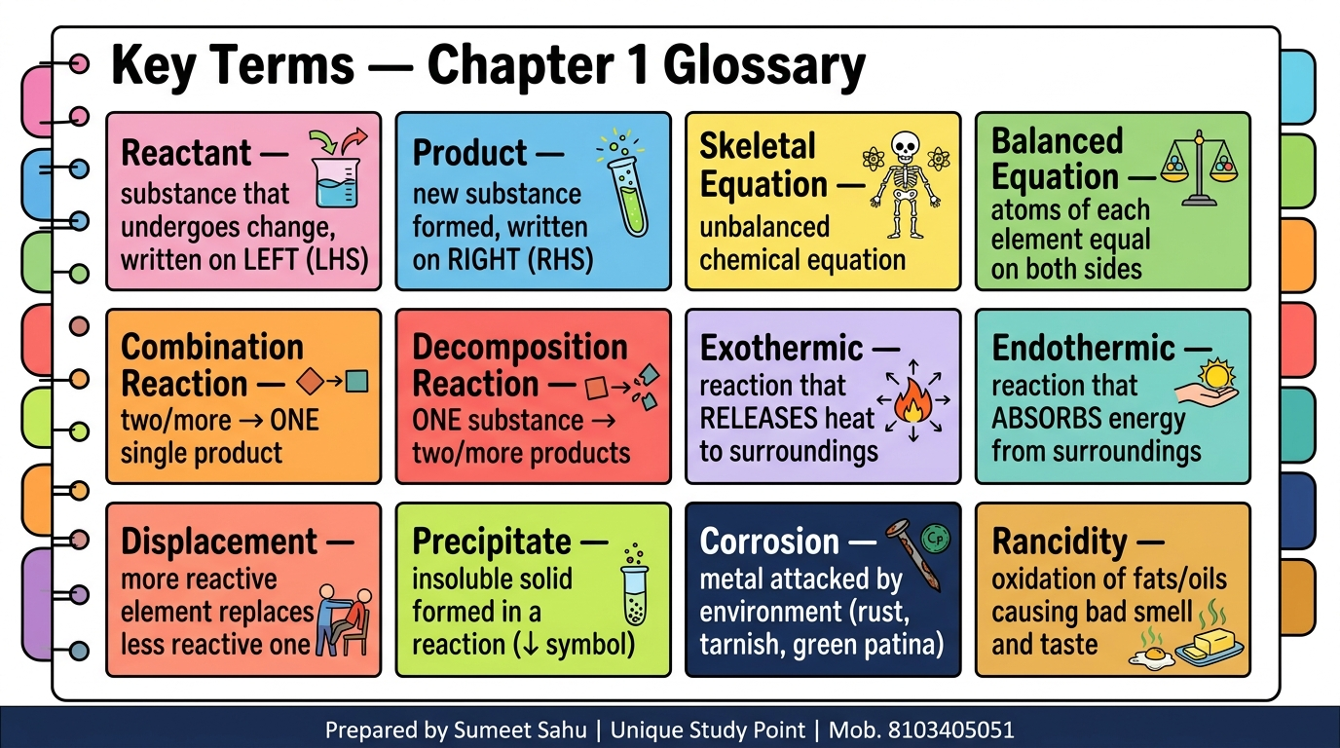
Notes:
Slide 35 of 46: Key Terms — Chapter 1 Glossary (12 Terms)

Slide 36
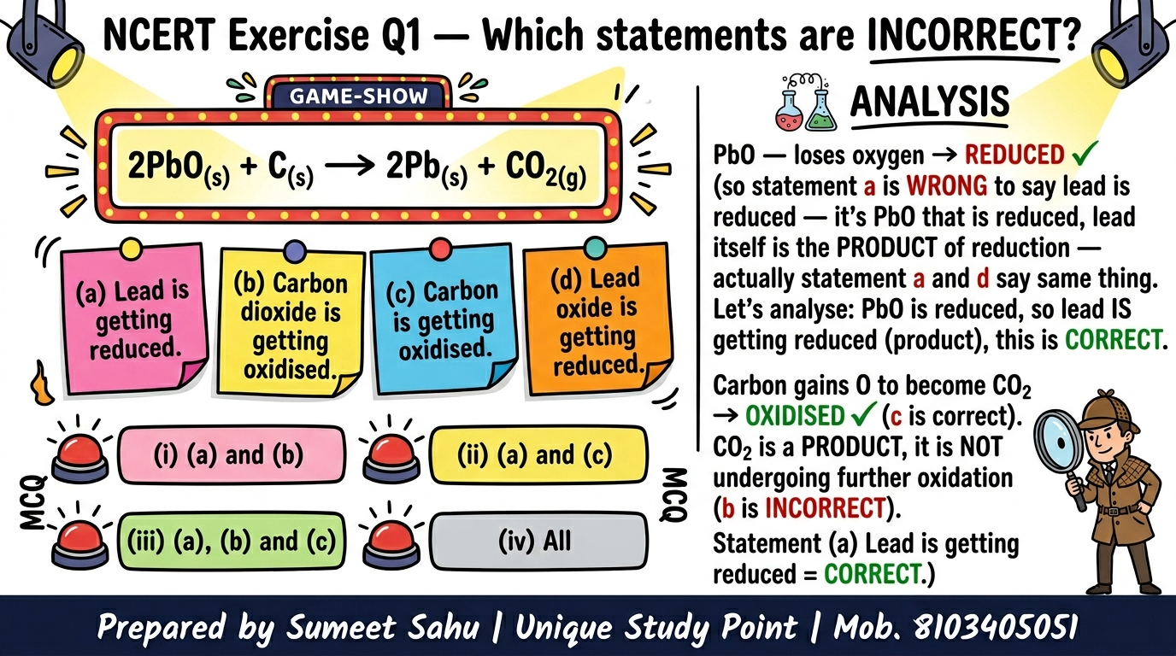
Notes:
Slide 36 of 46: NCERT Exercise Q1 — Which Statements are Incorrect?

Slide 37
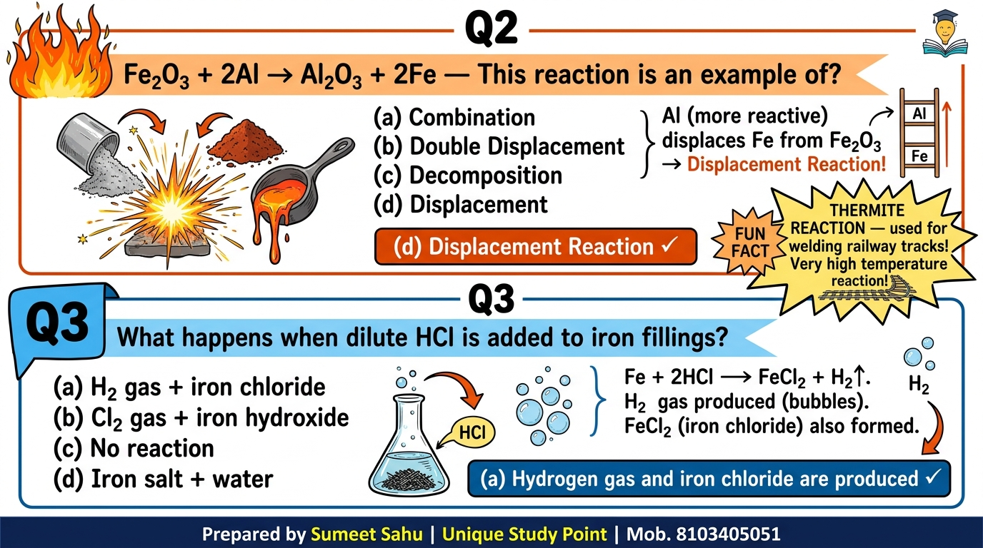
Notes:
Slide 37 of 46: NCERT Exercise Q2 + Q3 — Thermite Reaction + HCl on Iron

Slide 38
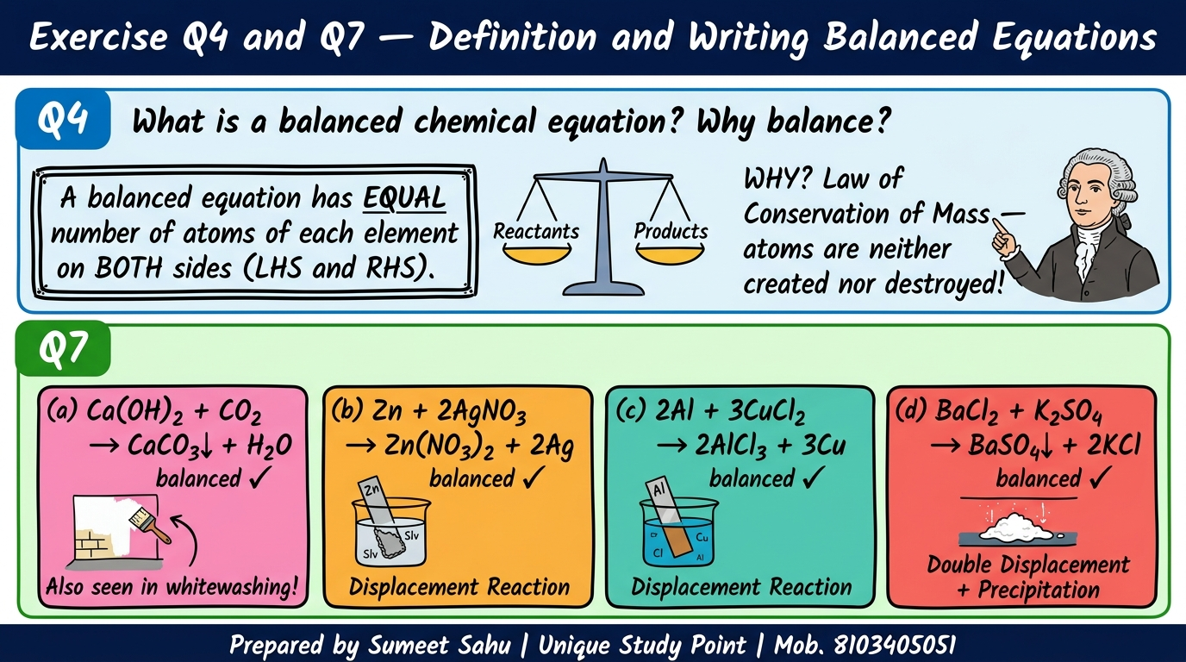
Notes:
Slide 38 of 46: NCERT Exercise Q4 + Q7 — Definition + Write Balanced Equations

Slide 39
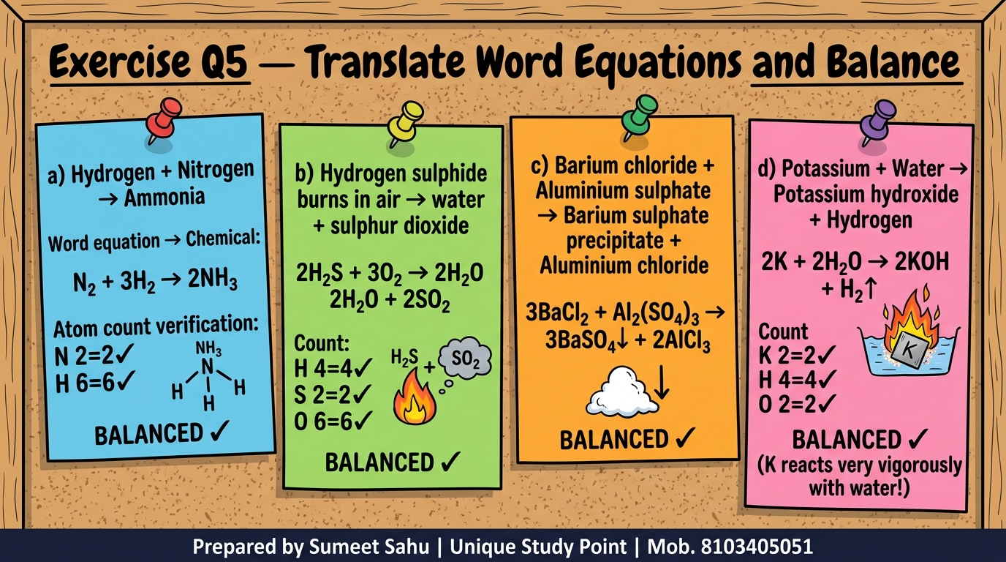
Notes:
Slide 39 of 46: NCERT Exercise Q5 — Translate Word Equations and Balance

Slide 40
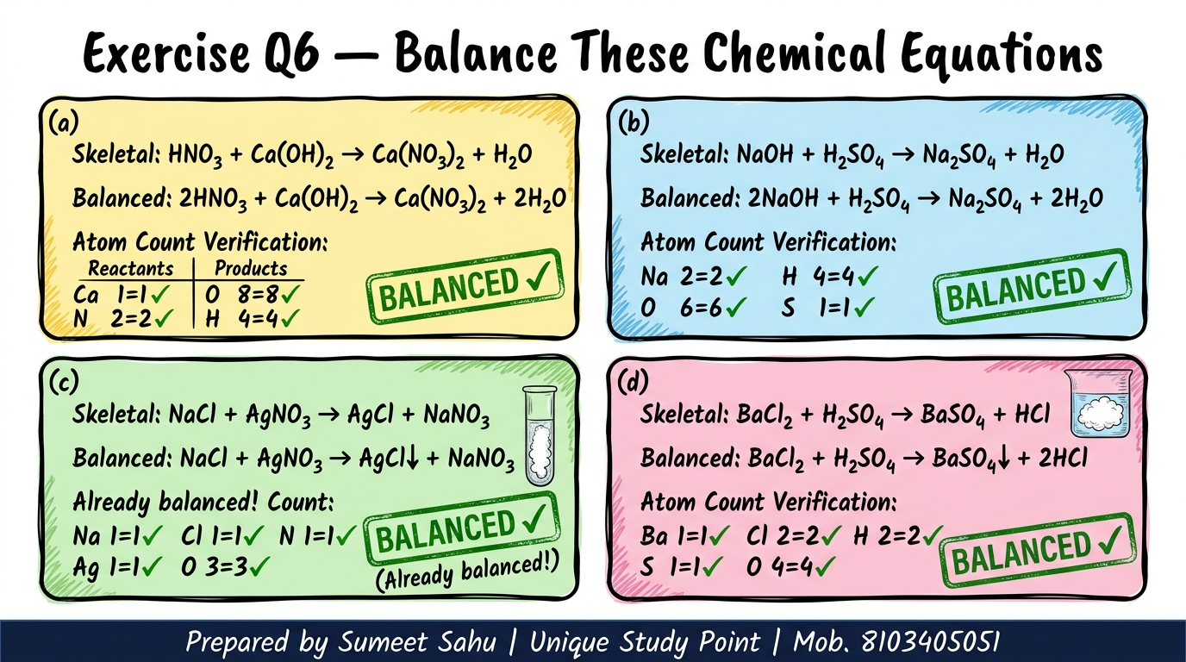
Notes:
Slide 40 of 46: NCERT Exercise Q6 — Balance These Chemical Equations

Slide 41
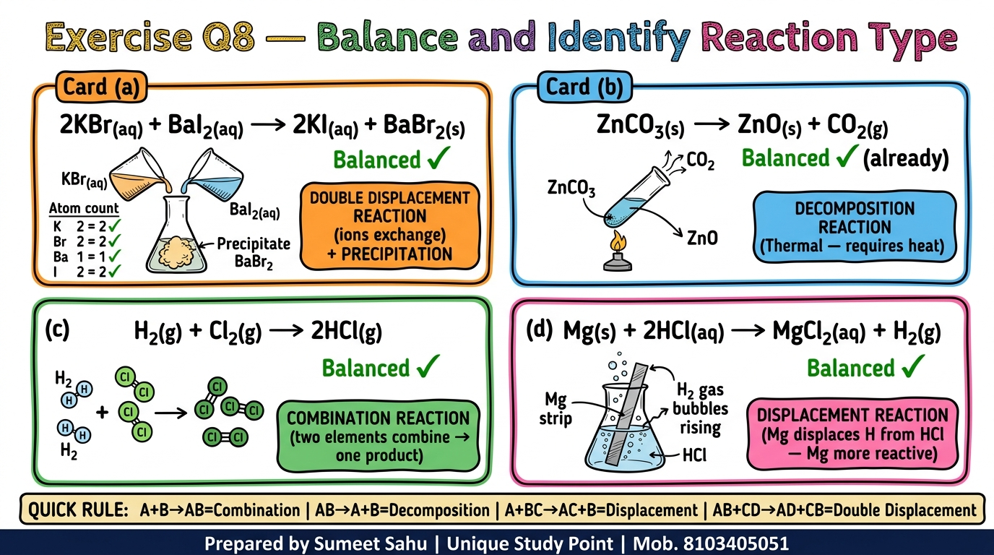
Notes:
Slide 41 of 46: NCERT Exercise Q8 — Balance and Identify Reaction Type

Slide 42
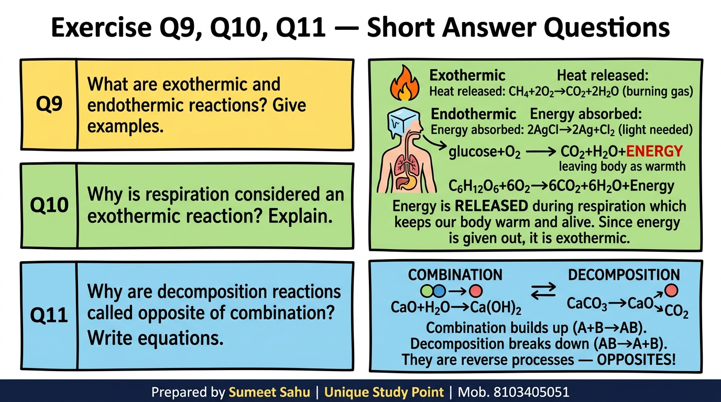
Notes:
Slide 42 of 46: NCERT Exercise Q9, Q10, Q11 — Short Answer Questions

Slide 43
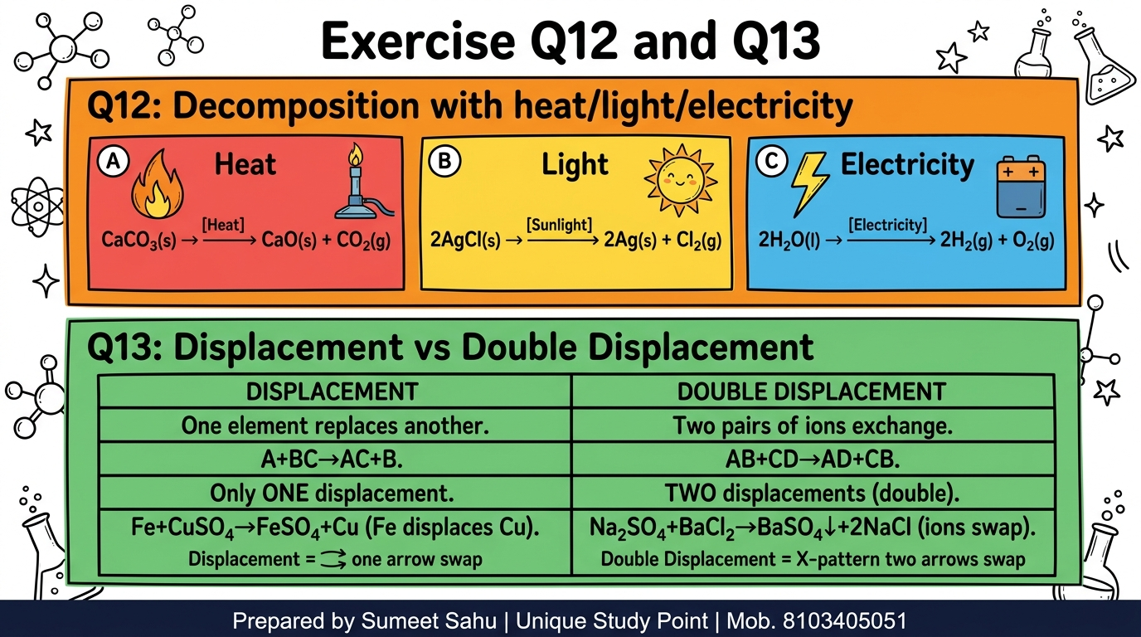
Notes:
Slide 43 of 46: NCERT Exercise Q12 + Q13 — Decomposition Energy Types + Displacement vs DD

Slide 44
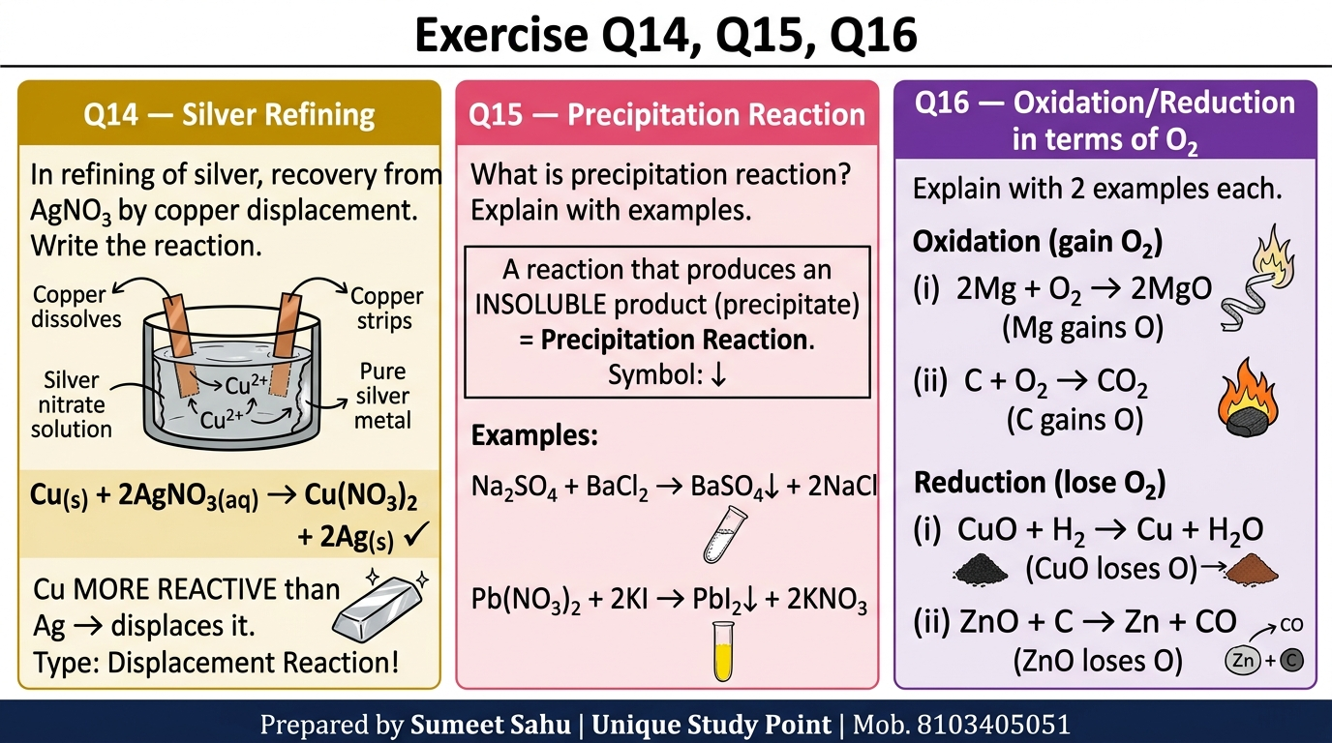
Notes:
Slide 44 of 46: NCERT Exercise Q14, Q15, Q16 — Silver Refining, Precipitation, Oxidation/Reduction

Slide 45
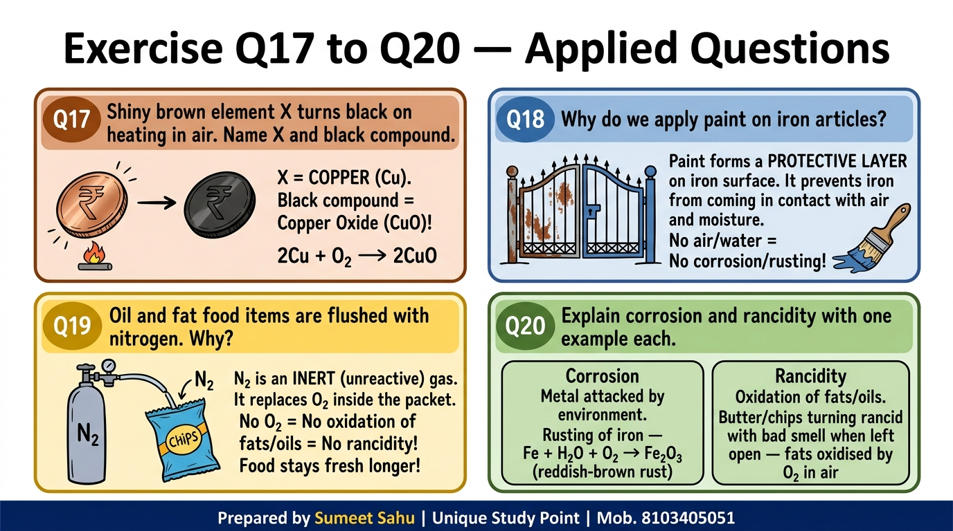
Notes:
Slide 45 of 46: NCERT Exercise Q17 to Q20 — Applied Questions (Cu→CuO, Paint, N₂ Flushing, Corrosion+Rancidity)

Slide 46
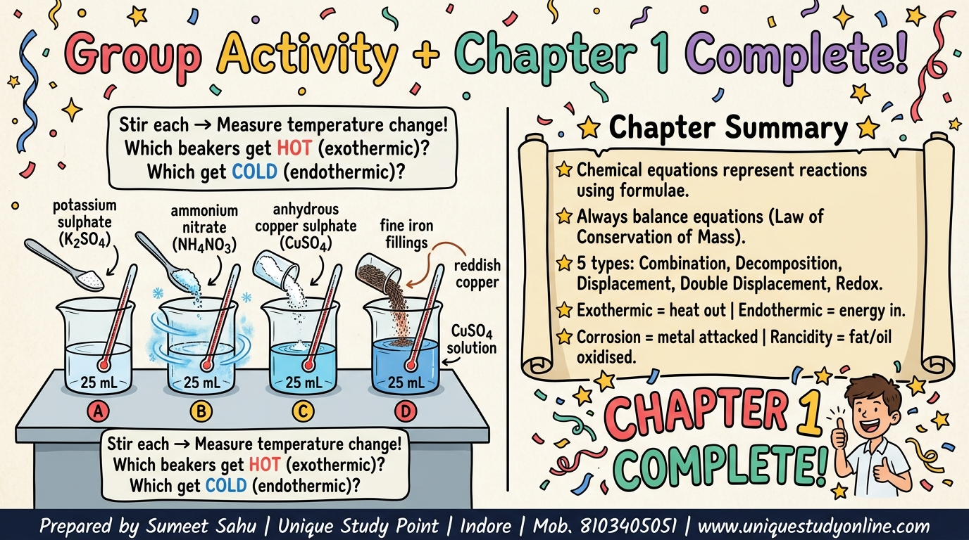
Notes:
Slide 46 of 46: Group Activity + Chapter 1 Complete! — Chapter Summary

