Slide 1
📚 Class 7 • Social Science • Chapter 1
Exploring Society: India and Beyond
🗺️ Geographical Diversity of India
"Sāre jahān se achchha" — Rakesh Sharma from Space!
🏔 Mountains
🌾 Plains
🏜 Desert
🌴 Peninsula
🏝 Islands
✏️ UNIQUE STUDY POINT | uniquestudyonline.com

Slide 2
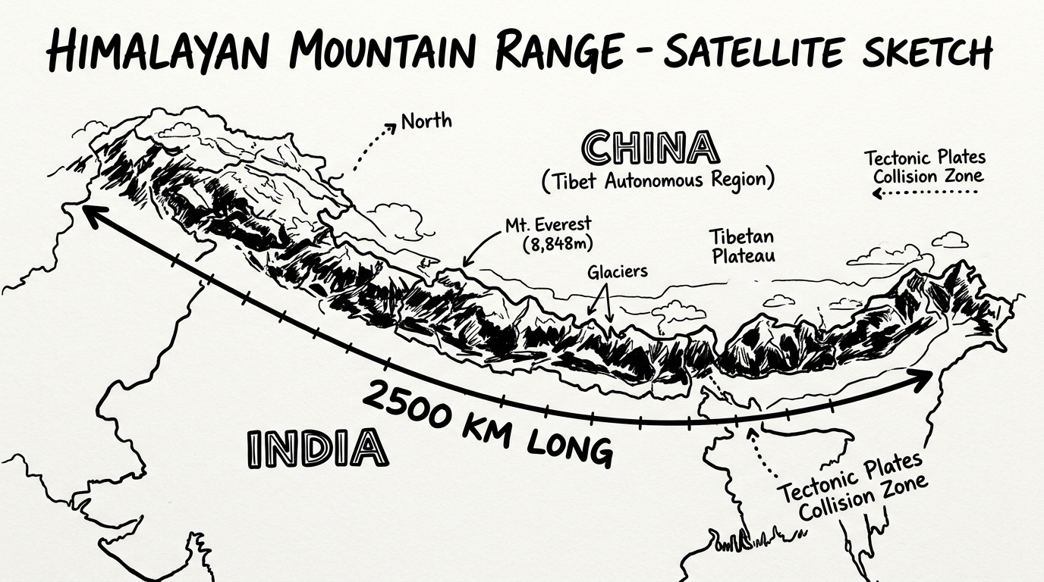
🌏 India – The Subcontinent
⭐ EXAM POINTS
🇮🇳 India = 7th largest country
🌏 Part of Asia (Indian Subcontinent)
🏔 Natural barrier: Himalayas (N)
🌊 Arabian Sea (W) • Bay of Bengal (E)
🌊 Indian Ocean (S)
👫 Neighbours: Pakistan, Bangladesh,
Nepal, Bhutan, Sri Lanka, Myanmar
📍 5 Regions: Mountains, Plains,
Desert, Peninsula, Islands
🚀 Rakesh Sharma (1st Indian in space, 1984) said India looks "Sāre jahān se achchha" — BETTER THAN THE WHOLE WORLD!

Slide 3
🏔 The Himalayas – Abode of Snow
⭐ EXAM MUST-KNOW
📏 Length: 2500 km (W→E)
🌍 Spans 6 countries (India, Nepal,
Bhutan, China, Pakistan, Afghanistan)
🏔 '8-Thousanders' = peaks >8000m
💧 'Water Tower of Asia' – feeds
Ganga, Indus, Brahmaputra
📖 'Himalaya' = hima (snow) +
ālaya (abode) in Sanskrit
🌱 Still growing 5mm/year!
🪨 Formed: India collided with
Eurasia ~50 million years ago
🏔 HIMADRI
🌿 HIMACHAL
🌳 SHIVALIK
Greater Himalayas
Lower Himalayas
Outer Himalayas
• Highest range • Mt. Everest (8,848m)
• Kanchenjunga • Snow-covered all year
• Few human settlements
• South of Himadri • Moderate climate
• Rich biodiversity
• Hill stations: Shimla, Nainital,
Darjeeling, Mussoorie
• Outermost & lowest range
• Rolling hills & dense forests
• Rich wildlife
• Transition to Gangetic Plains

Slide 4
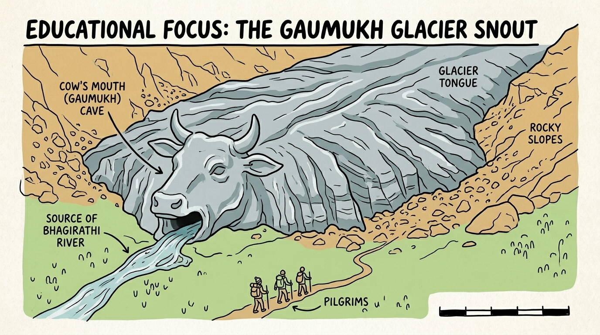
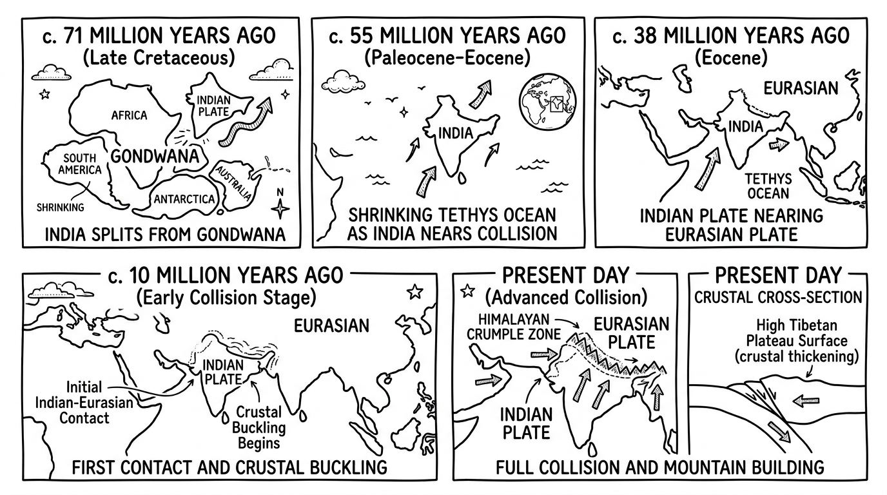
🧊 How Were the Himalayas Formed? + Gaumukh
🐄 GAUMUKH – 'Cow's Mouth'
🌍 FORMATION STORY
• Edge of Gangotri Glacier (one of India's largest)
1️⃣ 71 MY ago – India splits from Gondwana
• Bhagirathi River originates here → joins Ganga
2️⃣ 55 MY ago – Tethys Ocean shrinking
• Located in Uttarakhand
3️⃣ 38 MY ago – India nearing Eurasian Plate
• Sacred pilgrimage + trekking destination
4️⃣ 10 MY ago – Plates collide → crust buckles
• 'Next time you see Ganga – it started HERE!'
5️⃣ Today – Mountains STILL growing! (5mm/yr)

Slide 5
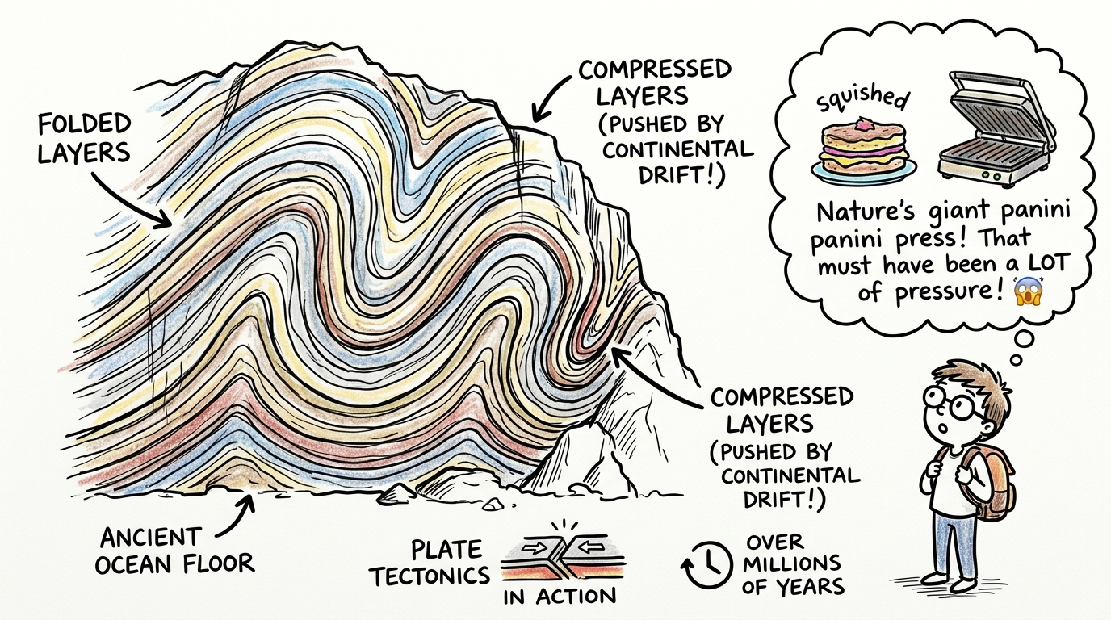
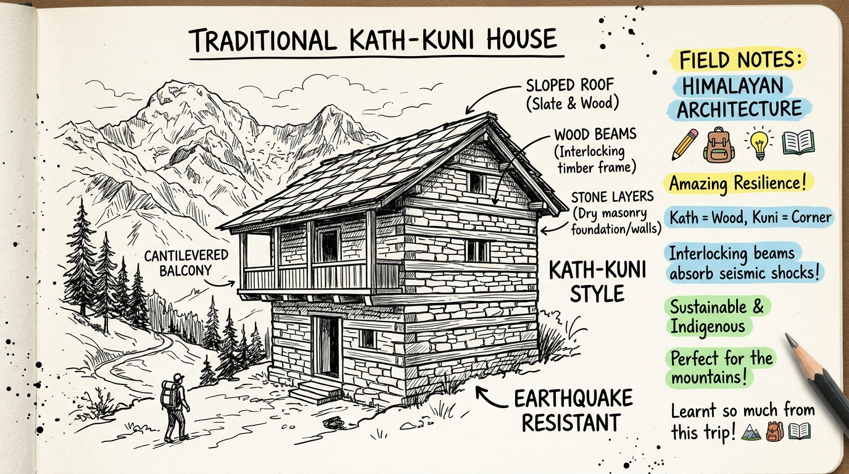
🪨 Folded Rocks • 🏠 Kath-Kuni Houses • 🦁 Himalayan Wildlife
🪨 Folded Rocks
🏠 Kath-Kuni Style
🦁 Himalayan Wildlife
• Ocean floor pushed up by plate collision
• Rocks compressed like a 'panini press'!
• Ancient ocean floor now forms Himalayas
• Can see layers in hillside rock-cuts
• Kath = Wood | Kuni = Corner
• Interlocking timber + dry stone walls
• Earthquake resistant design!
• Found in Himachal Pradesh
• Sustainable & indigenous architecture
• Snow Leopard – 'Ghost of Mountains'
• Himalayan Monal – State bird of Uttarakhand
• Rhododendron – sherbet made from flowers
• Beas River – flows through Manali/Kullu
• Great Himalayan NP – UNESCO Heritage

Slide 6
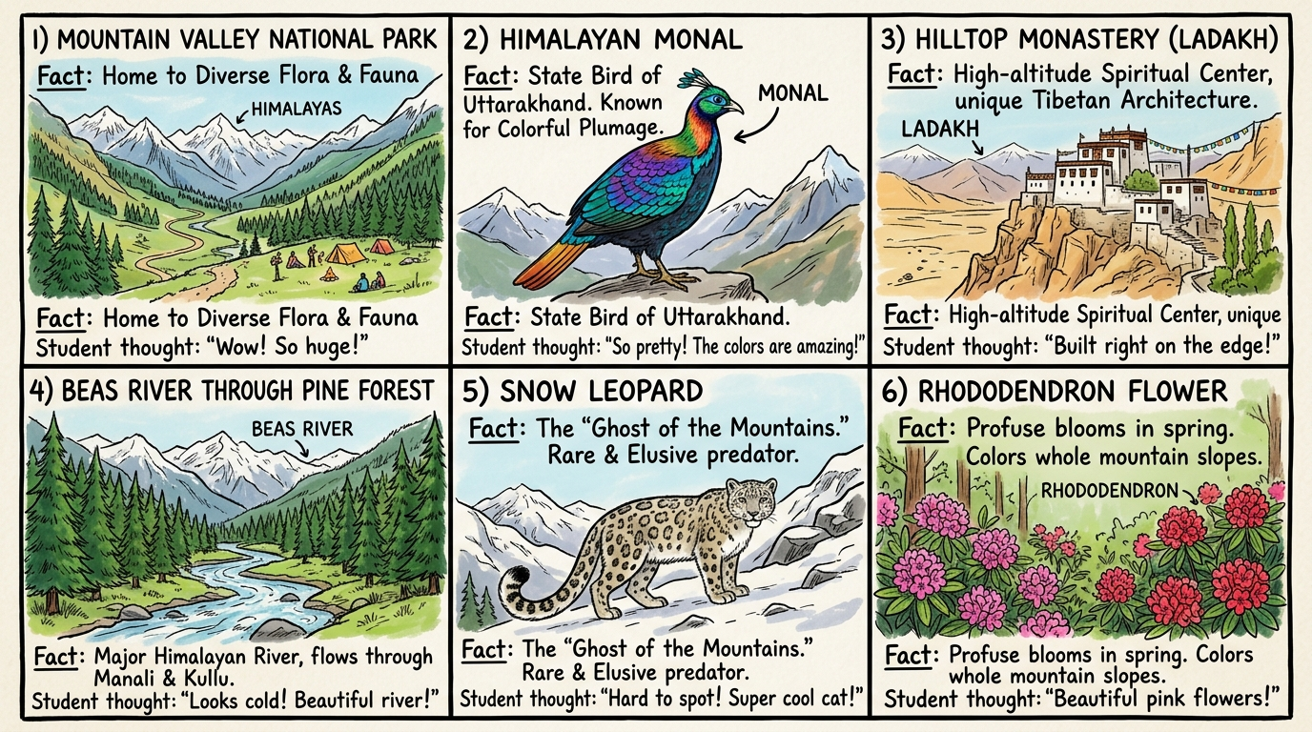
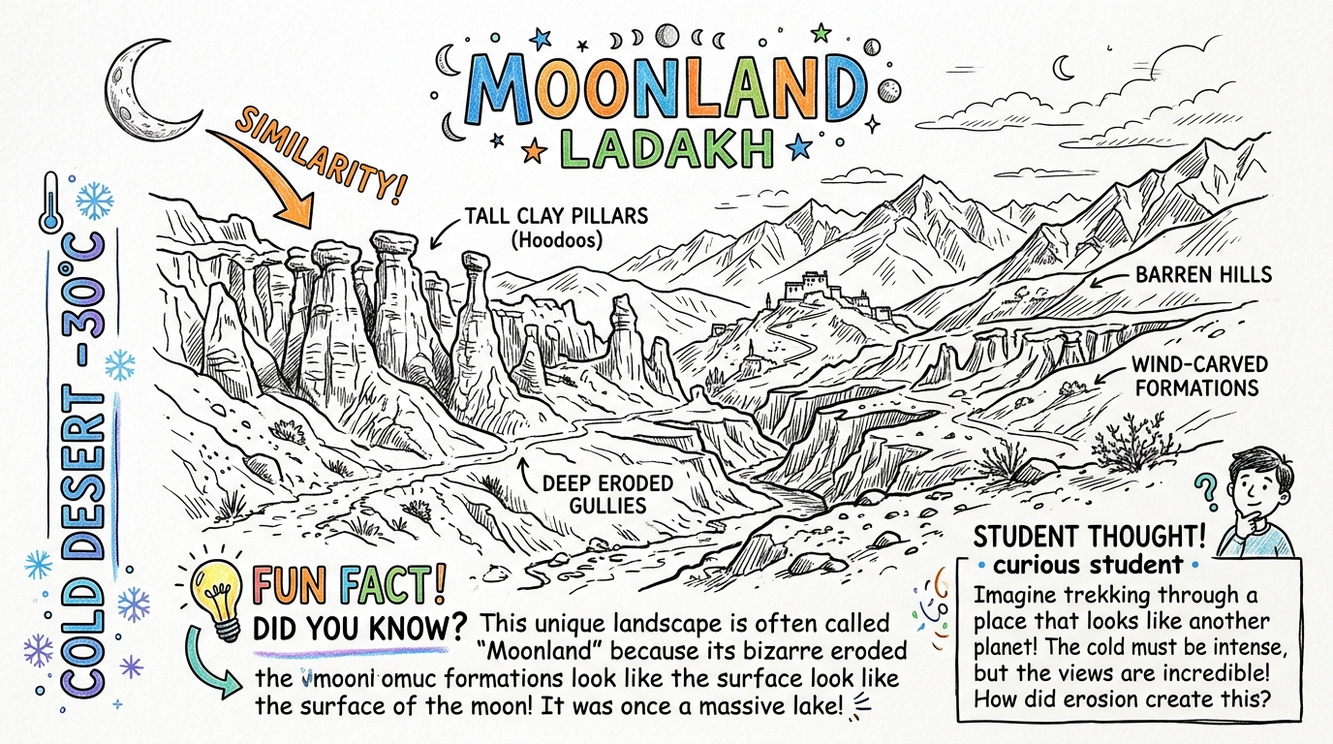
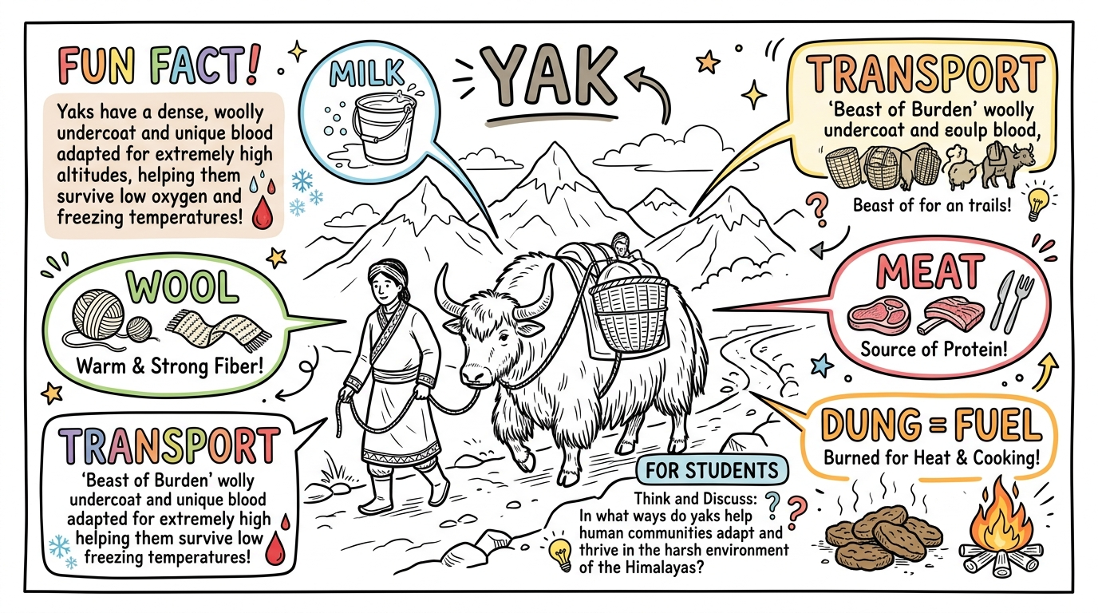
🏜 Cold Desert of India – LADAKH
⭐ EXAM POINTS – LADAKH
❄️ Cold Desert – winter temp: BELOW –30°C
🌙 Called 'MOONLAND' – lunar landscape
💧 Pangong Tso: 'Tso' = lake in Ladakhi
🐂 Yaks: milk, meat, wool, dung-fuel, transport
🏛 Known for ancient monasteries
🎉 Festivals: Losar, Hemis Festival

Slide 7
💙 Pangong Tso – Amazing Facts
⭐ Highest SALTWATER lake in world at 4,225 metres!
🌊 SALTY WATER
🥶 FROZEN IN WINTER
📍 BORDER LAKE
🐦 WILDLIFE HOTSPOT
🎨 COLOUR CHANGE
Endorheic lake –
no outlet, minerals
build up
Freezes completely –
people & vehicles
cross it on ice!
60% in Tibet/China
40% in Ladakh/India
Breeding ground for
Bar-headed Goose &
migratory birds
Deep blue → turquoise
→ green depending
on sunlight!

Slide 8
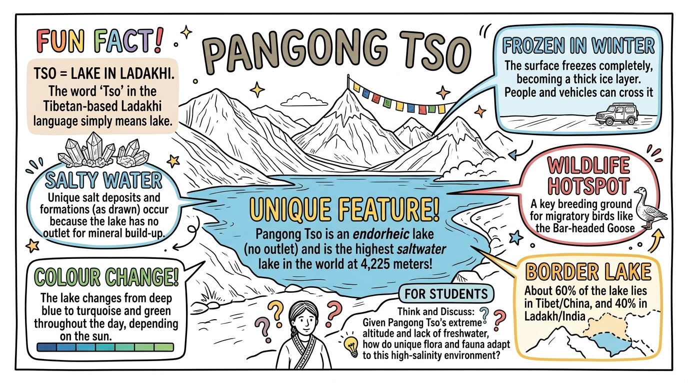
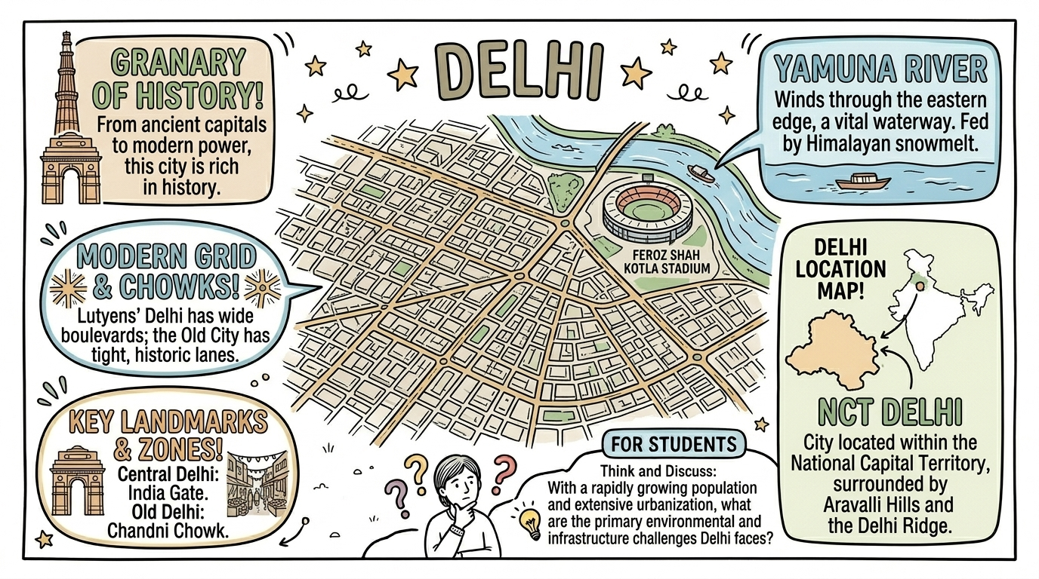
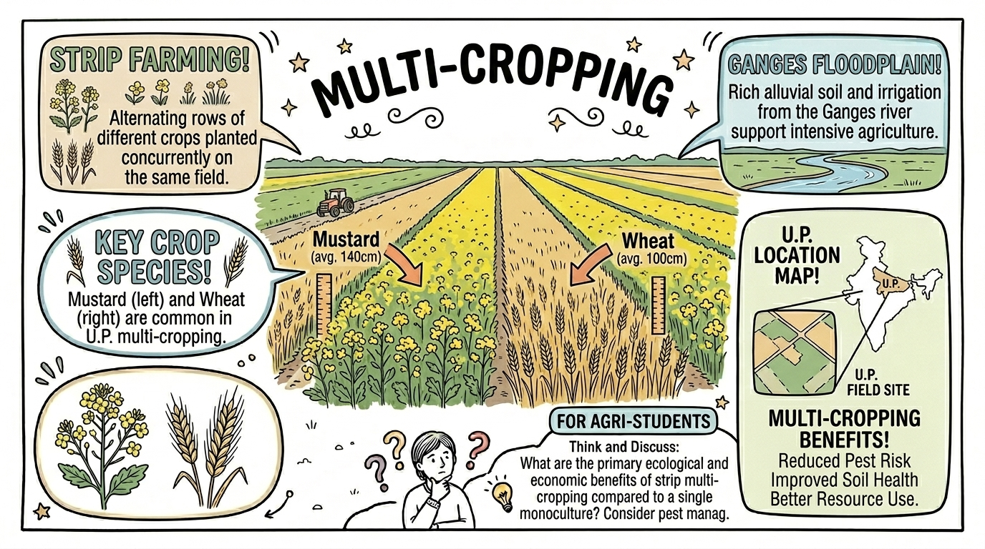
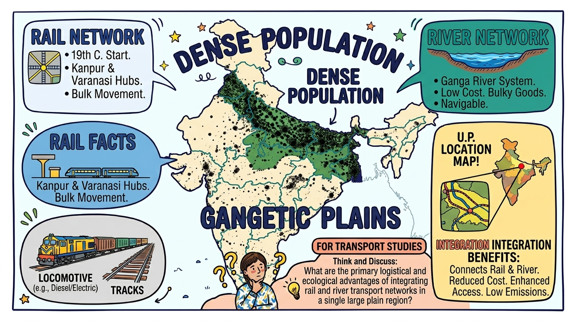
🌾 The Gangetic Plains – Granary of India
⭐ Key Facts: Fed by Ganga, Indus, Brahmaputra • Fertile ALLUVIAL soil • Rabi (wheat, barley–winter) • Kharif (rice, sugarcane–summer) • Most densely populated region • Flat land → road & rail networks easy to build

Slide 9
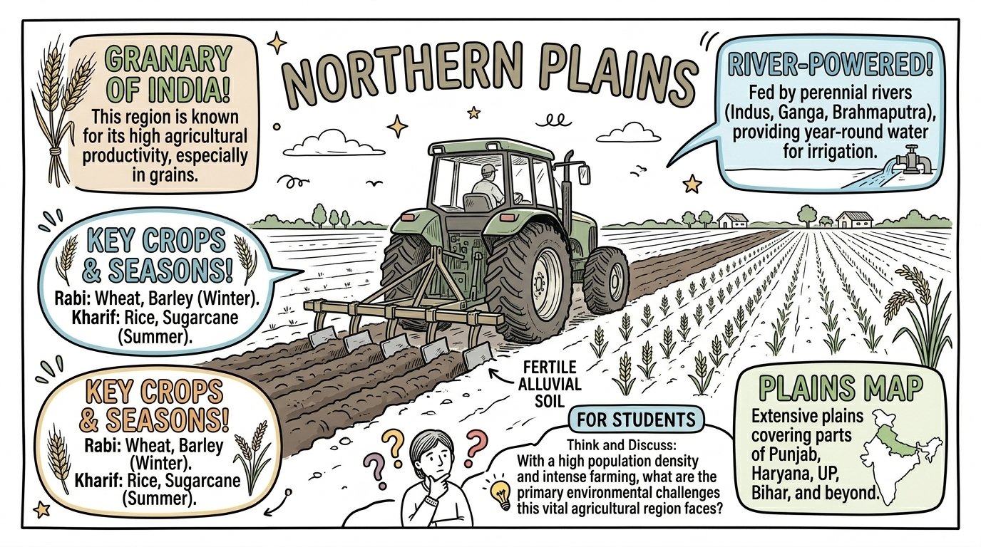
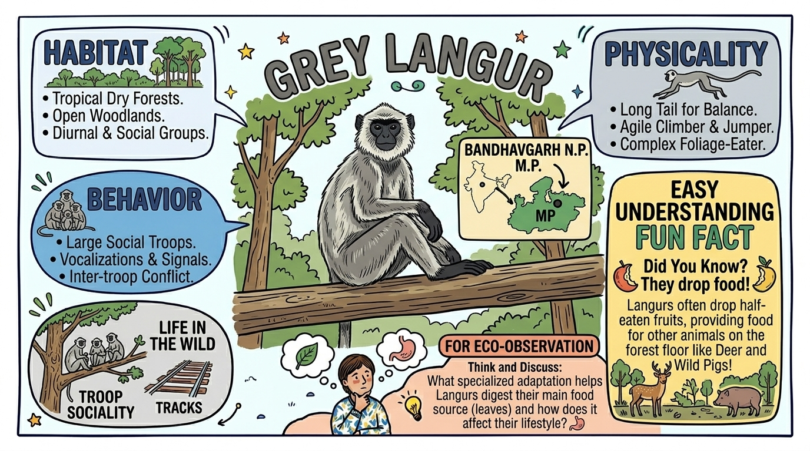
🏙 Delhi & Transport in the Gangetic Plains
🏛 DELHI FACTS
🚂 RAILWAYS
🐒 WILDLIFE
• Located within NCT (National Capital Territory)
• Surrounded by Aravalli Hills & Delhi Ridge
• Yamuna River flows on eastern edge
• India Gate, Chandni Chowk, Qutub Minar
• Lutyens' Delhi – wide boulevards
• Started in 19th century under British rule
• Kanpur & Varanasi – major rail hubs
• Key for bulk movement of goods
• All-weather transport system
• Connects the vast Gangetic Plains
• Grey Langur – found in Bandhavgarh NP, MP
• Bengal Tiger – Project Tiger launched 1973
• Tiger reserves created across India
• Laws protect endangered species
• Indian Gharial & Peacock also protected

Slide 10
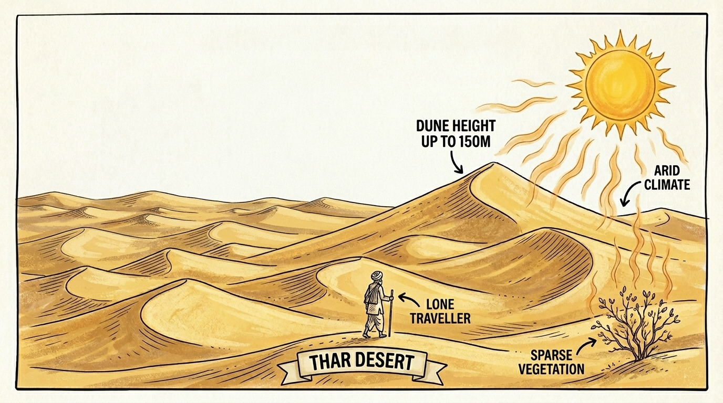
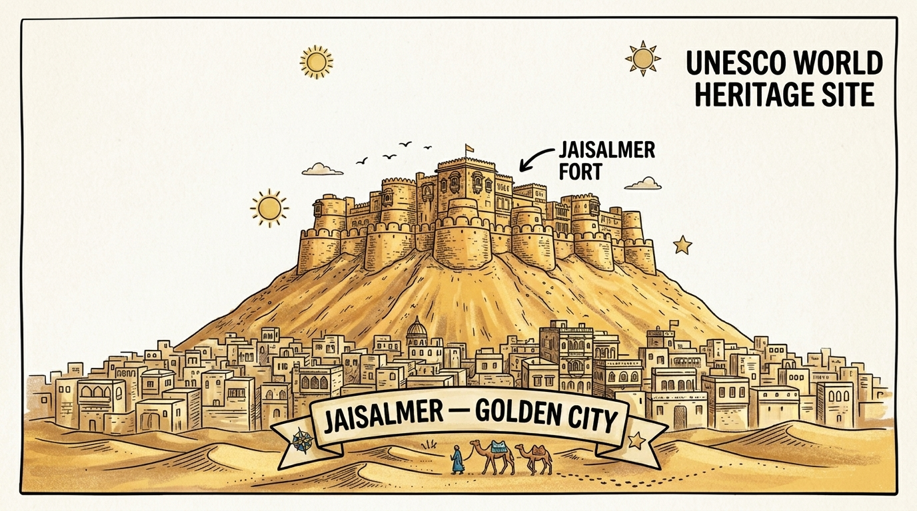
🏜 The Great Indian Desert – THAR
🌅 THAR BASICS
🏰 JAISALMER
💧 WATER WISDOM
• Vast arid region – mostly in RAJASTHAN
• Also spans Gujarat, Punjab, Haryana
• Natural barrier – deters movement
• Dunes up to 150 METRES high!
• Dunes formed by WIND shifting sand
• Called the 'GOLDEN CITY'
• Located in heart of Thar Desert
• Jaisalmer Fort = UNESCO World Heritage Site
• Pushkar Mela – world's largest camel fair
• Camels = 'Ship of the Desert'
• Water is SCARCE – women walk miles
• Traditional cleaning = sand scouring!
• Taanka / Kund = rainwater harvesting
• Stores rainwater for drinking
• Ingenious ancient conservation method

Slide 11
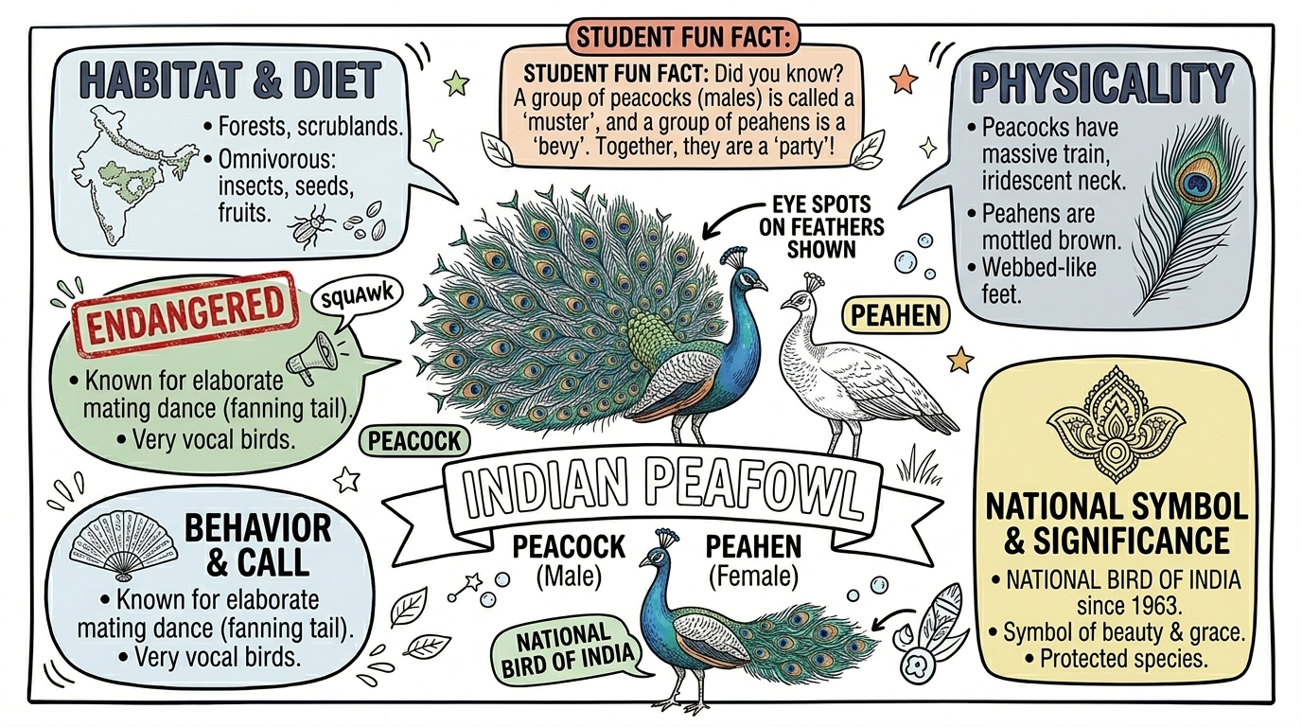
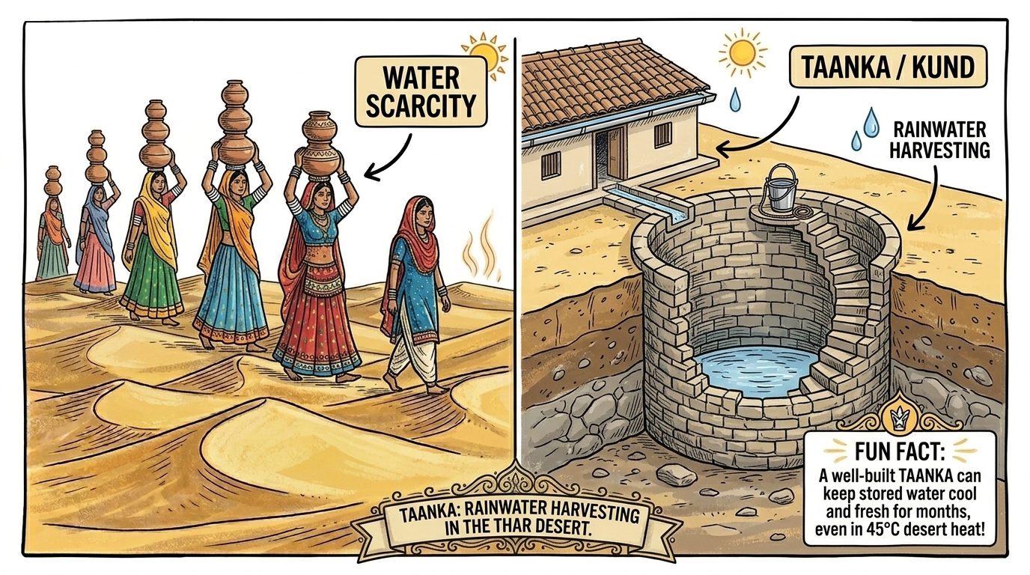
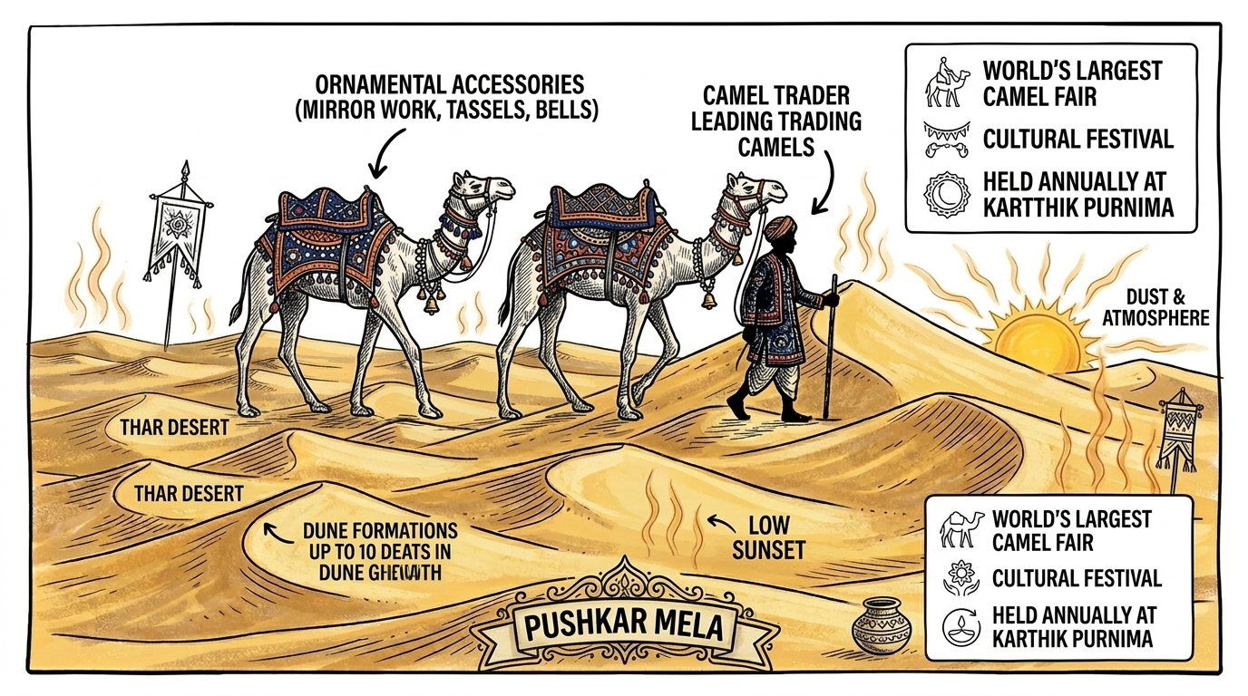
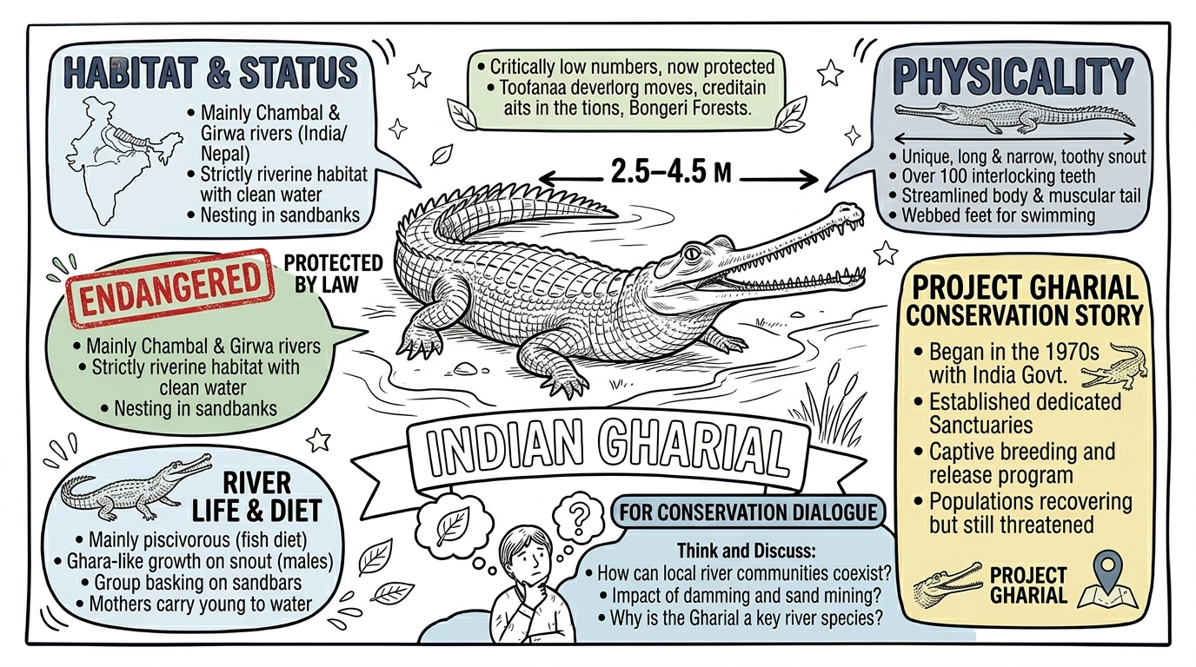
🦚 Peacock • 🐊 Gharial • 🐪 Pushkar Mela • 💧 Taanka
🐊 GHARIAL = 2.5–4.5m, endangered, protected by law – found in Ganga
🦅 PEACOCK = National Bird of India (since 1963) – Protected species

Slide 12
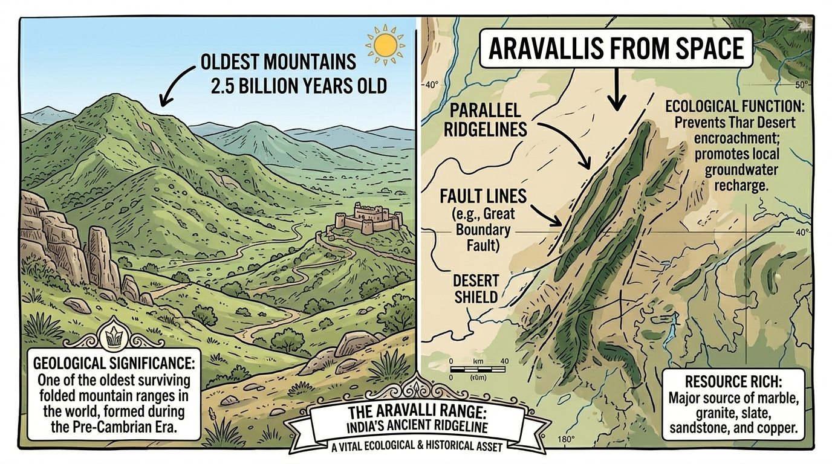
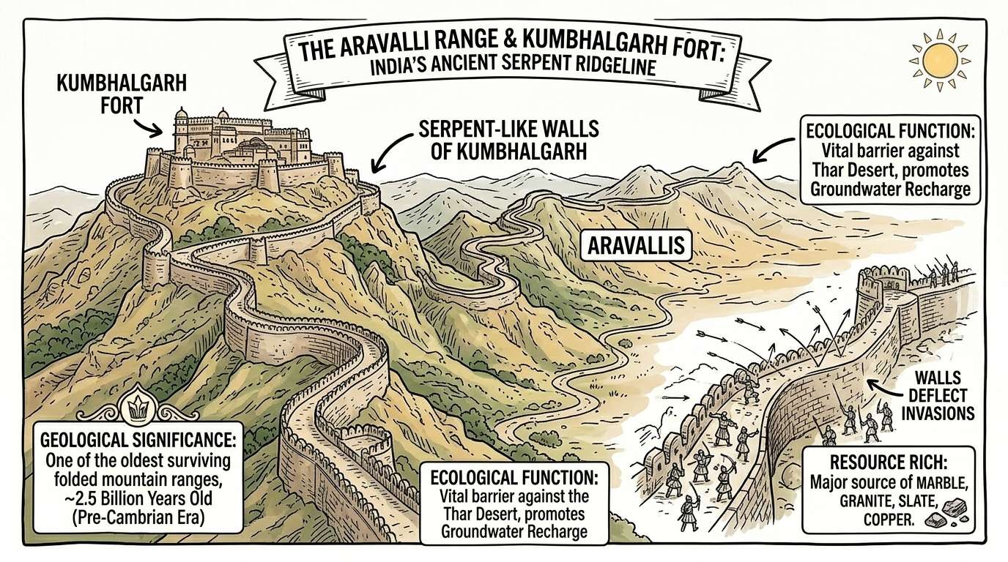
⛰ The Aravalli Hills – World's Oldest Mountains
🕰
2.5 BILLION YEARS
📏
HIGHEST PEAK
🌵
DESERT SHIELD
💎
MINERAL RICH
🏰
HISTORIC FORTS
Oldest surviving
folded mountains
in the world
(Pre-Cambrian Era)
Mount Abu
> 1700 metres
Most hills: 300–900m
Prevents Thar Desert
from expanding east!
Vital ecological role
Marble, Granite,
Zinc, Copper
Zawar mines – world's
first zinc extraction!
Chittorgarh,
Kumbhalgarh,
Ranthambore

Slide 13
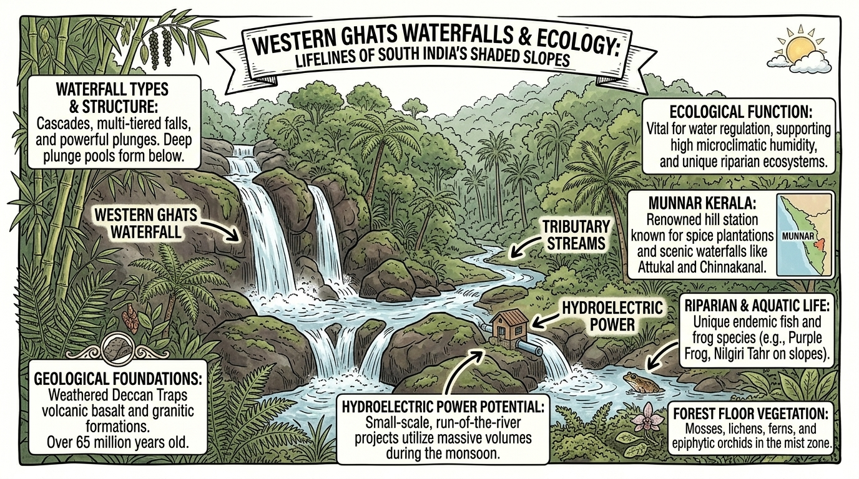
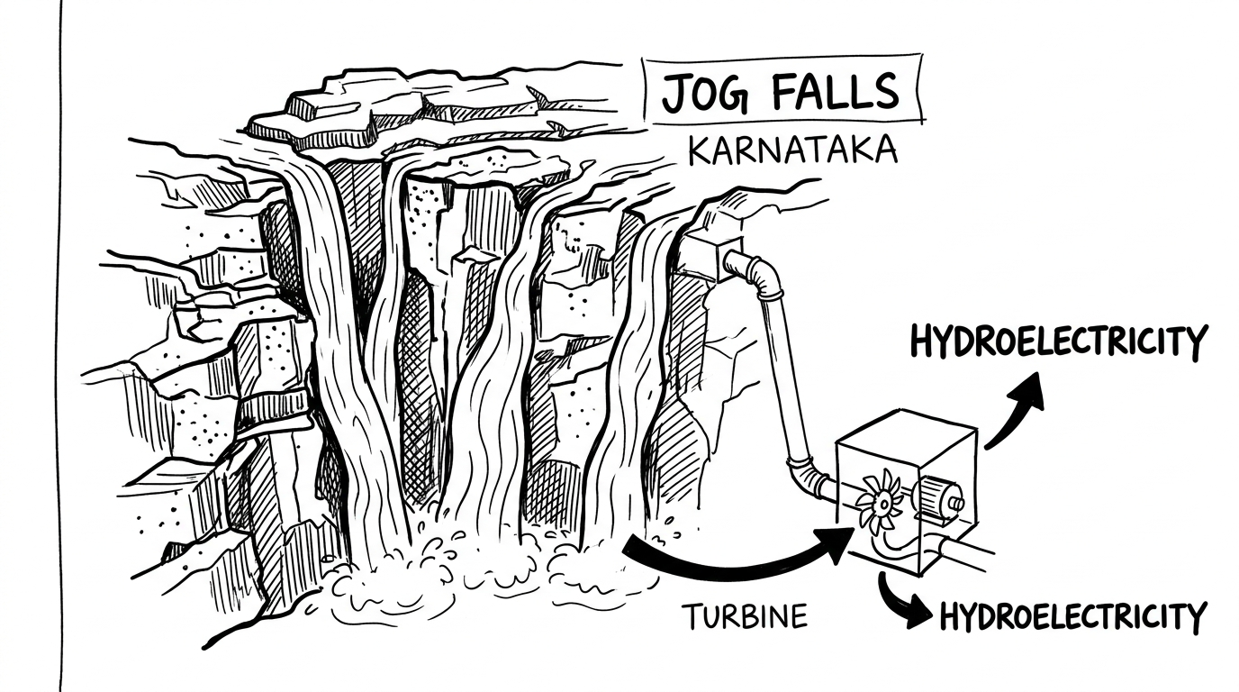
🌴 The Peninsular Plateau & Western Ghats
🌊 WHAT IS IT?
⛰ GHATS
🏞 WATERFALLS
🌿 RIVERS
• Peninsula = land surrounded by water on 3 sides
• Arabian Sea (W), Bay of Bengal (E),
Indian Ocean (S)
• Triangular shape
• Very OLD landform!
• Western Ghats = taller, runs along W coast
• Also called SAHYADRI Hills in north
• Eastern Ghats = lower, broken hills
• Deccan Plateau between them
• W. Ghats = UNESCO World Heritage Site
• Rivers flow over uneven plateau → waterfalls!
• JOG FALLS (Karnataka) – hydroelectricity!
• 'Hydro' = water → turbines → electricity
• Waterfalls attract tourists too
• Also used for irrigation
• East-flowing: Godavari, Krishna, Mahanadi
• West-flowing: Narmada, Tapti
• Tribal communities: Santhal, Gond,
Baiga, Bhil, Korku
• Rich in coal, minerals & forests

Slide 14
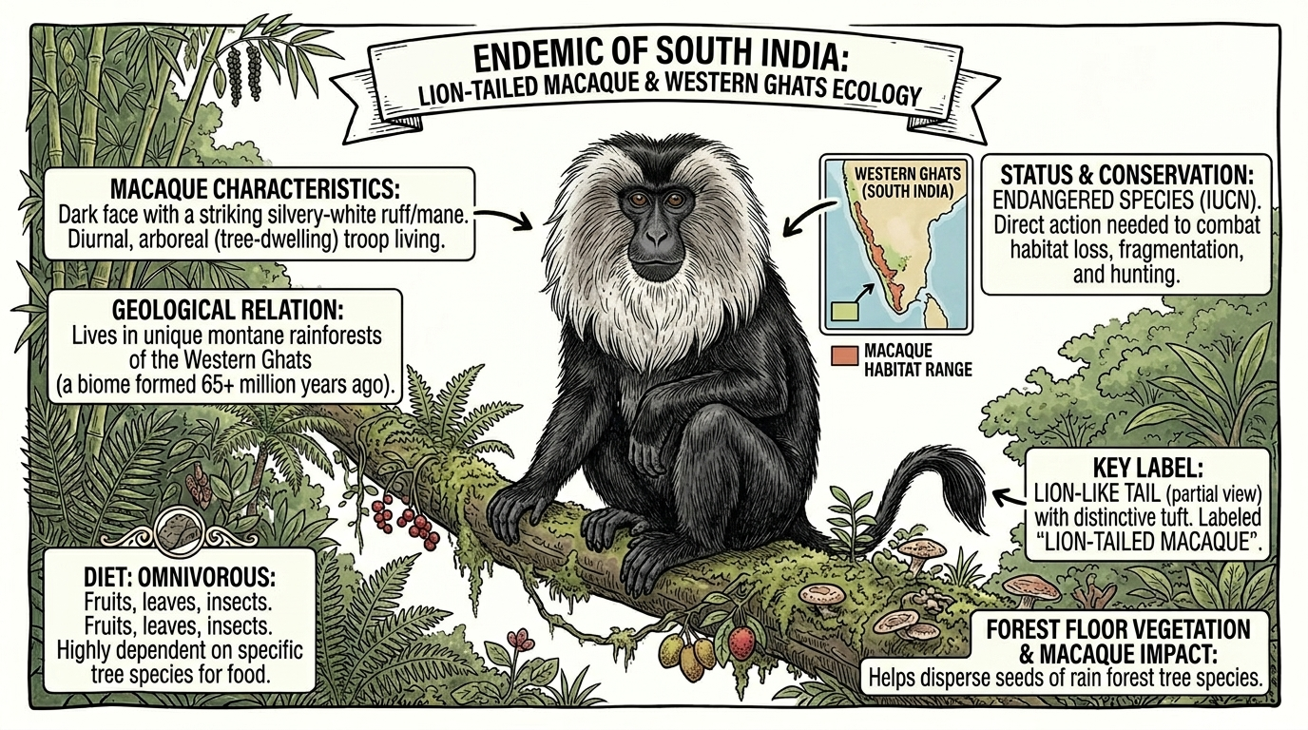
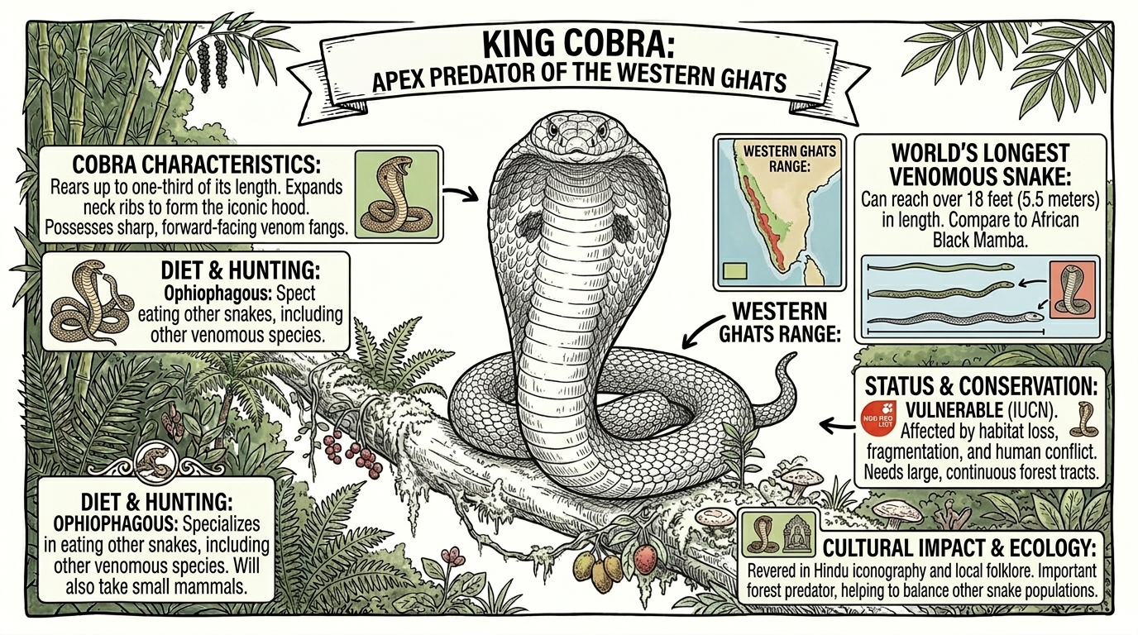
🦁 Lion-Tailed Macaque • 🐍 King Cobra • 🌿 Biodiversity
🐒 LION-TAILED MACAQUE
🐍 KING COBRA
🌿 W. GHATS FACTS
• Dark face + striking silvery-white mane
• ENDEMIC to Western Ghats (found only here!)
• ENDANGERED species (IUCN Red List)
• Arboreal – lives in trees
• Helps disperse rainforest tree seeds
• World's LONGEST venomous snake (5.5m!)
• Apex predator of Western Ghats
• OPHIOPHAGOUS = eats other snakes!
• Revered in Hindu iconography
• Vulnerable status – habitat loss threat
• UNESCO World Heritage Site
• Blocks monsoon winds → rain shadow effect
• Very humid western slopes
• Home to insectivorous plants!
• Also: Purple Frog, Nilgiri Tahr

Slide 15
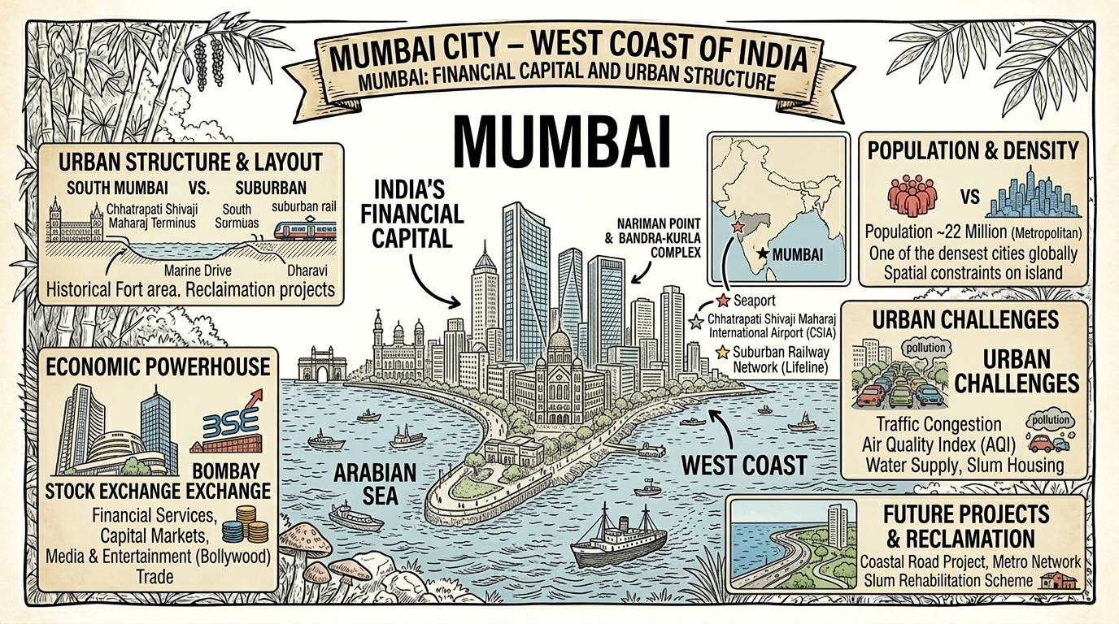
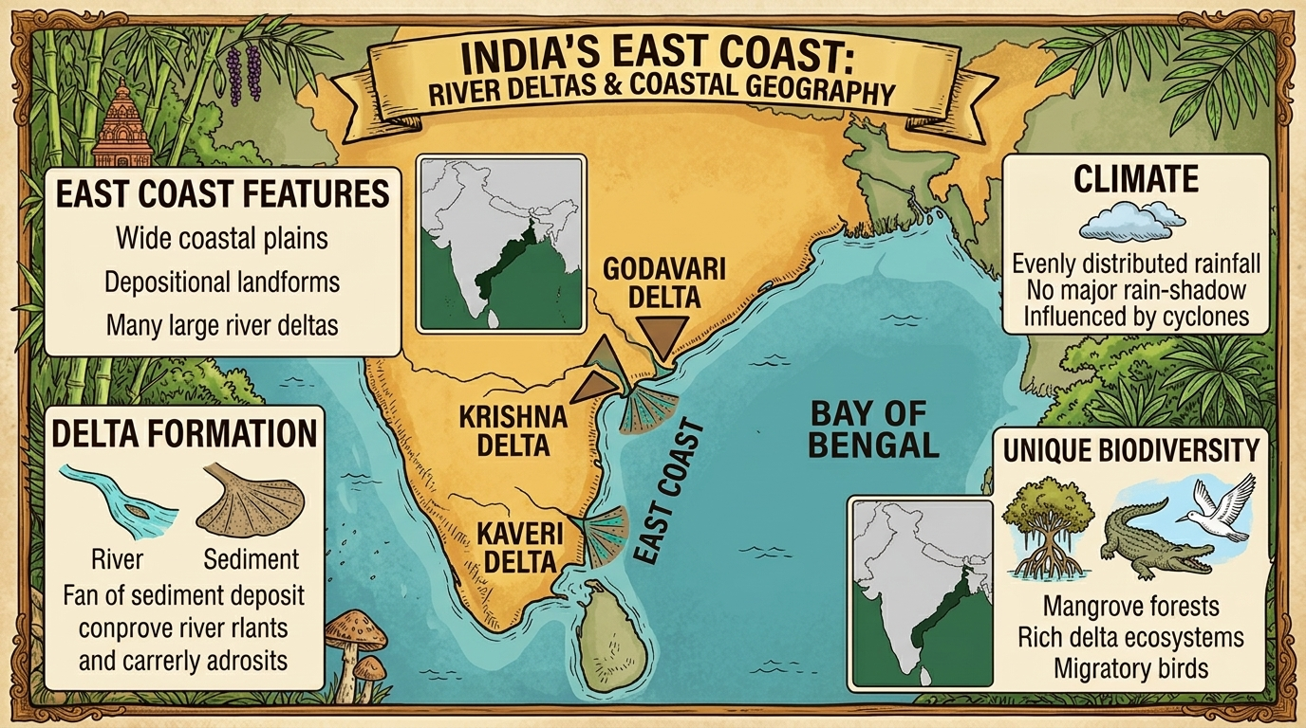
🌊 India's Amazing Coastlines (7500 km!)
🌊 WEST COAST
🌊 EAST COAST
🌊 DELTA FACTS
• Gujarat to Kerala
• Maharashtra, Goa, Karnataka in between
• Rivers from W. Ghats form ESTUARIES
• Narmada & Tapti = largest estuaries
• Mumbai = India's financial capital
• Major ports: Mumbai, Mangalore, Kochi
• Between Eastern Ghats & Bay of Bengal
• Ganga delta to Kanyakumari
• Major RIVER DELTAS here!
• Godavari, Krishna, Kaveri, Mahanadi
• Chilika Lake, Pulicat Lake (lagoon)
• Fertile delta land – ideal for farming
• Delta = sediment deposited at river mouth
• Forms triangular / fan-shaped land
• Very fertile – good for agriculture
• Important for fishing communities
• Cyclone-prone region (Bay of Bengal)
• Mangrove forests protect coast

Slide 16
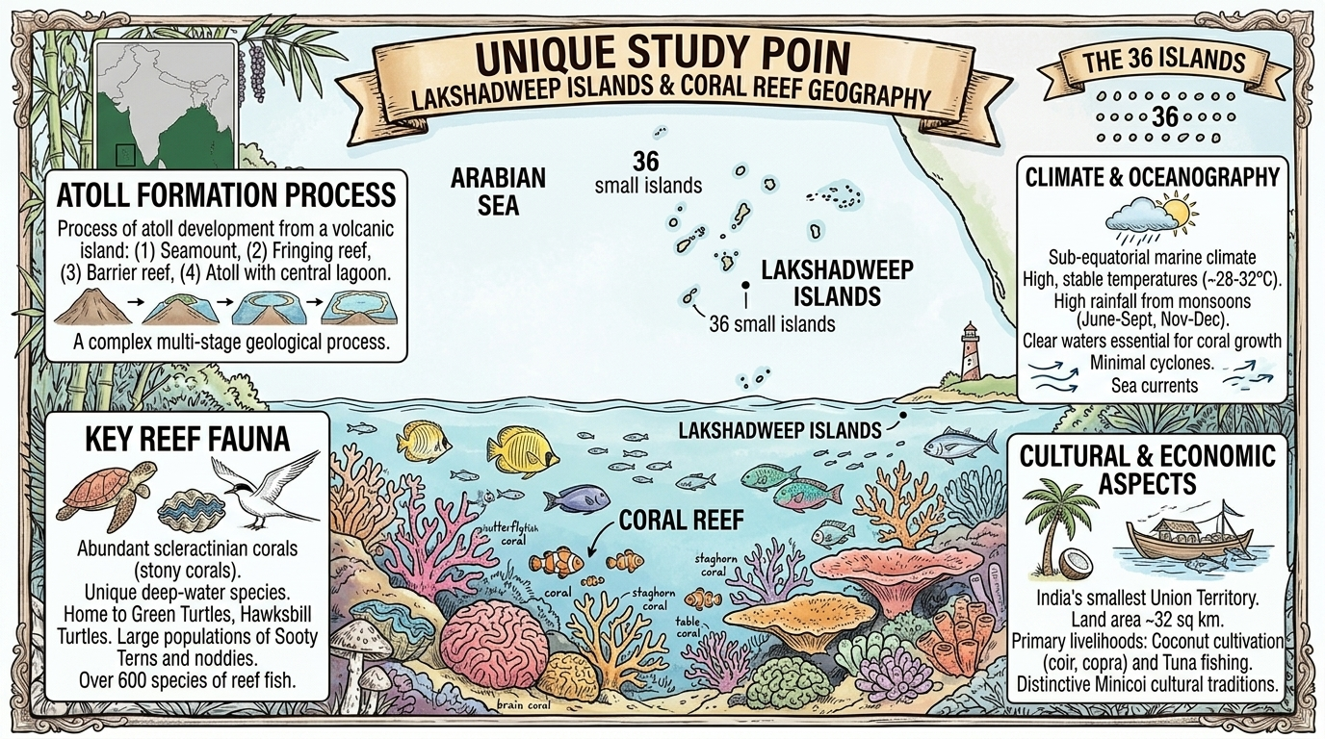
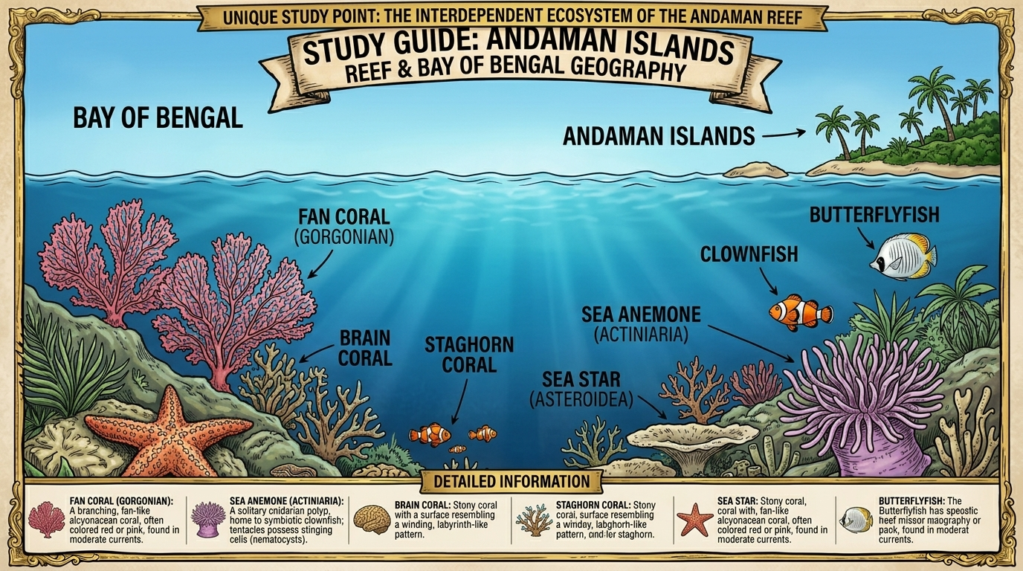
🏝 Indian Islands – Lakshadweep & Andaman & Nicobar
🏝 LAKSHADWEEP
🏝 ANDAMAN & NICOBAR
🐠 ISLANDS EXAM POINTS
• Archipelago in ARABIAN SEA
• Close to Malabar coast of Kerala
• 36 islands made of CORAL
• Not all islands are inhabited
• India's smallest Union Territory
• Coconut & tuna fishing economy
• 500+ large & small VOLCANIC islands
• Located in BAY OF BENGAL
• 'Outposts' of India – strategic location!
• BARREN ISLAND = only active volcano in India
• Cellular Jail – freedom fighters imprisoned here
• Rich coral reefs & unique wildlife
• Coral reefs = 'rainforests of the sea'
• Unique tribes lived there for thousands of years
• Andaman reef: Brain coral, Staghorn coral,
Clownfish, Sea anemone, Butterflyfish
• Lakshadweep: Green Turtles, 600+ fish species
• Both = UNESCO potential sites

Slide 17
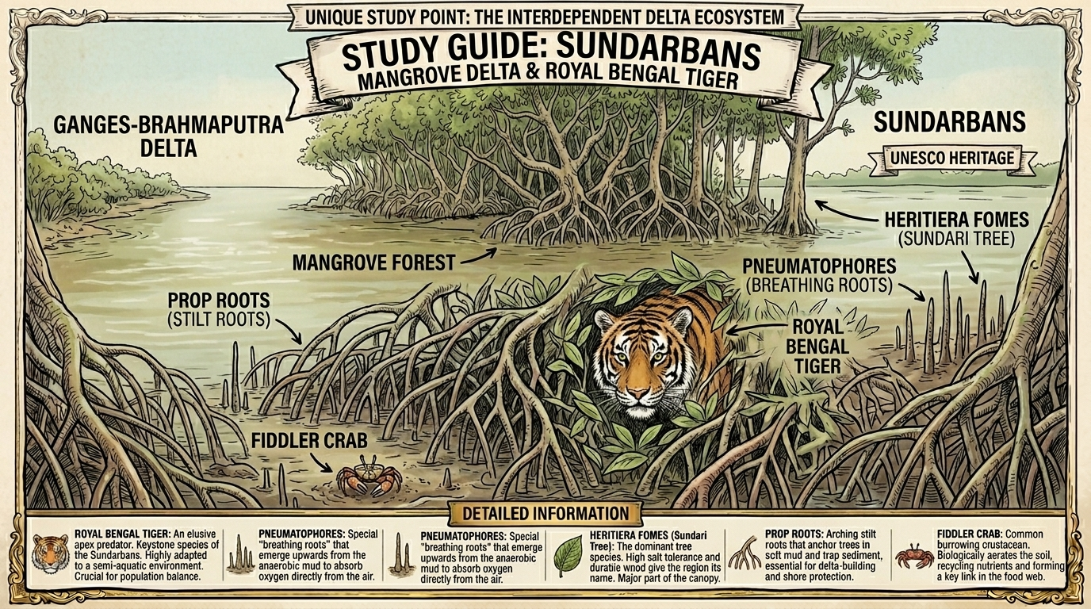
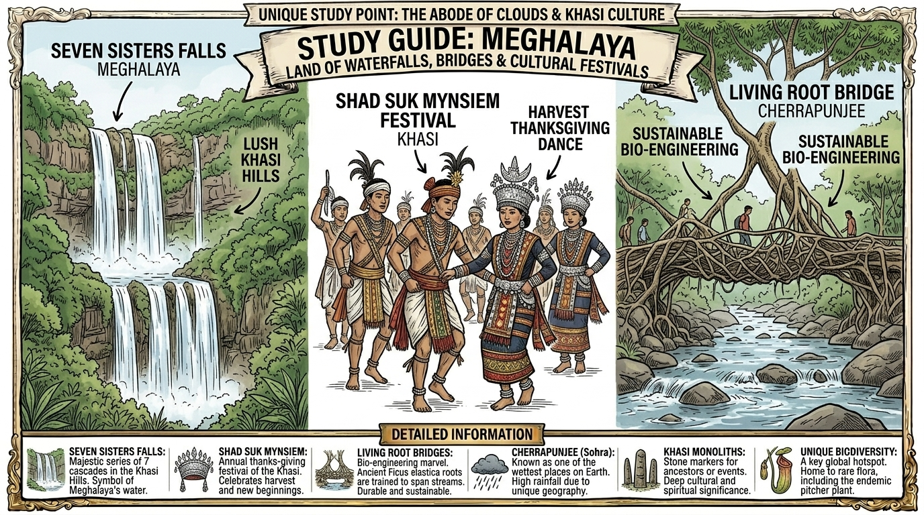
🐅 Sundarbans & 🌿 Northeast Hills
🐅 SUNDARBANS
🌿 NORTHEAST HILLS
🌉 LIVING ROOT BRIDGE
• Delta of Ganga + Brahmaputra + tributaries
• Half in INDIA, half in BANGLADESH
• UNESCO World Heritage Site!
• Home to ROYAL BENGAL TIGER
• Mangrove forests – Sundari tree
• Breathing roots = Pneumatophores
• Meghalaya Plateau: Garo, Khasi, Jaintia Hills
• One of HIGHEST RAINFALLS in the world!
• Cherrapunjee = one of wettest places on Earth
• Seven Sisters Waterfalls
• Living Root Bridges (Ficus elastica roots)
• Mawlynnong = 'Cleanest village in Asia'
• Created by KHASI tribe in Meghalaya
• Ficus elastica roots trained over decades
• Grow STRONGER with time!
• Bio-engineering marvel
• Shad Suk Mynsiem = Khasi harvest festival
• Deep nature-human connection

Slide 18
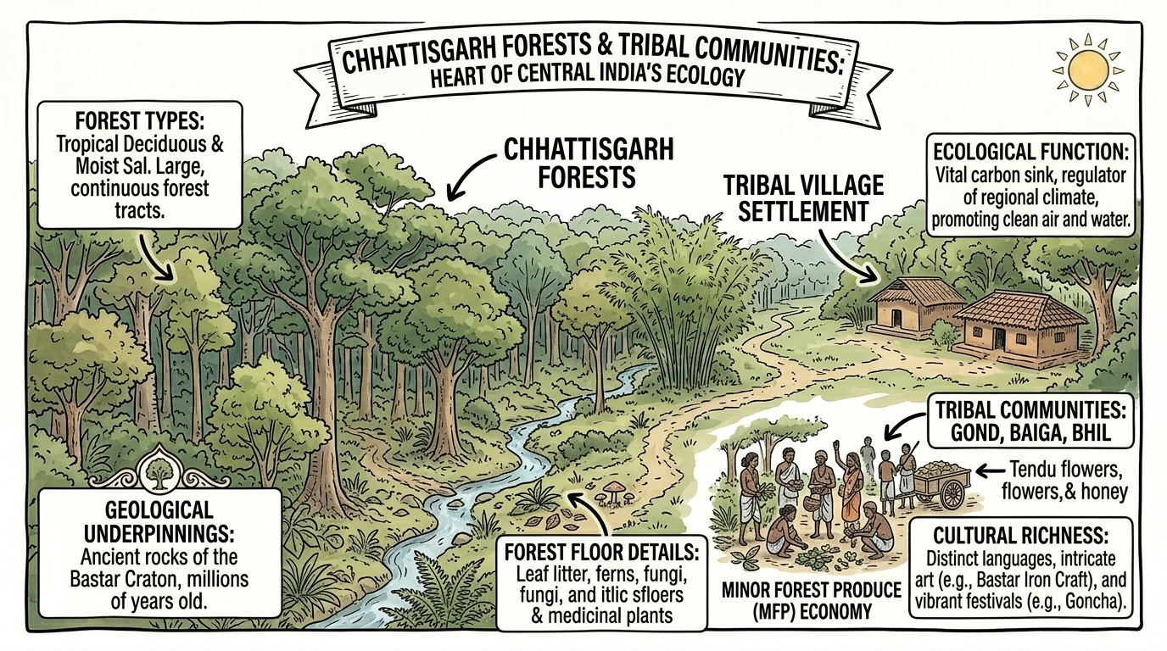
🌳 Chhattisgarh Forests & Tribal Communities
🌳 FOREST TYPES
👥 TRIBAL COMMUNITIES
⭐ EXAM POINTS
• Tropical Deciduous & Moist Sal forests
• Large, continuous forest tracts
• Ancient rocks of Bastar Craton
• Vital carbon sink for climate regulation
• Promotes clean air and water
• Gond, Baiga, Bhil, Santhal, Korku
• Distinct languages & traditions
• Connected to Nature – forest livelihood
• Bastar Iron Craft – cultural art
• Goncha festival – cultural celebration
• Collect Tendu leaves, forest produce
• Peninsular Plateau rich in minerals
• COAL mines → electricity production
• Coal = fossil fuel → contributes to global warming
• Dense forests = tribal homeland
• Tribal states: Jharkhand, Odisha, Assam,
MP, Chhattisgarh, Maharashtra, Telangana, Gujarat

Slide 19
🏆 UNESCO World Heritage Sites in This Chapter
🏆
🏆
🏆
🏆
🏆
Great Himalayan
National Park
Western Ghats
Jaisalmer Fort
Sundarbans
Cellular Jail
📍 Himachal Pradesh
📍 Gujarat to Kerala
📍 Rajasthan (Thar)
📍 West Bengal
📍 Andaman Islands
✅ Wide diversity of
flora & fauna
✅ Rich biodiversity,
high endemism
✅ Golden City –
Rajput architecture
✅ Mangrove delta,
Royal Bengal Tiger
✅ Freedom fighters
imprisoned here
⭐ EXAM TIP: UNESCO World Heritage Sites are FREQUENTLY ASKED in exams! Learn all 5 above.

Slide 20
⭐ MEGA REVISION – All Important Facts at a Glance
🏔 HIMALAYAS
❄ LADAKH + PLAINS
🏜 DESERT + PLATEAU
🌊 COASTS + ISLANDS
• Length = 2500 km
• Ladakh = Cold Desert, –30°C winters
• Thar = Great Indian Desert
• Coastline = 7500 km total
• 3 Ranges: Himadri, Himachal, Shivalik
• Moonland = moon-like terrain
• Spans: Rajasthan, Gujarat, Punjab, Haryana
• West Coast: Gujarat to Kerala
• 'Himalaya' = Abode of Snow (Sanskrit)
• Pangong Tso = highest saltwater lake (4225m)
• Sand dunes up to 150m high
• East Coast: river deltas (Godavari, Krishna, Kaveri)
• Formed by India-Eurasia collision
• Yak = milk, meat, wool, fuel, transport
• Taanka/Kund = rainwater harvesting
• Lakshadweep = 36 coral islands (Arabian Sea)
• Still growing 5mm/yr!
• Northern Plains = Granary of India
• Aravallis = 2.5 billion years old!
• Andaman & Nicobar = 500+ volcanic islands
• Water Tower of Asia
• Alluvial soil from Himalayan rivers
• Aravallis prevent Thar expanding east
• Barren Island = only active volcano in India
• Gaumukh = Bhagirathi origin
• Rabi = wheat/barley (winter)
• Zawar mines = world's first zinc smelting
• Cellular Jail = freedom fighter prison
• Kath-Kuni = earthquake-resistant houses
• Kharif = rice/sugarcane (summer)
• Deccan Plateau = rich in coal & minerals
• Sundarbans = UNESCO, Royal Bengal Tiger

Slide 21
📝 Practice Questions – Exam Ready!
Q1. What does 'Himalaya' mean in Sanskrit?
Q6. What is Taanka/Kund?
✅ Hima (snow) + Ālaya (abode) = 'Abode of Snow'
✅ Traditional rainwater harvesting system in Thar Desert (Rajasthan)
Q2. Name the three main ranges of the Himalayas.
Q7. Why are the Aravalli Hills important?
✅ Himadri (Greater), Himachal (Lower), Shivalik (Outer)
✅ Prevent Thar Desert from expanding east; rich in marble, zinc, copper
Q3. Why are the Himalayas called 'Water Tower of Asia'?
Q8. Name any three UNESCO Heritage Sites in this chapter.
✅ Snowmelt feeds major rivers: Ganga, Indus, Brahmaputra
✅ Great Himalayan NP, Western Ghats, Jaisalmer Fort, Sundarbans, Cellular Jail
Q4. What is Gaumukh and why is it important?
Q9. What is 'Kath-Kuni' style?
✅ Edge of Gangotri Glacier (Uttarakhand) – source of Bhagirathi River (tributary of Ganga)
✅ Traditional wooden + stone earthquake-resistant house style of western Himalayas
Q5. What is 'Moonland'? Where is it?
Q10. What is the only active volcano in India?
✅ Ladakh – rocky terrain eroded by wind/rain resembles moon surface
✅ Barren Island in the Andaman & Nicobar Islands

Slide 22
🇮🇳 India – A 'Mini-Continent'! 🌏
"Despite having mountains, deserts, plains,
coasts & islands — INDIA REMAINS ONE COUNTRY!"
🏔
🌾
🏜
🌴
🏝
🌿
Mountains
Plains
Desert
Peninsula
Islands
NE Hills
Himalayas
(North)
Gangetic
(Centre)
Thar
(West)
Deccan
(South)
Lakshadweep
& Andaman
Meghalaya
Plateau
📌 BEFORE WE MOVE ON…
✅ India gives its name to the SUBCONTINENT it is part of.
✅ Diverse geography: snowy peaks → scorching desert → fertile plains → tropical coasts
✅ Geography shaped India's CLIMATE, CULTURE, HISTORY & CIVILISATION
✅ Rivers, mountains, deserts & coasts affect how people LIVE, WORK & EAT
✅ 'Sāre jahān se achchha' – India is truly amazing! 🇮🇳
📱 UNIQUE STUDY POINT | uniquestudyonline.com | ☎ 8103405051

