Slide 1
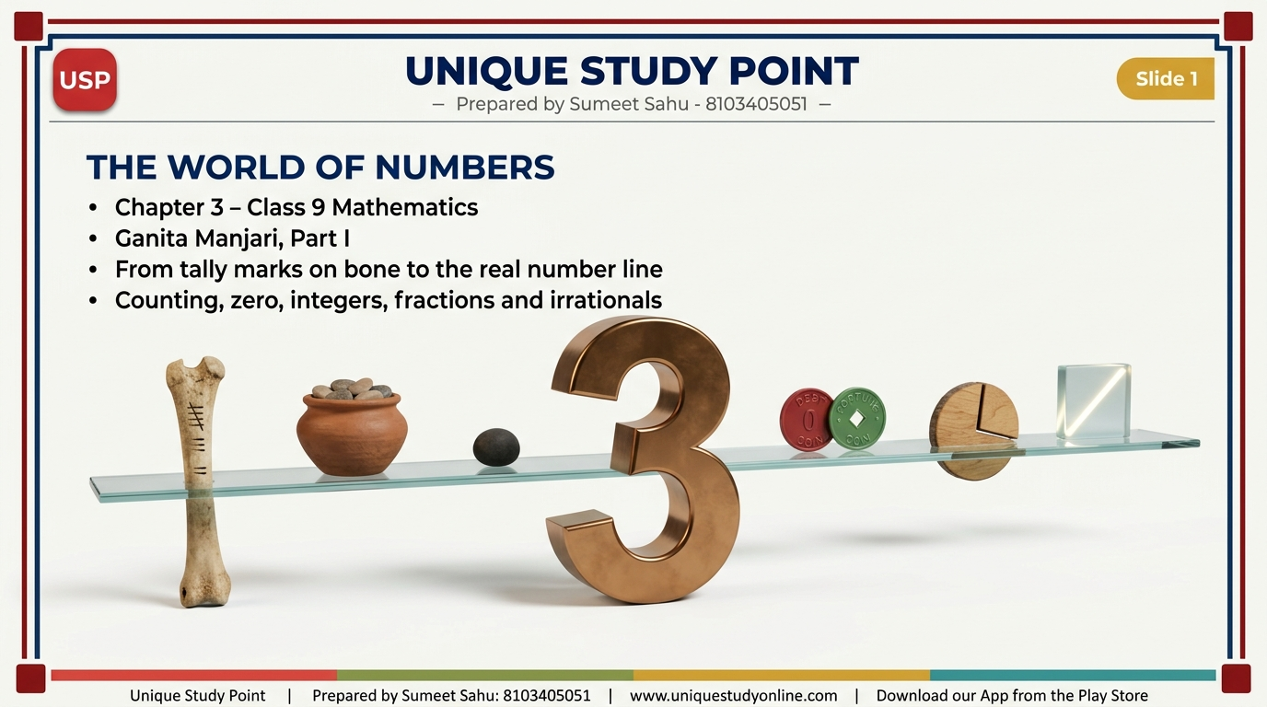
Notes:
Slide 1 - THE WORLD OF NUMBERS
Chapter 3, Class 9 Mathematics - Ganita Manjari Part I. The journey from tally marks on bone to the real number line.

Slide 2
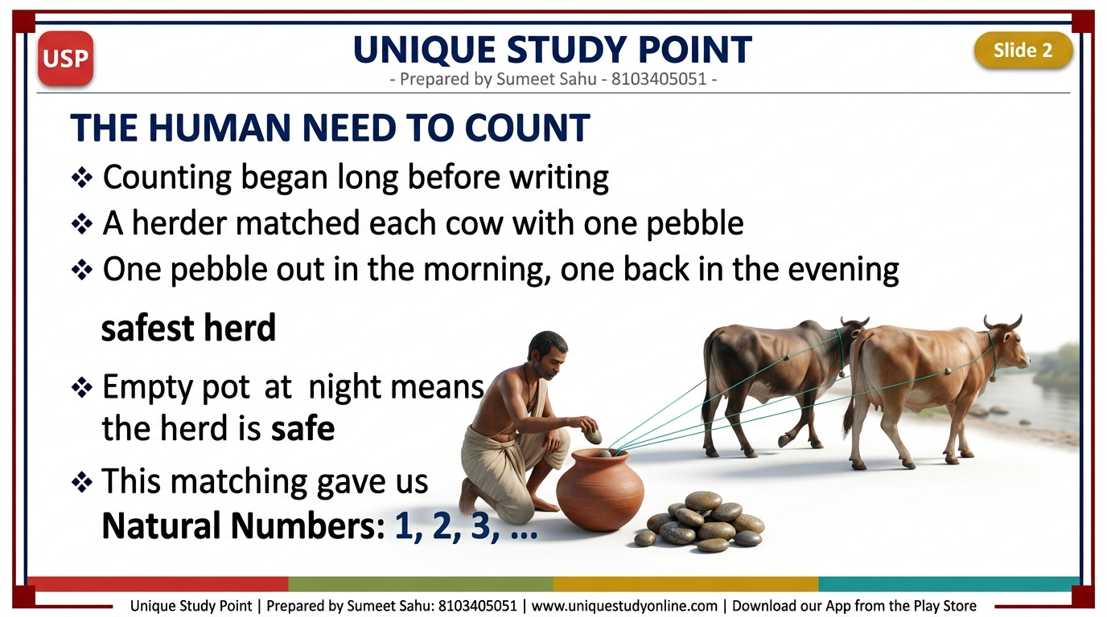
Notes:
Slide 2 - The Human Need to Count
Counting began before writing. A herder matched each cow with one pebble - one pebble out in the morning, one back in the evening. An empty pot means the herd is safe. This one-to-one matching gave us the Natural Numbers 1, 2, 3, ...

Slide 3
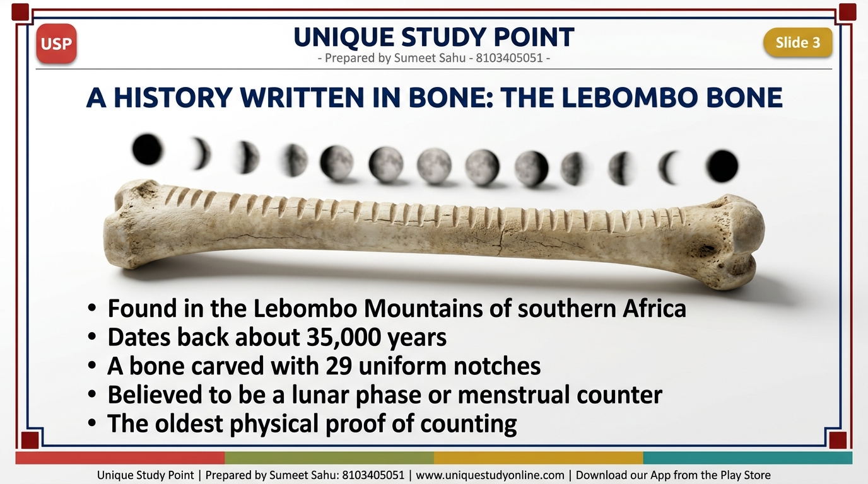
Notes:
Slide 3 - A History Written in Bone: The Lebombo Bone
The Lebombo Bone: found in the Lebombo Mountains of southern Africa, about 35,000 years old, carved with 29 uniform notches. Believed to be a lunar phase or menstrual counter - the oldest physical proof of counting.

Slide 4
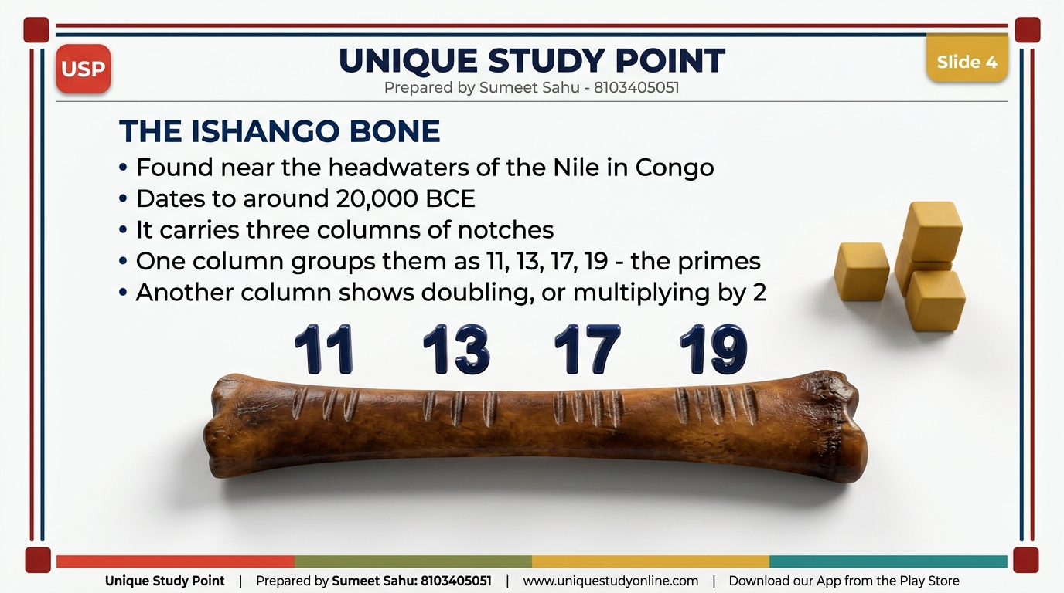
Notes:
Slide 4 - The Ishango Bone
The Ishango Bone: found near the headwaters of the Nile in Congo, around 20,000 BCE. Three columns of notches. One column groups them as 11, 13, 17, 19 - the primes between 10 and 20. Another column shows doubling.

Slide 5
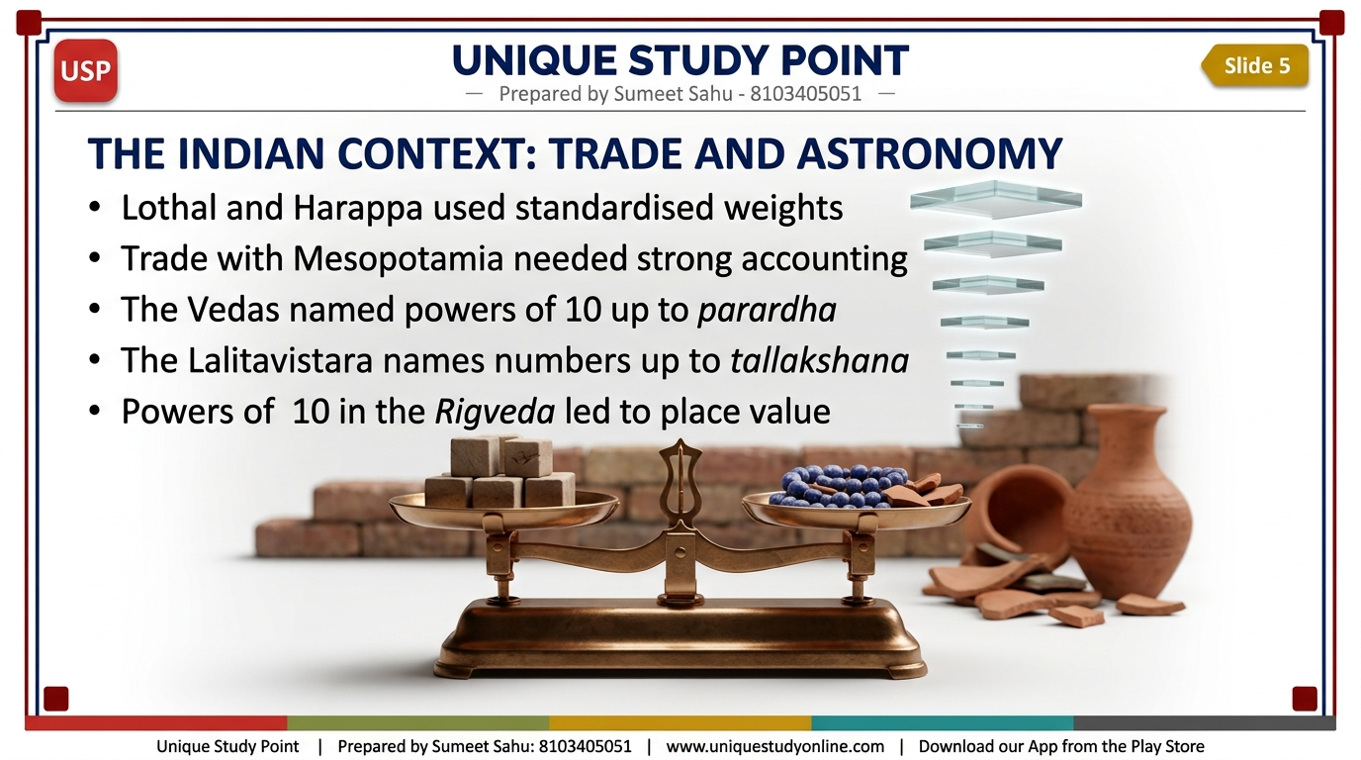
Notes:
Slide 5 - The Indian Context: Trade and Astronomy
Lothal and Harappa used standardised weights for trade with Mesopotamia. The Vedas named powers of 10 up to parardha (ten to the power twelve). The Lalitavistara names numbers up to tallakshana (ten to the power fifty-three). Powers of 10 in the Rigveda led to place value.

Slide 6
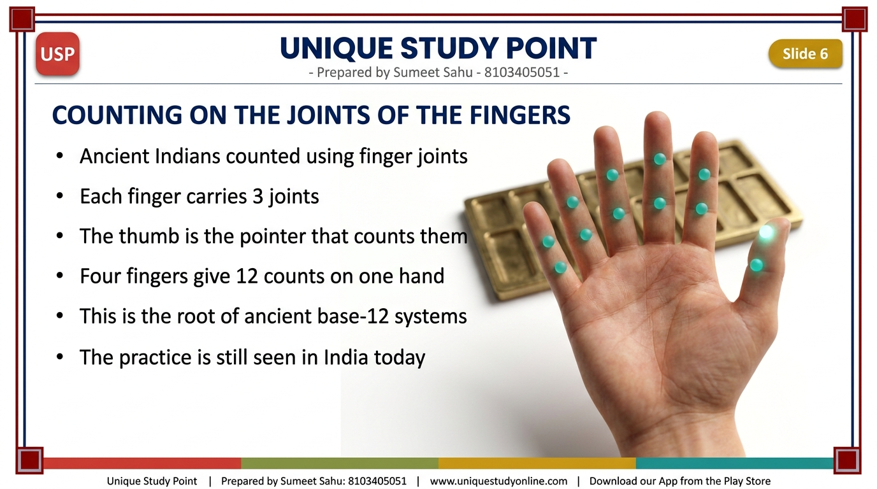
Notes:
Slide 6 - Counting on the Joints of the Fingers
Ancient Indians counted using finger joints. Each finger has 3 joints and the thumb is the pointer. Four fingers give 12 counts on one hand - the root of ancient base-12 systems. Still seen in India today. (Exercise Set 3.1, Q4)

Slide 7
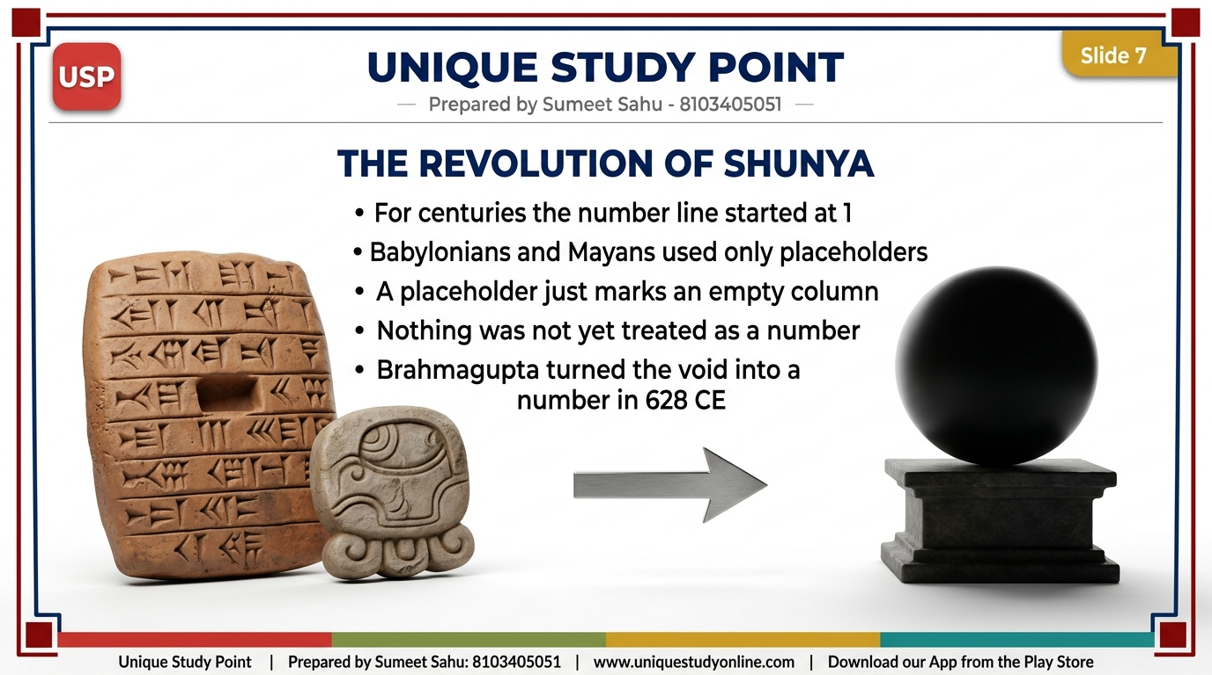
Notes:
Slide 7 - The Revolution of Shunya
For centuries the number line started at 1. Babylonians and Mayans used only placeholders to mark an empty column - 'nothing' was not yet a number you could add, subtract or multiply. Brahmagupta turned the void into a number in 628 CE.

Slide 8
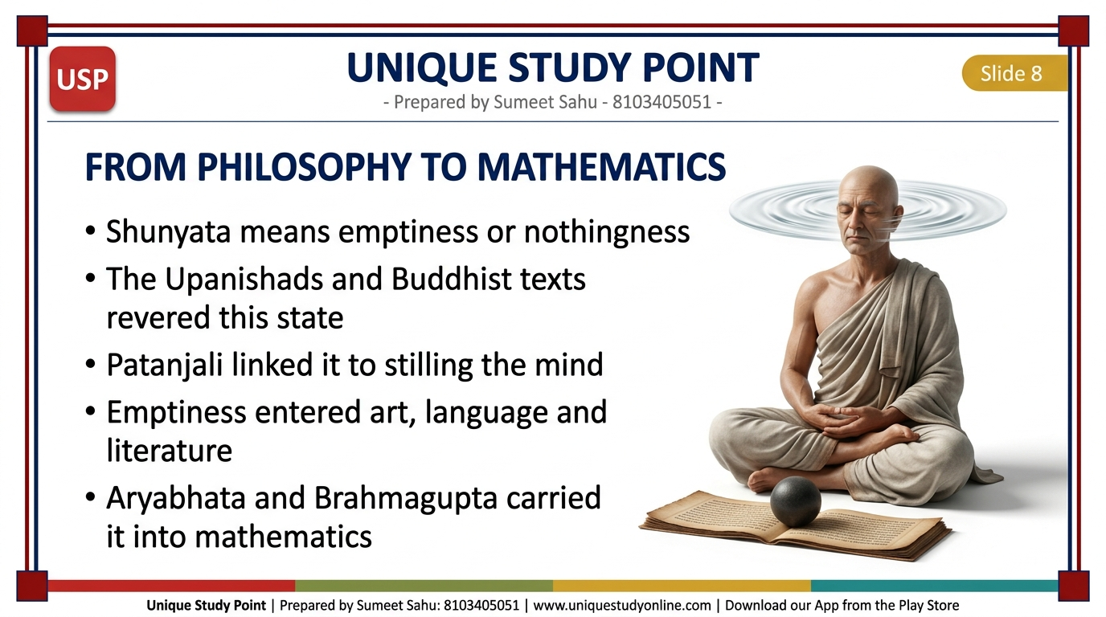
Notes:
Slide 8 - From Philosophy to Mathematics
Shunyata means emptiness or nothingness. The Upanishads and Buddhist texts revered this state; Patanjali linked it to stilling the mind. Emptiness entered art, language and literature, and Aryabhata and finally Brahmagupta carried it into mathematics.

Slide 9
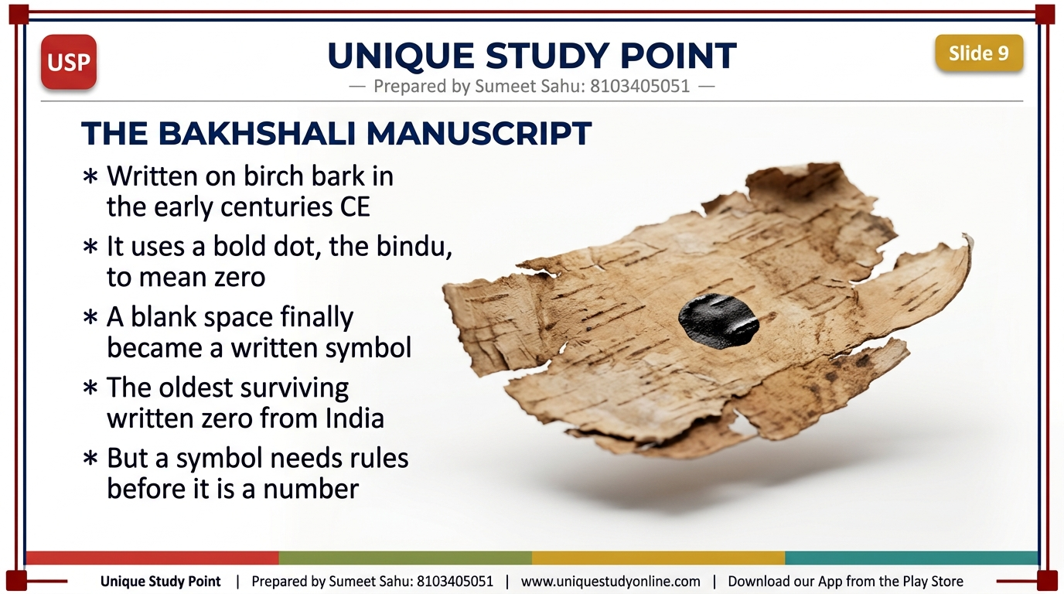
Notes:
Slide 9 - The Bakhshali Manuscript
The Bakhshali Manuscript, written on birch bark in the early centuries CE, uses a bold dot - the bindu - to mean zero. A blank space finally became a written symbol. But a symbol needs rules before it becomes a number.

Slide 10
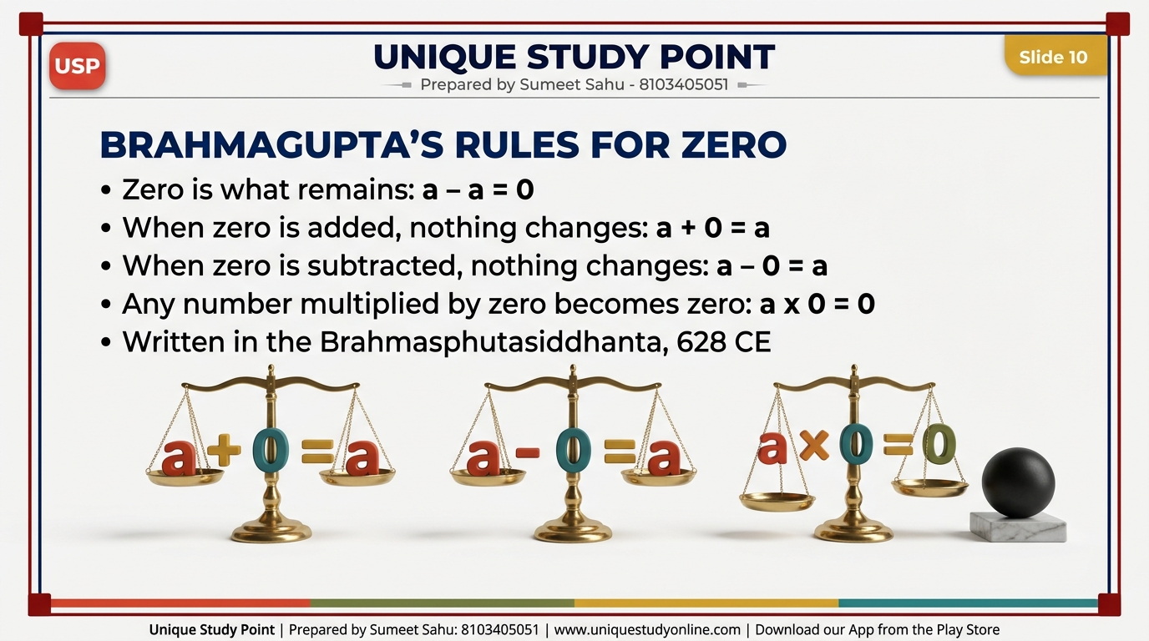
Notes:
Slide 10 - Brahmagupta's Rules for Zero
Brahmagupta's rules for zero, from the Brahmasphutasiddhanta (628 CE): zero is a - a; a + 0 = a; a - 0 = a; a x 0 = 0.

Slide 11
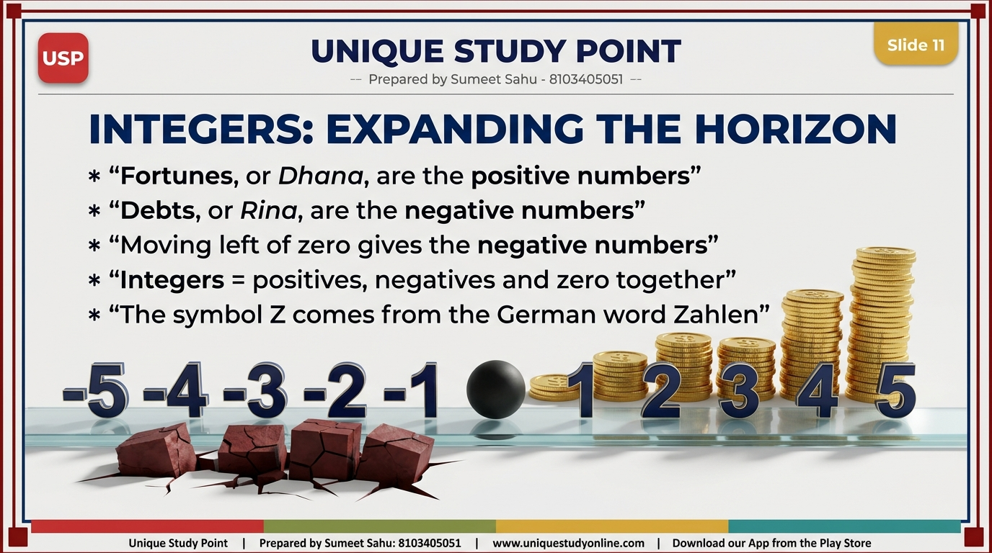
Notes:
Slide 11 - Integers: Expanding the Horizon
Fortunes (Dhana) are positive numbers; Debts (Rina) are negative numbers. Moving left of zero gives the negatives. Integers = positives, negatives and zero. The symbol Z comes from the German word Zahlen, meaning numbers.

Slide 12
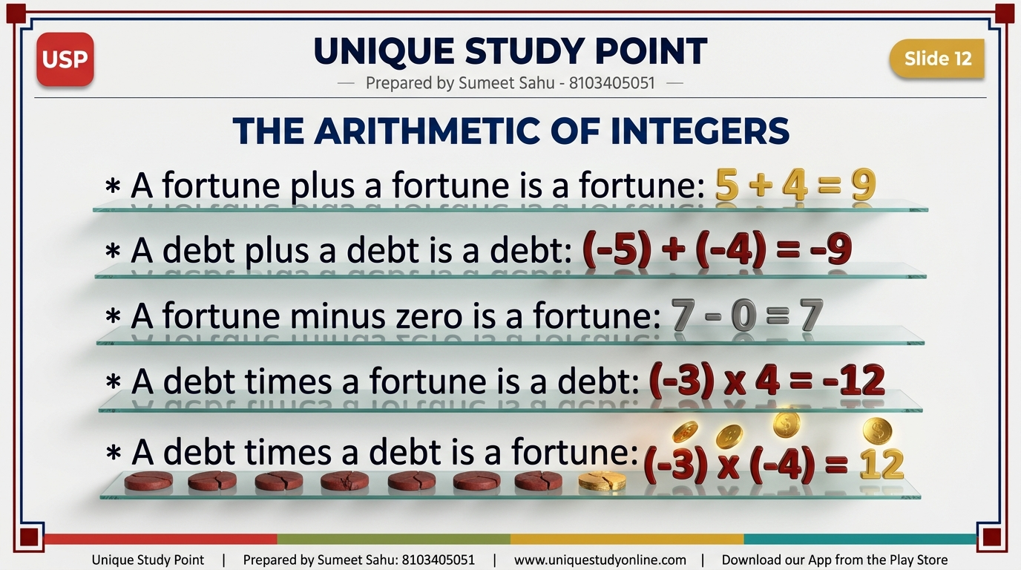
Notes:
Slide 12 - The Arithmetic of Integers
Brahmagupta's five rules, still used exactly as written over 1,300 years ago: fortune + fortune = fortune (5 + 4 = 9); debt + debt = debt ((-5) + (-4) = -9); fortune - zero = fortune (7 - 0 = 7); debt x fortune = debt ((-3) x 4 = -12); debt x debt = fortune ((-3) x (-4) = 12).

Slide 13
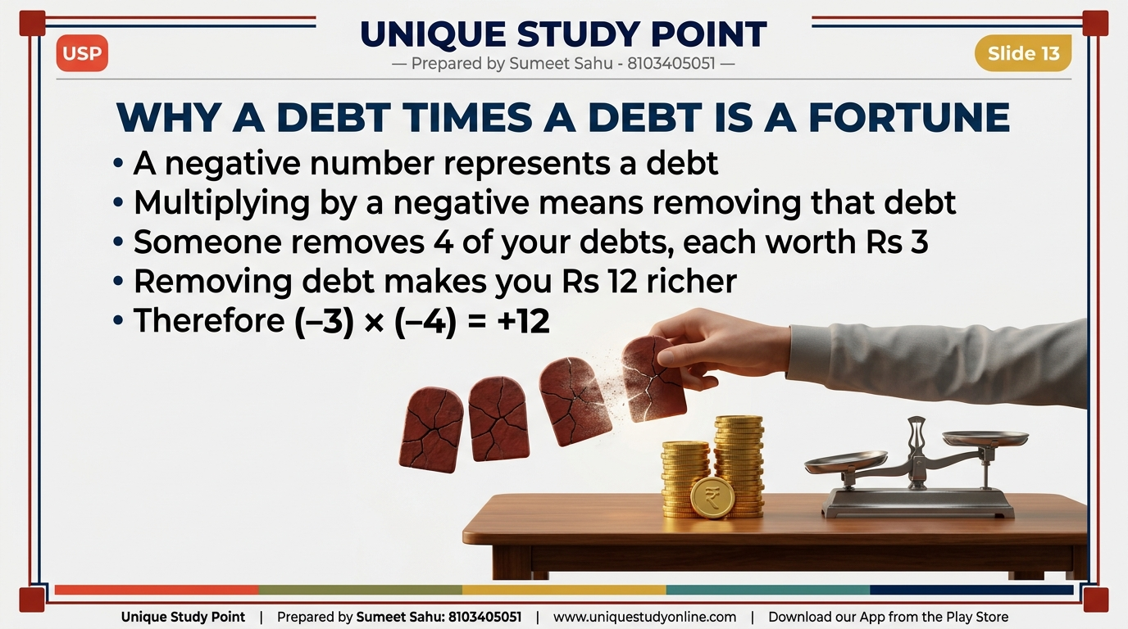
Notes:
Slide 13 - Why a Debt Times a Debt is a Fortune
A negative number is a debt. Multiplying by a negative means REMOVING that debt. Remove 4 debts of Rs 3 each and you are Rs 12 richer. Therefore (-3) x (-4) = +12.

Slide 14
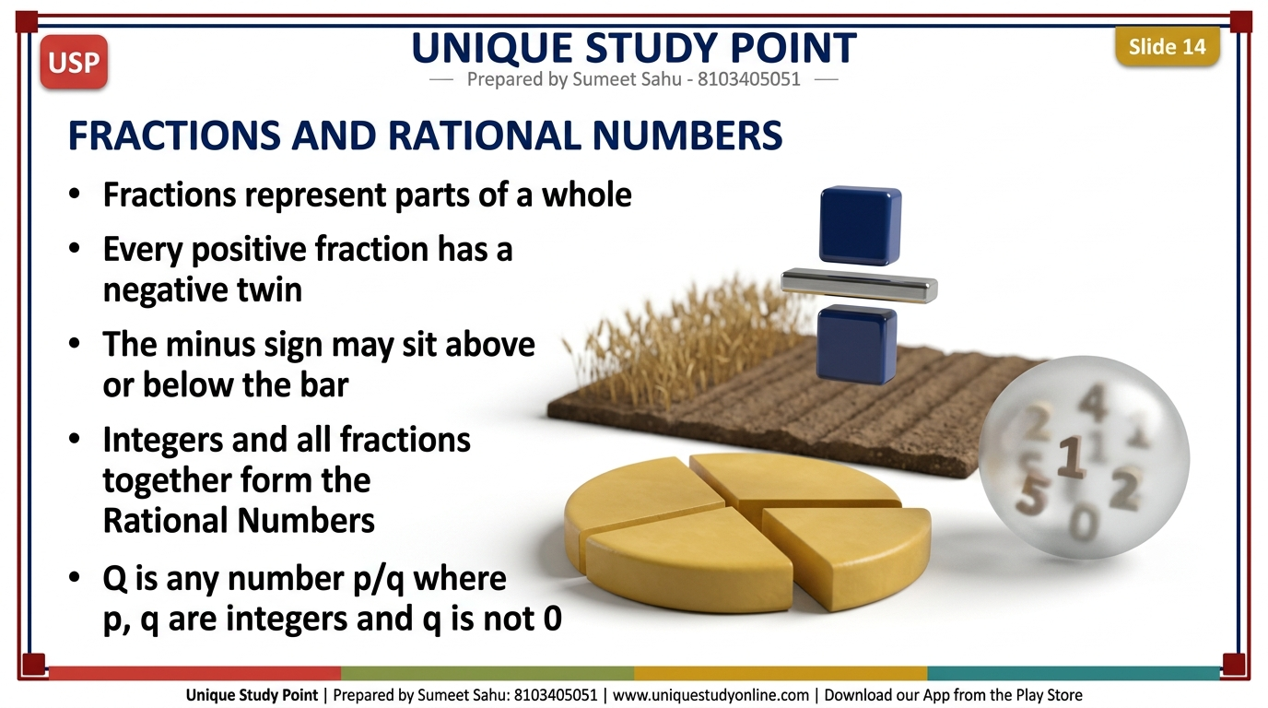
Notes:
Slide 14 - Fractions and Rational Numbers
Fractions represent parts of a whole. Every positive fraction has a negative twin, and the minus sign may sit above or below the bar. Integers and all fractions together form the Rational Numbers Q - any number p/q where p and q are integers and q is not 0.

Slide 15
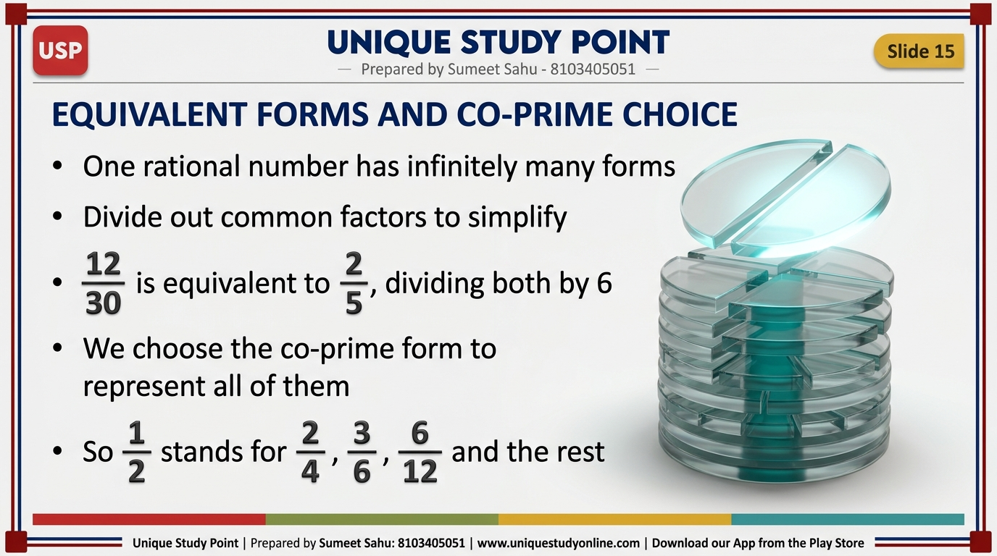
Notes:
Slide 15 - Equivalent Forms and Co-Prime Choice
One rational number has infinitely many forms. Divide out common factors to simplify: 12/30 becomes 2/5 by dividing both by 6. We choose the co-prime form, so 1/2 represents 2/4, 3/6, 6/12 and the rest.

Slide 16
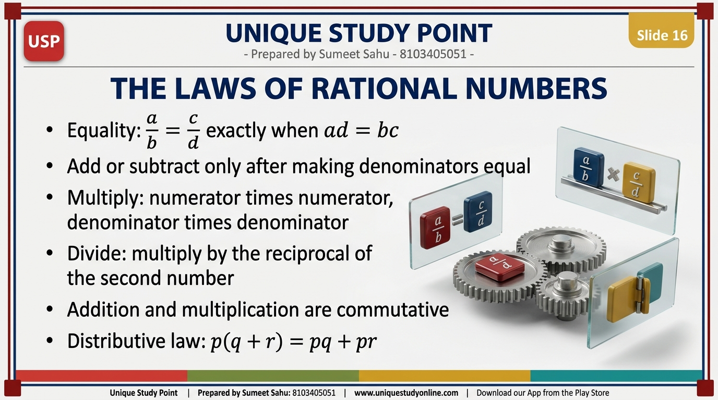
Notes:
Slide 16 - The Laws of Rational Numbers
Equality: a/b = c/d exactly when ad = bc. Add or subtract only after making denominators equal. Multiply numerators and denominators. Divide by multiplying with the reciprocal. Addition and multiplication are commutative, and the distributive law holds: p(q + r) = pq + pr.

Slide 17
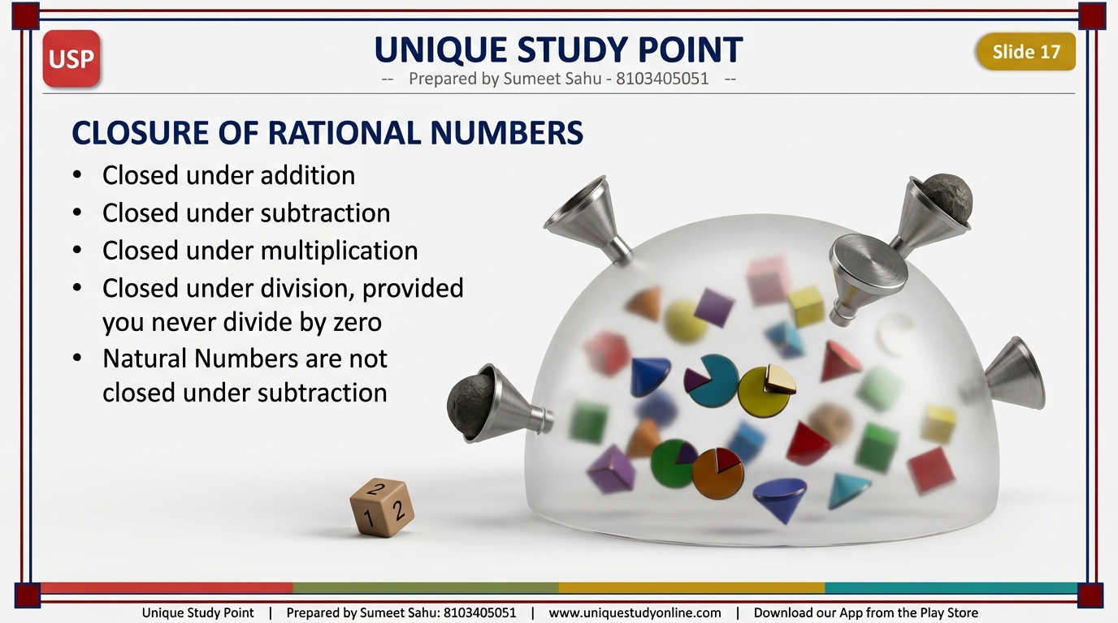
Notes:
Slide 17 - Closure of Rational Numbers
Rational numbers are closed under addition, subtraction, multiplication, and division - provided you never divide by zero. Contrast: Natural Numbers are NOT closed under subtraction.

Slide 18
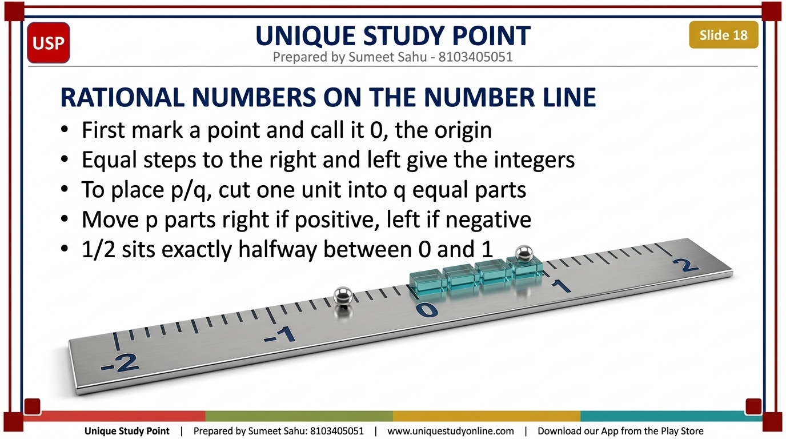
Notes:
Slide 18 - Rational Numbers on the Number Line
Mark a point as 0, the origin. Equal steps give the integers. To place p/q, cut one unit into q equal parts and move p parts right if positive, left if negative. 1/2 sits exactly halfway between 0 and 1.

Slide 19
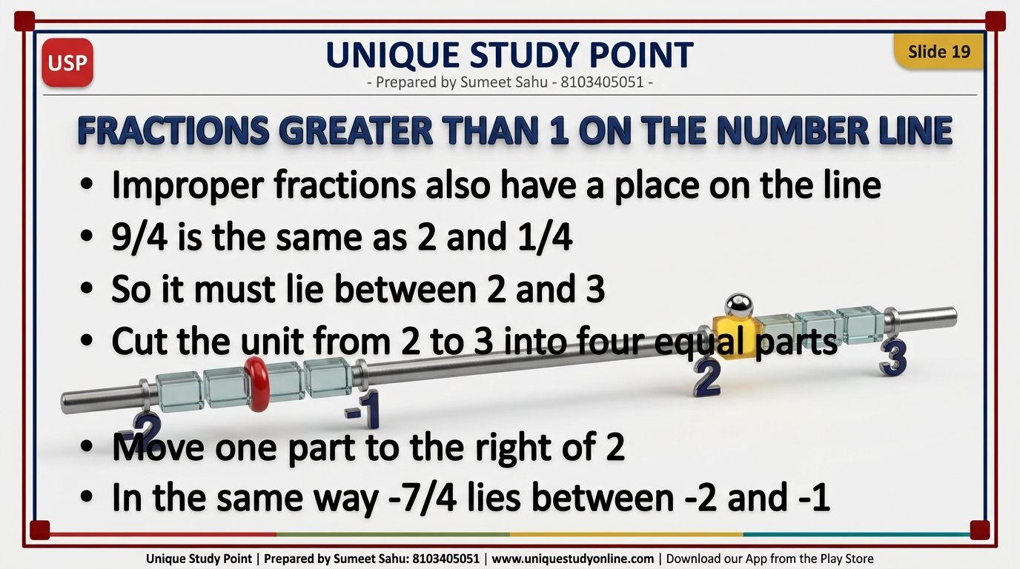
Notes:
Slide 19 - Fractions Greater Than 1 on the Number Line
Improper fractions also sit on the line. 9/4 = 2 and 1/4, so it lies between 2 and 3: cut that unit into four equal parts and move one part right of 2. Similarly -7/4 lies between -2 and -1.

Slide 20
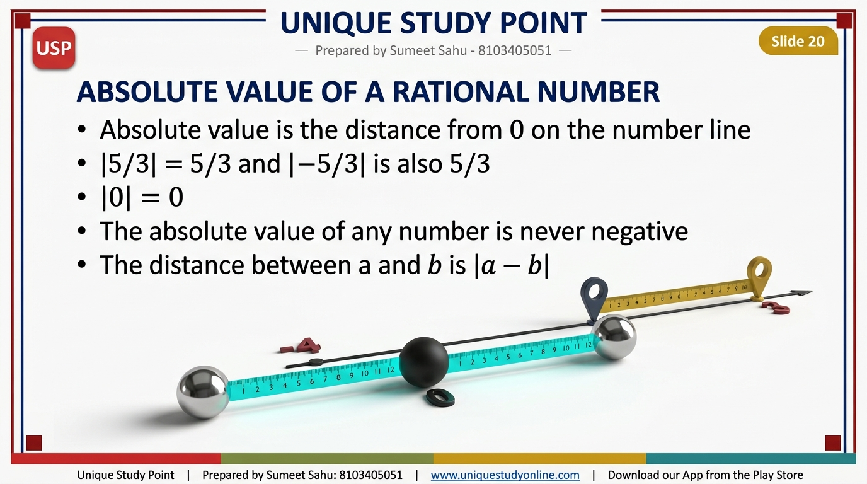
Notes:
Slide 20 - Absolute Value of a Rational Number
Absolute value is distance from 0. |5/3| = 5/3 and |-5/3| = 5/3 too. |0| = 0. Absolute value is never negative. The distance between a and b is |a - b|.

Slide 21
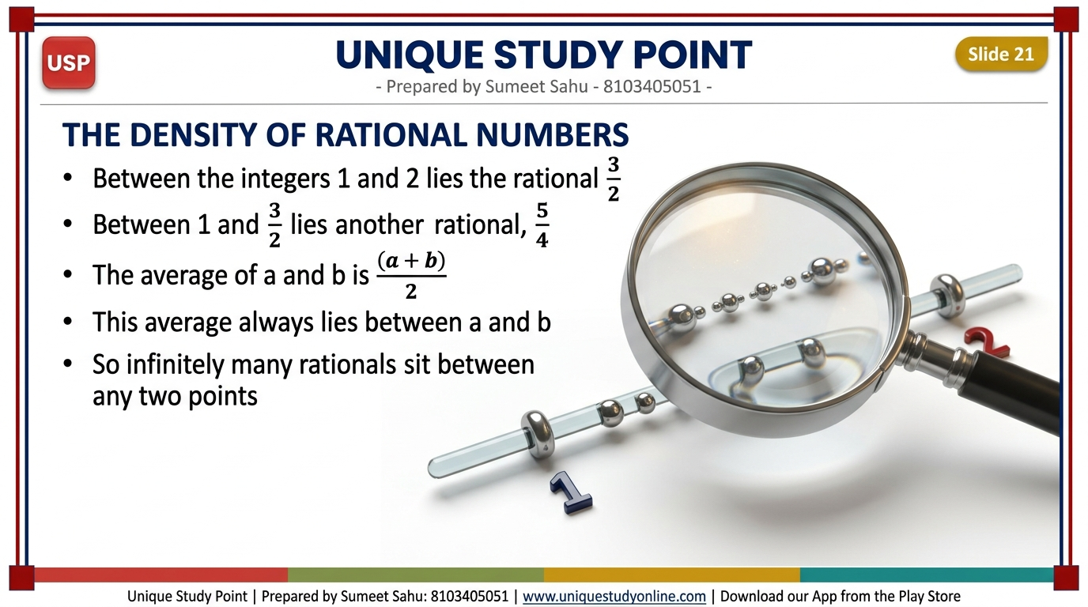
Notes:
Slide 21 - The Density of Rational Numbers
Between the integers 1 and 2 lies 3/2. Between 1 and 3/2 lies 5/4. The average of a and b, (a + b)/2, always lies between them - so there are infinitely many rationals between any two points.

Slide 22
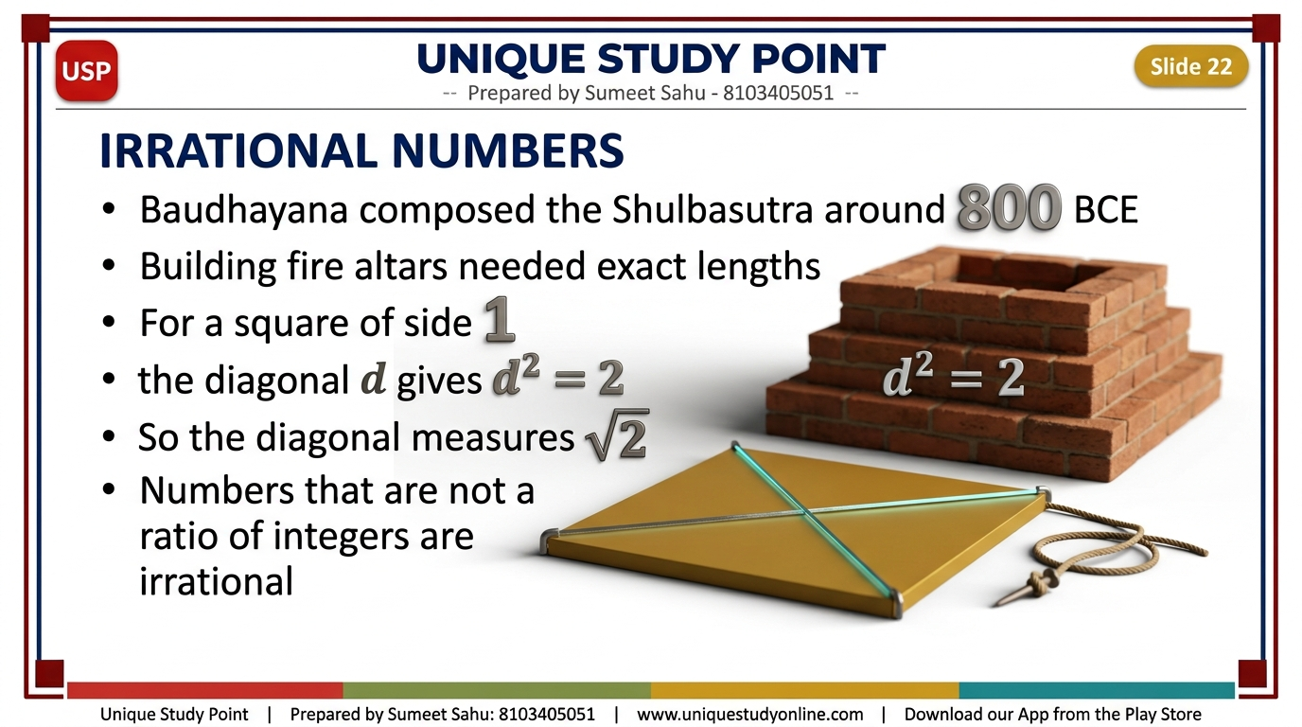
Notes:
Slide 22 - Irrational Numbers
Baudhayana composed the Shulbasutra around 800 BCE; building fire altars needed exact lengths. For a square of side 1, the diagonal d gives d squared = 2, so the diagonal is root 2. Numbers that are not a ratio of integers are irrational.

Slide 23
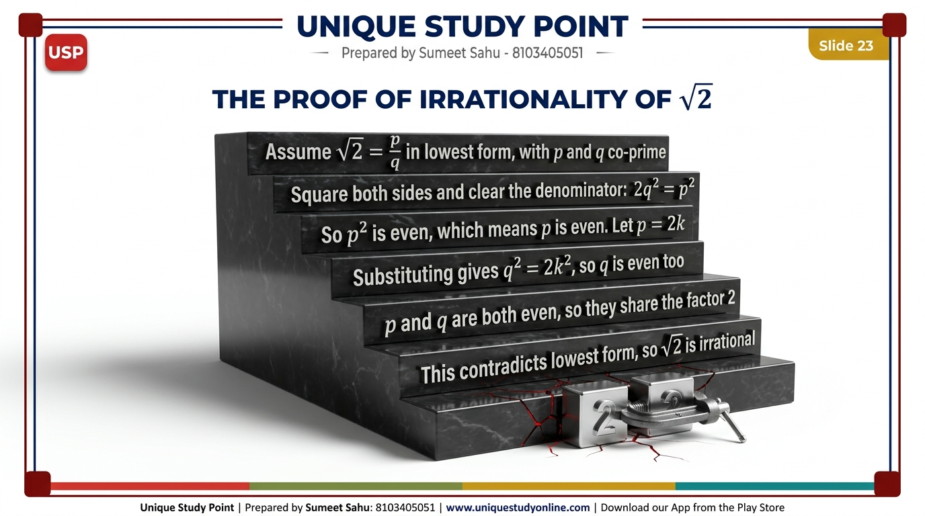
Notes:
Slide 23 - The Proof of Irrationality of Root 2
Proof by contradiction (Hippasus, c. 400 BCE): assume root 2 = p/q in lowest form. Squaring gives 2q squared = p squared, so p squared is even and p is even. Let p = 2k, then q squared = 2k squared, so q is even too. Both even contradicts lowest form - therefore root 2 is irrational.

Slide 24
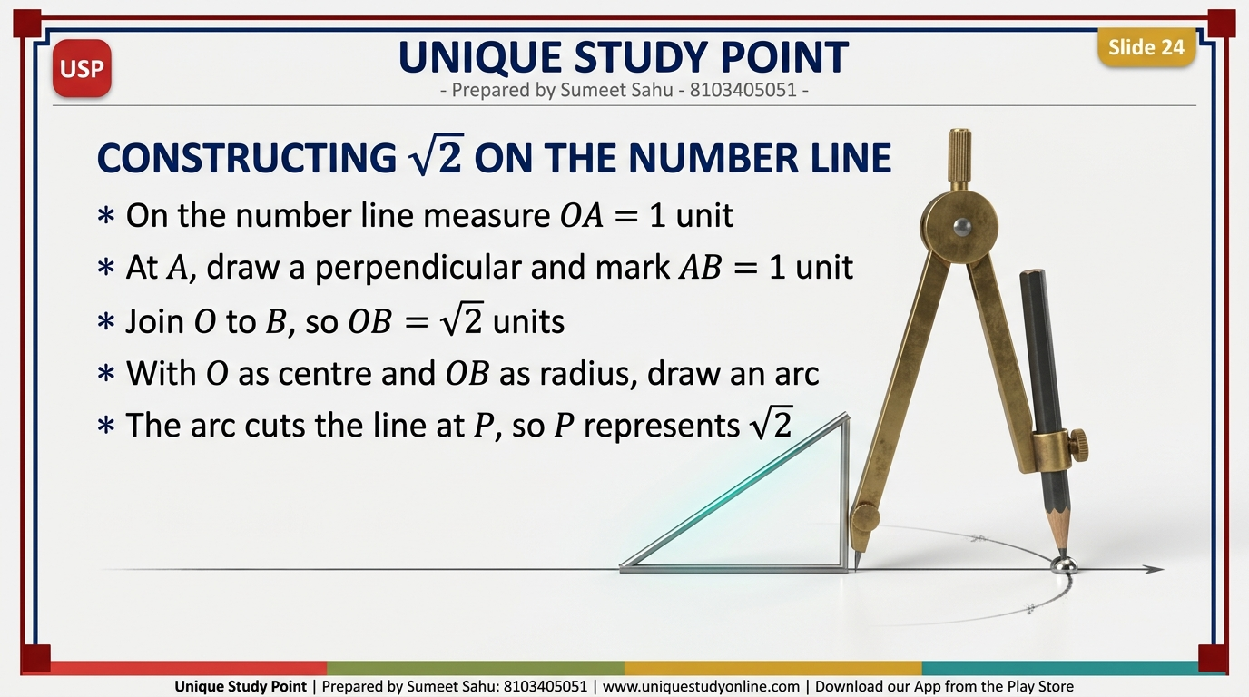
Notes:
Slide 24 - Constructing Root 2 on the Number Line
Measure OA = 1 unit on the number line. At A draw a perpendicular and mark AB = 1 unit. Join O to B, so OB = root 2. With O as centre and OB as radius draw an arc - it cuts the line at P, so P represents root 2. The same method extends to any root n.

Slide 25
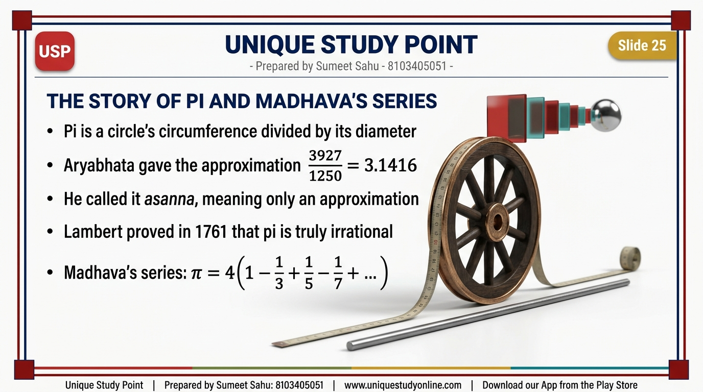
Notes:
Slide 25 - The Story of Pi and Madhava's Series
Pi = circumference / diameter. Aryabhata (499 CE) gave 3927/1250 = 3.1416 but called it asanna, only an approximation. Lambert proved pi irrational in 1761. Madhava of Sangamagrama, founder of the Kerala School, found the exact infinite series: pi = 4(1 - 1/3 + 1/5 - 1/7 + ...).

Slide 26
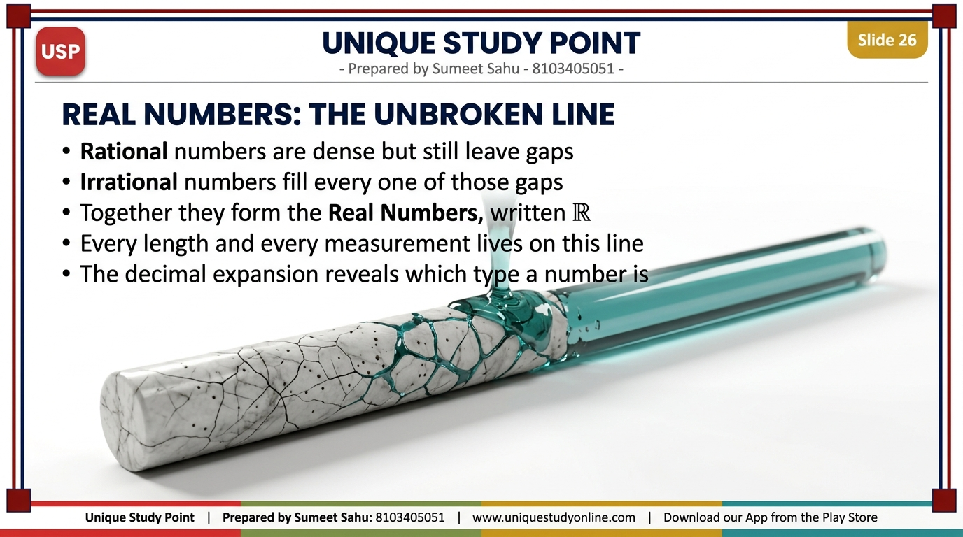
Notes:
Slide 26 - Real Numbers: The Unbroken Line
Rational numbers are dense but still leave gaps. Irrational numbers fill every gap. Together they form the Real Numbers R - every length and measurement lives on this line. The decimal expansion reveals which type a number is.

Slide 27
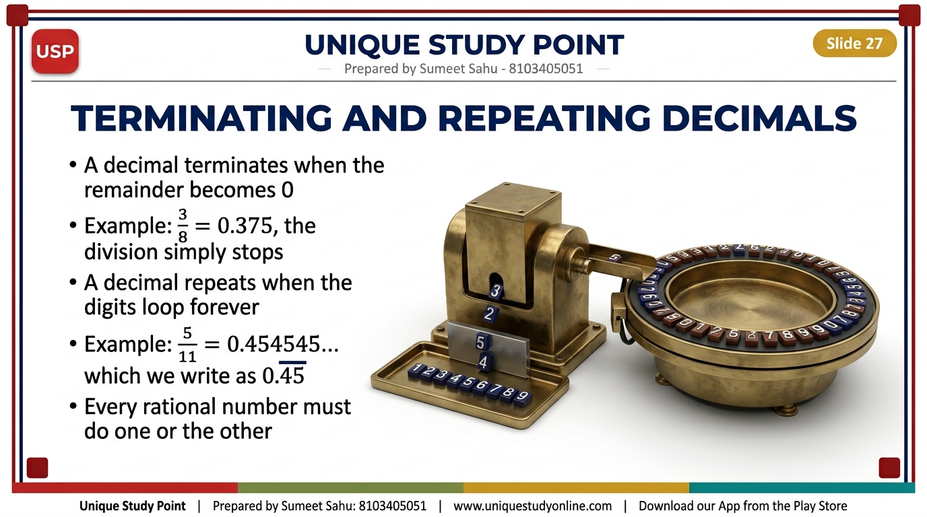
Notes:
Slide 27 - Terminating and Repeating Decimals
A decimal terminates when the remainder becomes 0: 3/8 = 0.375. It repeats when the digits loop forever: 5/11 = 0.454545... = 0.45 with a bar. Every rational number must do one or the other.

Slide 28
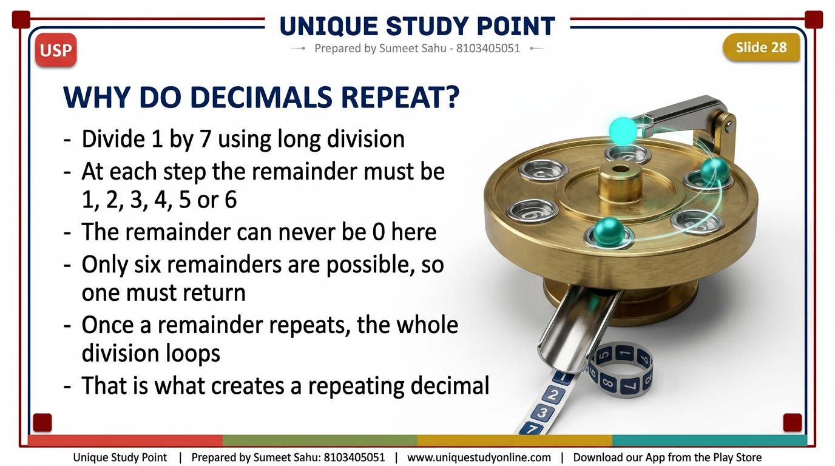
Notes:
Slide 28 - Why Do Decimals Repeat?
Divide 1 by 7. At each step the remainder must be 1, 2, 3, 4, 5 or 6 - never 0. Only six remainders are possible, so one must eventually return. Once a remainder repeats, the whole division loops - that is what creates a repeating decimal.

Slide 29
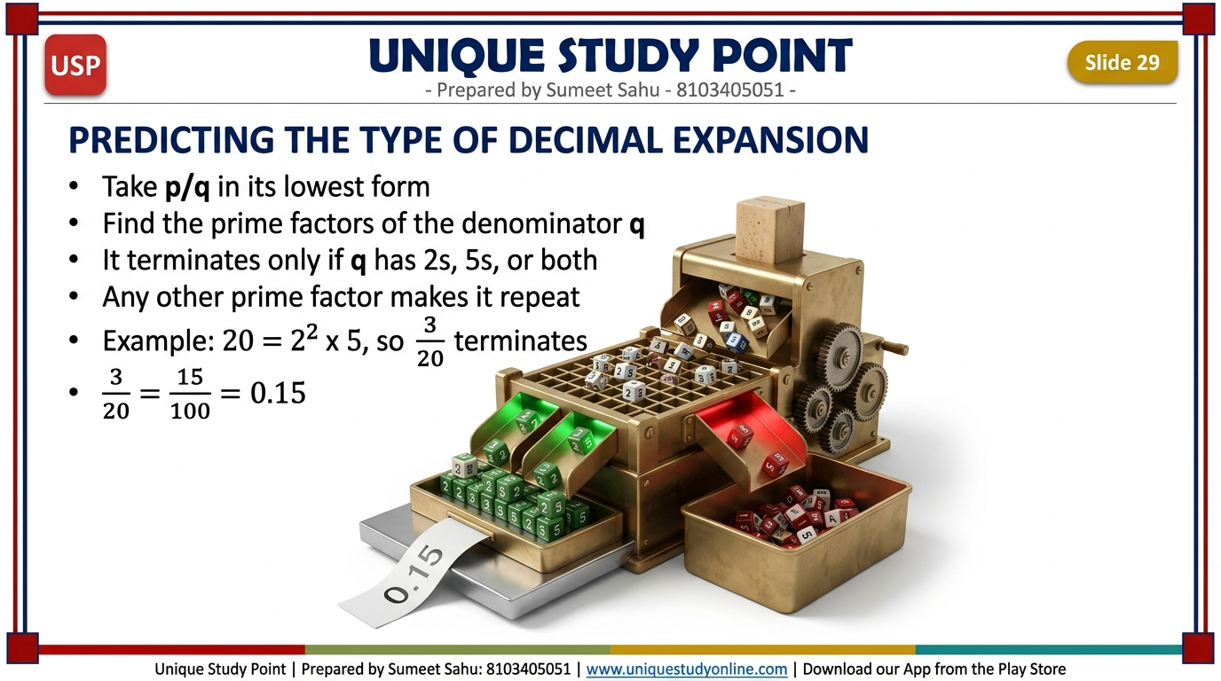
Notes:
Slide 29 - Predicting the Type of Decimal Expansion
Take p/q in lowest form and find the prime factors of q. It terminates only if q has 2s, 5s or both; any other prime factor makes it repeat. Example: 20 = 2 squared x 5, so 3/20 terminates: 3/20 = 15/100 = 0.15.

Slide 30
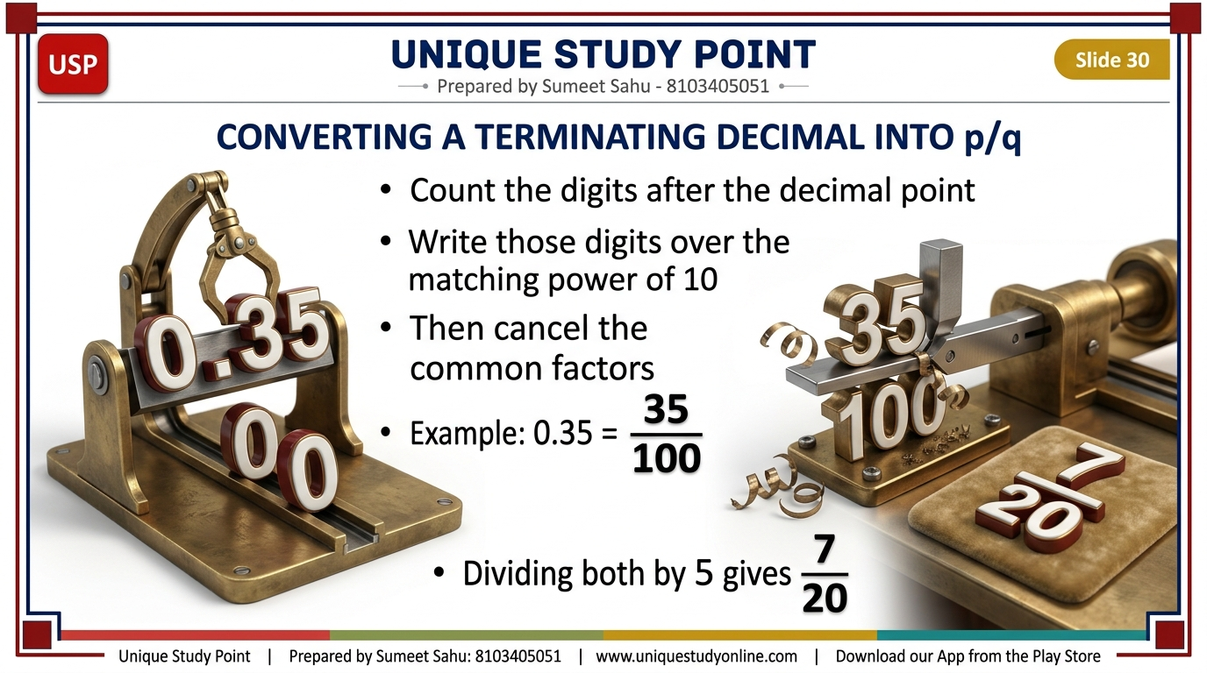
Notes:
Slide 30 - Converting a Terminating Decimal into p/q
Case 1 (terminating). Count the digits after the decimal point and write them over the matching power of 10, then cancel common factors. Example 4: 0.35 = 35/100 = 7/20.

Slide 31
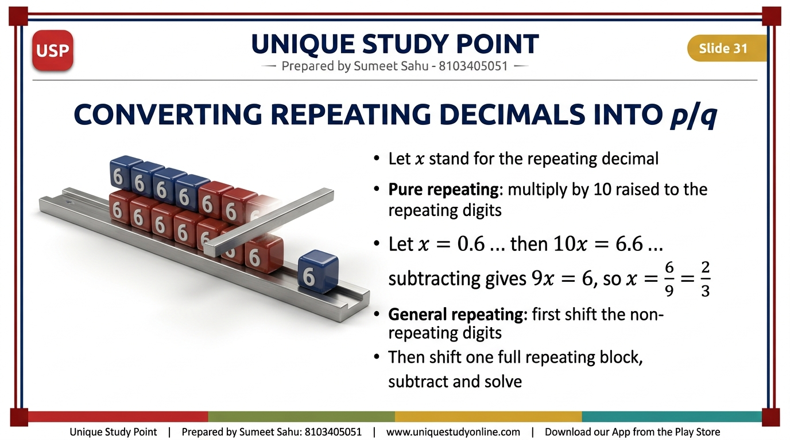
Notes:
Slide 31 - Converting Repeating Decimals into p/q
Case 2 (pure repeating): let x be the decimal, multiply by 10 to the power of the repeating digits, subtract and solve. 0.6 repeating = 6/9 = 2/3; 0.45 repeating gives 99x = 45 so x = 5/11. Case 3 (general repeating): first shift the non-repeating digits, then shift one full repeating block, subtract and solve. 0.16 repeating = 1/6; 2.357 repeating = 1061/450.

Slide 32
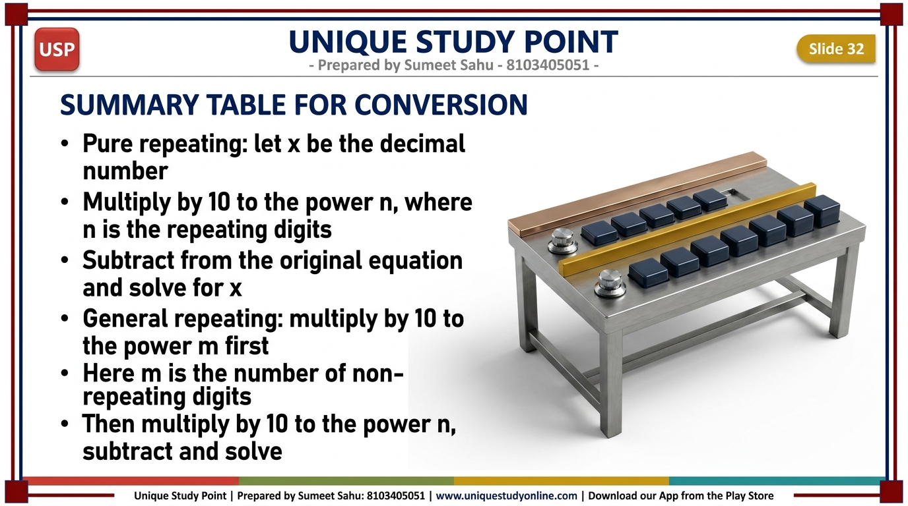
Notes:
Slide 32 - Summary Table for Conversion
Pure repeating: let x = the decimal; multiply by 10 to the power n where n = the number of repeating digits; subtract from the original equation and solve for x. General repeating: multiply by 10 to the power m where m = the number of non-repeating digits; then multiply by 10 to the power n; subtract from the previous equation and solve for x.

Slide 33
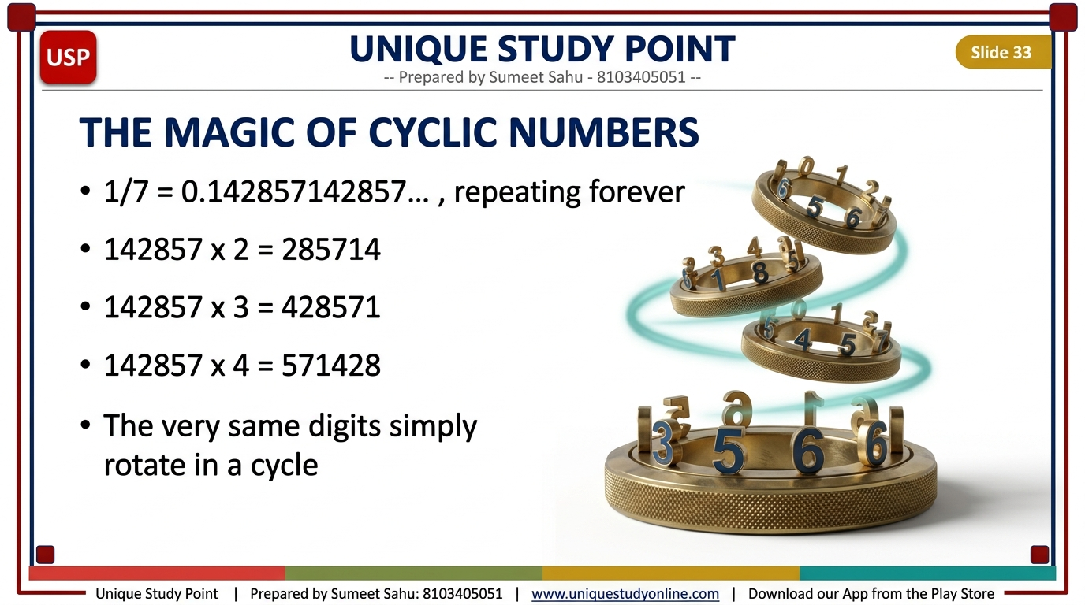
Notes:
Slide 33 - The Magic of Cyclic Numbers
1/7 = 0.142857 repeating. The block 142857 is a cyclic number: x2 = 285714, x3 = 428571, x4 = 571428, x5 = 714285, x6 = 857142. The same digits simply rotate in a cycle.

Slide 34
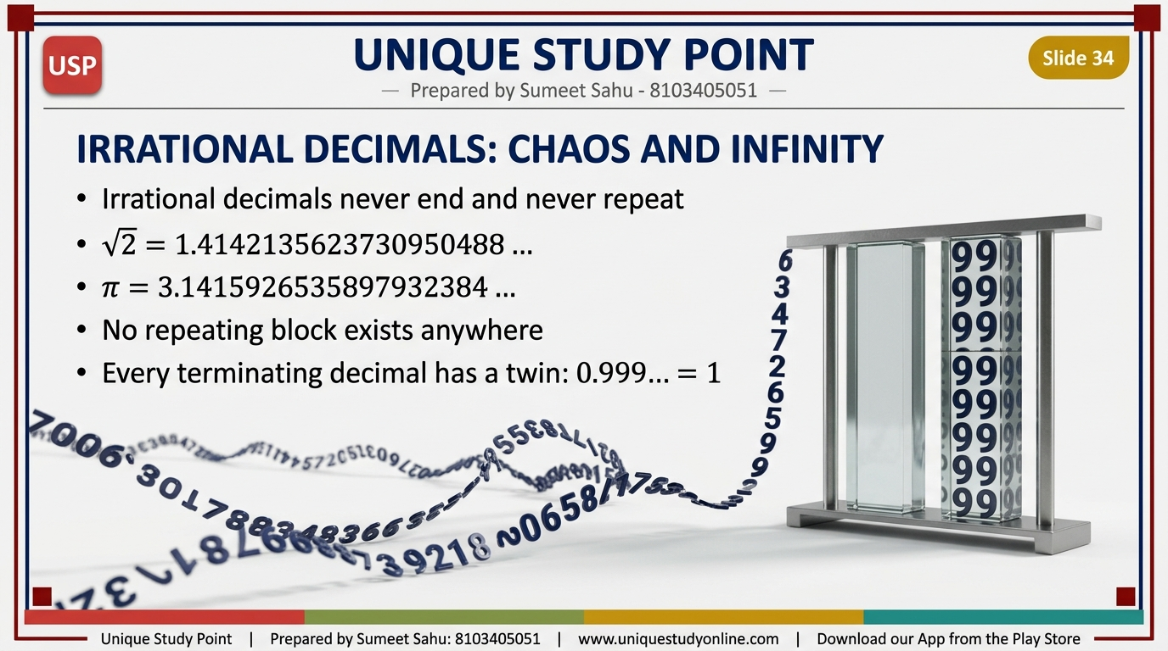
Notes:
Slide 34 - Irrational Decimals: Chaos and Infinity
Irrational decimals never end and never repeat: root 2 = 1.4142135623730950488..., pi = 3.1415926535897932384... No repeating block exists. Note also the non-uniqueness of decimals: every terminating decimal has a nines twin, so 0.999... = 1 exactly.

Slide 35
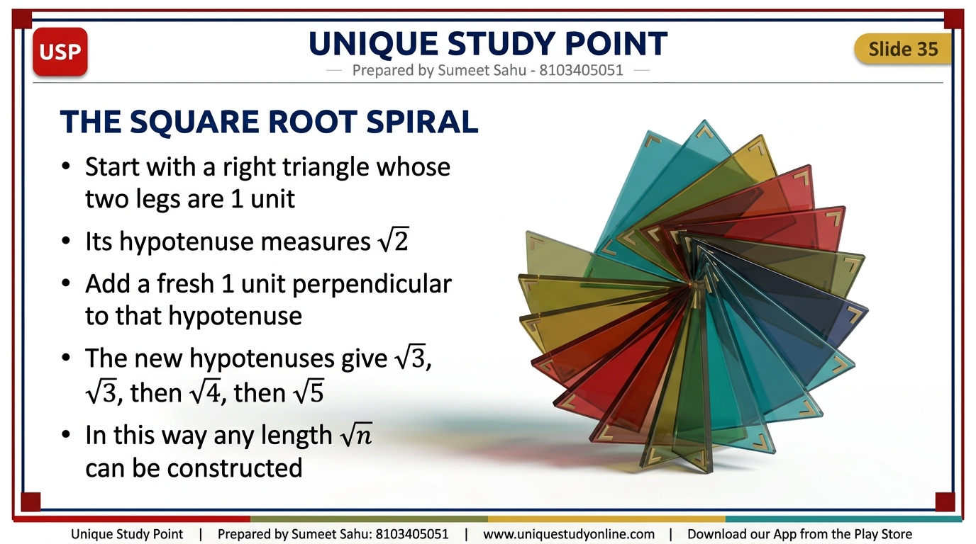
Notes:
Slide 35 - The Square Root Spiral
Start with a right triangle whose legs are both 1 unit - its hypotenuse is root 2. Add a fresh 1 unit perpendicular to that hypotenuse; the new hypotenuses give root 3, root 4, root 5, and so on. Any length root n can be constructed. (Fig. 3.14)

Slide 36
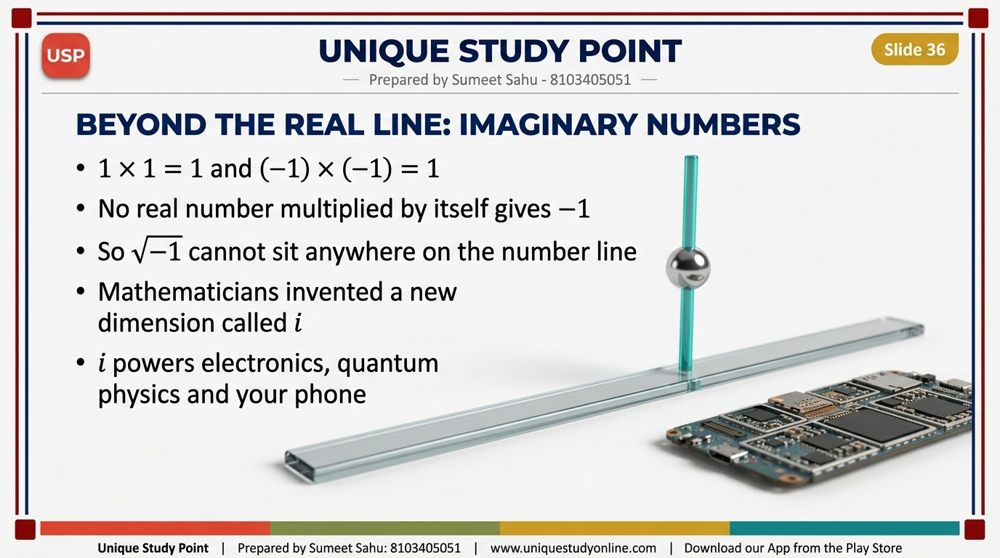
Notes:
Slide 36 - Beyond the Real Line: Imaginary Numbers
1 x 1 = 1 and (-1) x (-1) = 1, so no real number squared gives -1. Root of -1 cannot sit on the number line. Mathematicians invented a new dimension, i - the Imaginary Numbers, essential for electrical engineering, quantum mechanics and the chip in your phone.

Slide 37
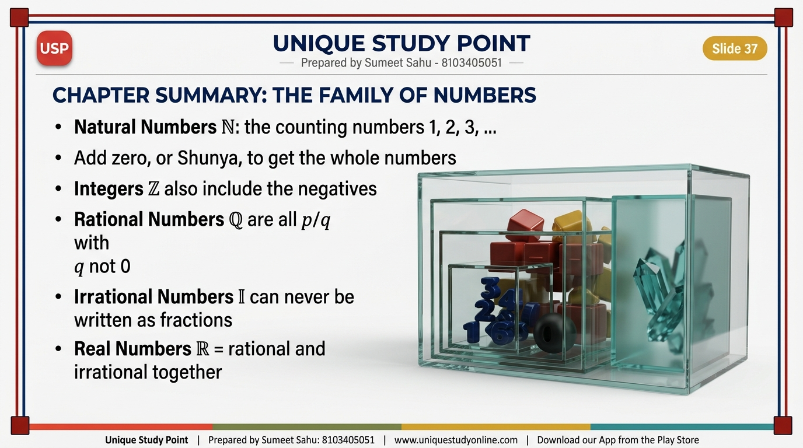
Notes:
Slide 37 - Chapter Summary: The Family of Numbers
Natural Numbers N: 1, 2, 3, ... Add zero (Shunya) for the whole numbers. Integers Z add the negatives. Rational Numbers Q are all p/q with q not 0 - terminating or repeating decimals. Irrational Numbers I can never be written as fractions. Real Numbers R = rational + irrational together.

Slide 38
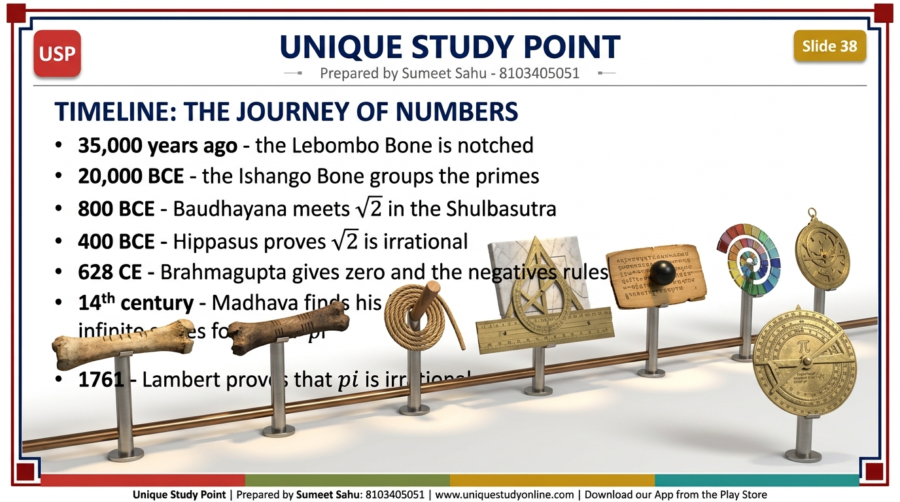
Notes:
Slide 38 - Timeline: The Journey of Numbers
35,000 years ago the Lebombo Bone is notched. 20,000 BCE the Ishango Bone groups the primes. 800 BCE Baudhayana meets root 2 in the Shulbasutra. 400 BCE Hippasus proves root 2 irrational. 628 CE Brahmagupta gives zero and the negatives their rules. 14th century Madhava finds his infinite series for pi. 1761 Lambert proves pi is irrational.

Slide 39
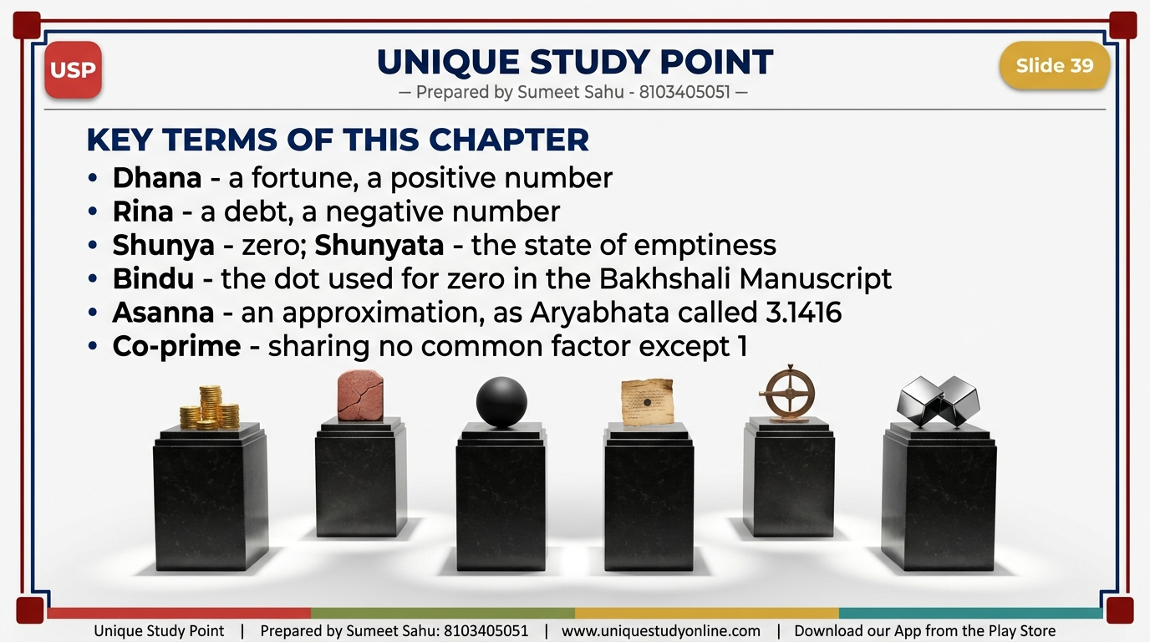
Notes:
Slide 39 - Key Terms of This Chapter
Dhana - a fortune, a positive number. Rina - a debt, a negative number. Shunya - zero; Shunyata - the state of emptiness. Bindu - the dot used for zero in the Bakhshali Manuscript. Asanna - an approximation, as Aryabhata called 3.1416. Co-prime - sharing no common factor except 1.

Slide 40
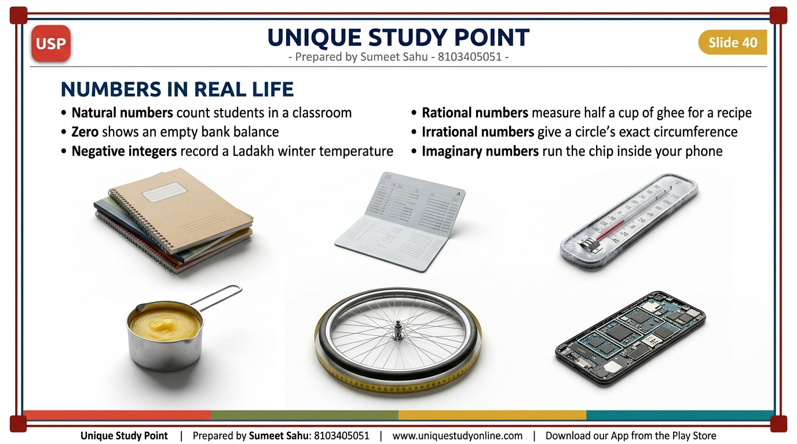
Notes:
Slide 40 - Numbers in Real Life
Natural numbers count students in a classroom. Zero shows an empty bank balance. Negative integers record a Ladakh winter temperature. Rational numbers measure half a cup of ghee. Irrational numbers give a circle's exact circumference. Imaginary numbers run the chip inside your phone.

Slide 41
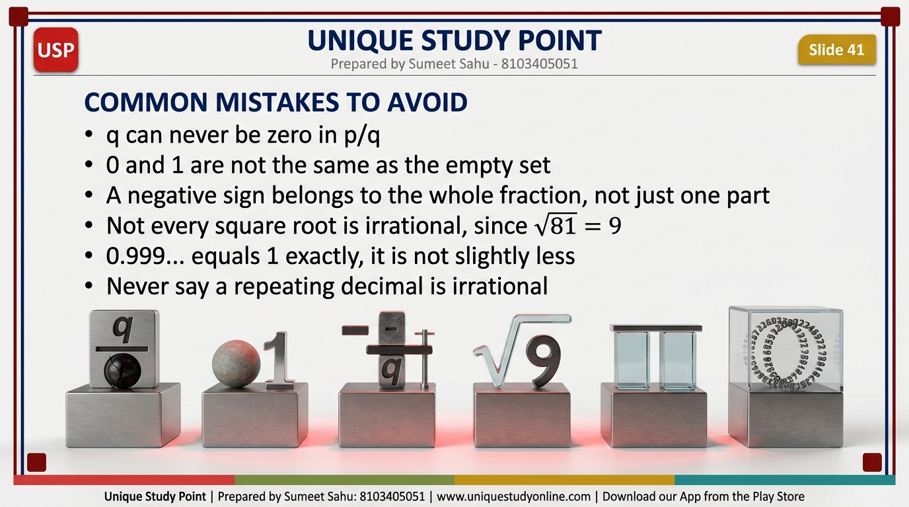
Notes:
Slide 41 - Common Mistakes to Avoid
q can never be zero in p/q. 0 and 1 are not the same as the empty set. A negative sign belongs to the whole fraction, not just one part. Not every square root is irrational - root 81 = 9. 0.999... equals 1 exactly. And never call a repeating decimal irrational.

Slide 42
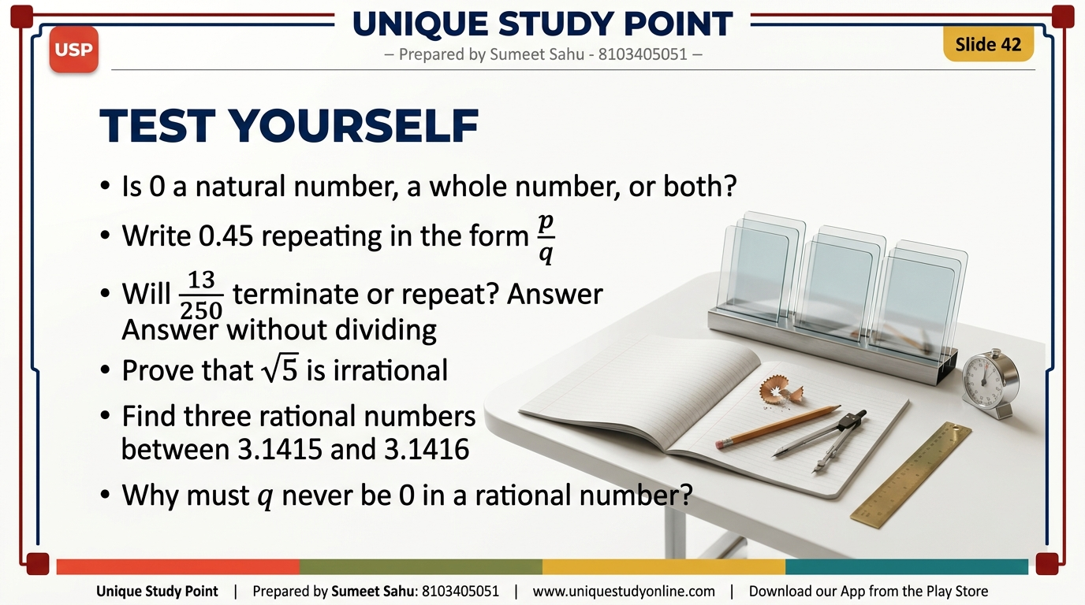
Notes:
Slide 42 - Test Yourself
Quick revision questions for the class. Discuss answers together, then assign the full Exercise Sets 3.1 to 3.5 and the End-of-Chapter Exercises from the textbook.

Slide 43

Notes:
Slide 43 - Thank You and Keep Learning
Free CBSE notes, PPTs and worksheets for Class 6 to Class 10 at www.uniquestudyonline.com. Download the Unique Study Point app from the Play Store. Prepared by Sumeet Sahu - 8103405051. Session 2026-27.

