Slide 1
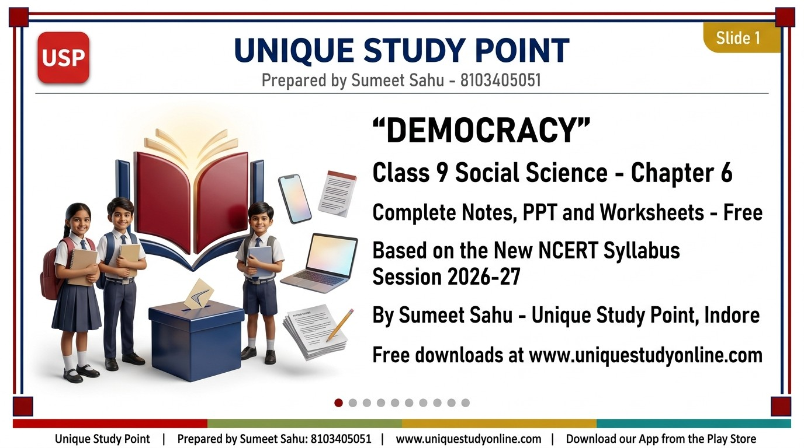
Notes:
DEMOCRACY
- Class 9 Social Science - Chapter 6
- Complete Notes, PPT and Worksheets - Free
- Based on the New NCERT Syllabus, Session 2026-27
- By Sumeet Sahu - Unique Study Point, Indore
- Free downloads at www.uniquestudyonline.com
Unique Study Point | Sumeet Sahu | 8103405051 | www.uniquestudyonline.com

Slide 2
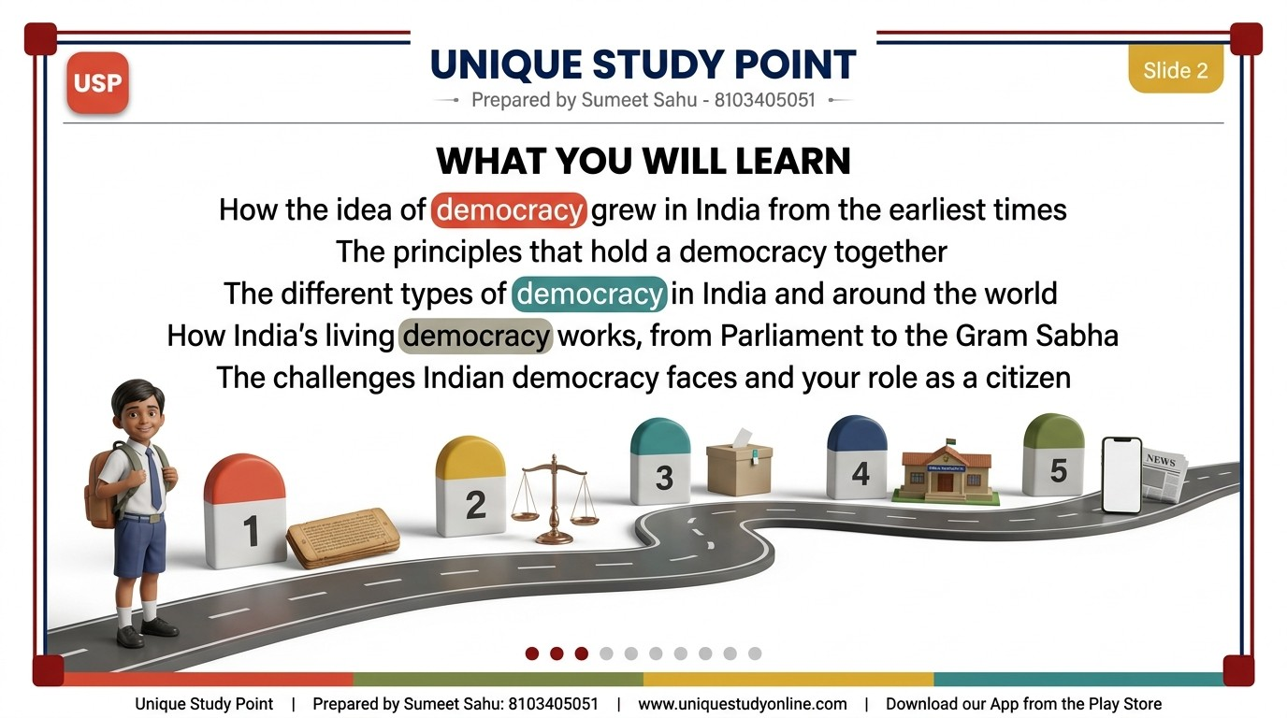
Notes:
WHAT YOU WILL LEARN
- How the idea of democracy grew in India from the earliest times
- The principles that hold a democracy together
- The different types of democracy in India and around the world
- How India's living democracy works, from Parliament to the Gram Sabha
- The challenges Indian democracy faces and your role as a citizen
Unique Study Point | Sumeet Sahu | 8103405051 | www.uniquestudyonline.com

Slide 3
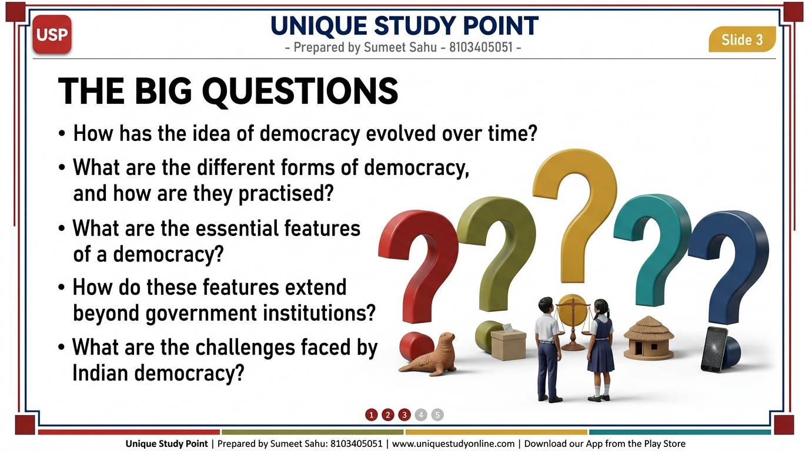
Notes:
THE BIG QUESTIONS
- How has the idea of democracy evolved over time?
- What are the different forms of democracy, and how are they practised?
- What are the essential features of a democracy?
- How do these features extend beyond government institutions?
- What are the challenges faced by Indian democracy?
Unique Study Point | Sumeet Sahu | 8103405051 | www.uniquestudyonline.com

Slide 4
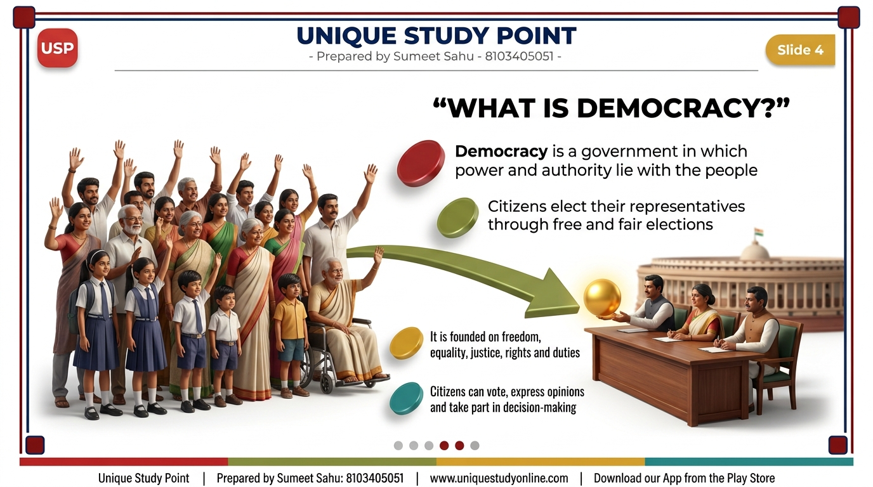
Notes:
WHAT IS DEMOCRACY?
- Democracy is a government in which power and authority lie with the people
- Citizens elect their representatives through free and fair elections
- It is founded on freedom, equality, justice, rights and duties
- Citizens can vote, express opinions and take part in decision-making
Unique Study Point | Sumeet Sahu | 8103405051 | www.uniquestudyonline.com

Slide 5
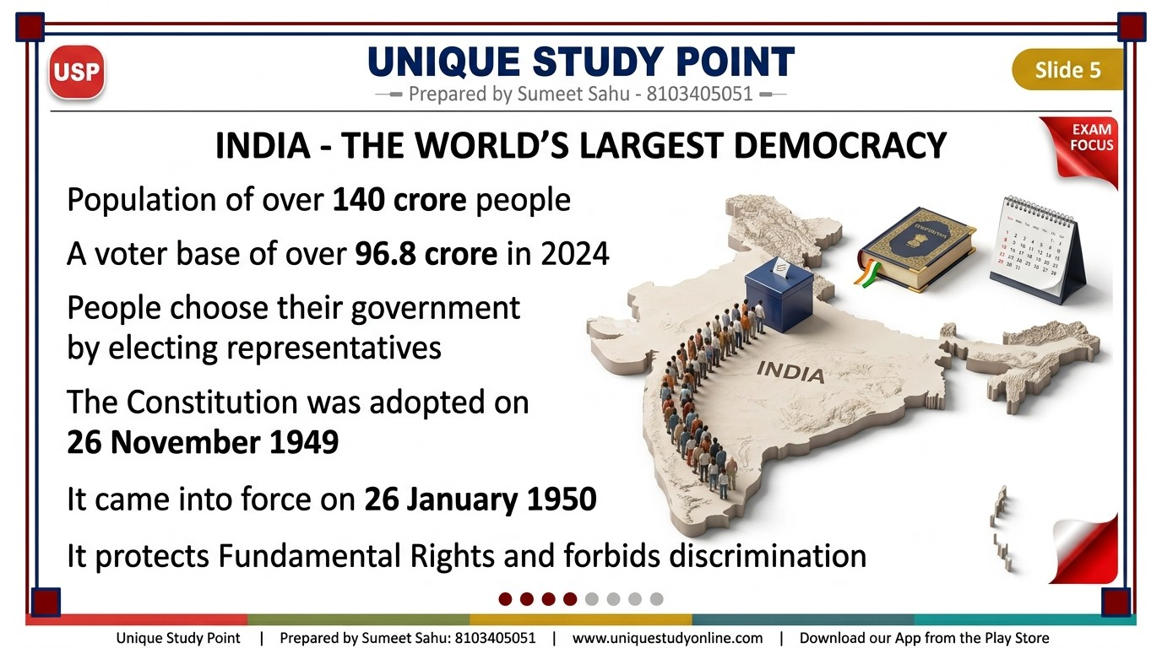
Notes:
INDIA - THE WORLD'S LARGEST DEMOCRACY
- Population of over 140 crore people
- A voter base of over 96.8 crore in 2024
- People choose their government by electing representatives
- The Constitution was adopted on 26 November 1949
- It came into force on 26 January 1950
- It protects Fundamental Rights and forbids discrimination
Unique Study Point | Sumeet Sahu | 8103405051 | www.uniquestudyonline.com

Slide 6
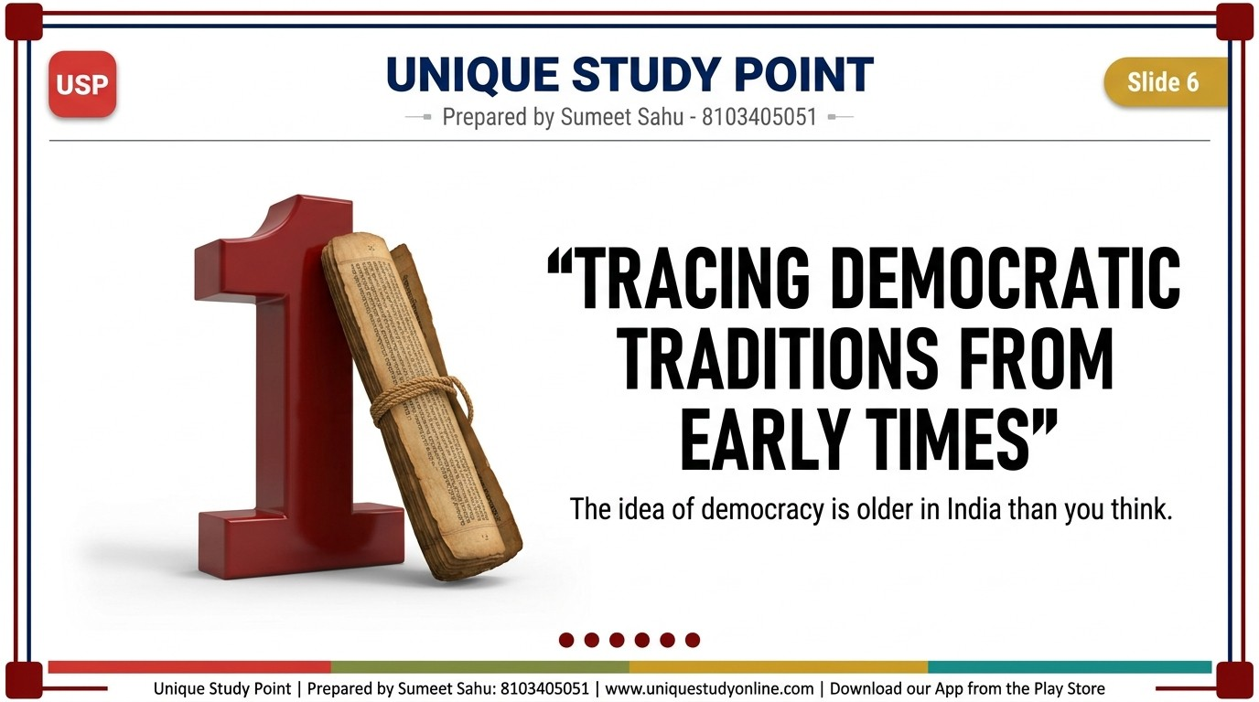
Notes:
TRACING DEMOCRATIC TRADITIONS FROM EARLY TIMES
- A huge solid 3D numeral standing beside the title, reading: 1
- One line below the title, smaller: The idea of democracy is older in India than you think
Unique Study Point | Sumeet Sahu | 8103405051 | www.uniquestudyonline.com

Slide 7
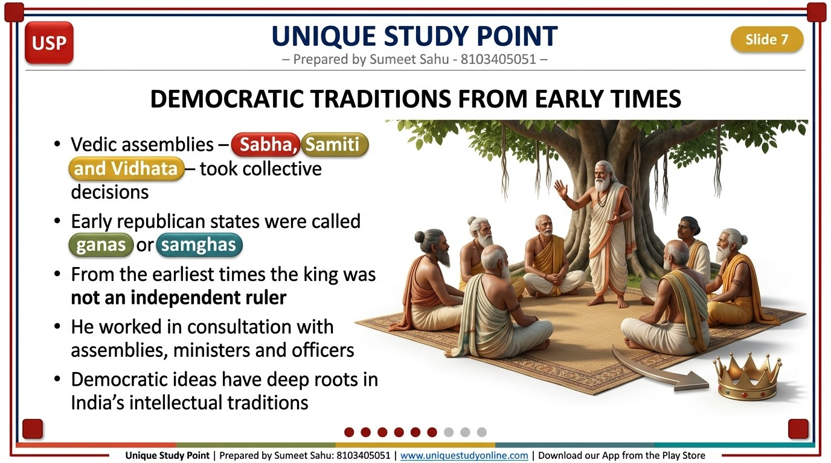
Notes:
DEMOCRATIC TRADITIONS FROM EARLY TIMES
- Vedic assemblies - Sabha, Samiti and Vidhata - took collective decisions
- Early republican states were called ganas or samghas
- From the earliest times the king was not an independent ruler
- He worked in consultation with assemblies, ministers and officers
- Democratic ideas have deep roots in India's intellectual traditions
Unique Study Point | Sumeet Sahu | 8103405051 | www.uniquestudyonline.com

Slide 8
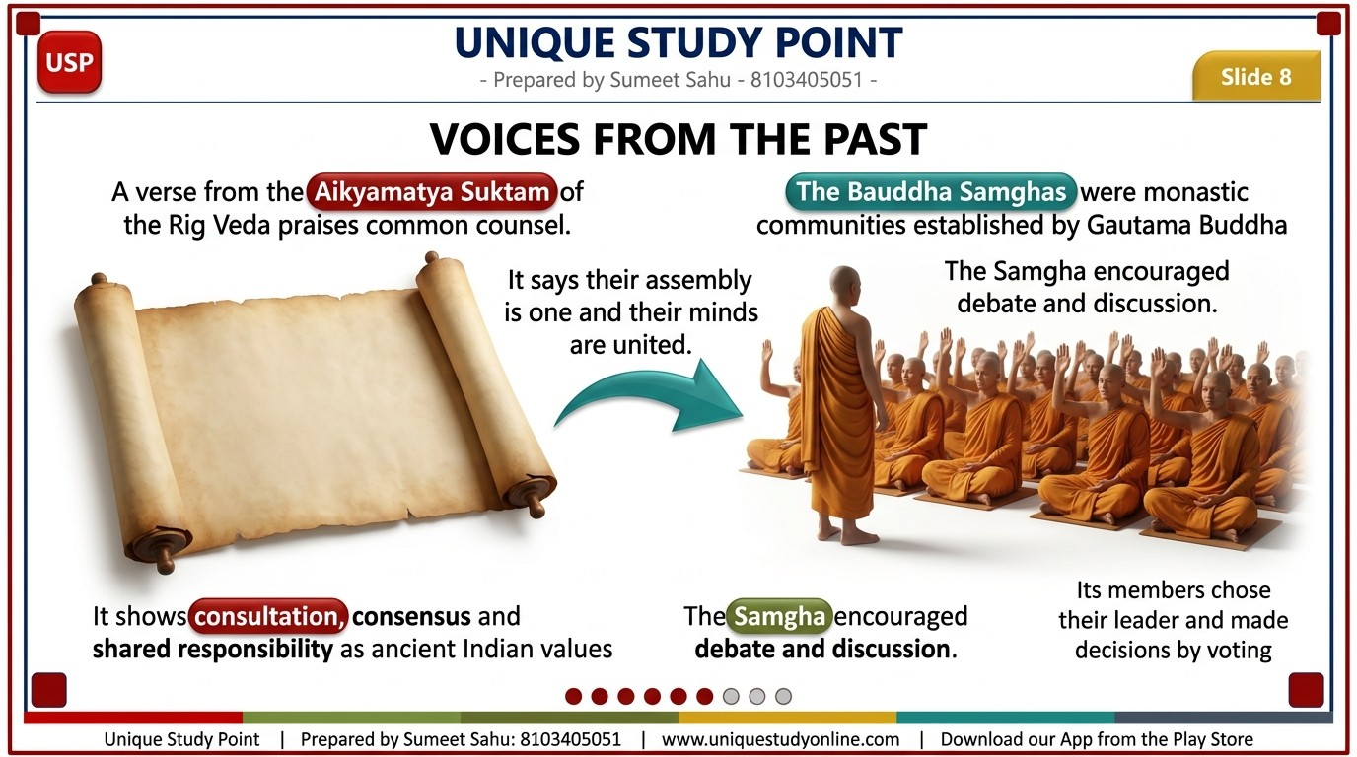
Notes:
VOICES FROM THE PAST
- A verse from the Aikyamatya Suktam of the Rig Veda praises common counsel
- It says their assembly is one and their minds are united
- It shows consultation, consensus and shared responsibility as ancient Indian values
- The Bauddha Samghas were monastic communities established by Gautama Buddha
- The Samgha encouraged debate and discussion
- Its members chose their leader and made decisions by voting
Unique Study Point | Sumeet Sahu | 8103405051 | www.uniquestudyonline.com

Slide 9
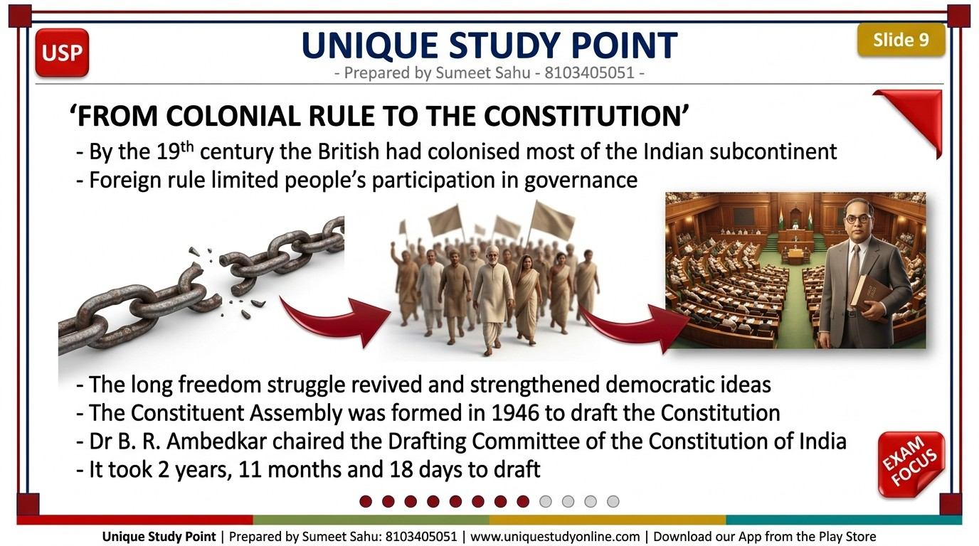
Notes:
FROM COLONIAL RULE TO THE CONSTITUTION
- By the 19th century the British had colonised most of the Indian subcontinent
- Foreign rule limited people's participation in governance
- The long freedom struggle revived and strengthened democratic ideas
- The Constituent Assembly was formed in 1946 to draft the Constitution
- Dr B. R. Ambedkar chaired the Drafting Committee of the Constitution of India
- It took 2 years, 11 months and 18 days to draft
Unique Study Point | Sumeet Sahu | 8103405051 | www.uniquestudyonline.com

Slide 10
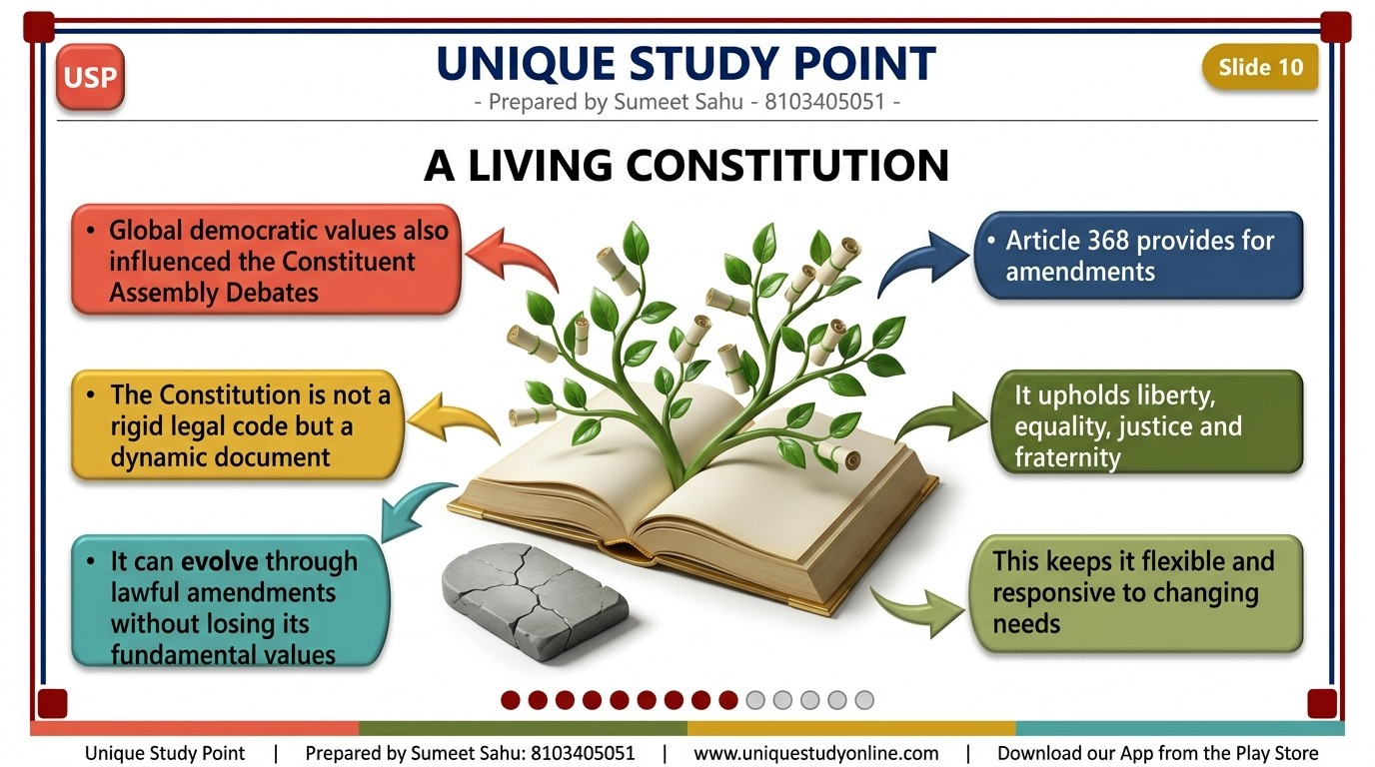
Notes:
A LIVING CONSTITUTION
- Global democratic values also influenced the Constituent Assembly Debates
- The Constitution is not a rigid legal code but a dynamic document
- It can evolve through lawful amendments without losing its fundamental values
- Article 368 provides for amendments
- It upholds liberty, equality, justice and fraternity
- This keeps it flexible and responsive to changing needs
Unique Study Point | Sumeet Sahu | 8103405051 | www.uniquestudyonline.com

Slide 11
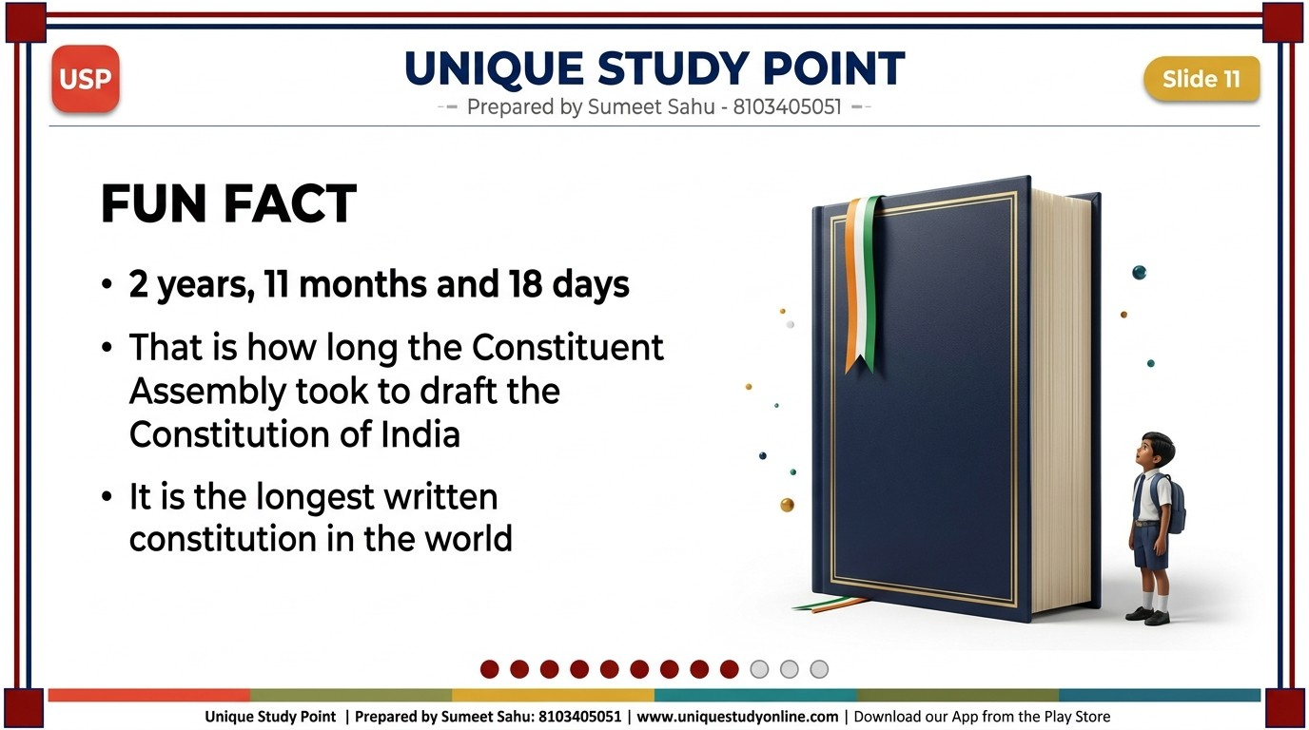
Notes:
FUN FACT
- 2 years, 11 months and 18 days
- That is how long the Constituent Assembly took to draft the Constitution of India
- It is the longest written constitution in the world
Unique Study Point | Sumeet Sahu | 8103405051 | www.uniquestudyonline.com

Slide 12

Notes:
PRINCIPLES OF DEMOCRACY
- A huge solid 3D numeral standing beside the title, reading: 2
- One line below the title, smaller: The non-negotiable rules that hold a democracy together
Unique Study Point | Sumeet Sahu | 8103405051 | www.uniquestudyonline.com

Slide 13
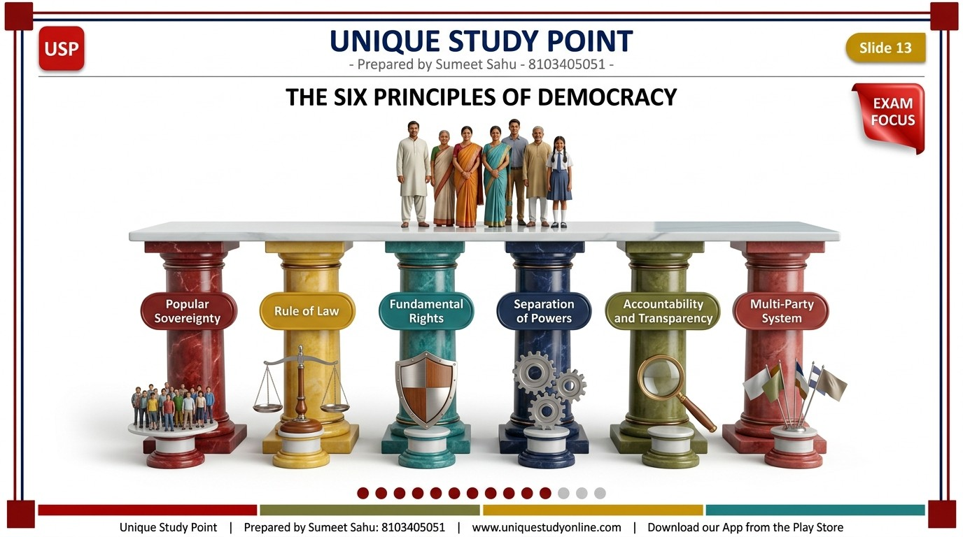
Notes:
THE SIX PRINCIPLES OF DEMOCRACY
- Popular Sovereignty
- Rule of Law
- Fundamental Rights
- Separation of Powers
- Accountability and Transparency
- Multi-Party System
Unique Study Point | Sumeet Sahu | 8103405051 | www.uniquestudyonline.com

Slide 14
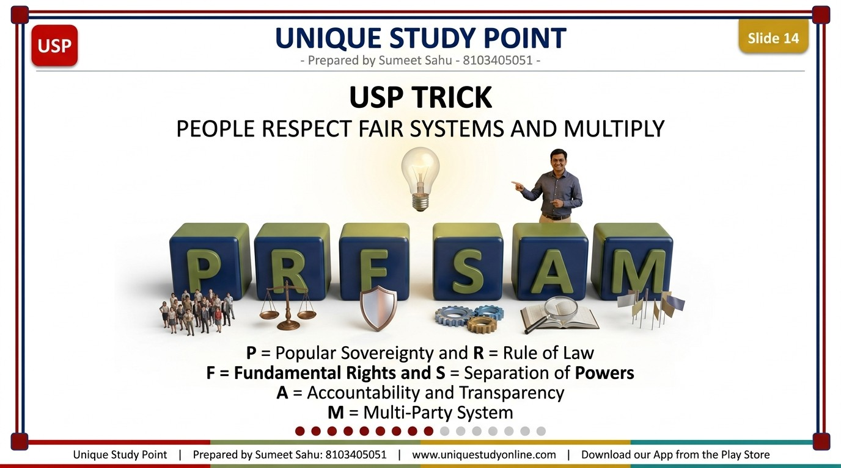
Notes:
USP TRICK
- PEOPLE RESPECT FAIR SYSTEMS AND MULTIPLY
- P = Popular Sovereignty and R = Rule of Law
- F = Fundamental Rights and S = Separation of Powers
- A = Accountability and Transparency
- M = Multi-Party System
Unique Study Point | Sumeet Sahu | 8103405051 | www.uniquestudyonline.com

Slide 15
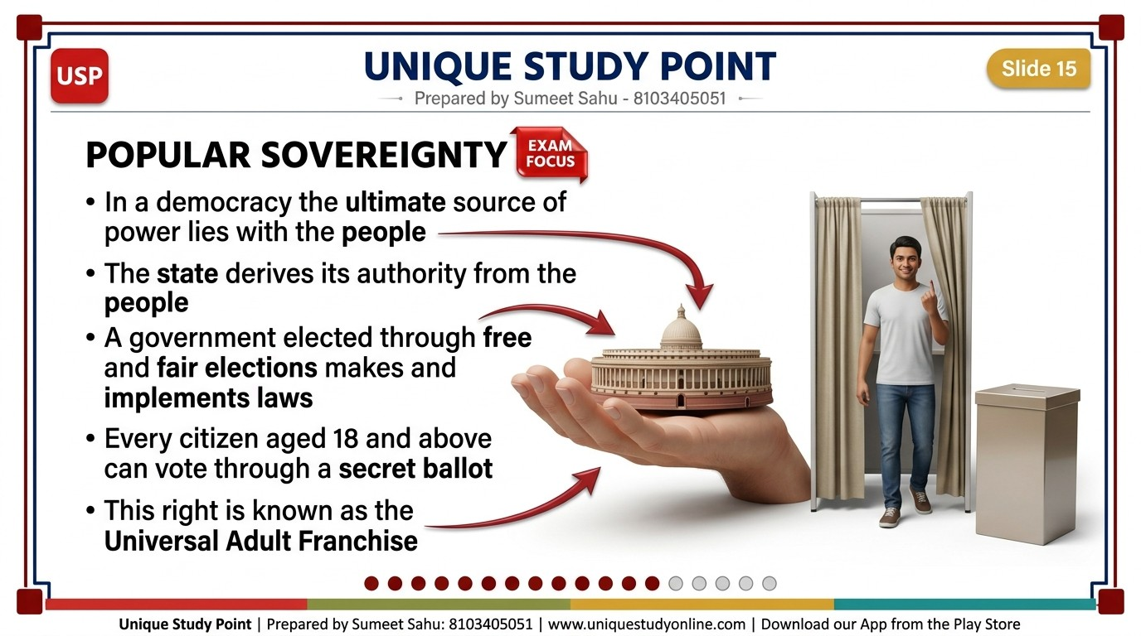
Notes:
POPULAR SOVEREIGNTY
- In a democracy the ultimate source of power lies with the people
- The state derives its authority from the people
- A government elected through free and fair elections makes and implements laws
- Every citizen aged 18 and above can vote through a secret ballot
- This right is known as the Universal Adult Franchise
Unique Study Point | Sumeet Sahu | 8103405051 | www.uniquestudyonline.com

Slide 16
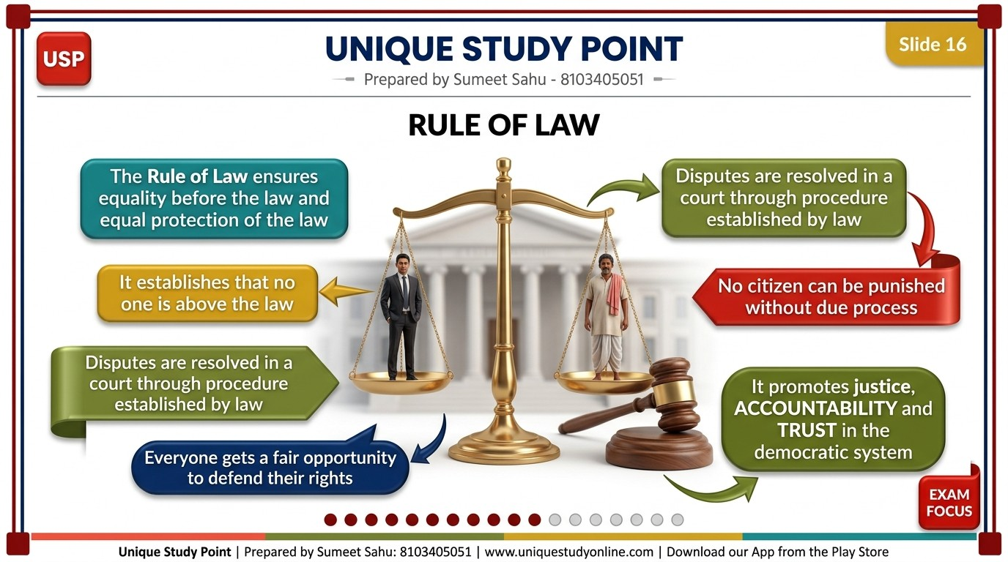
Notes:
RULE OF LAW
- The Rule of Law ensures equality before the law and equal protection of the law
- It establishes that no one is above the law
- Disputes are resolved in a court through procedure established by law
- No citizen can be punished without due process
- Everyone gets a fair opportunity to defend their rights
- It promotes justice, accountability and trust in the democratic system
Unique Study Point | Sumeet Sahu | 8103405051 | www.uniquestudyonline.com

Slide 17
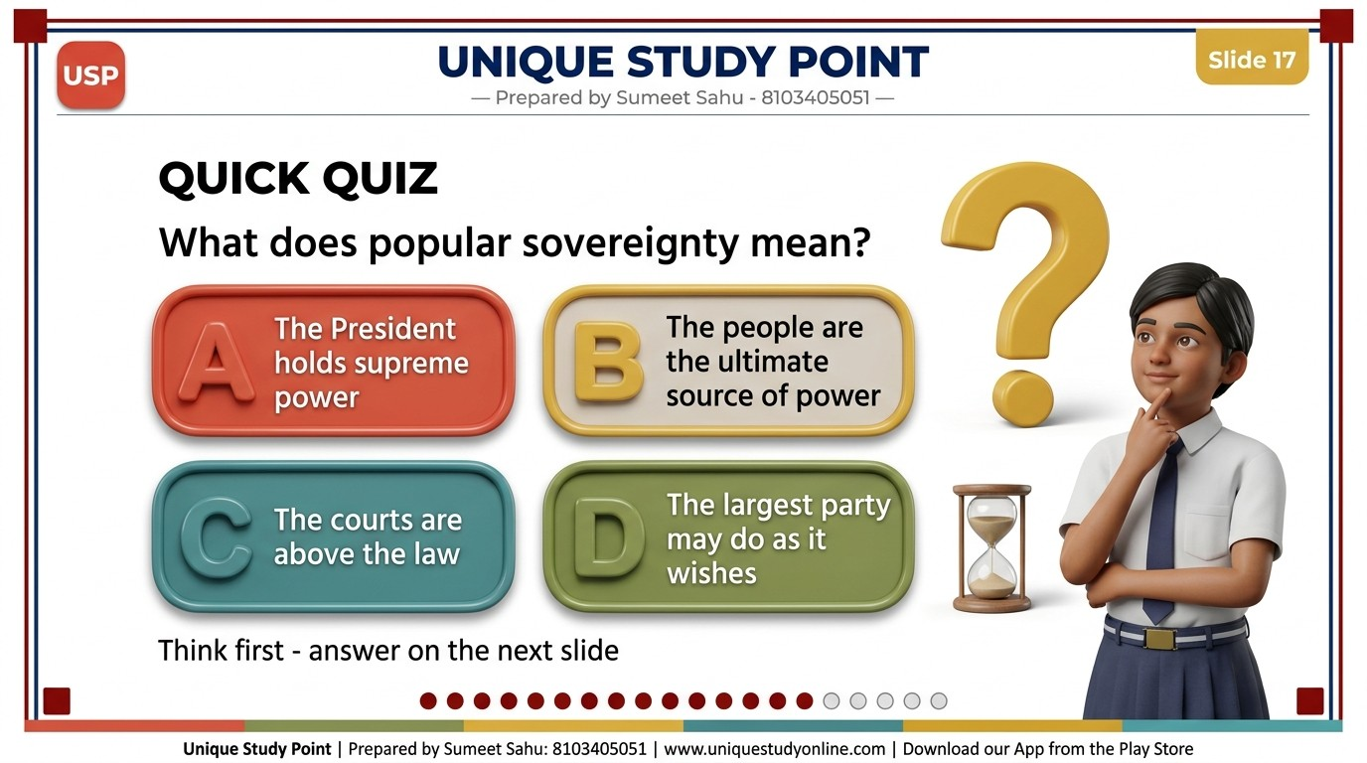
Notes:
QUICK QUIZ
- What does popular sovereignty mean?
- A. The President holds supreme power
- B. The people are the ultimate source of power
- C. The courts are above the law
- D. The largest party may do as it wishes
- One line at the bottom, smaller: Think first - answer on the next slide
Unique Study Point | Sumeet Sahu | 8103405051 | www.uniquestudyonline.com

Slide 18
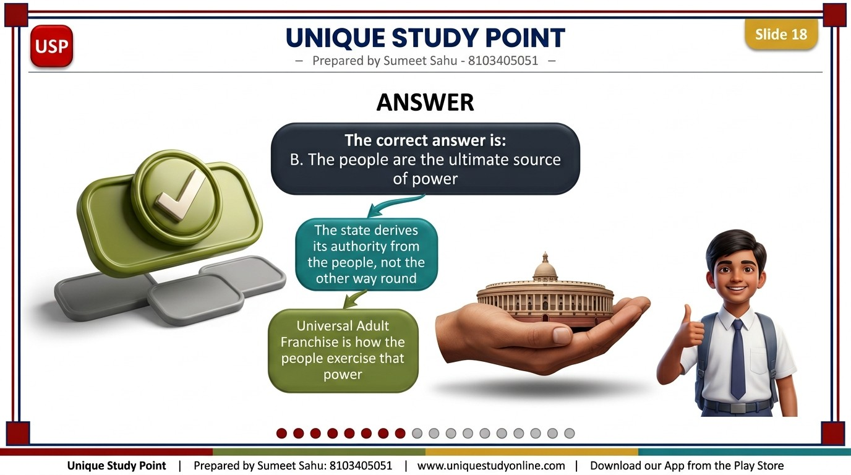
Notes:
ANSWER
- The correct answer is: B. The people are the ultimate source of power
- The state derives its authority from the people, not the other way round
- Universal Adult Franchise is how the people exercise that power
Unique Study Point | Sumeet Sahu | 8103405051 | www.uniquestudyonline.com

Slide 19
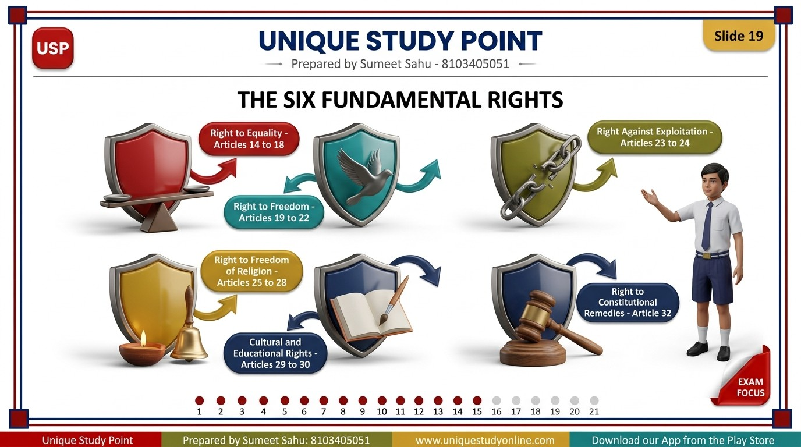
Notes:
THE SIX FUNDAMENTAL RIGHTS
- Right to Equality - Articles 14 to 18
- Right to Freedom - Articles 19 to 22
- Right Against Exploitation - Articles 23 to 24
- Right to Freedom of Religion - Articles 25 to 28
- Cultural and Educational Rights - Articles 29 to 30
- Right to Constitutional Remedies - Article 32
Unique Study Point | Sumeet Sahu | 8103405051 | www.uniquestudyonline.com

Slide 20
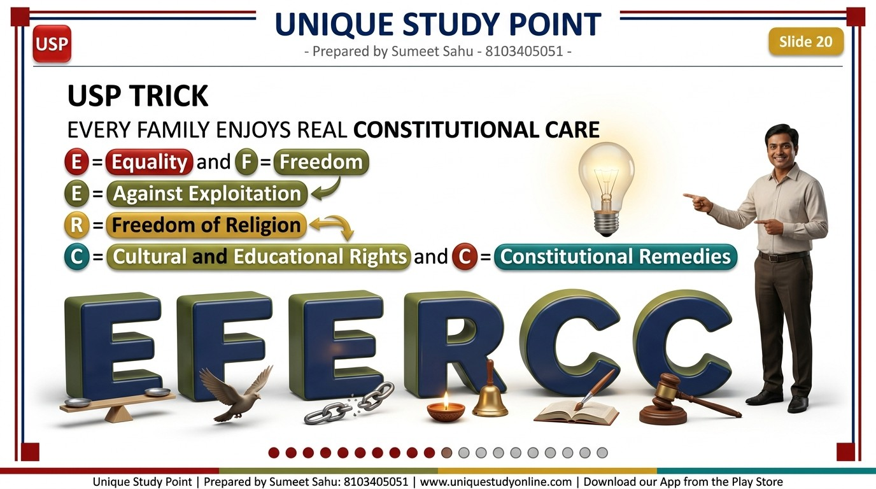
Notes:
USP TRICK
- EVERY FAMILY ENJOYS REAL CONSTITUTIONAL CARE
- E = Equality and F = Freedom
- E = Against Exploitation
- R = Freedom of Religion
- C = Cultural and Educational Rights and C = Constitutional Remedies
Unique Study Point | Sumeet Sahu | 8103405051 | www.uniquestudyonline.com

Slide 21
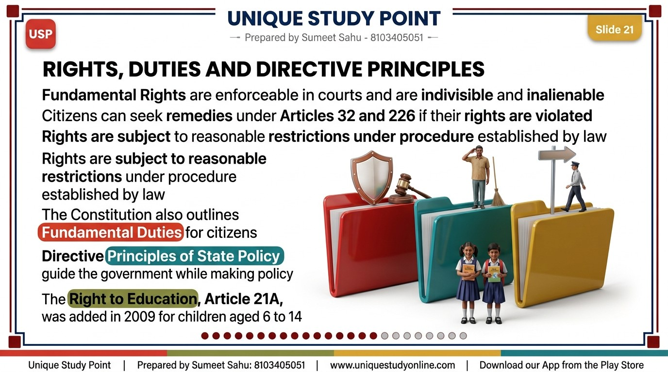
Notes:
RIGHTS, DUTIES AND DIRECTIVE PRINCIPLES
- Fundamental Rights are enforceable in courts and are indivisible and inalienable
- Citizens can seek remedies under Articles 32 and 226 if their rights are violated
- Rights are subject to reasonable restrictions under procedure established by law
- The Constitution also outlines Fundamental Duties for citizens
- Directive Principles of State Policy guide the government while making policy
- The Right to Education, Article 21A, was added in 2009 for children aged 6 to 14
Unique Study Point | Sumeet Sahu | 8103405051 | www.uniquestudyonline.com

Slide 22
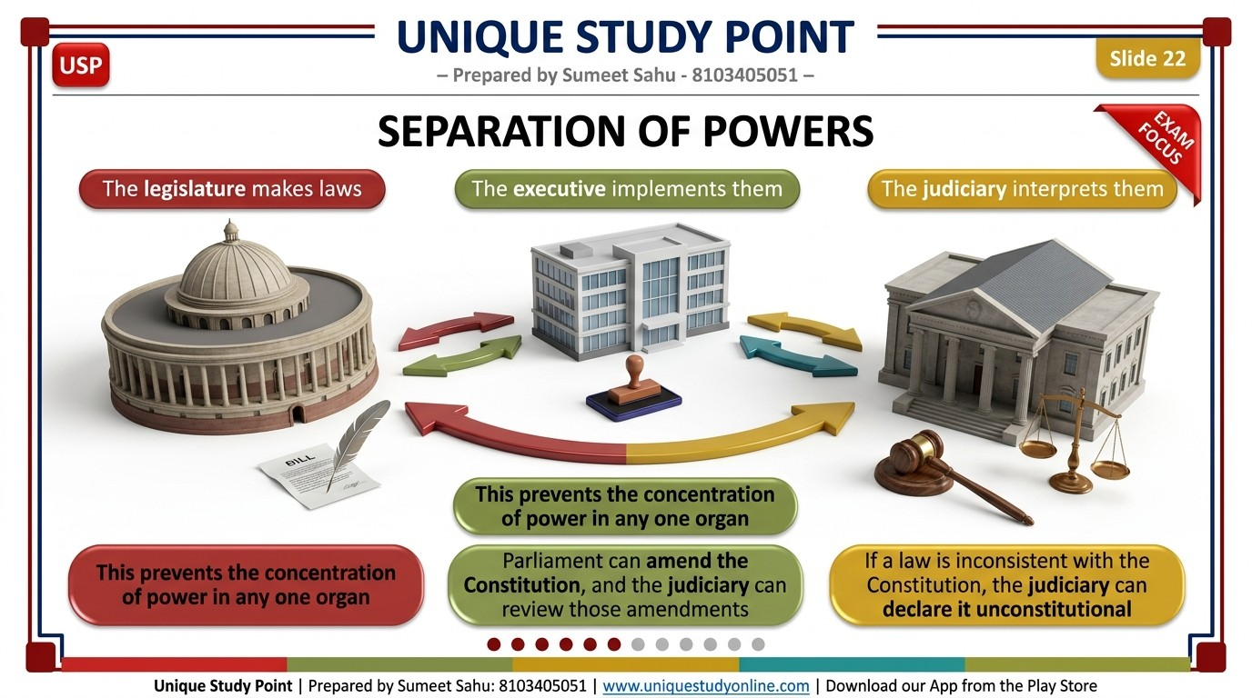
Notes:
SEPARATION OF POWERS
- The legislature makes laws
- The executive implements them
- The judiciary interprets them
- This prevents the concentration of power in any one organ
- Parliament can amend the Constitution, and the judiciary can review those amendments
- If a law is inconsistent with the Constitution, the judiciary can declare it unconstitutional
Unique Study Point | Sumeet Sahu | 8103405051 | www.uniquestudyonline.com

Slide 23
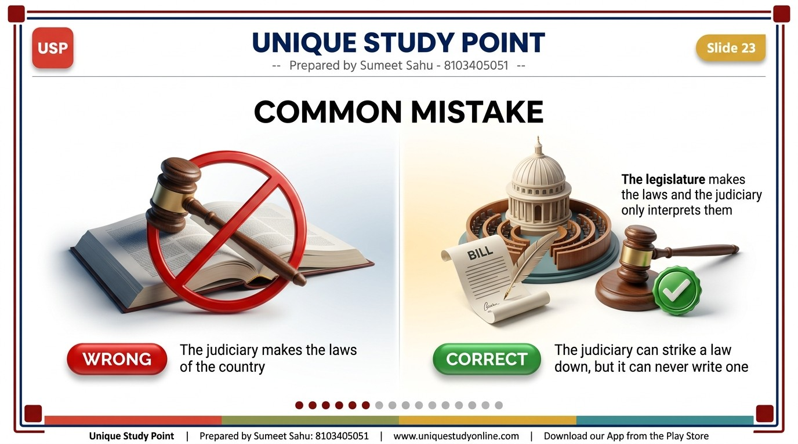
Notes:
COMMON MISTAKE
- Inside a red 3D chip, the words: WRONG
- The judiciary makes the laws of the country
- Inside a green 3D chip, the words: CORRECT
- The legislature makes the laws and the judiciary only interprets them
- The judiciary can strike a law down, but it can never write one
Unique Study Point | Sumeet Sahu | 8103405051 | www.uniquestudyonline.com

Slide 24
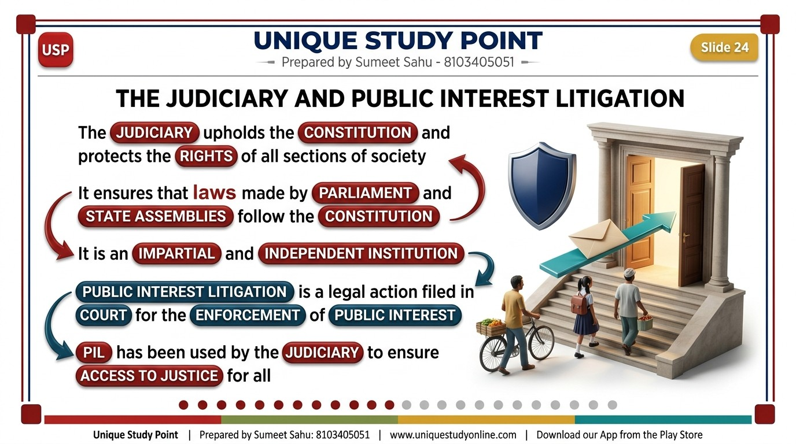
Notes:
THE JUDICIARY AND PUBLIC INTEREST LITIGATION
- The judiciary upholds the Constitution and protects the rights of all sections of society
- It ensures that laws made by Parliament and State Assemblies follow the Constitution
- It is an impartial and independent institution
- Public Interest Litigation is a legal action filed in court for the enforcement of public interest
- PIL has been used by the judiciary to ensure access to justice for all
Unique Study Point | Sumeet Sahu | 8103405051 | www.uniquestudyonline.com

Slide 25
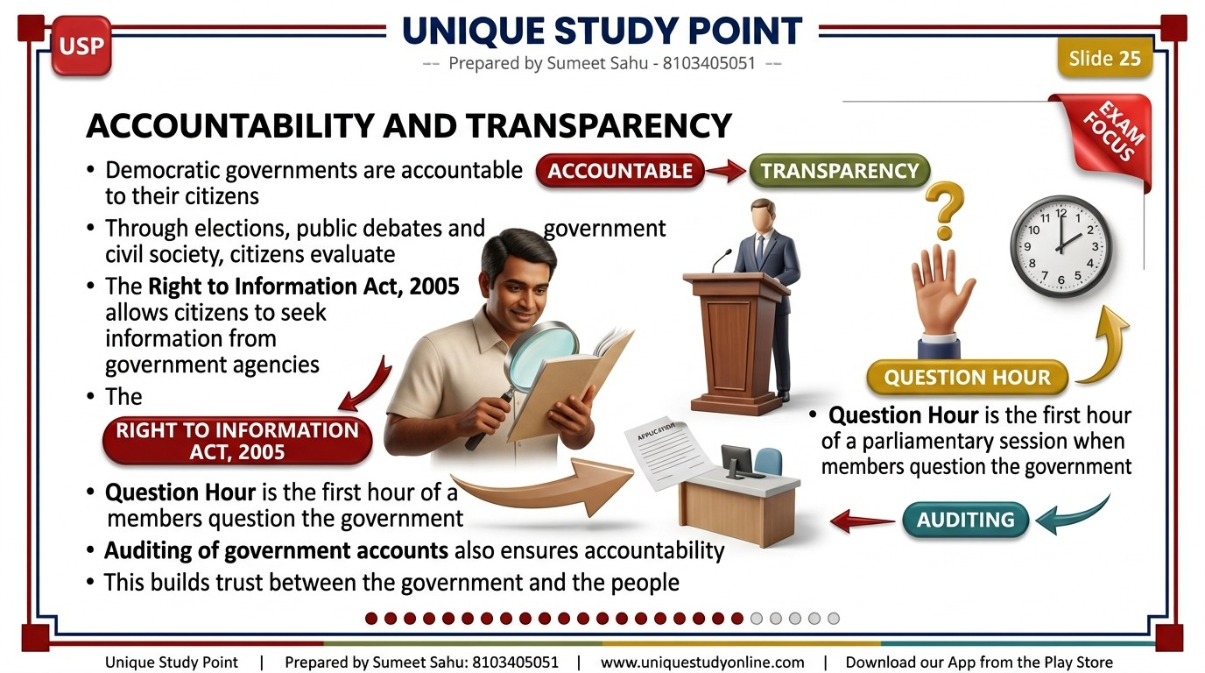
Notes:
ACCOUNTABILITY AND TRANSPARENCY
- Democratic governments are accountable to their citizens
- Through elections, public debates and civil society, citizens evaluate the government
- The Right to Information Act, 2005 allows citizens to seek information from government agencies
- Question Hour is the first hour of a parliamentary session when members question the government
- Auditing of government accounts also ensures accountability
- This builds trust between the government and the people
Unique Study Point | Sumeet Sahu | 8103405051 | www.uniquestudyonline.com

Slide 26
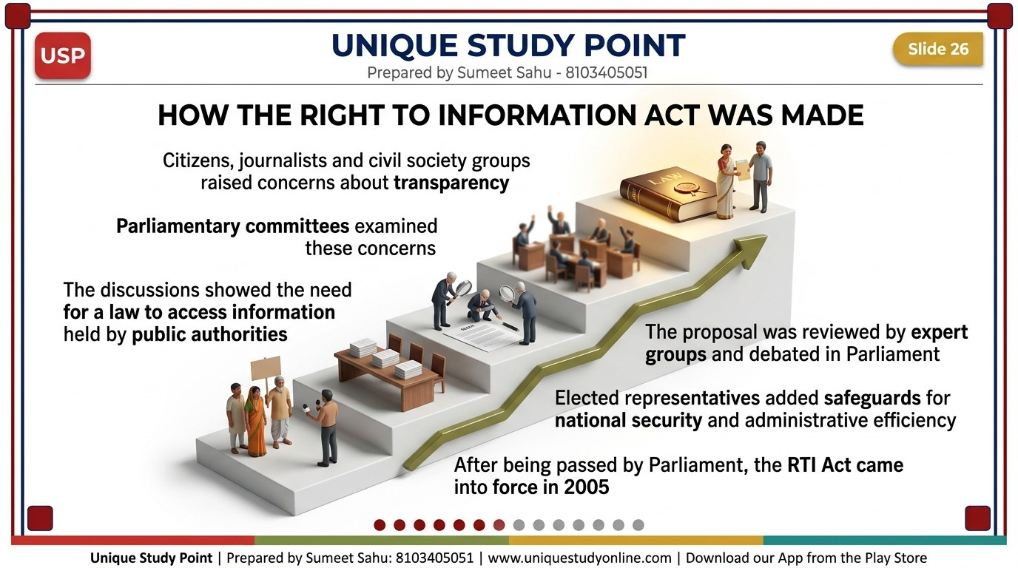
Notes:
HOW THE RIGHT TO INFORMATION ACT WAS MADE
- Citizens, journalists and civil society groups raised concerns about transparency
- Parliamentary committees examined these concerns
- The discussions showed the need for a law to access information held by public authorities
- The proposal was reviewed by expert groups and debated in Parliament
- Elected representatives added safeguards for national security and administrative efficiency
- After being passed by Parliament, the RTI Act came into force in 2005
Unique Study Point | Sumeet Sahu | 8103405051 | www.uniquestudyonline.com

Slide 27
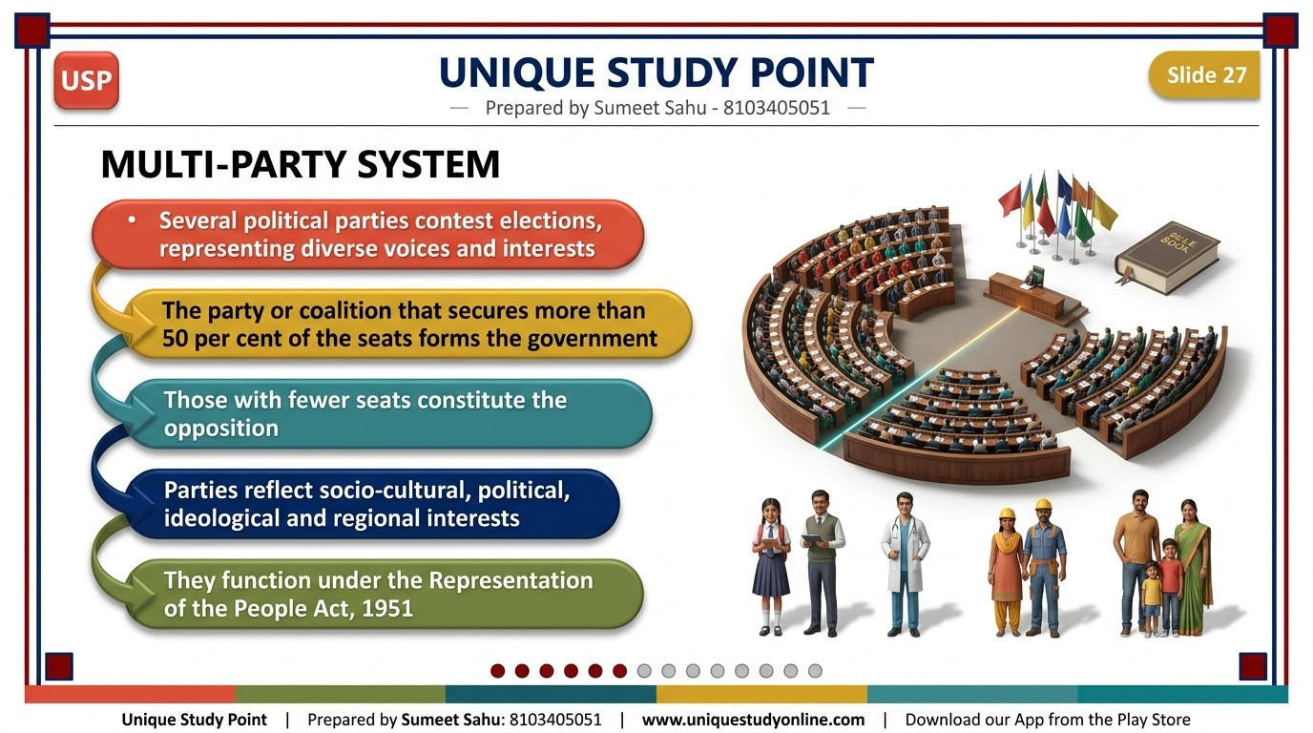
Notes:
MULTI-PARTY SYSTEM
- Several political parties contest elections, representing diverse voices and interests
- The party or coalition that secures more than 50 per cent of the seats forms the government
- Those with fewer seats constitute the opposition
- Parties reflect socio-cultural, political, ideological and regional interests
- They function under the Representation of the People Act, 1951
Unique Study Point | Sumeet Sahu | 8103405051 | www.uniquestudyonline.com

Slide 28
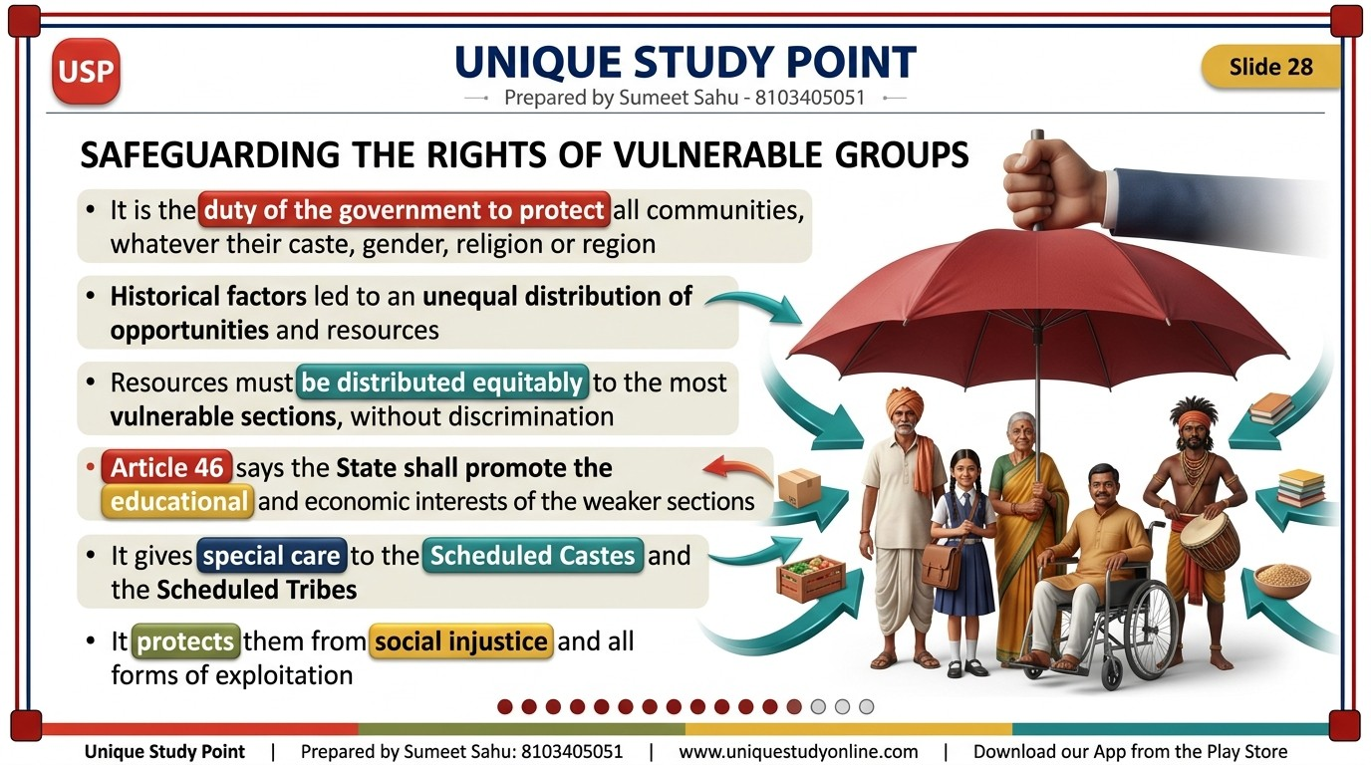
Notes:
SAFEGUARDING THE RIGHTS OF VULNERABLE GROUPS
- It is the duty of the government to protect all communities, whatever their caste, gender, religion or region
- Historical factors led to an unequal distribution of opportunities and resources
- Resources must be distributed equitably to the most vulnerable sections, without discrimination
- Article 46 says the State shall promote the educational and economic interests of the weaker sections
- It gives special care to the Scheduled Castes and the Scheduled Tribes
- It protects them from social injustice and all forms of exploitation
Unique Study Point | Sumeet Sahu | 8103405051 | www.uniquestudyonline.com

Slide 29
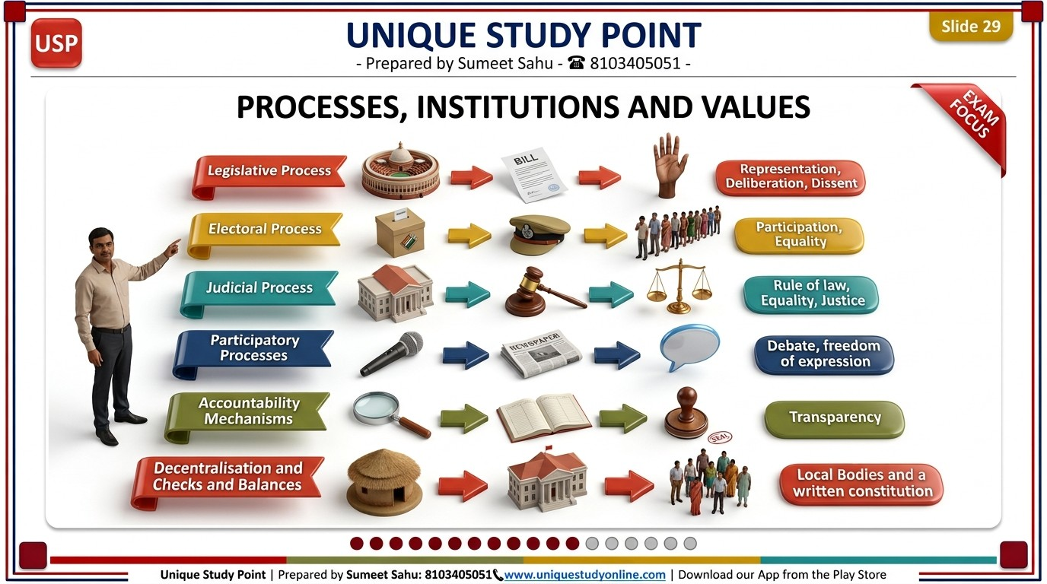
Notes:
PROCESSES, INSTITUTIONS AND VALUES
- Legislative Process - Legislature - Representation, Deliberation, Dissent
- Electoral Process - Election Commission of India - Participation, Equality
- Judicial Process - Courts - Rule of law, Equality, Justice
- Participatory Processes - Media and Civil Society - Debate, freedom of expression
- Accountability Mechanisms - CAG, CIC, Lokpal, CVC - Transparency
- Decentralisation and Checks and Balances - Local bodies and a written constitution
Unique Study Point | Sumeet Sahu | 8103405051 | www.uniquestudyonline.com

Slide 30

Notes:
WANT THE FULL NOTES - FREE?
- Complete Notes, PPT and Worksheets for this chapter
- Free PDF download - no login needed
- Classes 6 to 10 - New NCERT Syllabus 2026-27
- Visit www.uniquestudyonline.com
- Download our App from the Google Play Store
Unique Study Point | Sumeet Sahu | 8103405051 | www.uniquestudyonline.com

Slide 31
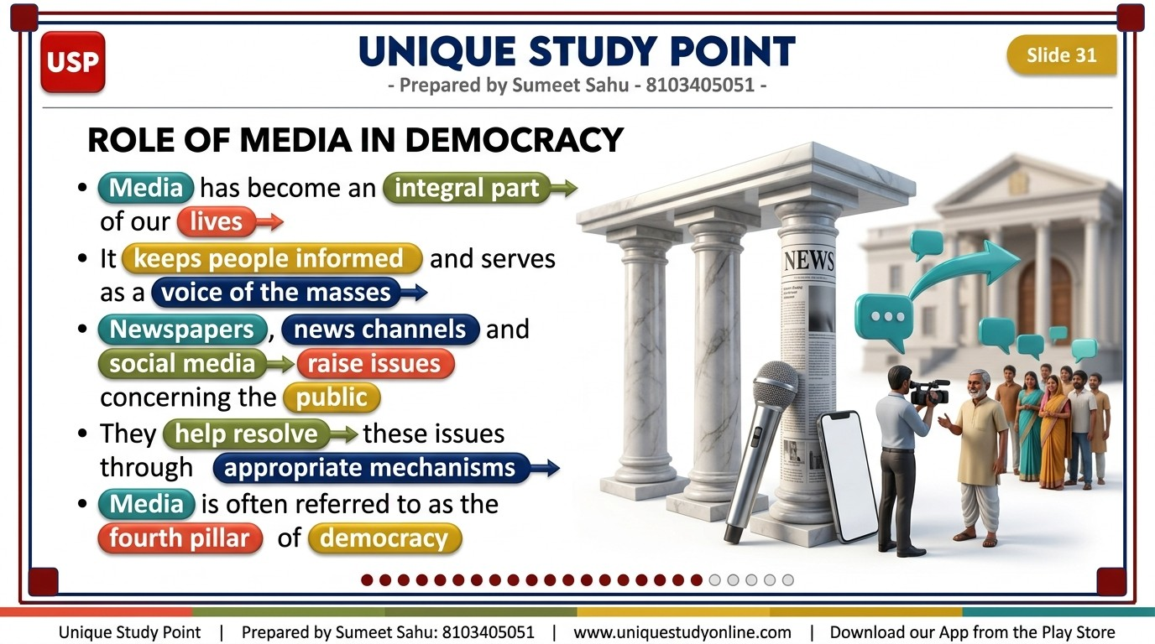
Notes:
ROLE OF MEDIA IN DEMOCRACY
- Media has become an integral part of our lives
- It keeps people informed and serves as a voice of the masses
- Newspapers, news channels and social media raise issues concerning the public
- They help resolve these issues through appropriate mechanisms
- Media is often referred to as the fourth pillar of democracy
Unique Study Point | Sumeet Sahu | 8103405051 | www.uniquestudyonline.com

Slide 32
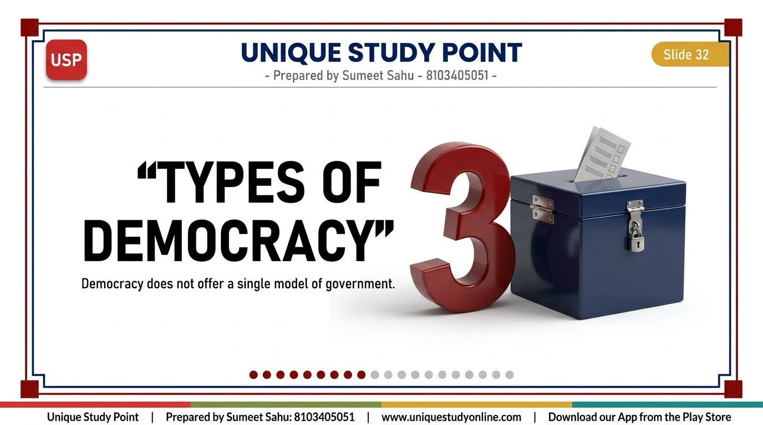
Notes:
TYPES OF DEMOCRACY
- A huge solid 3D numeral standing beside the title, reading: 3
- One line below the title, smaller: Democracy does not offer a single model of government
Unique Study Point | Sumeet Sahu | 8103405051 | www.uniquestudyonline.com

Slide 33
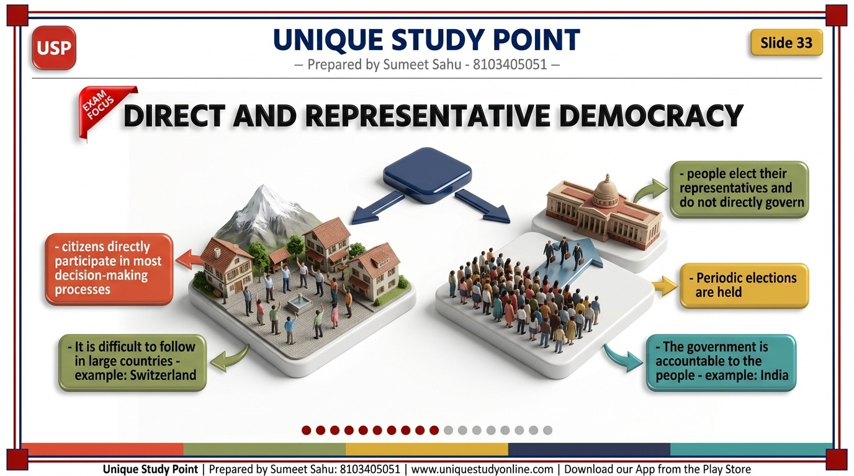
Notes:
DIRECT AND REPRESENTATIVE DEMOCRACY
- Direct Democracy - citizens directly participate in most decision-making processes
- It is difficult to follow in large countries - example: Switzerland
- Representative Democracy - people elect their representatives and do not directly govern
- Periodic elections are held
- The government is accountable to the people - example: India
Unique Study Point | Sumeet Sahu | 8103405051 | www.uniquestudyonline.com

Slide 34
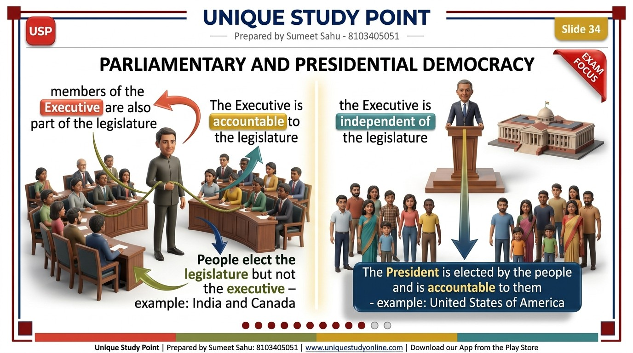
Notes:
PARLIAMENTARY AND PRESIDENTIAL DEMOCRACY
- Parliamentary - members of the Executive are also part of the legislature
- The Executive is accountable to the legislature
- People elect the legislature but not the executive - example: India and Canada
- Presidential - the Executive is independent of the legislature
- The President is elected by the people and is accountable to them - example: United States of America
Unique Study Point | Sumeet Sahu | 8103405051 | www.uniquestudyonline.com

Slide 35
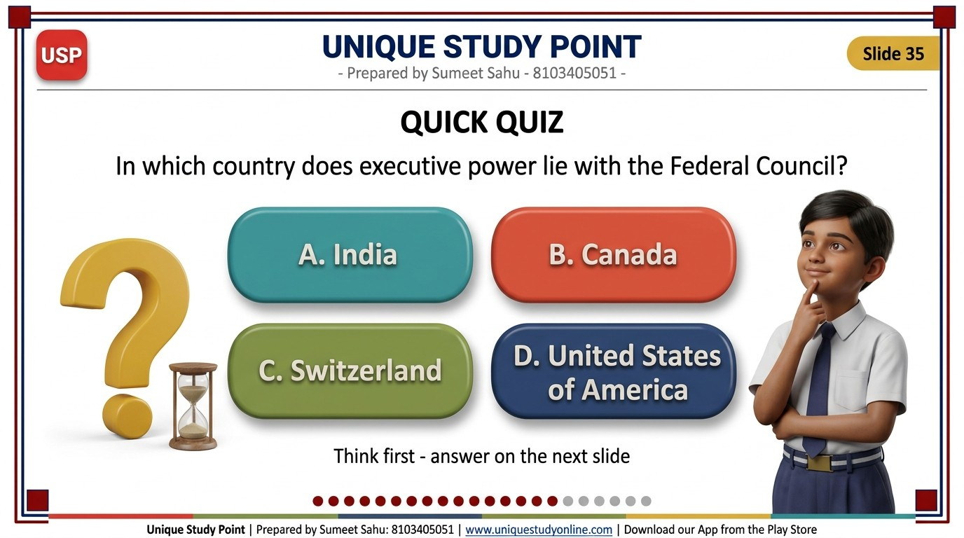
Notes:
QUICK QUIZ
- In which country does executive power lie with the Federal Council?
- A. India
- B. Canada
- C. Switzerland
- D. United States of America
- One line at the bottom, smaller: Think first - answer on the next slide
Unique Study Point | Sumeet Sahu | 8103405051 | www.uniquestudyonline.com

Slide 36
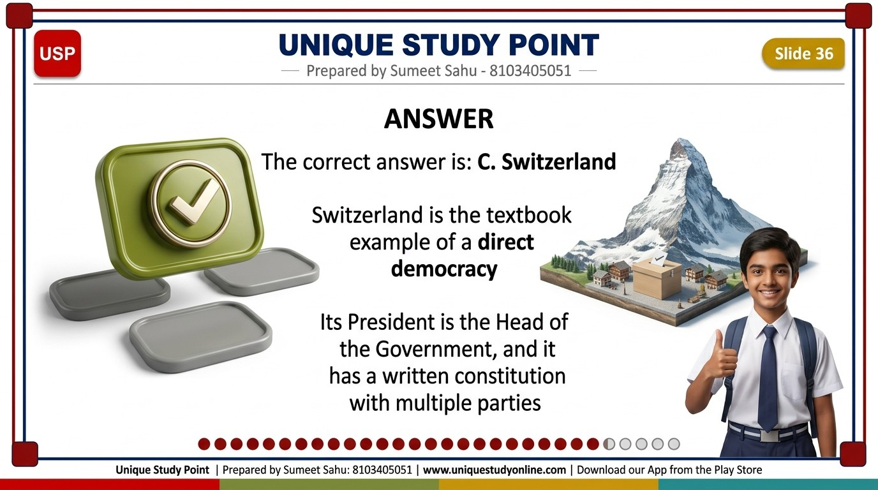
Notes:
ANSWER
- The correct answer is: C. Switzerland
- Switzerland is the textbook example of a direct democracy
- Its President is the Head of the Government, and it has a written constitution with multiple parties
Unique Study Point | Sumeet Sahu | 8103405051 | www.uniquestudyonline.com

Slide 37
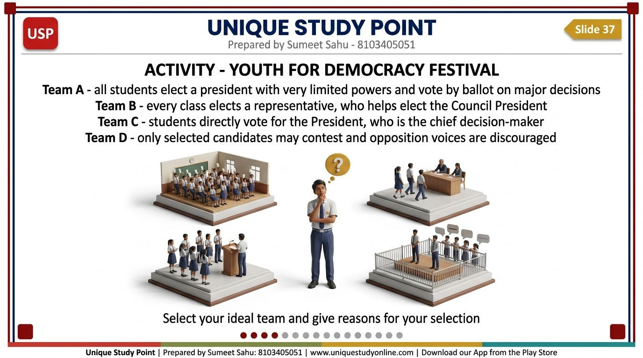
Notes:
ACTIVITY - YOUTH FOR DEMOCRACY FESTIVAL
- Team A - all students elect a president with very limited powers and vote by ballot on major decisions
- Team B - every class elects a representative, who helps elect the Council President
- Team C - students directly vote for the President, who is the chief decision-maker
- Team D - only selected candidates may contest and opposition voices are discouraged
- Select your ideal team and give reasons for your selection
Unique Study Point | Sumeet Sahu | 8103405051 | www.uniquestudyonline.com

Slide 38
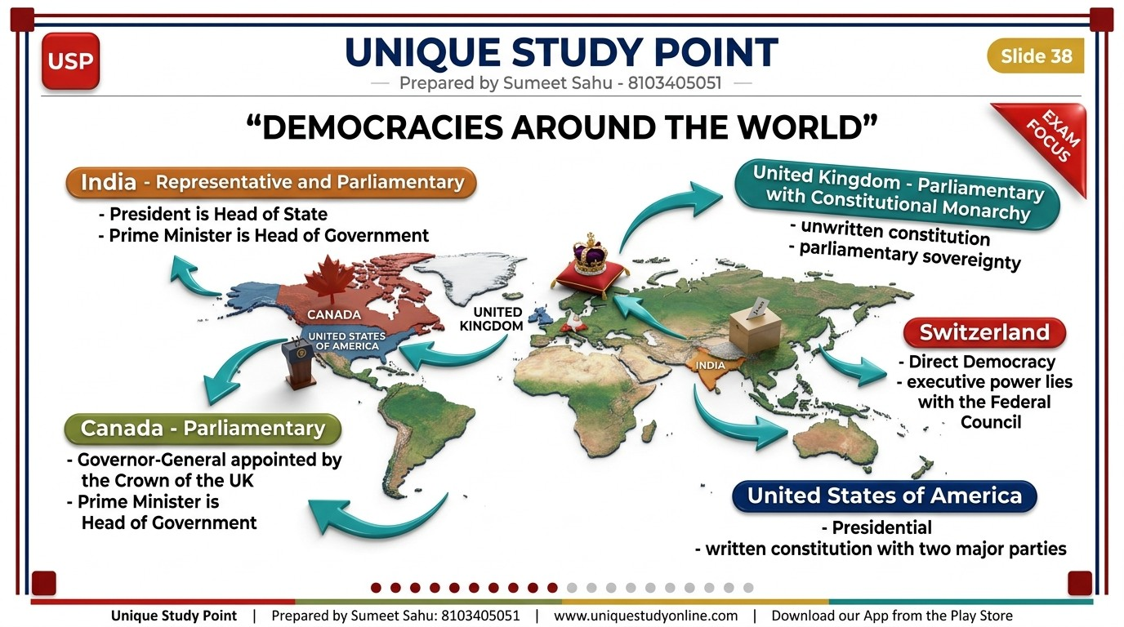
Notes:
DEMOCRACIES AROUND THE WORLD
- India - Representative and Parliamentary - President is Head of State, Prime Minister is Head of Government
- Canada - Parliamentary - Governor-General appointed by the Crown of the UK, Prime Minister is Head of Government
- United Kingdom - Parliamentary with Constitutional Monarchy - unwritten constitution, parliamentary sovereignty
- Switzerland - Direct Democracy - executive power lies with the Federal Council
- United States of America - Presidential - written constitution with two major parties
Unique Study Point | Sumeet Sahu | 8103405051 | www.uniquestudyonline.com

Slide 39
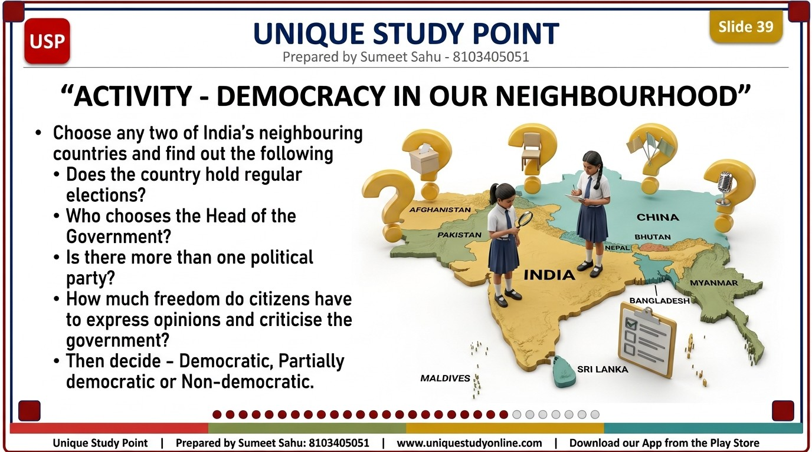
Notes:
ACTIVITY - DEMOCRACY IN OUR NEIGHBOURHOOD
- Choose any two of India's neighbouring countries and find out the following
- Does the country hold regular elections?
- Who chooses the Head of the Government?
- Is there more than one political party?
- How much freedom do citizens have to express opinions and criticise the government?
- Then decide - Democratic, Partially democratic or Non-democratic
Unique Study Point | Sumeet Sahu | 8103405051 | www.uniquestudyonline.com

Slide 40
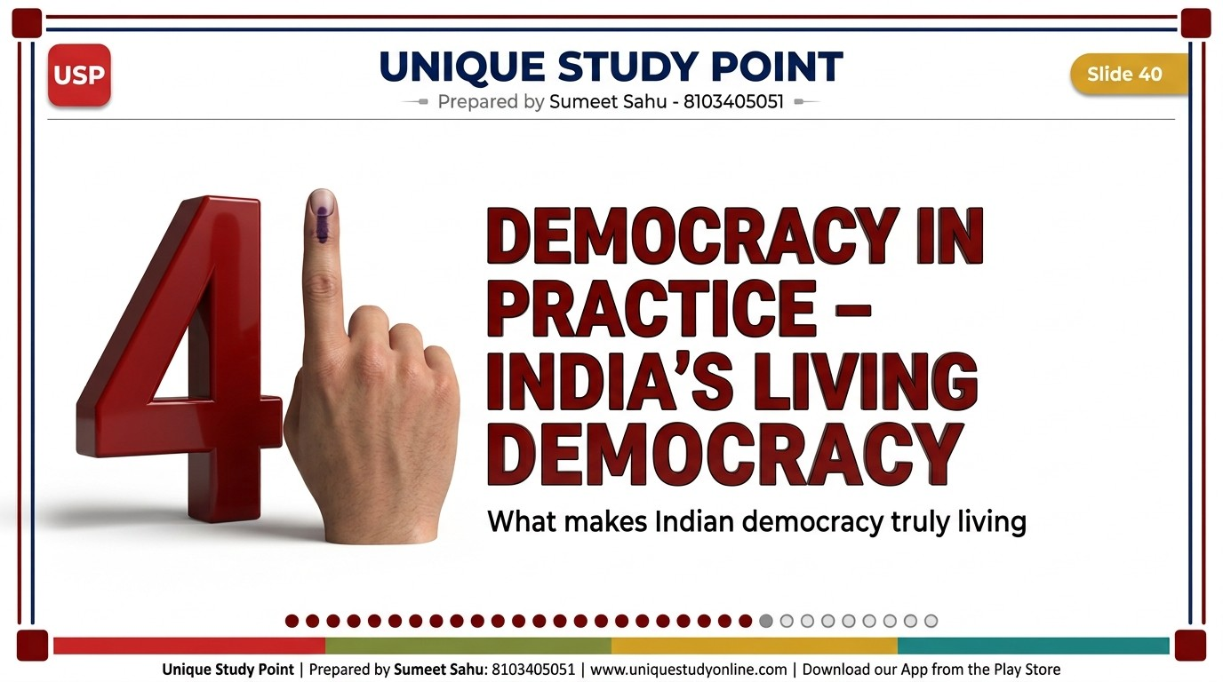
Notes:
DEMOCRACY IN PRACTICE - INDIA'S LIVING DEMOCRACY
- A huge solid 3D numeral standing beside the title, reading: 4
- One line below the title, smaller: What makes Indian democracy truly living
Unique Study Point | Sumeet Sahu | 8103405051 | www.uniquestudyonline.com

Slide 41
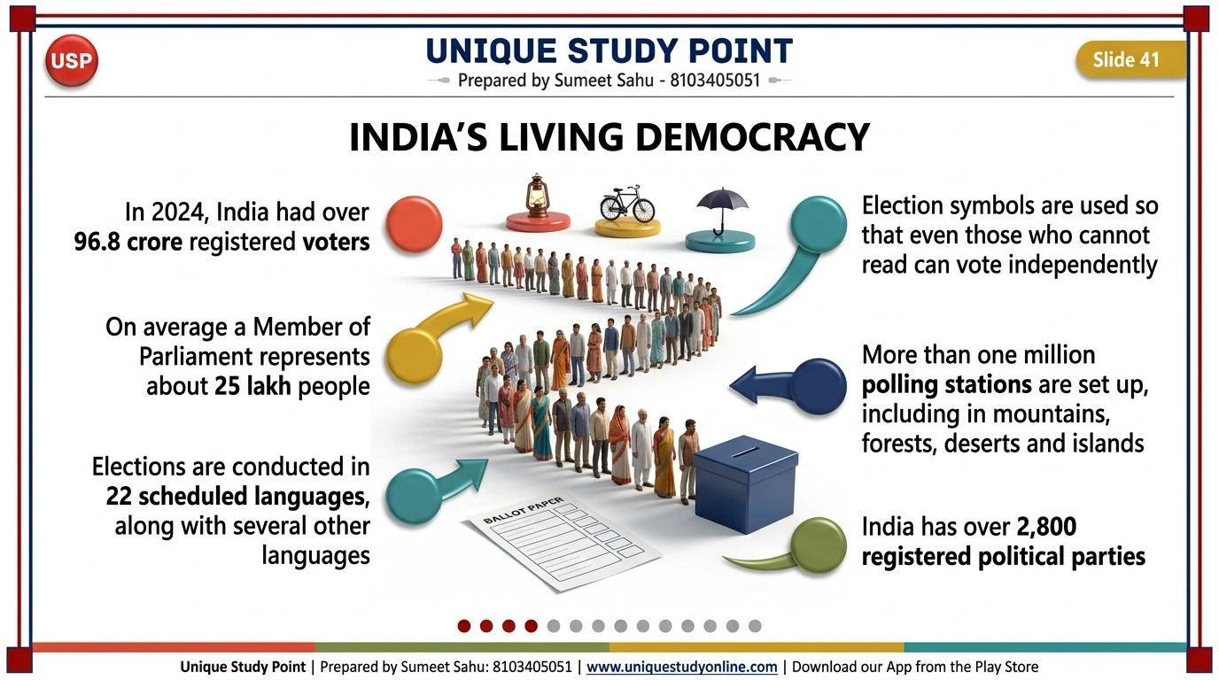
Notes:
INDIA'S LIVING DEMOCRACY
- In 2024, India had over 96.8 crore registered voters
- On average a Member of Parliament represents about 25 lakh people
- Elections are conducted in 22 scheduled languages, along with several other languages
- Election symbols are used so that even those who cannot read can vote independently
- More than one million polling stations are set up, including in mountains, forests, deserts and islands
- India has over 2,800 registered political parties
Unique Study Point | Sumeet Sahu | 8103405051 | www.uniquestudyonline.com

Slide 42
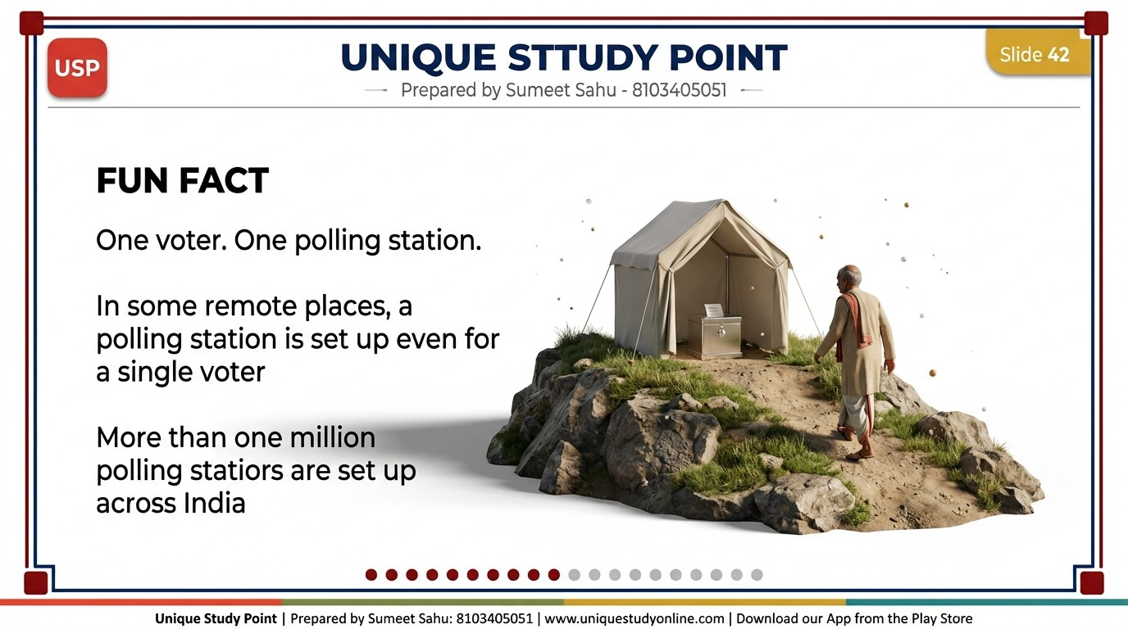
Notes:
FUN FACT
- One voter. One polling station.
- In some remote places, a polling station is set up even for a single voter
- More than one million polling stations are set up across India
Unique Study Point | Sumeet Sahu | 8103405051 | www.uniquestudyonline.com

Slide 43
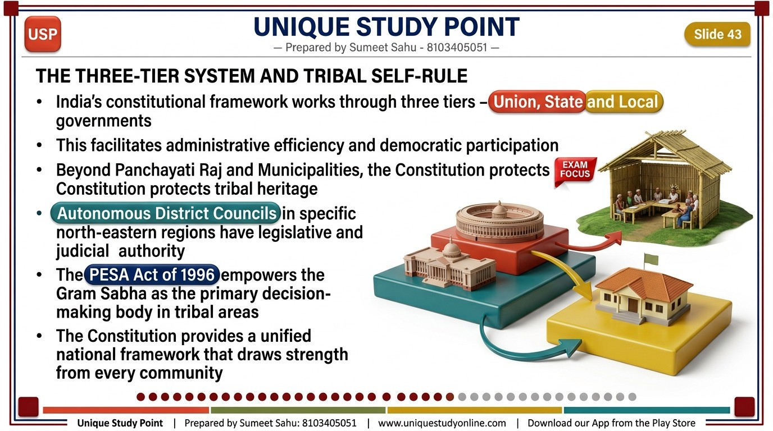
Notes:
THE THREE-TIER SYSTEM AND TRIBAL SELF-RULE
- India's constitutional framework works through three tiers - Union, State and Local governments
- This facilitates administrative efficiency and democratic participation
- Beyond Panchayati Raj and Municipalities, the Constitution protects tribal heritage
- Autonomous District Councils in specific north-eastern regions have legislative and judicial authority
- The PESA Act of 1996 empowers the Gram Sabha as the primary decision-making body in tribal areas
- The Constitution provides a unified national framework that draws strength from every community
Unique Study Point | Sumeet Sahu | 8103405051 | www.uniquestudyonline.com

Slide 44
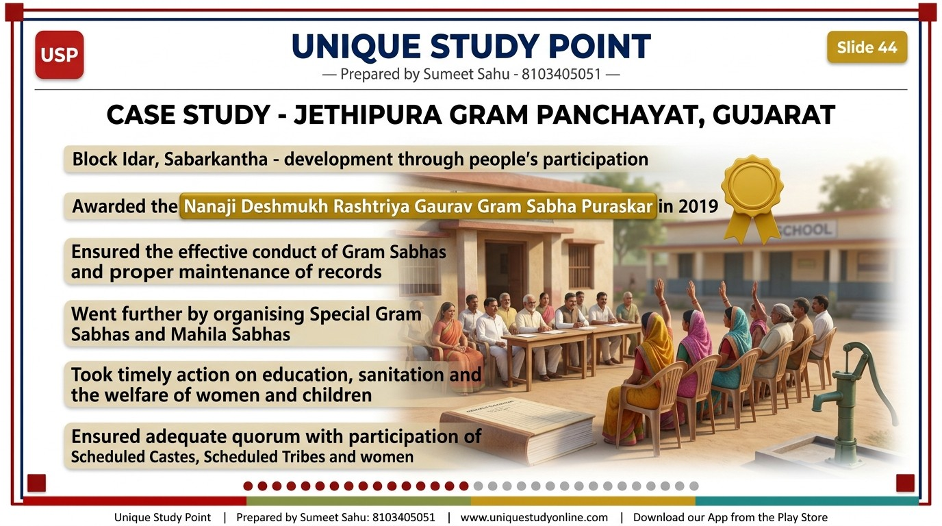
Notes:
CASE STUDY - JETHIPURA GRAM PANCHAYAT, GUJARAT
- Block Idar, Sabarkantha - development through people's participation
- Awarded the Nanaji Deshmukh Rashtriya Gaurav Gram Sabha Puraskar in 2019
- Ensured the effective conduct of Gram Sabhas and proper maintenance of records
- Went further by organising Special Gram Sabhas and Mahila Sabhas
- Took timely action on education, sanitation and the welfare of women and children
- Ensured adequate quorum with participation of Scheduled Castes, Scheduled Tribes and women
Unique Study Point | Sumeet Sahu | 8103405051 | www.uniquestudyonline.com

Slide 45
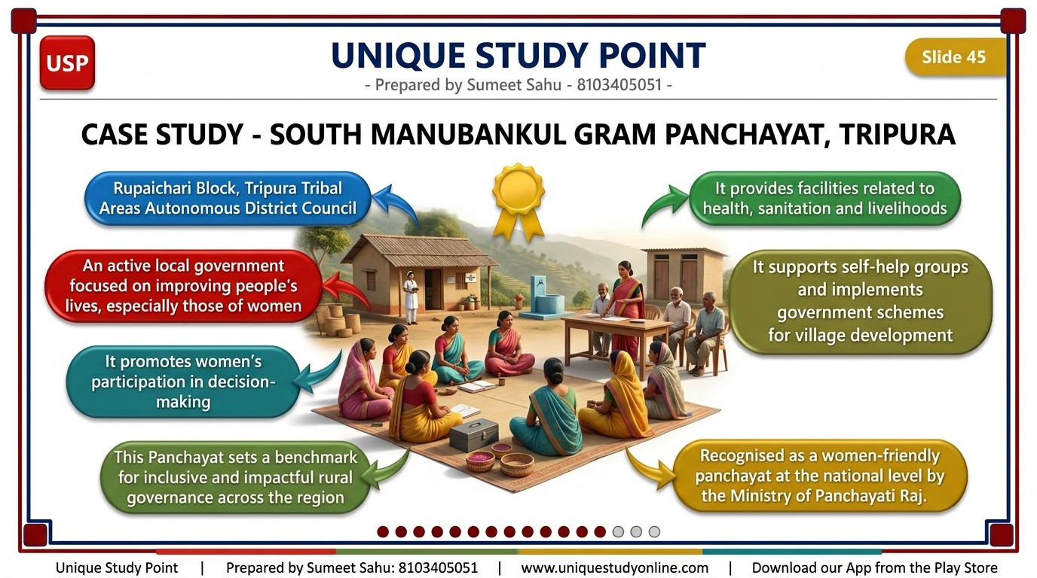
Notes:
CASE STUDY - SOUTH MANUBANKUL GRAM PANCHAYAT, TRIPURA
- Rupaichari Block, Tripura Tribal Areas Autonomous District Council
- An active local government focused on improving people's lives, especially those of women
- It promotes women's participation in decision-making
- It provides facilities related to health, sanitation and livelihoods
- It supports self-help groups and implements government schemes for village development
- Recognised as a women-friendly panchayat at the national level by the Ministry of Panchayati Raj
Unique Study Point | Sumeet Sahu | 8103405051 | www.uniquestudyonline.com

Slide 46
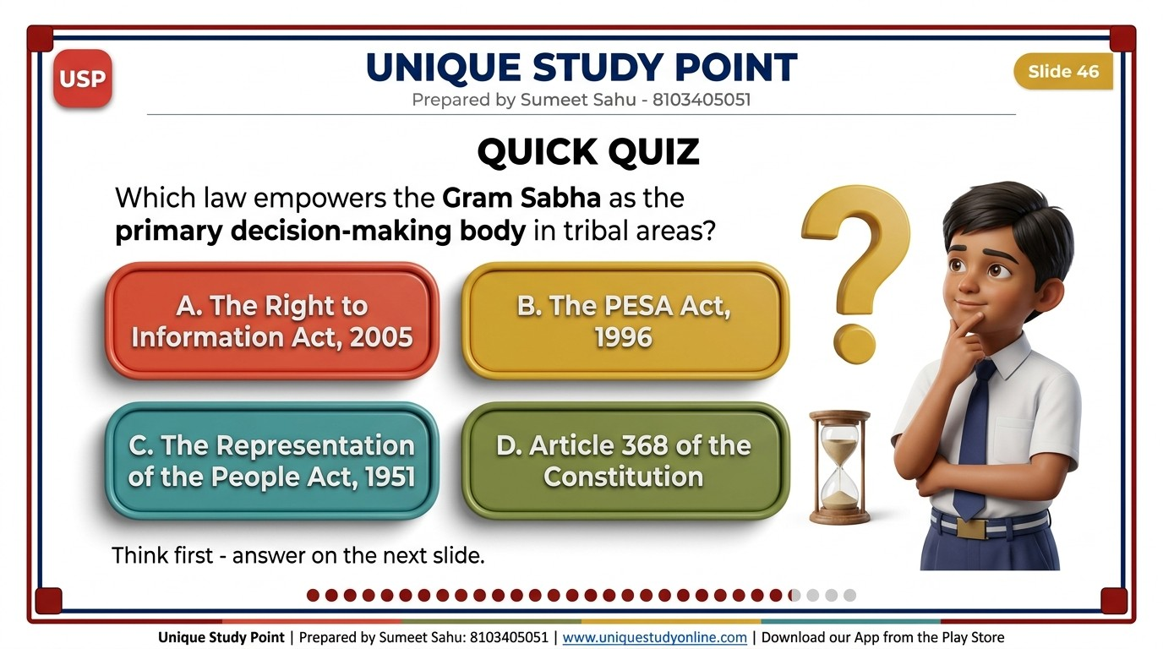
Notes:
QUICK QUIZ
- Which law empowers the Gram Sabha as the primary decision-making body in tribal areas?
- A. The Right to Information Act, 2005
- B. The PESA Act, 1996
- C. The Representation of the People Act, 1951
- D. Article 368 of the Constitution
- One line at the bottom, smaller: Think first - answer on the next slide
Unique Study Point | Sumeet Sahu | 8103405051 | www.uniquestudyonline.com

Slide 47
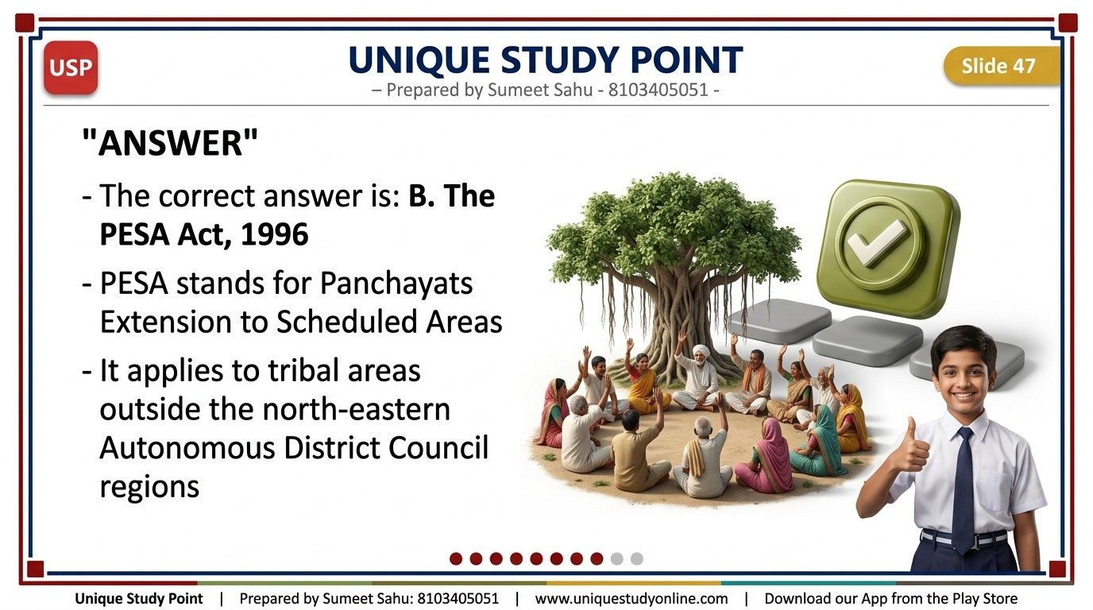
Notes:
ANSWER
- The correct answer is: B. The PESA Act, 1996
- PESA stands for Panchayats Extension to Scheduled Areas
- It applies to tribal areas outside the north-eastern Autonomous District Council regions
Unique Study Point | Sumeet Sahu | 8103405051 | www.uniquestudyonline.com

Slide 48
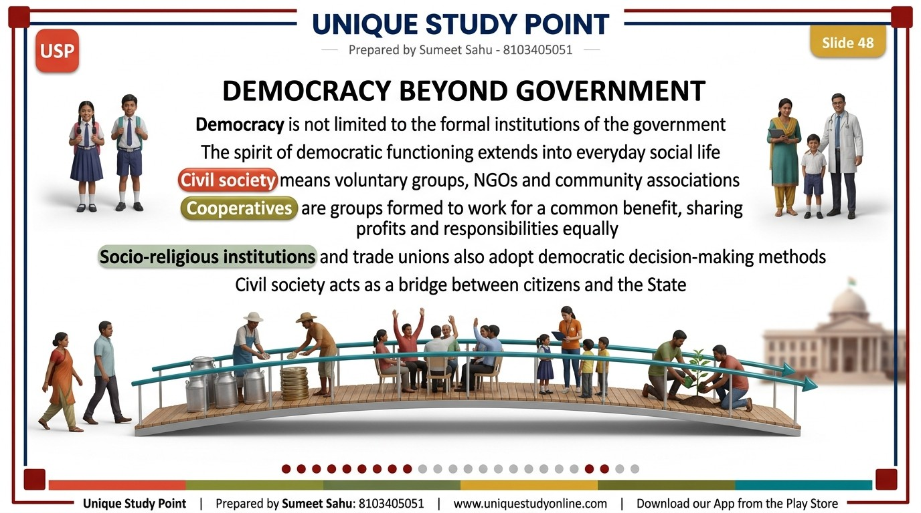
Notes:
DEMOCRACY BEYOND GOVERNMENT
- Democracy is not limited to the formal institutions of the government
- The spirit of democratic functioning extends into everyday social life
- Civil society means voluntary groups, NGOs and community associations
- Cooperatives are groups formed to work for a common benefit, sharing profits and responsibilities equally
- Socio-religious institutions and trade unions also adopt democratic decision-making methods
- Civil society acts as a bridge between citizens and the State
Unique Study Point | Sumeet Sahu | 8103405051 | www.uniquestudyonline.com

Slide 49
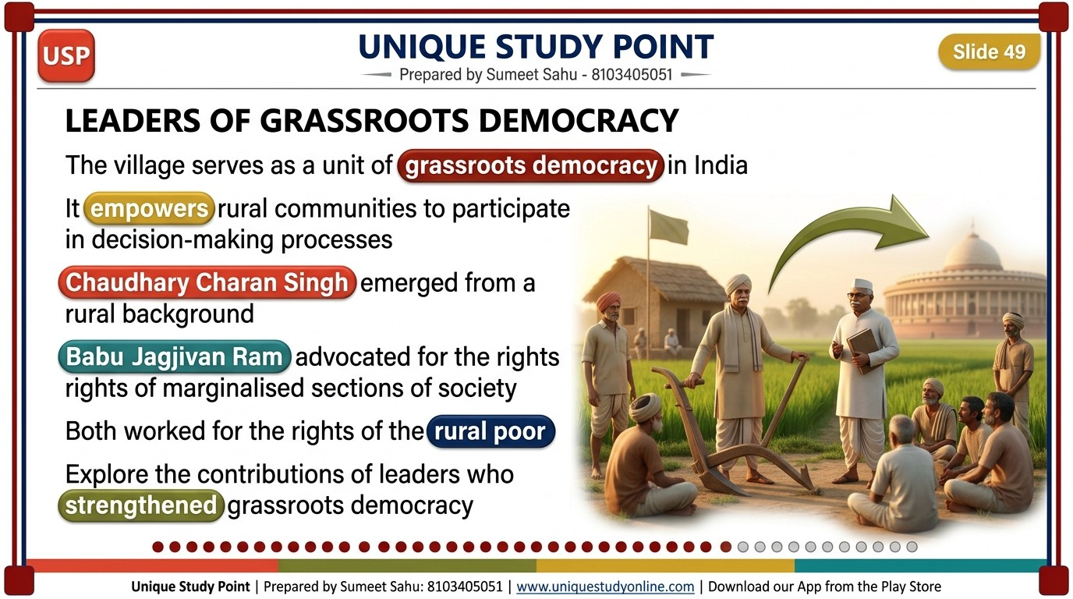
Notes:
LEADERS OF GRASSROOTS DEMOCRACY
- The village serves as a unit of grassroots democracy in India
- It empowers rural communities to participate in decision-making processes
- Chaudhary Charan Singh emerged from a rural background
- Babu Jagjivan Ram advocated for the rights of marginalised sections of society
- Both worked for the rights of the rural poor
- Explore the contributions of leaders who strengthened grassroots democracy
Unique Study Point | Sumeet Sahu | 8103405051 | www.uniquestudyonline.com

Slide 50
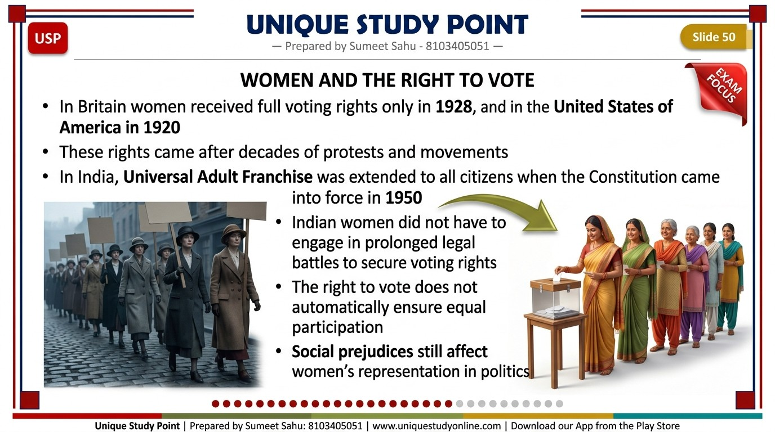
Notes:
WOMEN AND THE RIGHT TO VOTE
- In Britain women received full voting rights only in 1928, and in the United States of America in 1920
- These rights came after decades of protests and movements
- In India, Universal Adult Franchise was extended to all citizens when the Constitution came into force in 1950
- Indian women did not have to engage in prolonged legal battles to secure voting rights
- The right to vote does not automatically ensure equal participation
- Social prejudices still affect women's representation in politics
Unique Study Point | Sumeet Sahu | 8103405051 | www.uniquestudyonline.com

Slide 51
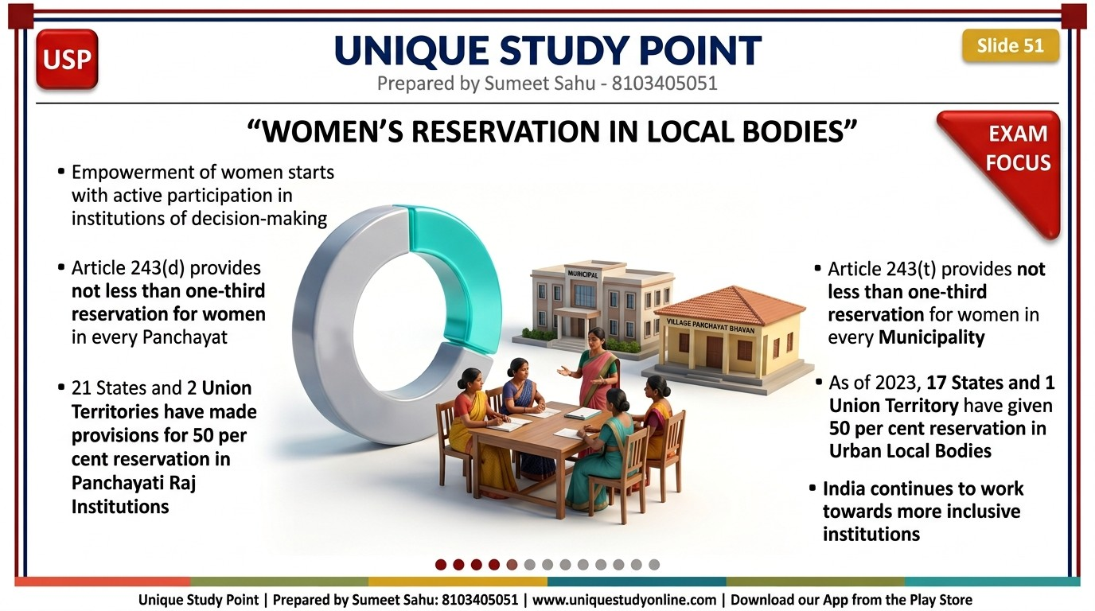
Notes:
WOMEN'S RESERVATION IN LOCAL BODIES
- Empowerment of women starts with active participation in institutions of decision-making
- Article 243(d) provides not less than one-third reservation for women in every Panchayat
- 21 States and 2 Union Territories have made provisions for 50 per cent reservation in Panchayati Raj Institutions
- Article 243(t) provides not less than one-third reservation for women in every Municipality
- As of 2023, 17 States and 1 Union Territory have given 50 per cent reservation in Urban Local Bodies
- India continues to work towards more inclusive institutions
Unique Study Point | Sumeet Sahu | 8103405051 | www.uniquestudyonline.com

Slide 52
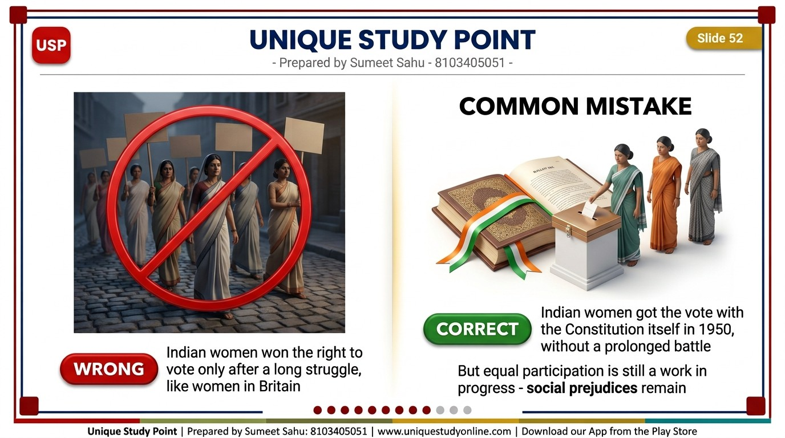
Notes:
COMMON MISTAKE
- Inside a red 3D chip, the words: WRONG
- Indian women won the right to vote only after a long struggle, like women in Britain
- Inside a green 3D chip, the words: CORRECT
- Indian women got the vote with the Constitution itself in 1950, without a prolonged battle
- But equal participation is still a work in progress - social prejudices remain
Unique Study Point | Sumeet Sahu | 8103405051 | www.uniquestudyonline.com

Slide 53

Notes:
CHALLENGES TO DEMOCRATIC PRACTICES IN INDIA
- A huge solid 3D numeral standing beside the title, reading: 5
- One line below the title, smaller: Democracy requires constant care, awareness and participation
Unique Study Point | Sumeet Sahu | 8103405051 | www.uniquestudyonline.com

Slide 54

Notes:
CHALLENGES TO INDIAN DEMOCRACY
- India continues to face challenges such as illiteracy, misinformation and inequality
- Fake news on social media can influence opinion, create confusion and even lead to conflict
- Poverty, regionalism, gender inequality and social discrimination create barriers to equal participation
- Gaps in the effective implementation of laws and policies may reduce public trust
- Damaging public property, spreading misinformation or violating public rules weaken democratic values
- Indifference towards public issues also harms the health of a democracy
Unique Study Point | Sumeet Sahu | 8103405051 | www.uniquestudyonline.com

Slide 55

Notes:
ACTIVITY - SPOTTING FALSE INFORMATION
- In small groups, identify two or three examples of information shared on social media that may be misleading
- Discuss what made you question their reliability
- Discuss how such information can influence people's opinions
- Reflect on why access to accurate and authentic information is important in a democracy
- Always check the source before you believe or share
Unique Study Point | Sumeet Sahu | 8103405051 | www.uniquestudyonline.com

Slide 56

Notes:
THE EMERGENCY 1975 TO 1977
- In the early 1970s, rising unemployment, inflation and allegations of misgovernance led to widespread protests
- In June 1975 a National Emergency was imposed on the grounds of internal disturbance
- A majority of Fundamental Rights were suspended and the press was censored
- Numerous political leaders and activists were arrested
- Mass movements were led by Jayaprakash Narayan, popularly known as Lok Nayak, especially in Bihar and Gujarat
- The Emergency was lifted in 1977 and general elections were held
Unique Study Point | Sumeet Sahu | 8103405051 | www.uniquestudyonline.com

Slide 57

Notes:
LESSONS FROM THE EMERGENCY
- Articles 352, 356 and 360 deal with National Emergency, President's Rule and Financial Emergency
- Democratic institutions came under severe strain and citizens' freedom was restricted
- The defeat of the ruling government in 1977 demonstrated the strength of Indian democracy
- It highlighted the importance of constitutional safeguards and civil liberties
- It showed the value of active citizen participation in protecting democratic values
- The period revealed both the vulnerabilities and the resilience of India's institutions
Unique Study Point | Sumeet Sahu | 8103405051 | www.uniquestudyonline.com

Slide 58

Notes:
DEMOCRACY AND YOU
- A huge solid 3D numeral standing beside the title, reading: 6
- One line below the title, smaller: The strength of a democracy is its informed and responsible citizens
Unique Study Point | Sumeet Sahu | 8103405051 | www.uniquestudyonline.com

Slide 59

Notes:
DEMOCRACY AND YOU
- Being well-informed is one of the vital responsibilities of a young citizen
- Reading newspapers, watching news and using the internet responsibly keeps you aware
- Access to authentic information helps you form informed opinions on public issues
- The NSS and the NCC are designed to instil civic responsibility and social awareness
- Community service, teamwork and organised activities teach participation and service to the nation
- Civic responsibility also means respecting others' rights, abiding by laws and appreciating our diversity
Unique Study Point | Sumeet Sahu | 8103405051 | www.uniquestudyonline.com

Slide 60

Notes:
THINK, DISCUSS, ACT
- Think - how do your actions as a student contribute to your school community and to democracy?
- Discuss - talk to your classmates about a social or community issue that you care about
- Act - choose one activity to fulfil your civic responsibility this month
- Reflect on how your actions strengthen democracy and community spirit
- Conduct a model parliament session or Gram Sabha in class on a local issue
Unique Study Point | Sumeet Sahu | 8103405051 | www.uniquestudyonline.com

Slide 61

Notes:
QUICK QUIZ
- The Rule of Law is violated when:
- A. Laws are applied equally to all
- B. Courts review government actions
- C. Powerful individuals are treated above the law
- D. Citizens challenge laws through legal means
- One line at the bottom, smaller: Think first - answer on the next slide
Unique Study Point | Sumeet Sahu | 8103405051 | www.uniquestudyonline.com

Slide 62

Notes:
ANSWER
- The correct answer is: C. Powerful individuals are treated above the law
- The Rule of Law means no one is above the law, whatever their status or rank
- Options A, B and D are examples of the Rule of Law working, not failing
Unique Study Point | Sumeet Sahu | 8103405051 | www.uniquestudyonline.com

Slide 63

Notes:
KEY TERMS - PART 1
- Sovereignty - the supreme, final and independent legal authority of a State over its territory and citizens
- Federalism - power shared between the central and state governments, with residual power at the centre
- Equality before law - every individual, whatever their status or rank, is treated equally by the law
- Equal protection of law - all persons in similar circumstances are treated equally, without discrimination
- Procedure established by law - the procedure established by the law of the state or statute
- Public Interest Litigation - a legal action in a court of law for the enforcement of public interest
Unique Study Point | Sumeet Sahu | 8103405051 | www.uniquestudyonline.com

Slide 64

Notes:
KEY TERMS - PART 2
- Civil Society - voluntary groups, NGOs and community associations that function interdependently within society
- Cooperatives - groups formed to work for a common benefit; members share profits and responsibilities equally
- Quorum - the minimum number of members present at a meeting to make its proceedings valid
- Legislation - laws made by the government that help maintain order and regulate society
- Question Hour - the first hour of a parliamentary session when members ask questions to the government
- Civic responsibility - respecting others' rights, using social media responsibly and strengthening unity
Unique Study Point | Sumeet Sahu | 8103405051 | www.uniquestudyonline.com

Slide 65

Notes:
IMPORTANT QUESTIONS FOR PRACTICE
- How would democracy be affected if citizens stopped following laws and civic responsibilities?
- Why is the Rule of Law essential for protecting democracy?
- Is voting alone enough to make a country democratic? Support your answer with examples
- How can social media strengthen democracy, and how can it weaken democracy if used irresponsibly?
- What role does the Constitution play in strengthening democracy in India?
- What challenges do you think democracy in India faces today?
Unique Study Point | Sumeet Sahu | 8103405051 | www.uniquestudyonline.com

Slide 66

Notes:
BEFORE WE MOVE ON
- Democracy is a system of self-governance through institutions, rules and practices - not elections alone
- It is guided by transparency, participation, inclusion, fairness, equality and accountability
- Democratic ideas in India have deep roots in the Sabha and Samiti of the Vedic texts
- India's democracy rests on its Constitution - popular sovereignty, universal adult franchise, rights, rule of law and separation of powers
- Democracies across the world follow different systems but share common democratic values
- The strength of a democracy depends on informed and responsible citizens
Unique Study Point | Sumeet Sahu | 8103405051 | www.uniquestudyonline.com

Slide 67

Notes:
WHY CHOOSE UNIQUE STUDY POINT?
- 1000+ free Notes, PPTs and Worksheets for Classes 6 to 10
- Everything free - no login, no hidden charges
- Updated for the New NCERT Syllabus, Session 2026-27
- Made by an experienced teacher, not copied
- Download our App from the Google Play Store
- Visit www.uniquestudyonline.com today
- Join Unique Study Point Coaching, Amitesh Nagar, Indore
- Small batches - regular tests - parents kept updated
- Call Sumeet Sahu: 8103405051
Unique Study Point | Sumeet Sahu | 8103405051 | www.uniquestudyonline.com

