Slide 1
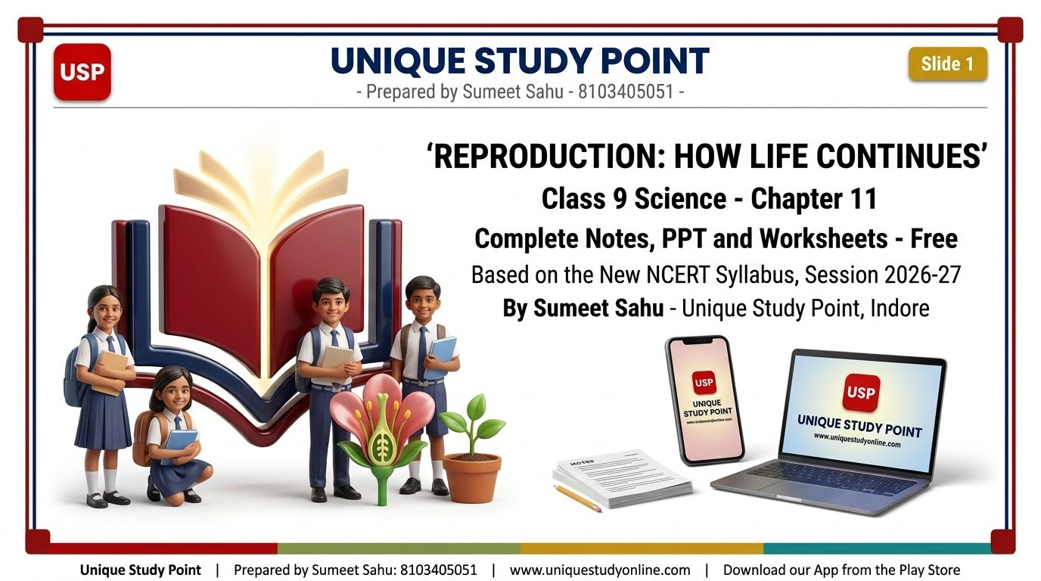
Notes:
Slide 1 - TITLE AND BRANDING
Unique Study Point | Prepared by Sumeet Sahu: 8103405051 | www.uniquestudyonline.com

Slide 2
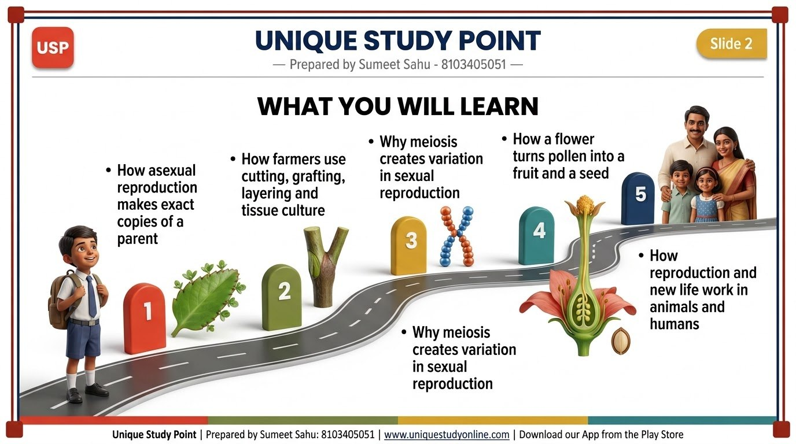
Notes:
Slide 2 - WHAT YOU WILL LEARN
Unique Study Point | Prepared by Sumeet Sahu: 8103405051 | www.uniquestudyonline.com

Slide 3
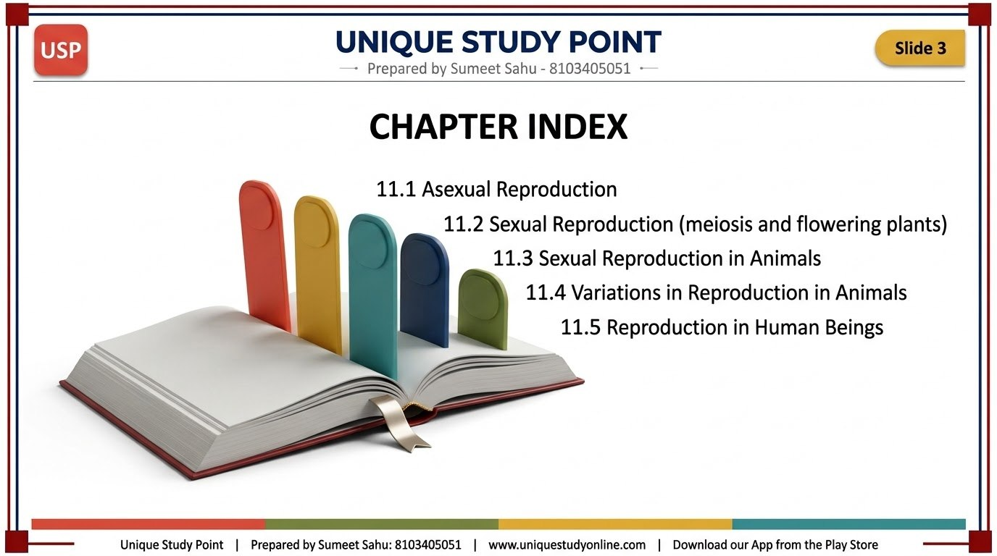
Notes:
Slide 3 - CHAPTER INDEX
Unique Study Point | Prepared by Sumeet Sahu: 8103405051 | www.uniquestudyonline.com

Slide 4
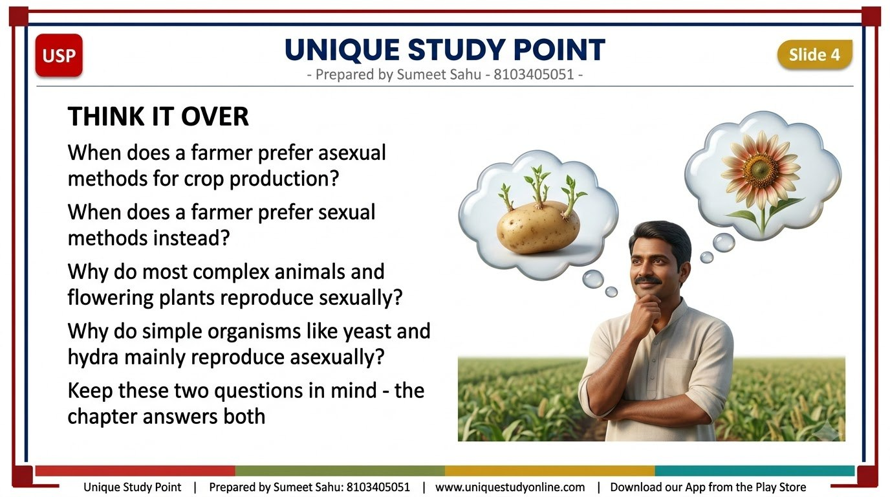
Notes:
Slide 4 - THINK IT OVER
Unique Study Point | Prepared by Sumeet Sahu: 8103405051 | www.uniquestudyonline.com

Slide 5
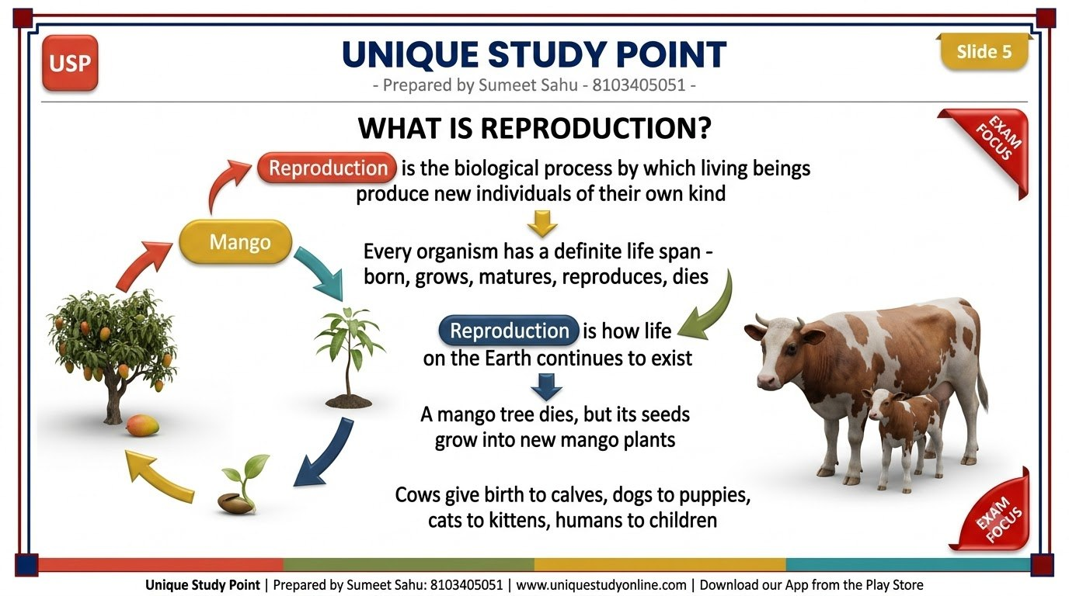
Notes:
Slide 5 - WHAT IS REPRODUCTION?
Unique Study Point | Prepared by Sumeet Sahu: 8103405051 | www.uniquestudyonline.com

Slide 6
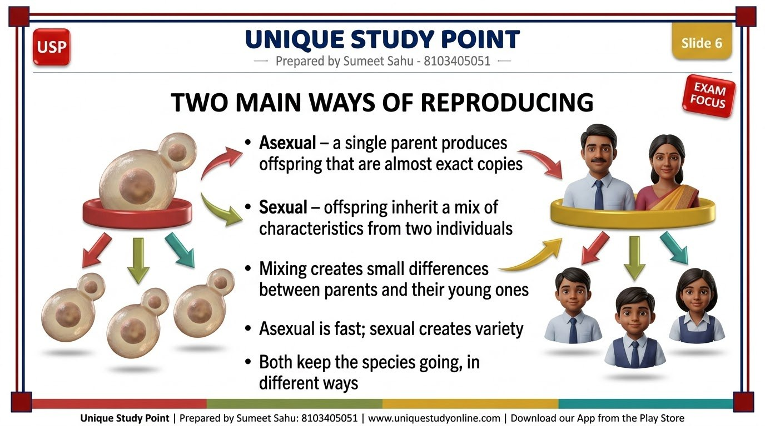
Notes:
Slide 6 - TWO MAIN WAYS OF REPRODUCING
Unique Study Point | Prepared by Sumeet Sahu: 8103405051 | www.uniquestudyonline.com

Slide 7

Notes:
Slide 7 - WHY SMALL DIFFERENCES MATTER
Unique Study Point | Prepared by Sumeet Sahu: 8103405051 | www.uniquestudyonline.com

Slide 8

Notes:
Slide 8 - SECTION DIVIDER - ASEXUAL REPRODUCTION
Unique Study Point | Prepared by Sumeet Sahu: 8103405051 | www.uniquestudyonline.com

Slide 9
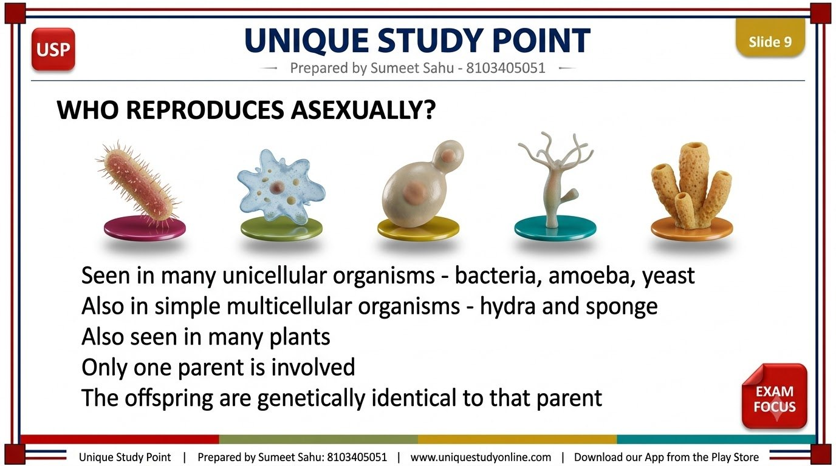
Notes:
Slide 9 - WHO REPRODUCES ASEXUALLY?
Unique Study Point | Prepared by Sumeet Sahu: 8103405051 | www.uniquestudyonline.com

Slide 10
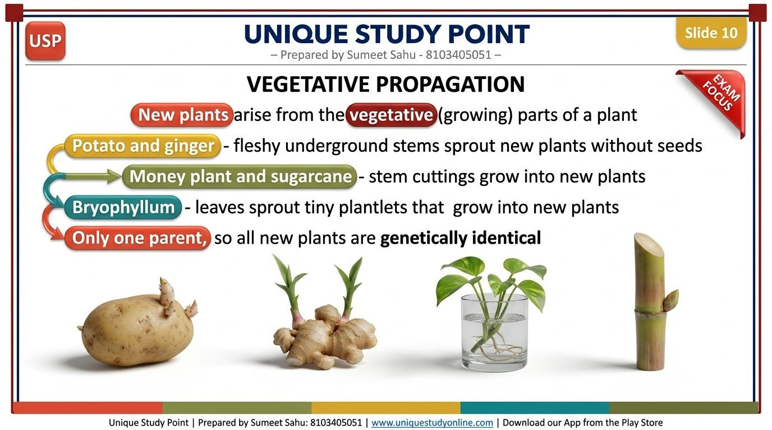
Notes:
Slide 10 - VEGETATIVE PROPAGATION
Unique Study Point | Prepared by Sumeet Sahu: 8103405051 | www.uniquestudyonline.com

Slide 11
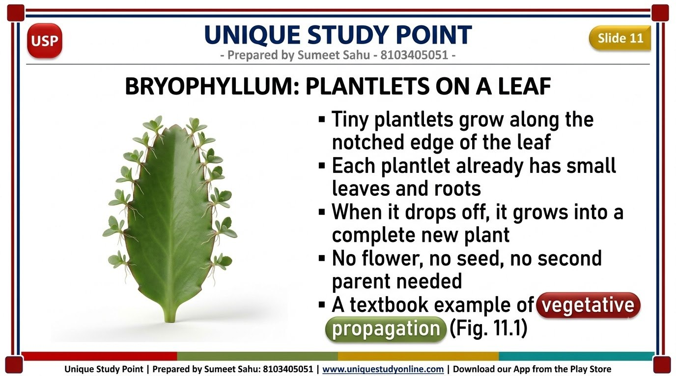
Notes:
Slide 11 - BRYOPHYLLUM: PLANTLETS ON A LEAF
Unique Study Point | Prepared by Sumeet Sahu: 8103405051 | www.uniquestudyonline.com

Slide 12
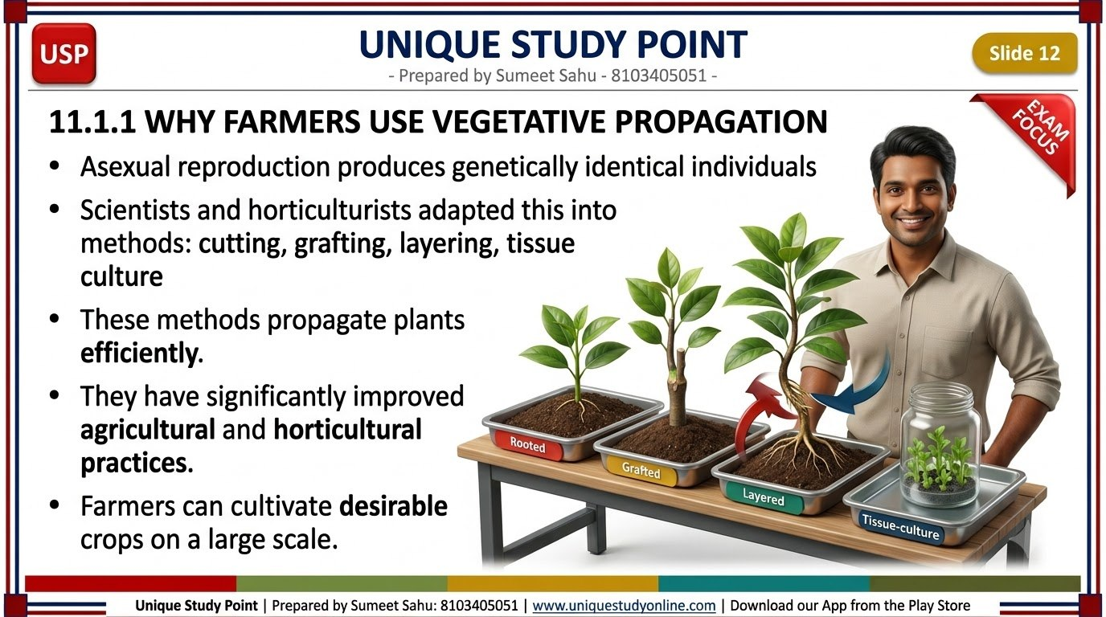
Notes:
Slide 12 - 11.1.1 WHY FARMERS USE VEGETATIVE PROPAGATION
Unique Study Point | Prepared by Sumeet Sahu: 8103405051 | www.uniquestudyonline.com

Slide 13
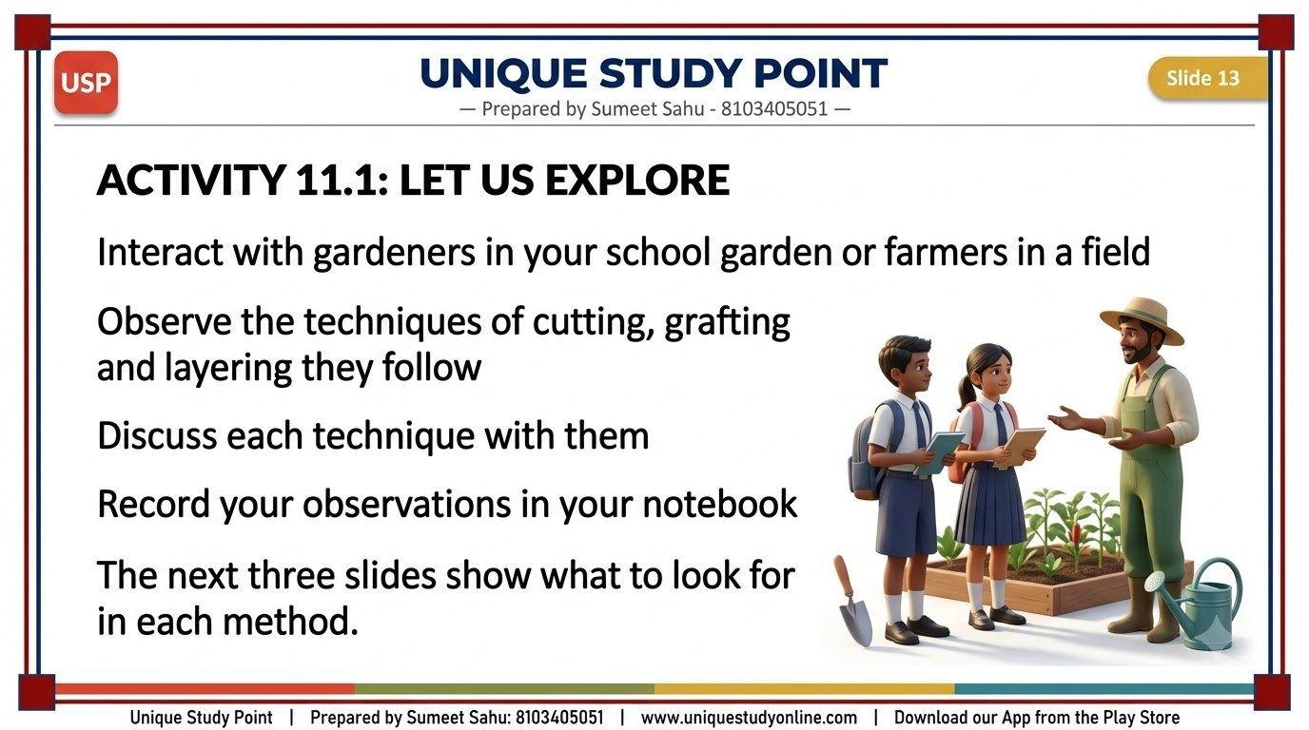
Notes:
Slide 13 - ACTIVITY 11.1: LET US EXPLORE
Unique Study Point | Prepared by Sumeet Sahu: 8103405051 | www.uniquestudyonline.com

Slide 14
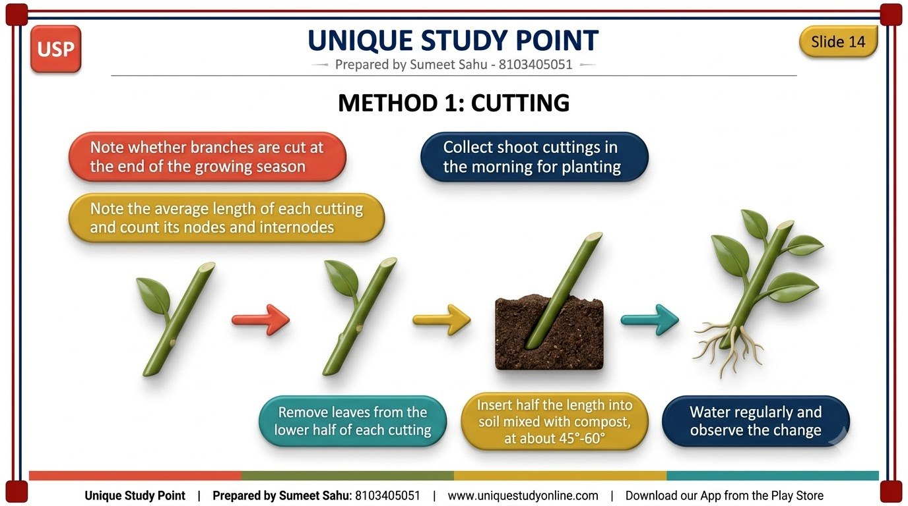
Notes:
Slide 14 - METHOD 1: CUTTING
Unique Study Point | Prepared by Sumeet Sahu: 8103405051 | www.uniquestudyonline.com

Slide 15
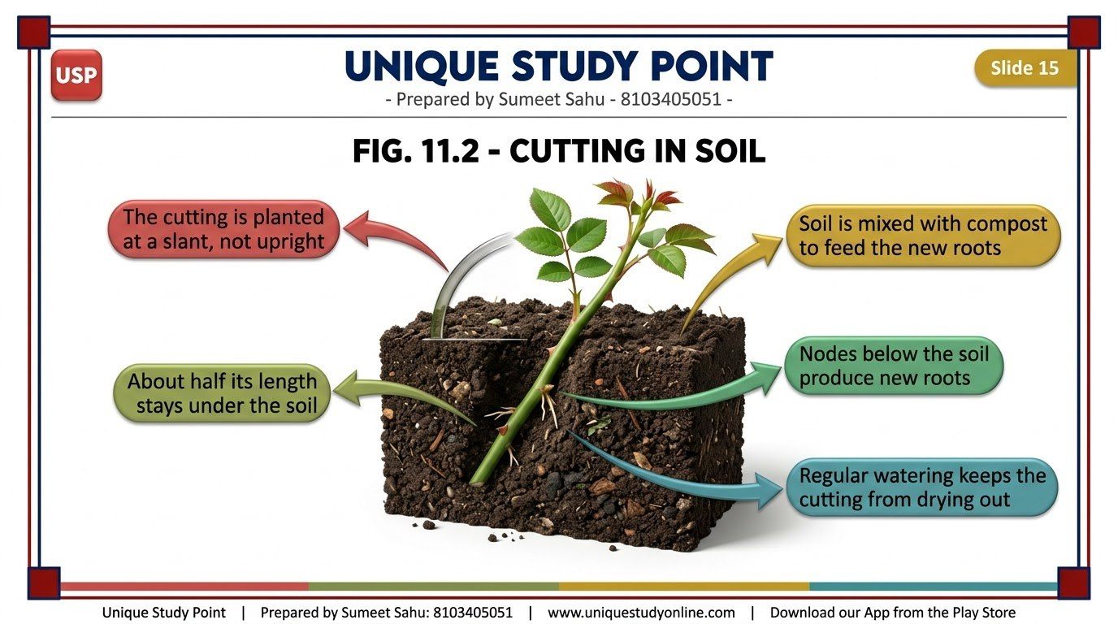
Notes:
Slide 15 - FIG. 11.2 - CUTTING IN SOIL
Unique Study Point | Prepared by Sumeet Sahu: 8103405051 | www.uniquestudyonline.com

Slide 16
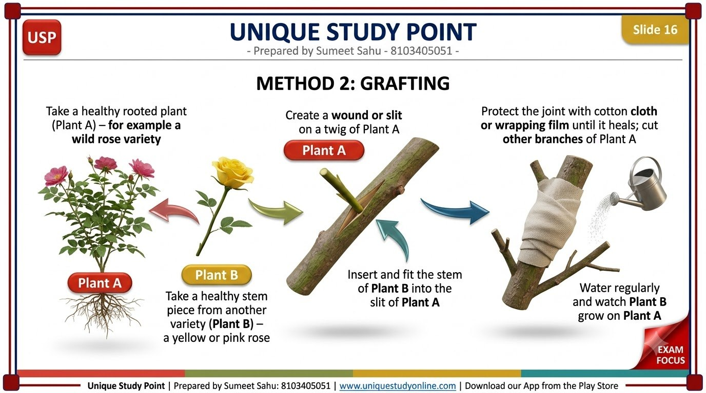
Notes:
Slide 16 - METHOD 2: GRAFTING
Unique Study Point | Prepared by Sumeet Sahu: 8103405051 | www.uniquestudyonline.com

Slide 17
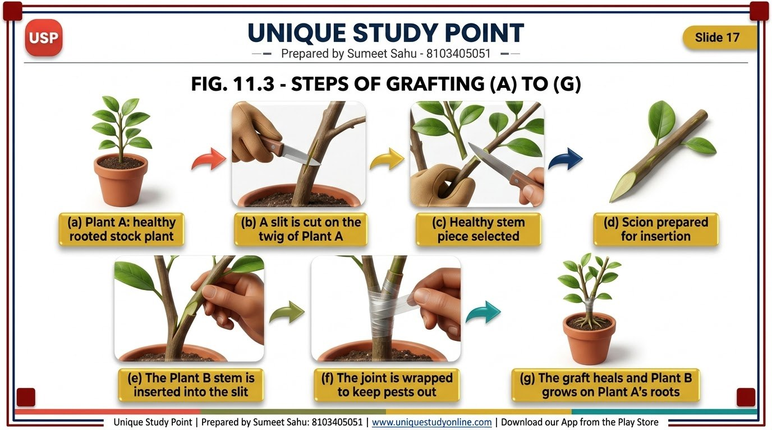
Notes:
Slide 17 - FIG. 11.3 - STEPS OF GRAFTING (A) TO (G)
Unique Study Point | Prepared by Sumeet Sahu: 8103405051 | www.uniquestudyonline.com

Slide 18
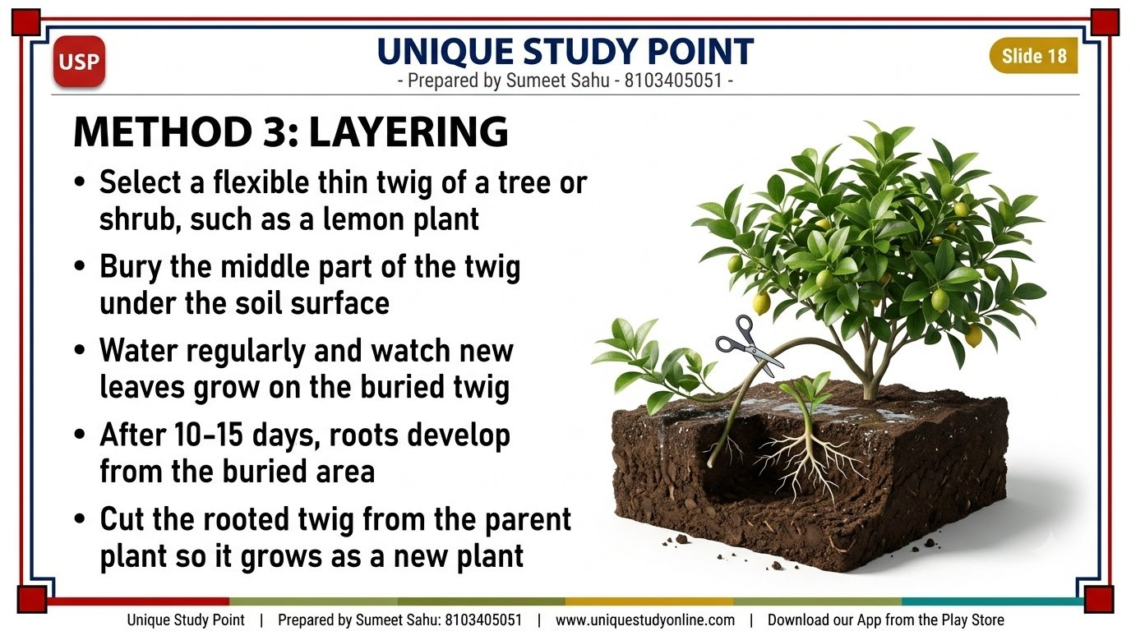
Notes:
Slide 18 - METHOD 3: LAYERING
Unique Study Point | Prepared by Sumeet Sahu: 8103405051 | www.uniquestudyonline.com

Slide 19
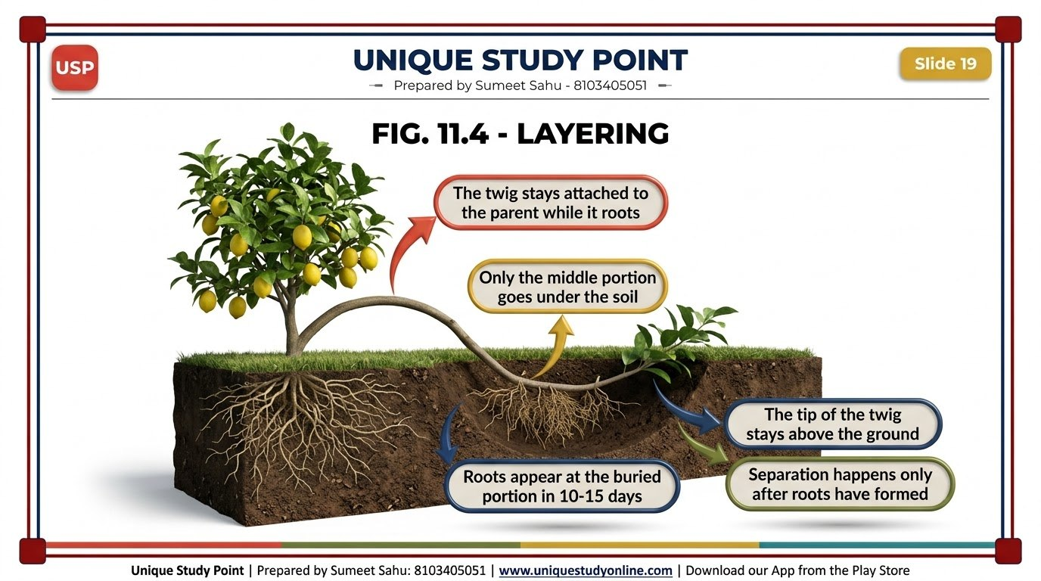
Notes:
Slide 19 - FIG. 11.4 - LAYERING
Unique Study Point | Prepared by Sumeet Sahu: 8103405051 | www.uniquestudyonline.com

Slide 20

Notes:
Slide 20 - BRIDGING SCIENCE AND SOCIETY: KVKS AND ICAR
Unique Study Point | Prepared by Sumeet Sahu: 8103405051 | www.uniquestudyonline.com

Slide 21
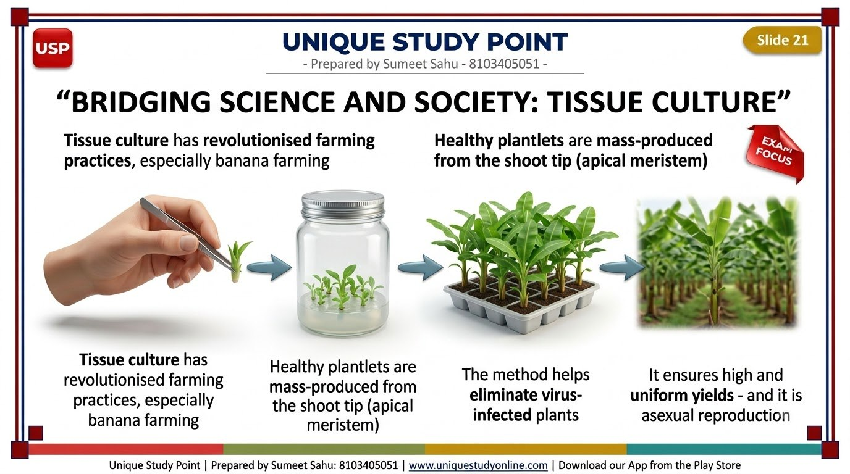
Notes:
Slide 21 - BRIDGING SCIENCE AND SOCIETY: TISSUE CULTURE
Unique Study Point | Prepared by Sumeet Sahu: 8103405051 | www.uniquestudyonline.com

Slide 22
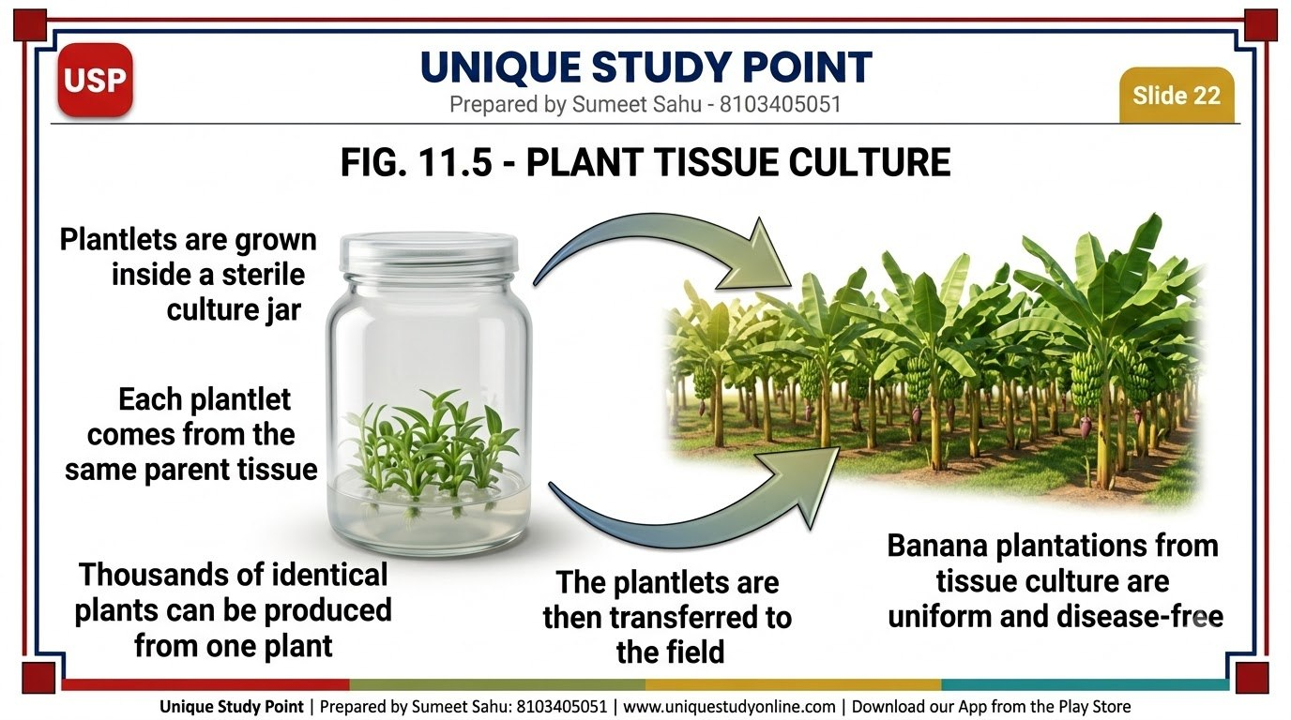
Notes:
Slide 22 - FIG. 11.5 - PLANT TISSUE CULTURE
Unique Study Point | Prepared by Sumeet Sahu: 8103405051 | www.uniquestudyonline.com

Slide 23
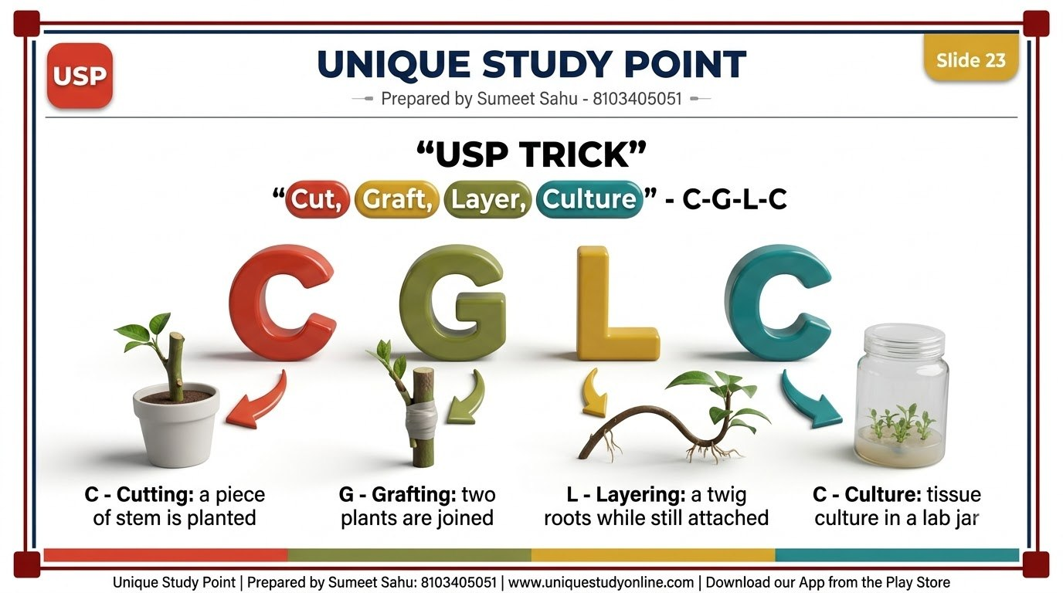
Notes:
Slide 23 - USP TRICK
Unique Study Point | Prepared by Sumeet Sahu: 8103405051 | www.uniquestudyonline.com

Slide 24
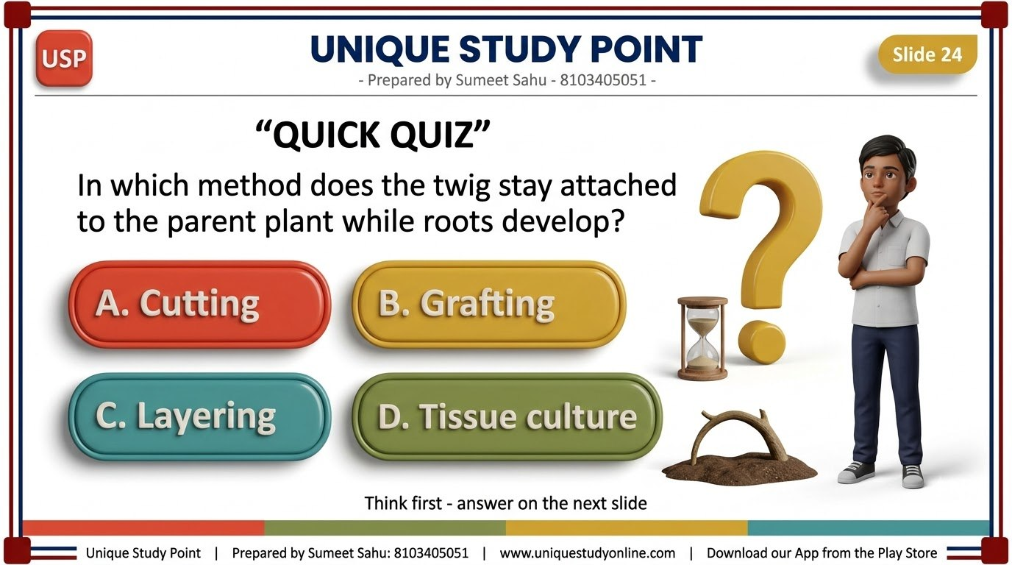
Notes:
Slide 24 - QUICK QUIZ
Unique Study Point | Prepared by Sumeet Sahu: 8103405051 | www.uniquestudyonline.com

Slide 25
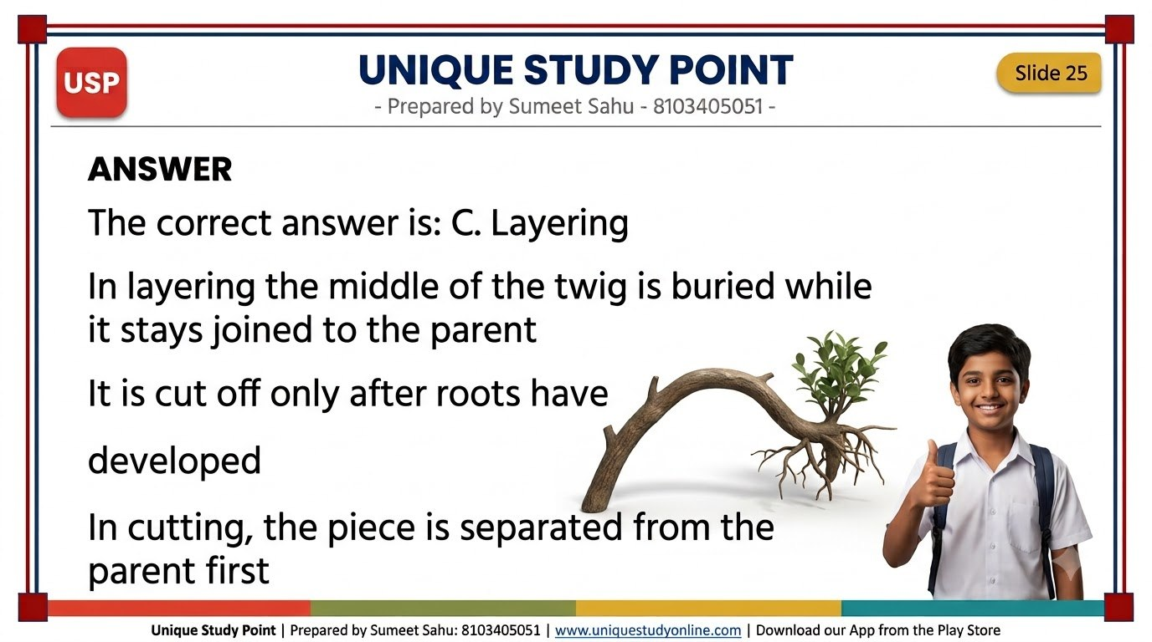
Notes:
Slide 25 - ANSWER
Unique Study Point | Prepared by Sumeet Sahu: 8103405051 | www.uniquestudyonline.com

Slide 26
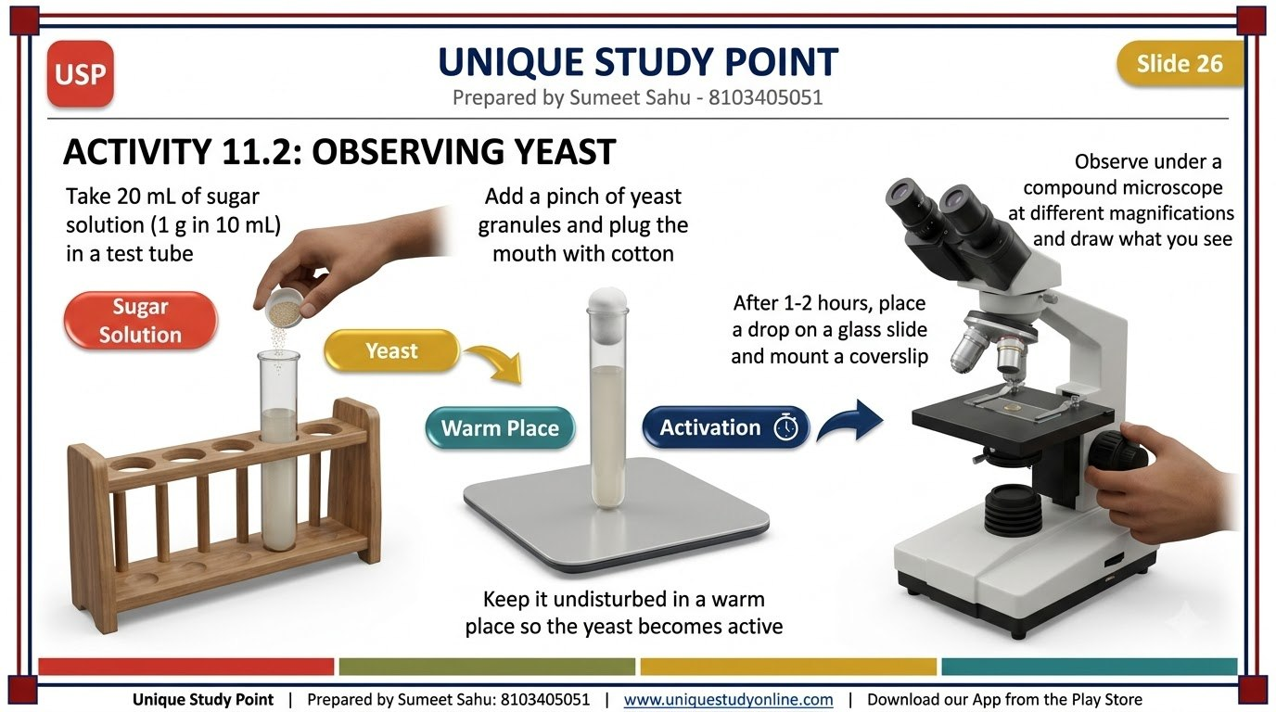
Notes:
Slide 26 - ACTIVITY 11.2: OBSERVING YEAST
Unique Study Point | Prepared by Sumeet Sahu: 8103405051 | www.uniquestudyonline.com

Slide 27
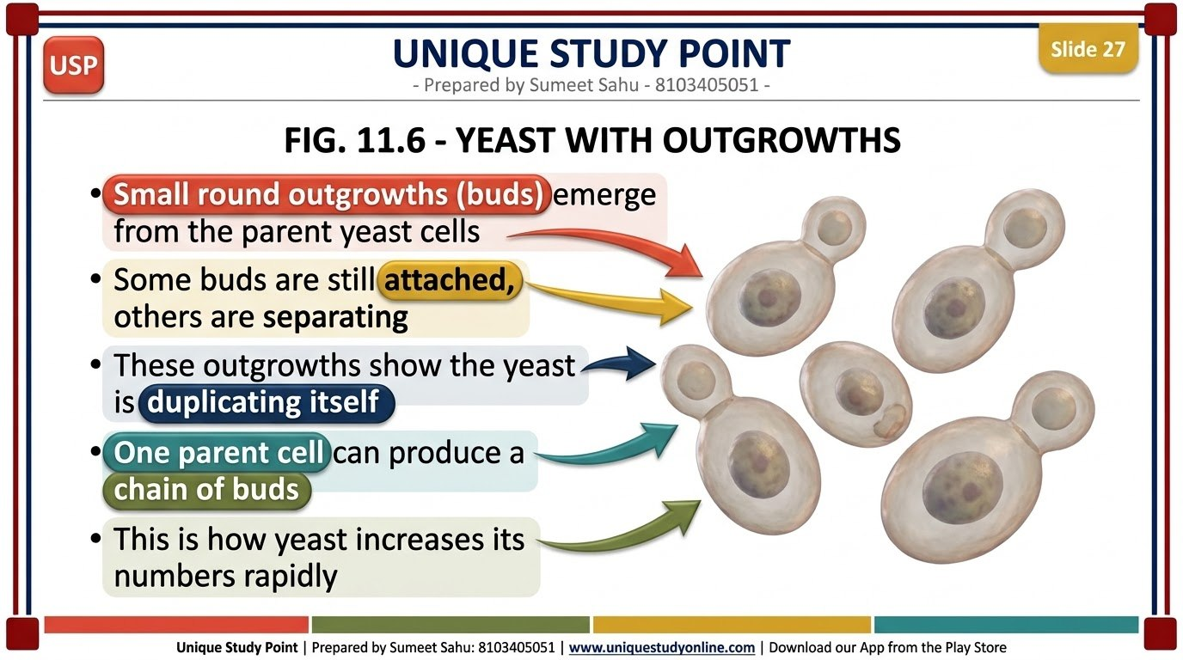
Notes:
Slide 27 - FIG. 11.6 - YEAST WITH OUTGROWTHS
Unique Study Point | Prepared by Sumeet Sahu: 8103405051 | www.uniquestudyonline.com

Slide 28
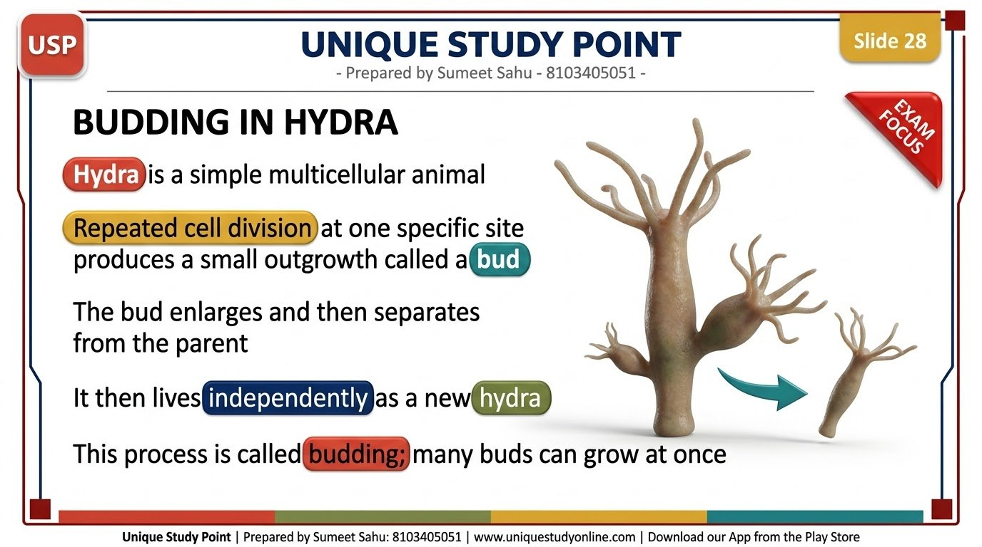
Notes:
Slide 28 - BUDDING IN HYDRA
Unique Study Point | Prepared by Sumeet Sahu: 8103405051 | www.uniquestudyonline.com

Slide 29
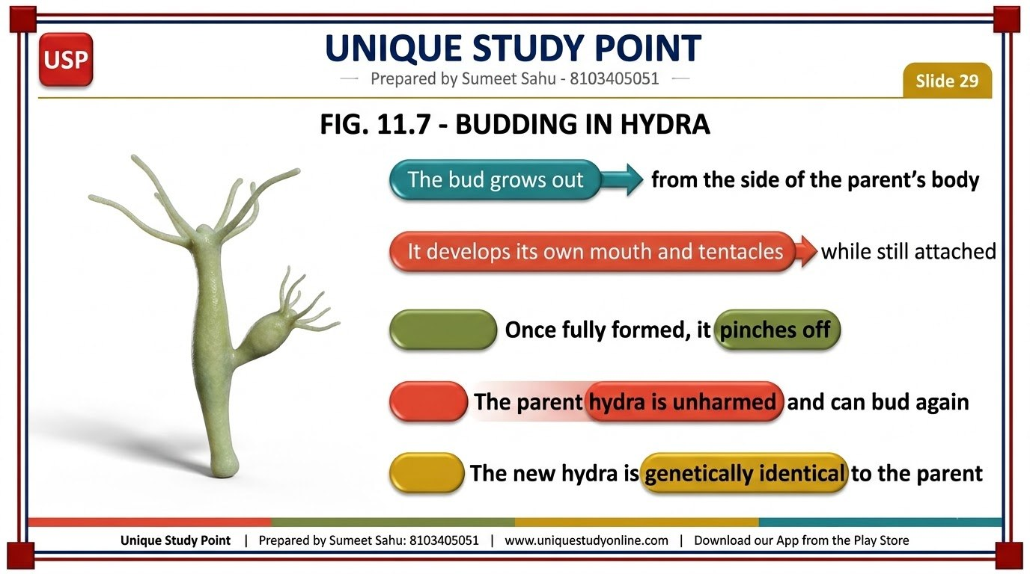
Notes:
Slide 29 - FIG. 11.7 - BUDDING IN HYDRA
Unique Study Point | Prepared by Sumeet Sahu: 8103405051 | www.uniquestudyonline.com

Slide 30
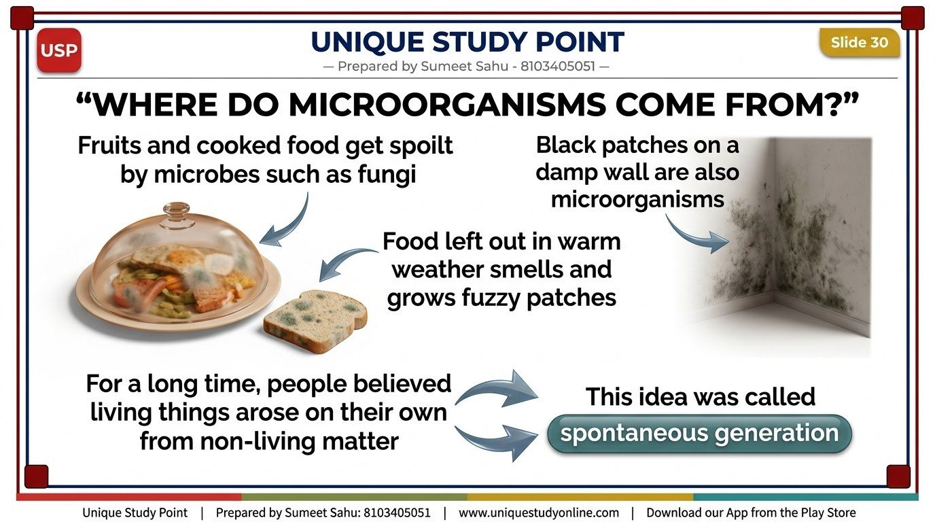
Notes:
Slide 30 - WHERE DO MICROORGANISMS COME FROM?
Unique Study Point | Prepared by Sumeet Sahu: 8103405051 | www.uniquestudyonline.com

Slide 31
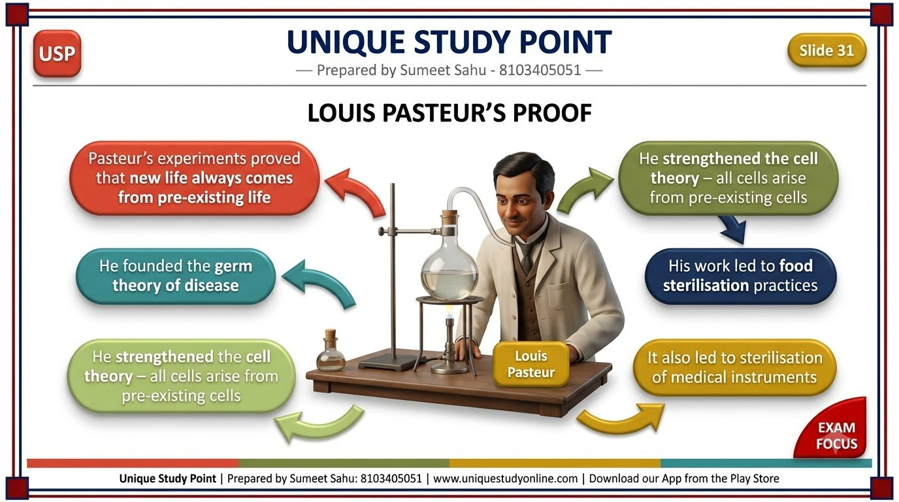
Notes:
Slide 31 - LOUIS PASTEUR'S PROOF
Unique Study Point | Prepared by Sumeet Sahu: 8103405051 | www.uniquestudyonline.com

Slide 32
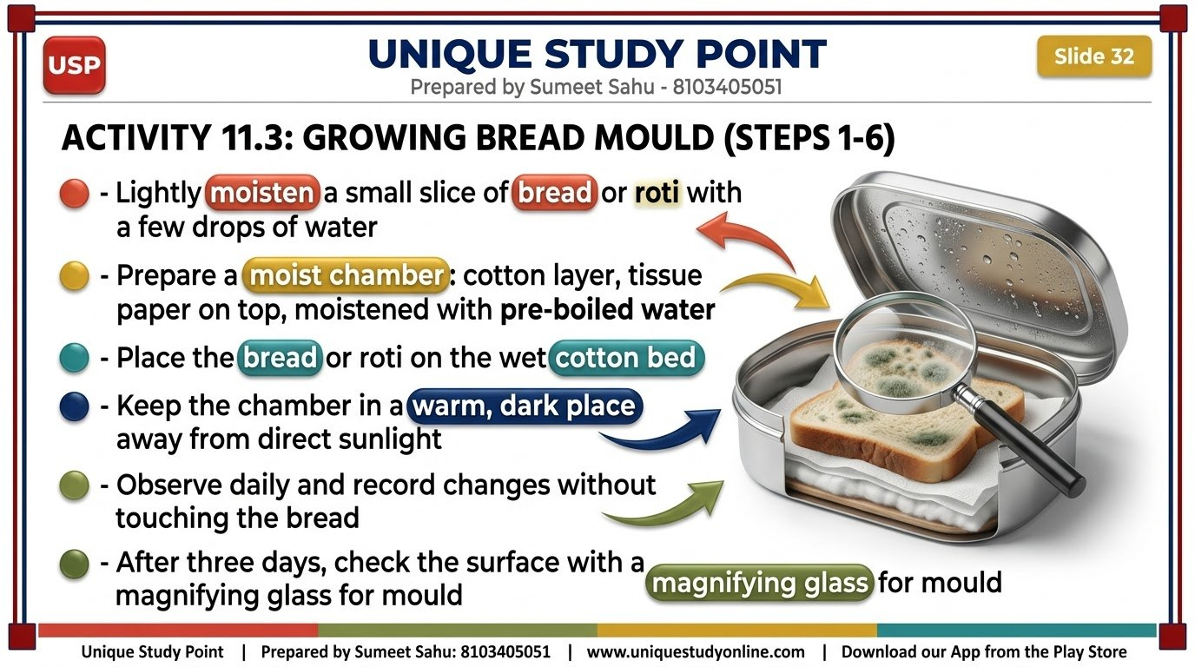
Notes:
Slide 32 - ACTIVITY 11.3: GROWING BREAD MOULD (STEPS 1-6)
Unique Study Point | Prepared by Sumeet Sahu: 8103405051 | www.uniquestudyonline.com

Slide 33
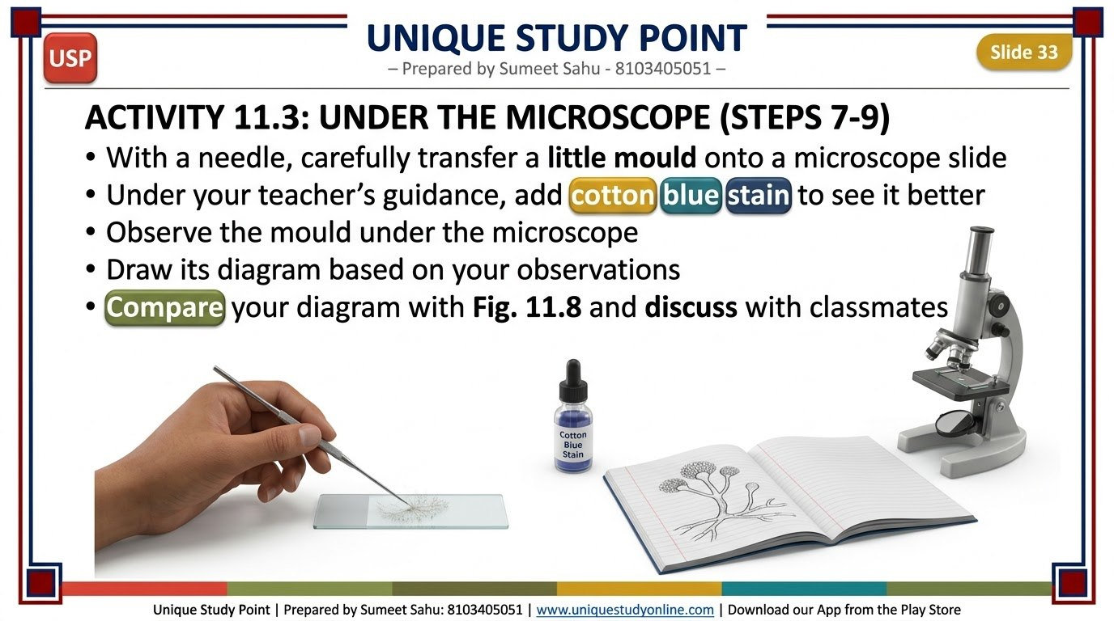
Notes:
Slide 33 - ACTIVITY 11.3: UNDER THE MICROSCOPE (STEPS 7-9)
Unique Study Point | Prepared by Sumeet Sahu: 8103405051 | www.uniquestudyonline.com

Slide 34
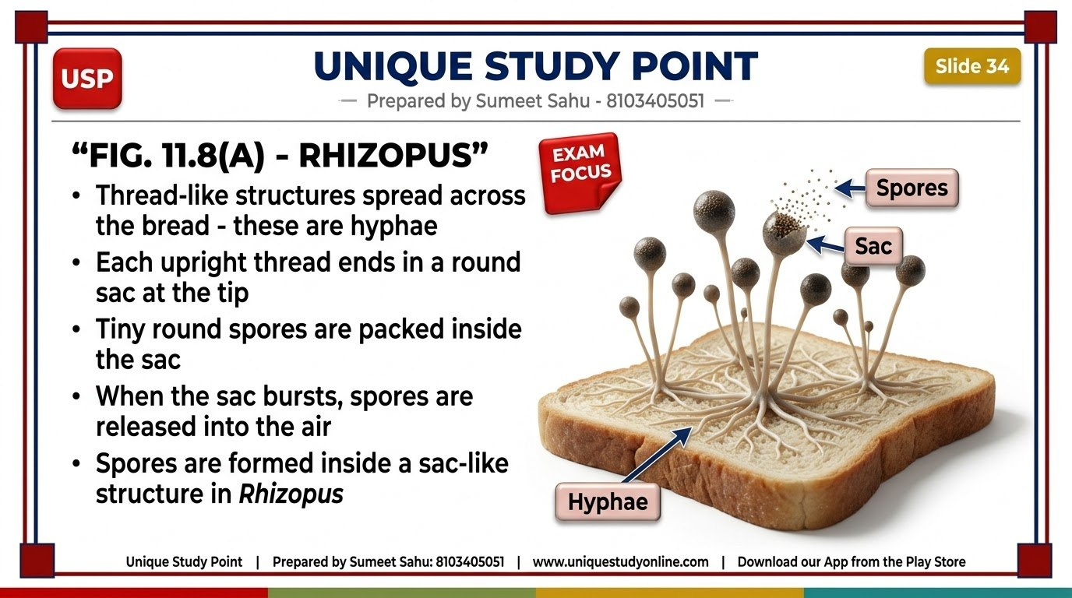
Notes:
Slide 34 - FIG. 11.8(A) - RHIZOPUS
Unique Study Point | Prepared by Sumeet Sahu: 8103405051 | www.uniquestudyonline.com

Slide 35
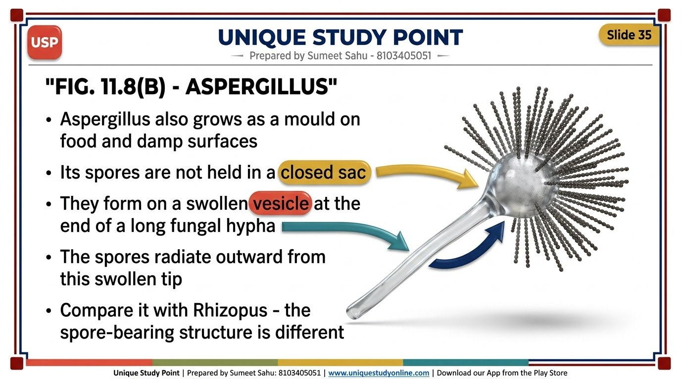
Notes:
Slide 35 - FIG. 11.8(B) - ASPERGILLUS
Unique Study Point | Prepared by Sumeet Sahu: 8103405051 | www.uniquestudyonline.com

Slide 36
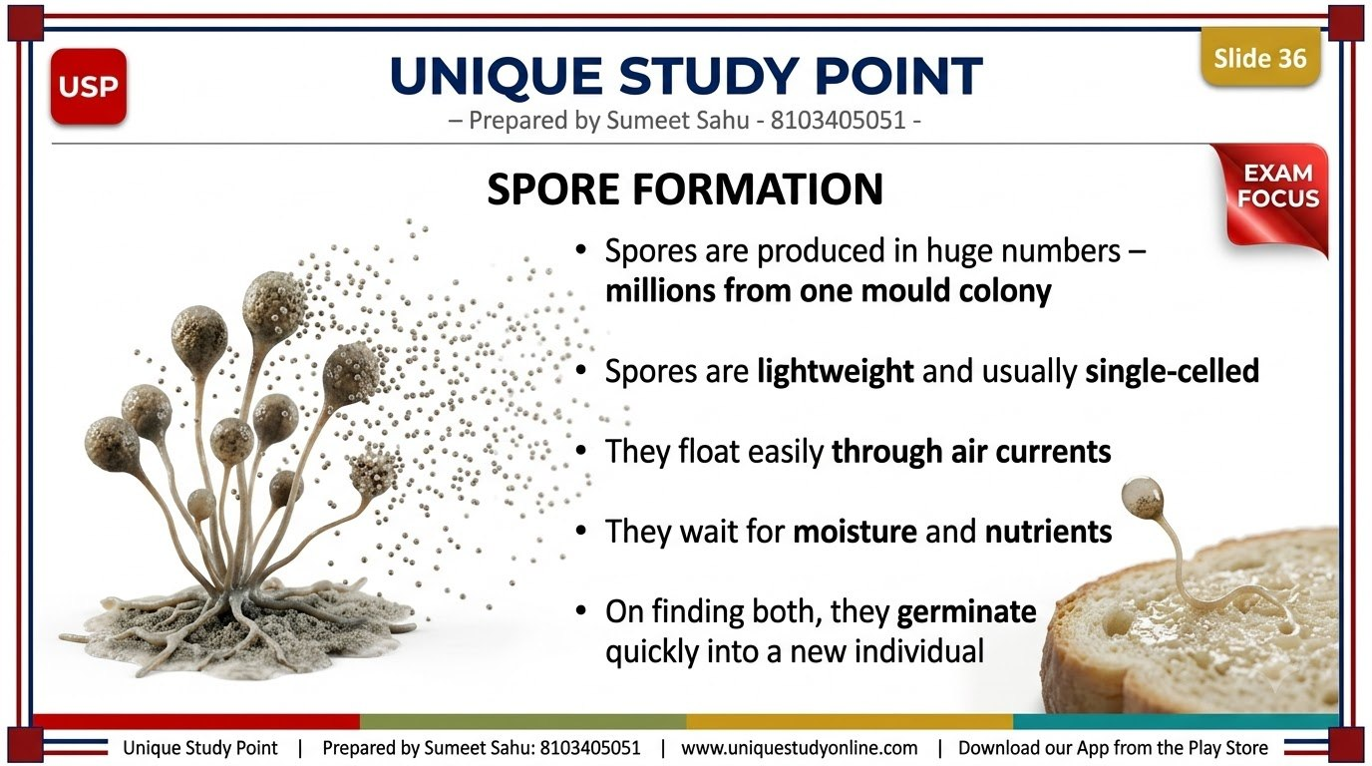
Notes:
Slide 36 - SPORE FORMATION
Unique Study Point | Prepared by Sumeet Sahu: 8103405051 | www.uniquestudyonline.com

Slide 37
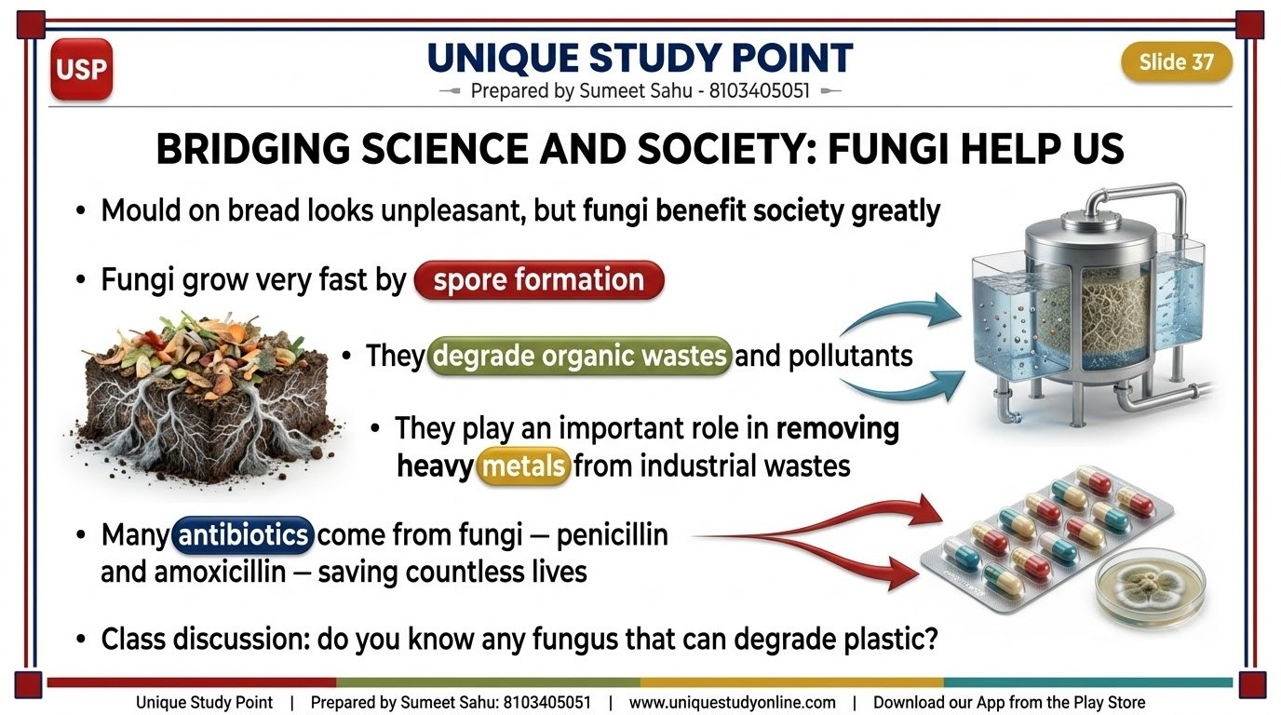
Notes:
Slide 37 - BRIDGING SCIENCE AND SOCIETY: FUNGI HELP US
Unique Study Point | Prepared by Sumeet Sahu: 8103405051 | www.uniquestudyonline.com

Slide 38
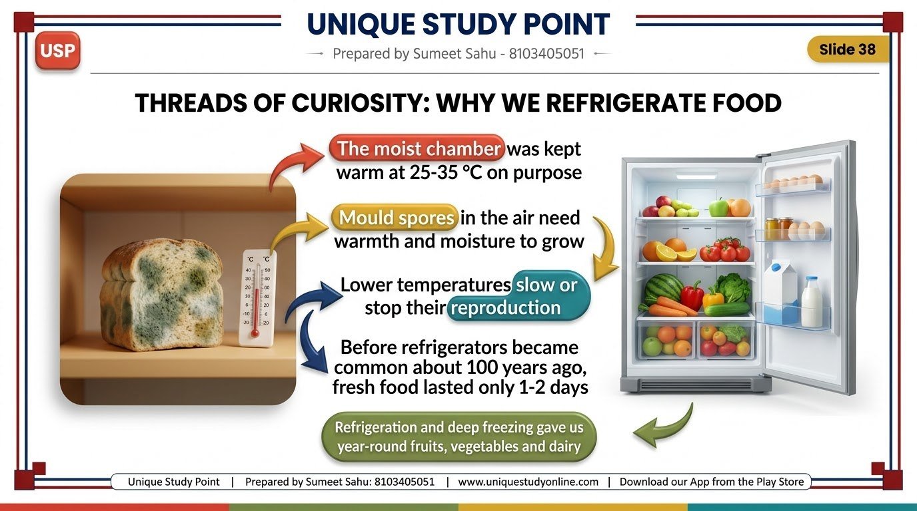
Notes:
Slide 38 - THREADS OF CURIOSITY: WHY WE REFRIGERATE FOOD
Unique Study Point | Prepared by Sumeet Sahu: 8103405051 | www.uniquestudyonline.com

Slide 39
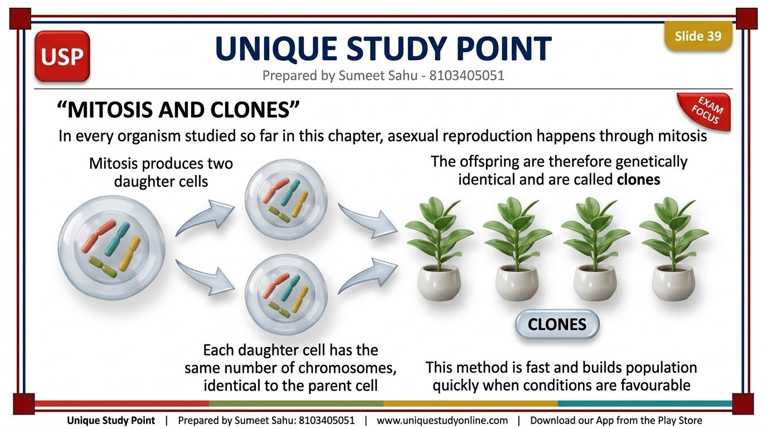
Notes:
Slide 39 - MITOSIS AND CLONES
Unique Study Point | Prepared by Sumeet Sahu: 8103405051 | www.uniquestudyonline.com

Slide 40
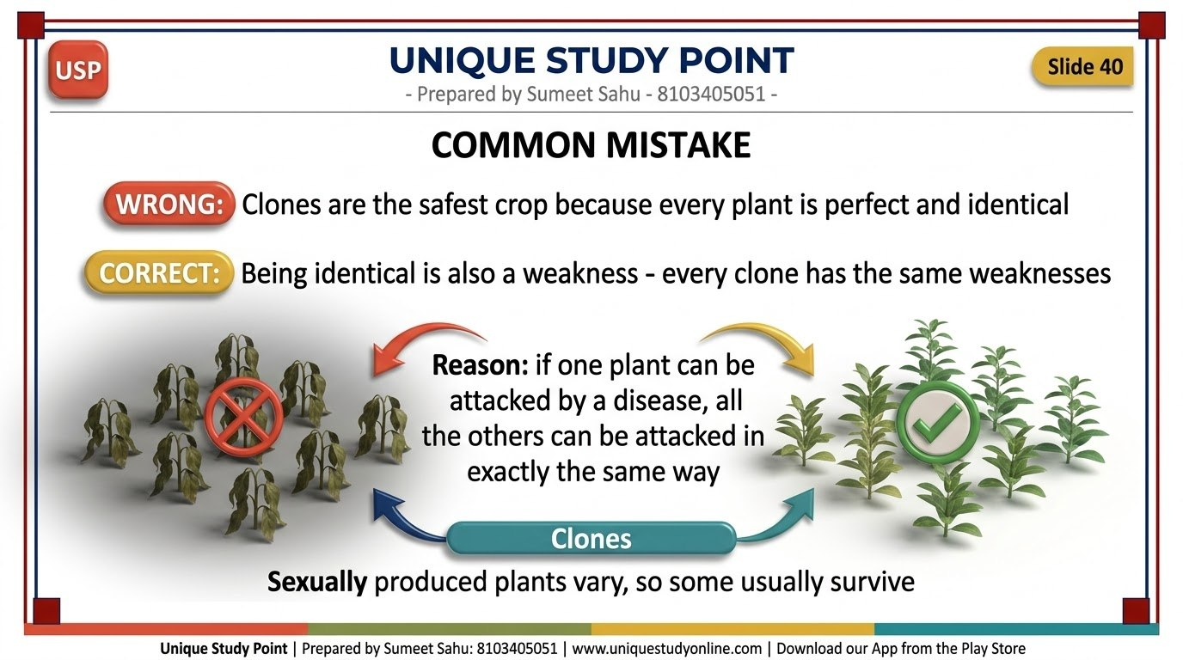
Notes:
Slide 40 - COMMON MISTAKE
Unique Study Point | Prepared by Sumeet Sahu: 8103405051 | www.uniquestudyonline.com

Slide 41
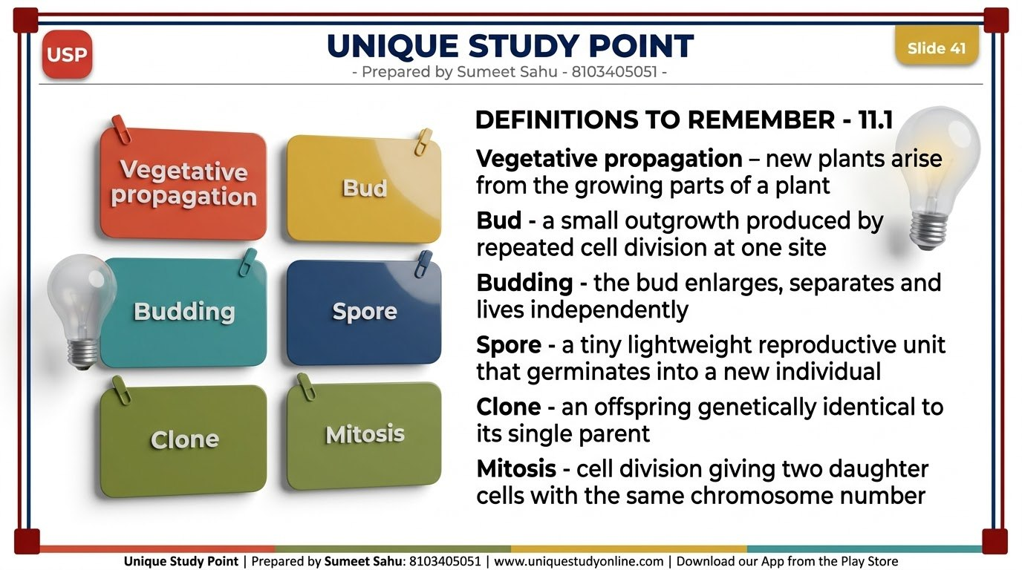
Notes:
Slide 41 - DEFINITIONS TO REMEMBER - 11.1
Unique Study Point | Prepared by Sumeet Sahu: 8103405051 | www.uniquestudyonline.com

Slide 42
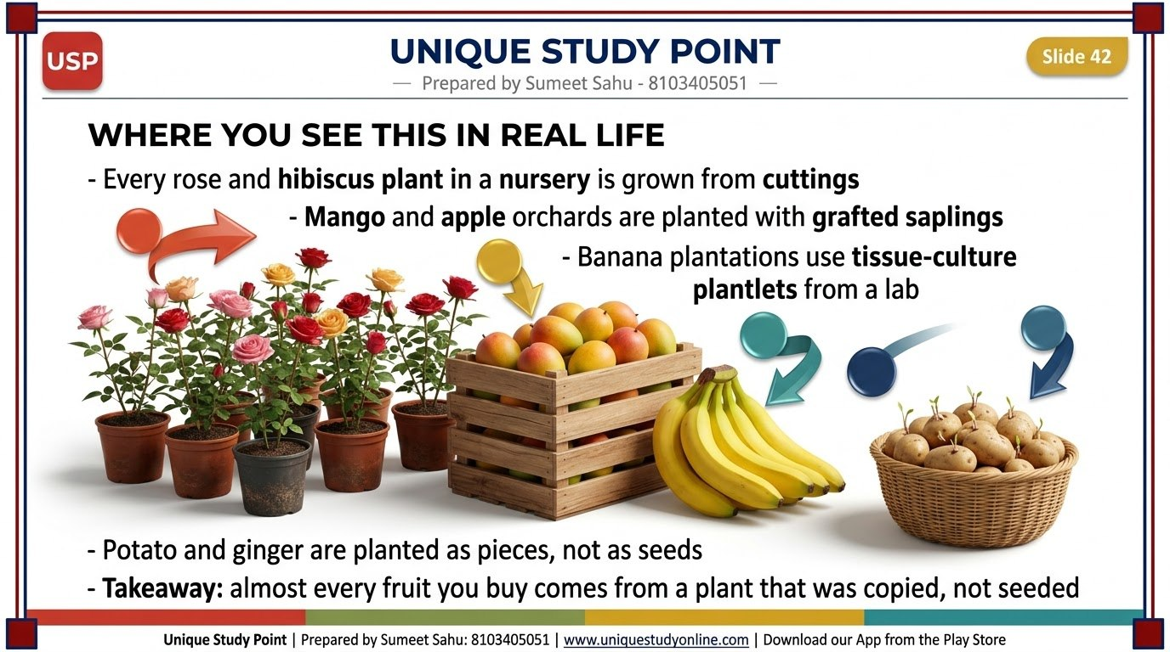
Notes:
Slide 42 - WHERE YOU SEE THIS IN REAL LIFE
Unique Study Point | Prepared by Sumeet Sahu: 8103405051 | www.uniquestudyonline.com

Slide 43
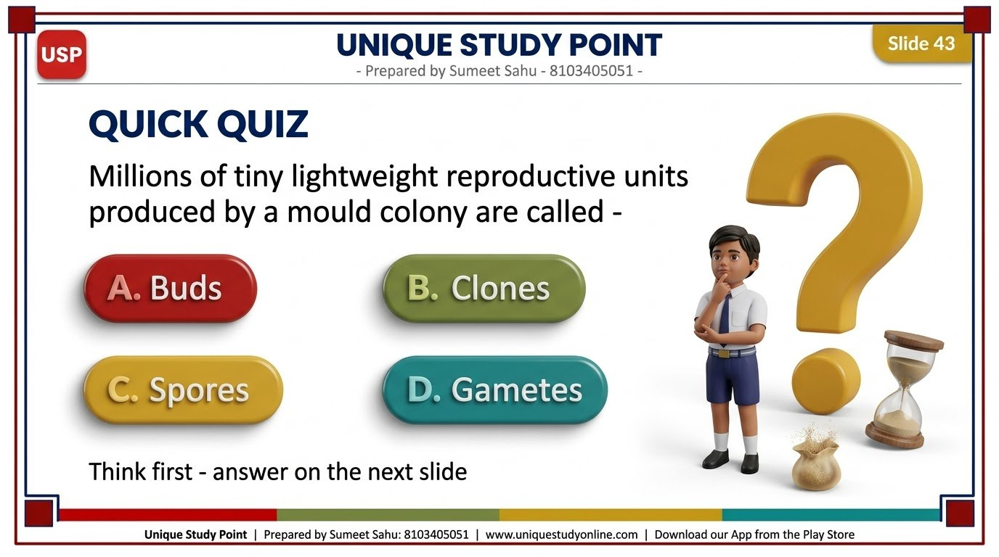
Notes:
Slide 43 - QUICK QUIZ
Unique Study Point | Prepared by Sumeet Sahu: 8103405051 | www.uniquestudyonline.com

Slide 44
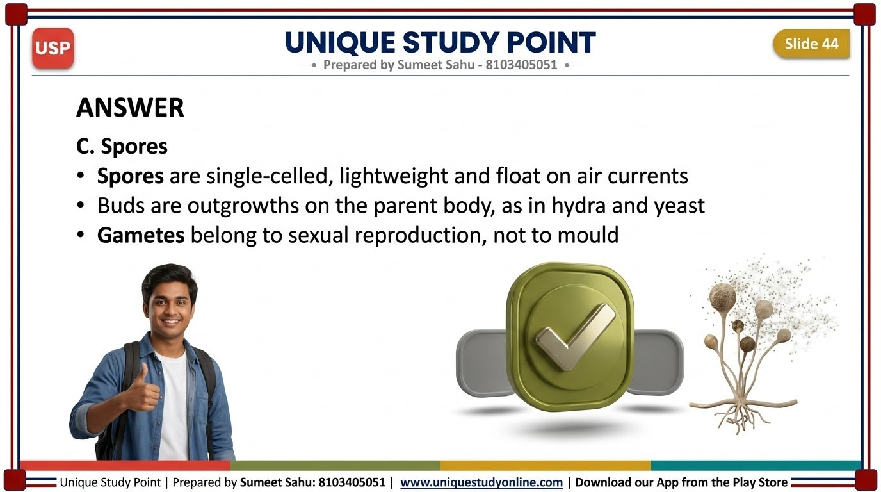
Notes:
Slide 44 - ANSWER
Unique Study Point | Prepared by Sumeet Sahu: 8103405051 | www.uniquestudyonline.com

Slide 45
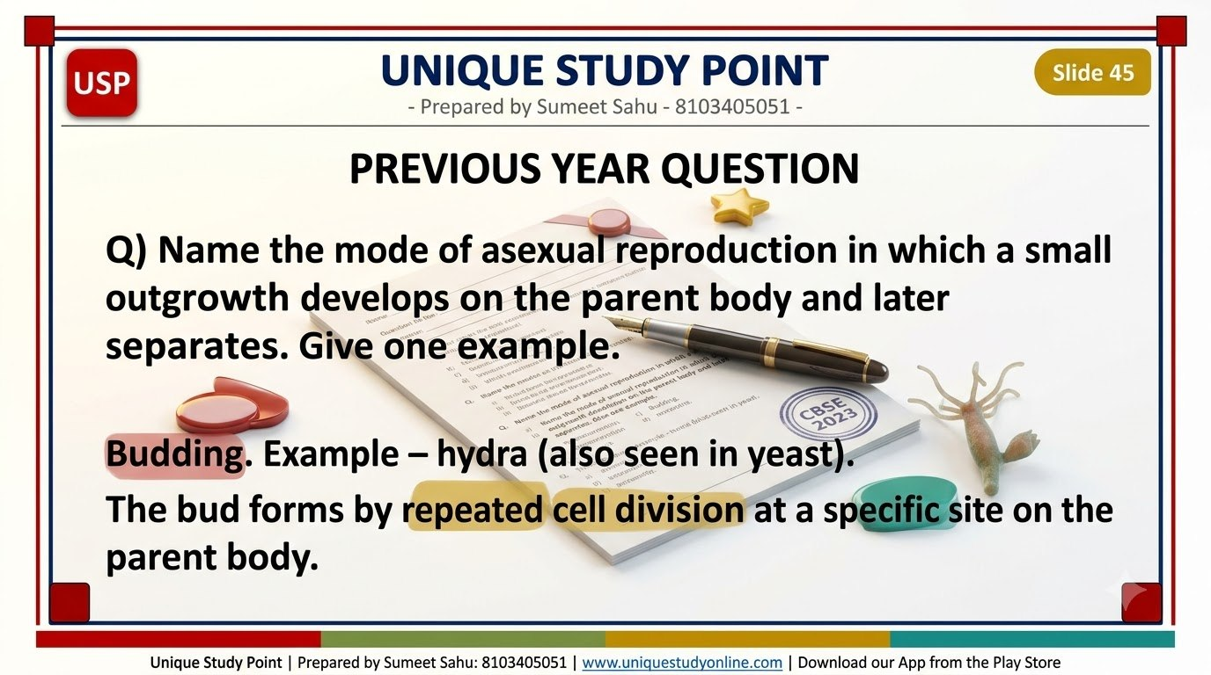
Notes:
Slide 45 - PREVIOUS YEAR QUESTION
Unique Study Point | Prepared by Sumeet Sahu: 8103405051 | www.uniquestudyonline.com

Slide 46
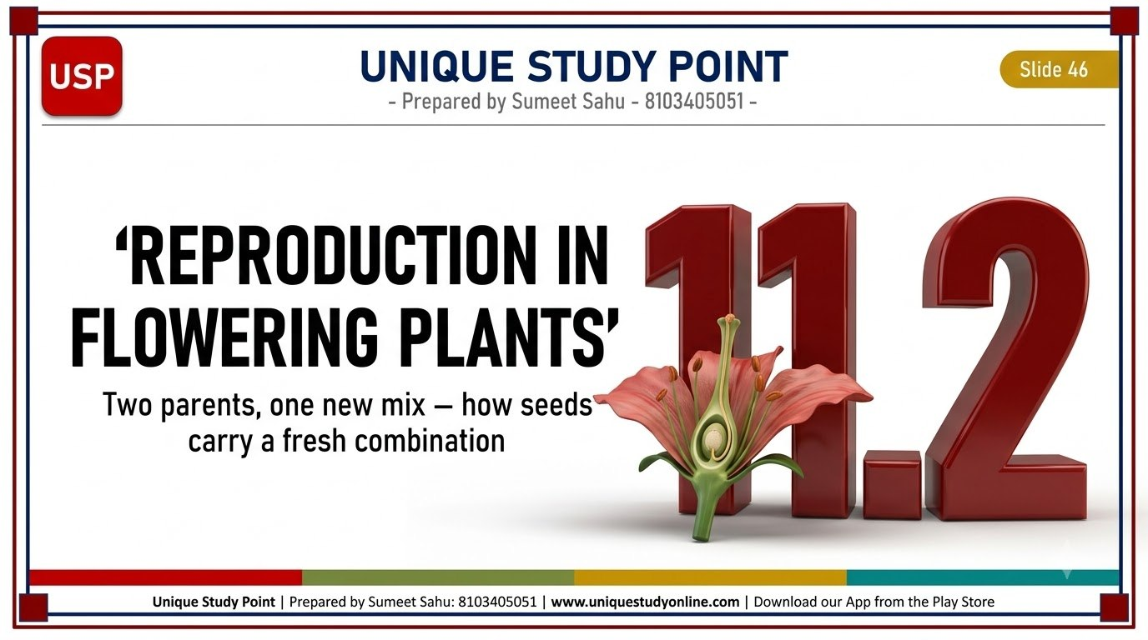
Notes:
Slide 46 - SECTION DIVIDER - SEXUAL REPRODUCTION
Unique Study Point | Prepared by Sumeet Sahu: 8103405051 | www.uniquestudyonline.com

Slide 47
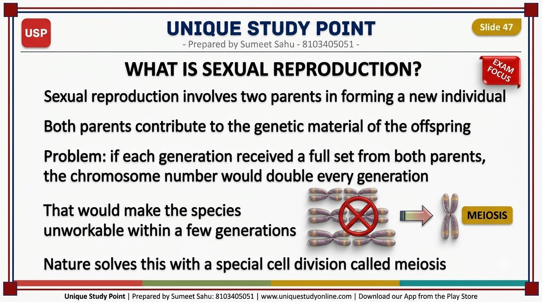
Notes:
Slide 47 - WHAT IS SEXUAL REPRODUCTION?
Unique Study Point | Prepared by Sumeet Sahu: 8103405051 | www.uniquestudyonline.com

Slide 48
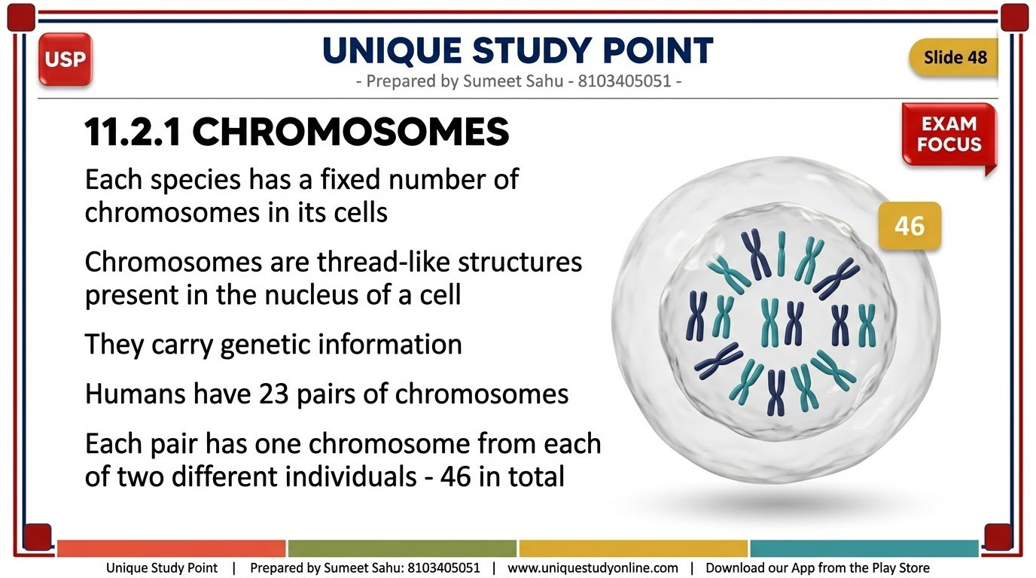
Notes:
Slide 48 - 11.2.1 CHROMOSOMES
Unique Study Point | Prepared by Sumeet Sahu: 8103405051 | www.uniquestudyonline.com

Slide 49
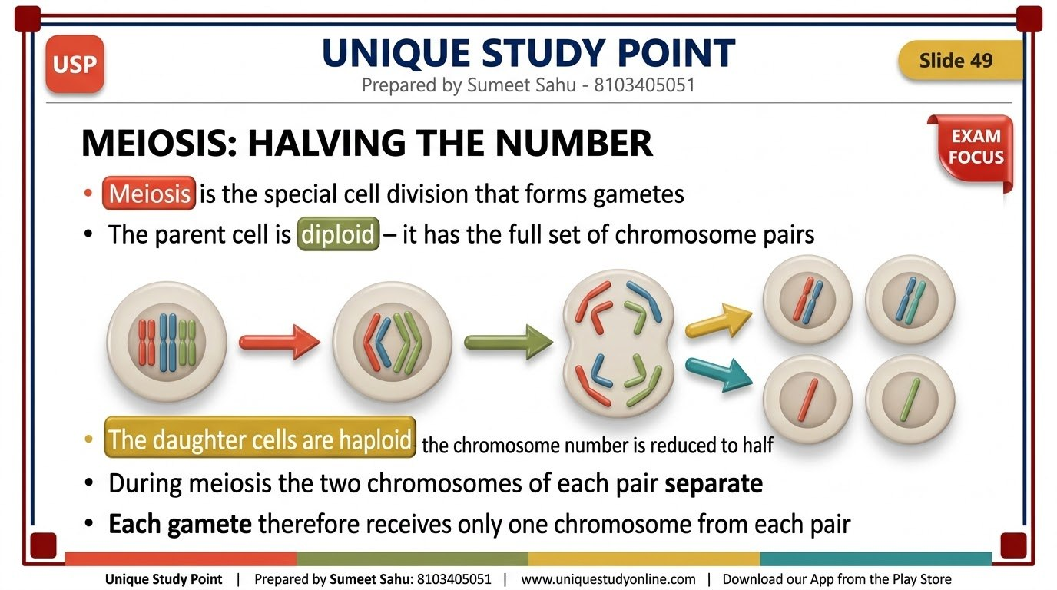
Notes:
Slide 49 - MEIOSIS: HALVING THE NUMBER
Unique Study Point | Prepared by Sumeet Sahu: 8103405051 | www.uniquestudyonline.com

Slide 50
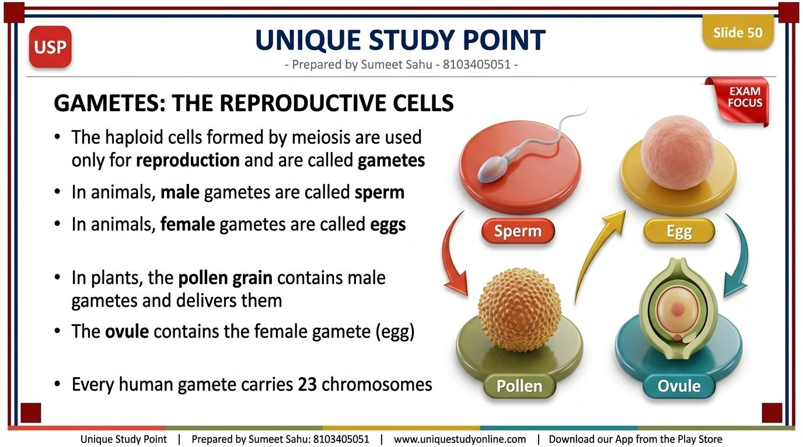
Notes:
Slide 50 - GAMETES: THE REPRODUCTIVE CELLS
Unique Study Point | Prepared by Sumeet Sahu: 8103405051 | www.uniquestudyonline.com

Slide 51
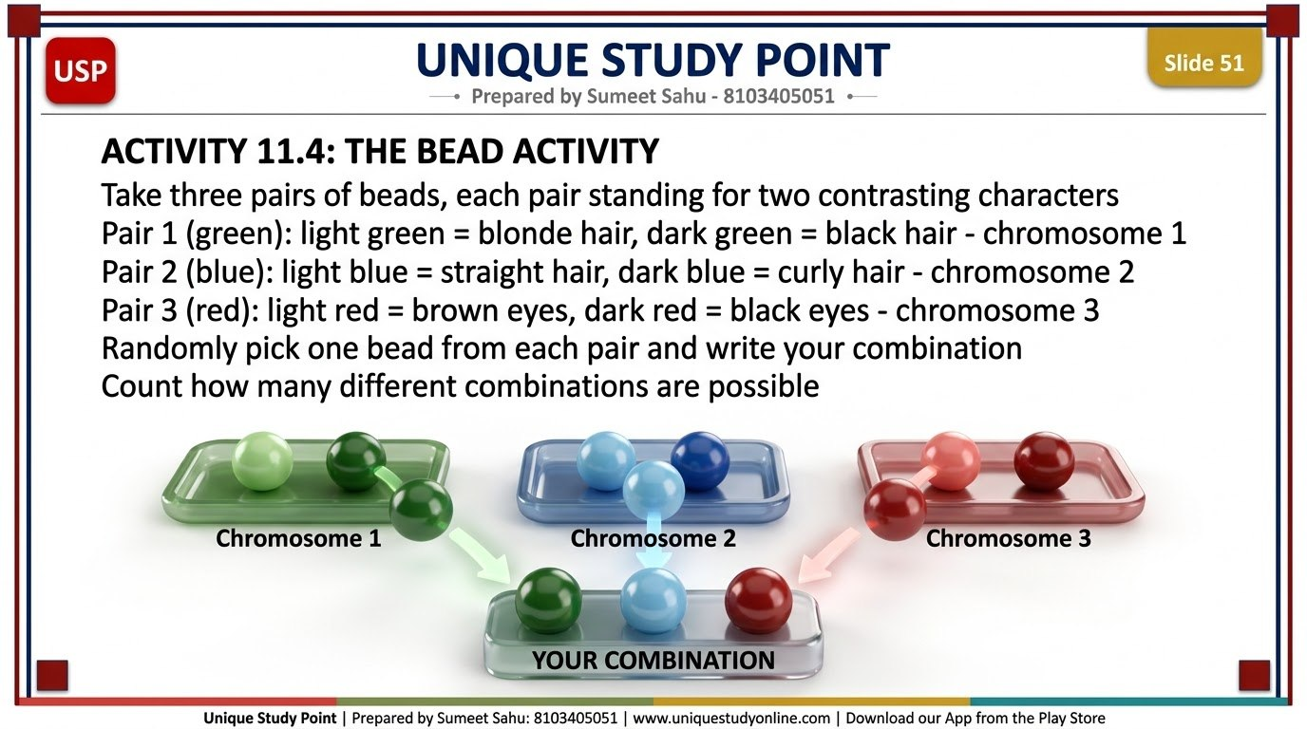
Notes:
Slide 51 - ACTIVITY 11.4: THE BEAD ACTIVITY
Unique Study Point | Prepared by Sumeet Sahu: 8103405051 | www.uniquestudyonline.com

Slide 52
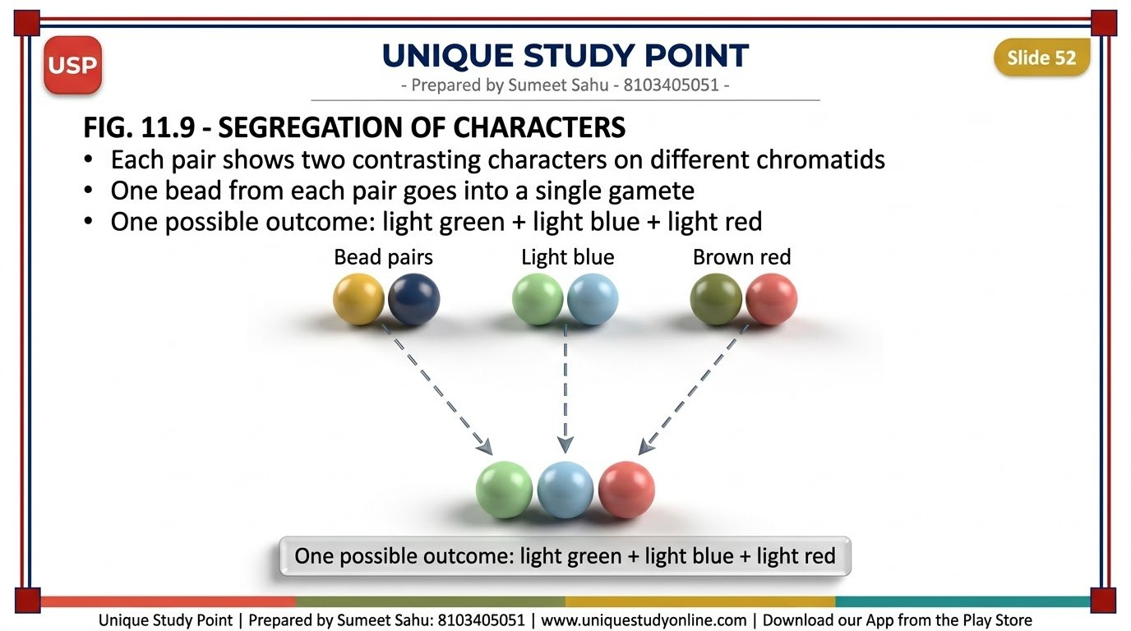
Notes:
Slide 52 - FIG. 11.9 - SEGREGATION OF CHARACTERS
Unique Study Point | Prepared by Sumeet Sahu: 8103405051 | www.uniquestudyonline.com

Slide 53
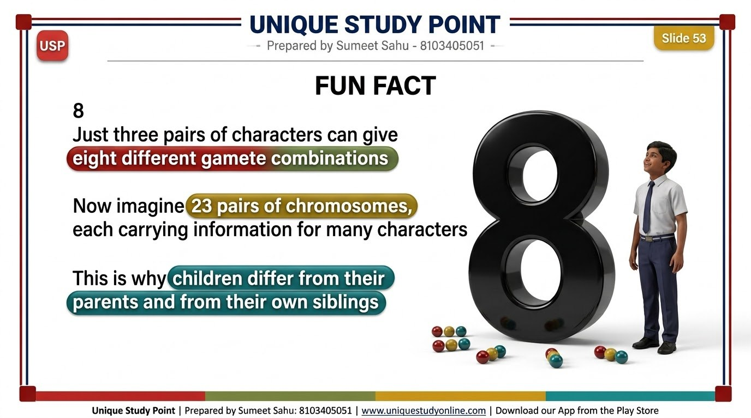
Notes:
Slide 53 - FUN FACT
Unique Study Point | Prepared by Sumeet Sahu: 8103405051 | www.uniquestudyonline.com

Slide 54

Notes:
Slide 54 - VARIATION AND EVOLUTION
Unique Study Point | Prepared by Sumeet Sahu: 8103405051 | www.uniquestudyonline.com

Slide 55

Notes:
Slide 55 - 11.2.2 FLOWERING PLANTS = ANGIOSPERMS
Unique Study Point | Prepared by Sumeet Sahu: 8103405051 | www.uniquestudyonline.com

Slide 56

Notes:
Slide 56 - SEPALS AND PETALS
Unique Study Point | Prepared by Sumeet Sahu: 8103405051 | www.uniquestudyonline.com

Slide 57

Notes:
Slide 57 - FIG. 11.10 - PARTS OF A FLOWER (L.S.)
Unique Study Point | Prepared by Sumeet Sahu: 8103405051 | www.uniquestudyonline.com

Slide 58

Notes:
Slide 58 - ACTIVITY 11.5: EXPLORING FLOWERS
Unique Study Point | Prepared by Sumeet Sahu: 8103405051 | www.uniquestudyonline.com

Slide 59

Notes:
Slide 59 - TABLE 11.1 - OBSERVATION TABLE
Unique Study Point | Prepared by Sumeet Sahu: 8103405051 | www.uniquestudyonline.com

Slide 60

Notes:
Slide 60 - A COMPLETE FLOWER - AND AN INCOMPLETE ONE
Unique Study Point | Prepared by Sumeet Sahu: 8103405051 | www.uniquestudyonline.com

Slide 61

Notes:
Slide 61 - THE STAMEN - MALE PART OF A FLOWER
Unique Study Point | Prepared by Sumeet Sahu: 8103405051 | www.uniquestudyonline.com

Slide 62

Notes:
Slide 62 - THE PISTIL - FEMALE PART OF A FLOWER
Unique Study Point | Prepared by Sumeet Sahu: 8103405051 | www.uniquestudyonline.com

Slide 63

Notes:
Slide 63 - FIG. 11.11 - STRUCTURE OF A PISTIL
Unique Study Point | Prepared by Sumeet Sahu: 8103405051 | www.uniquestudyonline.com

Slide 64

Notes:
Slide 64 - USP TRICK
Unique Study Point | Prepared by Sumeet Sahu: 8103405051 | www.uniquestudyonline.com

Slide 65

Notes:
Slide 65 - QUICK QUIZ
Unique Study Point | Prepared by Sumeet Sahu: 8103405051 | www.uniquestudyonline.com

Slide 66

Notes:
Slide 66 - ANSWER
Unique Study Point | Prepared by Sumeet Sahu: 8103405051 | www.uniquestudyonline.com

Slide 67

Notes:
Slide 67 - ACTIVITY 11.6: THE PEA PLANT INVESTIGATION
Unique Study Point | Prepared by Sumeet Sahu: 8103405051 | www.uniquestudyonline.com

Slide 68

Notes:
Slide 68 - FIG. 11.12 - EXPERIMENTAL SET-UP
Unique Study Point | Prepared by Sumeet Sahu: 8103405051 | www.uniquestudyonline.com

Slide 69

Notes:
Slide 69 - TABLE 11.2 AND THE INFERENCE
Unique Study Point | Prepared by Sumeet Sahu: 8103405051 | www.uniquestudyonline.com

Slide 70

Notes:
Slide 70 - POLLINATION DEFINED
Unique Study Point | Prepared by Sumeet Sahu: 8103405051 | www.uniquestudyonline.com

Slide 71

Notes:
Slide 71 - 11.2.3 SELF-POLLINATION
Unique Study Point | Prepared by Sumeet Sahu: 8103405051 | www.uniquestudyonline.com

Slide 72

Notes:
Slide 72 - CROSS-POLLINATION
Unique Study Point | Prepared by Sumeet Sahu: 8103405051 | www.uniquestudyonline.com

Slide 73

Notes:
Slide 73 - SELF VS CROSS-POLLINATION - FIG. 11.13
Unique Study Point | Prepared by Sumeet Sahu: 8103405051 | www.uniquestudyonline.com

Slide 74

Notes:
Slide 74 - 11.2.4 POLLINATORS
Unique Study Point | Prepared by Sumeet Sahu: 8103405051 | www.uniquestudyonline.com

Slide 75

Notes:
Slide 75 - WIND POLLINATION
Unique Study Point | Prepared by Sumeet Sahu: 8103405051 | www.uniquestudyonline.com

Slide 76

Notes:
Slide 76 - WATER POLLINATION
Unique Study Point | Prepared by Sumeet Sahu: 8103405051 | www.uniquestudyonline.com

Slide 77

Notes:
Slide 77 - INSECT POLLINATION
Unique Study Point | Prepared by Sumeet Sahu: 8103405051 | www.uniquestudyonline.com

Slide 78

Notes:
Slide 78 - BIRD POLLINATION AND NIGHT-BLOOMING FLOWERS
Unique Study Point | Prepared by Sumeet Sahu: 8103405051 | www.uniquestudyonline.com

Slide 79

Notes:
Slide 79 - FREE NOTES CTA
Unique Study Point | Prepared by Sumeet Sahu: 8103405051 | www.uniquestudyonline.com

Slide 80

Notes:
Slide 80 - 11.2.5 FERTILISATION BEGINS
Unique Study Point | Prepared by Sumeet Sahu: 8103405051 | www.uniquestudyonline.com

Slide 81

Notes:
Slide 81 - FIG. 11.14 - GERMINATION OF POLLEN ON STIGMA
Unique Study Point | Prepared by Sumeet Sahu: 8103405051 | www.uniquestudyonline.com

Slide 82

Notes:
Slide 82 - FROM ZYGOTE TO FRUIT AND SEED
Unique Study Point | Prepared by Sumeet Sahu: 8103405051 | www.uniquestudyonline.com

Slide 83

Notes:
Slide 83 - FIG. 11.15 - OVARY BECOMES FRUIT
Unique Study Point | Prepared by Sumeet Sahu: 8103405051 | www.uniquestudyonline.com

Slide 84

Notes:
Slide 84 - SEED DISPERSAL AND GERMINATION
Unique Study Point | Prepared by Sumeet Sahu: 8103405051 | www.uniquestudyonline.com

Slide 85

Notes:
Slide 85 - ACTIVITY 11.7 AND TABLE 11.3
Unique Study Point | Prepared by Sumeet Sahu: 8103405051 | www.uniquestudyonline.com

Slide 86

Notes:
Slide 86 - READING THE DATA - HYPOTHESIS AND PARAMETERS
Unique Study Point | Prepared by Sumeet Sahu: 8103405051 | www.uniquestudyonline.com

Slide 87

Notes:
Slide 87 - PAUSE AND PONDER - QUESTION 1
Unique Study Point | Prepared by Sumeet Sahu: 8103405051 | www.uniquestudyonline.com

Slide 88

Notes:
Slide 88 - PAUSE AND PONDER - ANSWER 1
Unique Study Point | Prepared by Sumeet Sahu: 8103405051 | www.uniquestudyonline.com

Slide 89

Notes:
Slide 89 - PAUSE AND PONDER - QUESTION 2
Unique Study Point | Prepared by Sumeet Sahu: 8103405051 | www.uniquestudyonline.com

Slide 90

Notes:
Slide 90 - PAUSE AND PONDER - ANSWER 2
Unique Study Point | Prepared by Sumeet Sahu: 8103405051 | www.uniquestudyonline.com

Slide 91

Notes:
Slide 91 - PAUSE AND PONDER - QUESTION 3
Unique Study Point | Prepared by Sumeet Sahu: 8103405051 | www.uniquestudyonline.com

Slide 92

Notes:
Slide 92 - PAUSE AND PONDER - ANSWER 3
Unique Study Point | Prepared by Sumeet Sahu: 8103405051 | www.uniquestudyonline.com

Slide 93

Notes:
Slide 93 - MEET A SCIENTIST: P. MAHESHWARI
Unique Study Point | Prepared by Sumeet Sahu: 8103405051 | www.uniquestudyonline.com

Slide 94

Notes:
Slide 94 - BRIDGING SCIENCE AND SOCIETY: PLANT BREEDING
Unique Study Point | Prepared by Sumeet Sahu: 8103405051 | www.uniquestudyonline.com

Slide 95

Notes:
Slide 95 - DEFINITIONS TO REMEMBER - 11.2
Unique Study Point | Prepared by Sumeet Sahu: 8103405051 | www.uniquestudyonline.com

Slide 96

Notes:
Slide 96 - WHERE YOU SEE THIS IN REAL LIFE
Unique Study Point | Prepared by Sumeet Sahu: 8103405051 | www.uniquestudyonline.com

Slide 97

Notes:
Slide 97 - COMMON MISTAKE
Unique Study Point | Prepared by Sumeet Sahu: 8103405051 | www.uniquestudyonline.com

Slide 98

Notes:
Slide 98 - QUICK QUIZ
Unique Study Point | Prepared by Sumeet Sahu: 8103405051 | www.uniquestudyonline.com

Slide 99

Notes:
Slide 99 - ANSWER
Unique Study Point | Prepared by Sumeet Sahu: 8103405051 | www.uniquestudyonline.com

Slide 100

Notes:
Slide 100 - PREVIOUS YEAR QUESTION
Unique Study Point | Prepared by Sumeet Sahu: 8103405051 | www.uniquestudyonline.com

Slide 101

Notes:
Slide 101 - SECTION DIVIDER - REPRODUCTION IN ANIMALS
Unique Study Point | Prepared by Sumeet Sahu: 8103405051 | www.uniquestudyonline.com

Slide 102

Notes:
Slide 102 - REPRODUCTION IN ANIMALS: OVERVIEW
Unique Study Point | Prepared by Sumeet Sahu: 8103405051 | www.uniquestudyonline.com

Slide 103

Notes:
Slide 103 - EXTERNAL FERTILISATION
Unique Study Point | Prepared by Sumeet Sahu: 8103405051 | www.uniquestudyonline.com

Slide 104

Notes:
Slide 104 - INTERNAL FERTILISATION
Unique Study Point | Prepared by Sumeet Sahu: 8103405051 | www.uniquestudyonline.com

Slide 105

Notes:
Slide 105 - EXTERNAL VS INTERNAL FERTILISATION
Unique Study Point | Prepared by Sumeet Sahu: 8103405051 | www.uniquestudyonline.com

Slide 106

Notes:
Slide 106 - PAUSE AND PONDER - QUESTION 4
Unique Study Point | Prepared by Sumeet Sahu: 8103405051 | www.uniquestudyonline.com

Slide 107

Notes:
Slide 107 - PAUSE AND PONDER - ANSWER 4
Unique Study Point | Prepared by Sumeet Sahu: 8103405051 | www.uniquestudyonline.com

Slide 108

Notes:
Slide 108 - PAUSE AND PONDER - QUESTION 5
Unique Study Point | Prepared by Sumeet Sahu: 8103405051 | www.uniquestudyonline.com

Slide 109

Notes:
Slide 109 - PAUSE AND PONDER - ANSWER 5
Unique Study Point | Prepared by Sumeet Sahu: 8103405051 | www.uniquestudyonline.com

Slide 110

Notes:
Slide 110 - TABLE 11.4 - VARIATION IN REPRODUCTIVE STRATEGIES
Unique Study Point | Prepared by Sumeet Sahu: 8103405051 | www.uniquestudyonline.com

Slide 111

Notes:
Slide 111 - YOLK, LARVA AND THE FEEDING STAGE
Unique Study Point | Prepared by Sumeet Sahu: 8103405051 | www.uniquestudyonline.com

Slide 112

Notes:
Slide 112 - FIG. 11.17 - LIFE CYCLE OF A BUTTERFLY
Unique Study Point | Prepared by Sumeet Sahu: 8103405051 | www.uniquestudyonline.com

Slide 113

Notes:
Slide 113 - REPTILES, BIRDS AND MAMMALS
Unique Study Point | Prepared by Sumeet Sahu: 8103405051 | www.uniquestudyonline.com

Slide 114

Notes:
Slide 114 - CARE AFTER BIRTH
Unique Study Point | Prepared by Sumeet Sahu: 8103405051 | www.uniquestudyonline.com

Slide 115

Notes:
Slide 115 - FUN FACT
Unique Study Point | Prepared by Sumeet Sahu: 8103405051 | www.uniquestudyonline.com

Slide 116

Notes:
Slide 116 - DEFINITIONS TO REMEMBER - 11.3 AND 11.4
Unique Study Point | Prepared by Sumeet Sahu: 8103405051 | www.uniquestudyonline.com

Slide 117

Notes:
Slide 117 - WHERE YOU SEE THIS IN REAL LIFE
Unique Study Point | Prepared by Sumeet Sahu: 8103405051 | www.uniquestudyonline.com

Slide 118

Notes:
Slide 118 - QUICK QUIZ
Unique Study Point | Prepared by Sumeet Sahu: 8103405051 | www.uniquestudyonline.com

Slide 119

Notes:
Slide 119 - ANSWER
Unique Study Point | Prepared by Sumeet Sahu: 8103405051 | www.uniquestudyonline.com

Slide 120

Notes:
Slide 120 - SECTION DIVIDER - REPRODUCTION IN HUMAN BEINGS
Unique Study Point | Prepared by Sumeet Sahu: 8103405051 | www.uniquestudyonline.com

Slide 121

Notes:
Slide 121 - 11.5.1 REPRODUCTIVE MATURITY
Unique Study Point | Prepared by Sumeet Sahu: 8103405051 | www.uniquestudyonline.com

Slide 122

Notes:
Slide 122 - THE HUMAN REPRODUCTIVE SYSTEM
Unique Study Point | Prepared by Sumeet Sahu: 8103405051 | www.uniquestudyonline.com

Slide 123

Notes:
Slide 123 - 11.5.2 MALE REPRODUCTIVE SYSTEM - TESTES
Unique Study Point | Prepared by Sumeet Sahu: 8103405051 | www.uniquestudyonline.com

Slide 124

Notes:
Slide 124 - MALE SYSTEM - THE PATHWAY OF SPERM
Unique Study Point | Prepared by Sumeet Sahu: 8103405051 | www.uniquestudyonline.com

Slide 125

Notes:
Slide 125 - FIG. 11.18 - MALE REPRODUCTIVE SYSTEM
Unique Study Point | Prepared by Sumeet Sahu: 8103405051 | www.uniquestudyonline.com

Slide 126

Notes:
Slide 126 - 11.5.3 FEMALE REPRODUCTIVE SYSTEM
Unique Study Point | Prepared by Sumeet Sahu: 8103405051 | www.uniquestudyonline.com

Slide 127

Notes:
Slide 127 - FIG. 11.19 - FEMALE REPRODUCTIVE SYSTEM
Unique Study Point | Prepared by Sumeet Sahu: 8103405051 | www.uniquestudyonline.com

Slide 128

Notes:
Slide 128 - MEET A SCIENTIST: IVF IN INDIA
Unique Study Point | Prepared by Sumeet Sahu: 8103405051 | www.uniquestudyonline.com

Slide 129

Notes:
Slide 129 - 11.5.4 GAMETOGENESIS
Unique Study Point | Prepared by Sumeet Sahu: 8103405051 | www.uniquestudyonline.com

Slide 130

Notes:
Slide 130 - TABLE 11.5 - SPERM VS EGG
Unique Study Point | Prepared by Sumeet Sahu: 8103405051 | www.uniquestudyonline.com

Slide 131

Notes:
Slide 131 - 11.5.5 OVULATION
Unique Study Point | Prepared by Sumeet Sahu: 8103405051 | www.uniquestudyonline.com

Slide 132

Notes:
Slide 132 - FERTILISATION AND IMPLANTATION
Unique Study Point | Prepared by Sumeet Sahu: 8103405051 | www.uniquestudyonline.com

Slide 133

Notes:
Slide 133 - FIG. 11.20 - PROCESS OF FERTILISATION
Unique Study Point | Prepared by Sumeet Sahu: 8103405051 | www.uniquestudyonline.com

Slide 134

Notes:
Slide 134 - 11.5.6 WHEN THE EGG IS NOT FERTILISED
Unique Study Point | Prepared by Sumeet Sahu: 8103405051 | www.uniquestudyonline.com

Slide 135

Notes:
Slide 135 - FIG. 11.21 - THE MENSTRUAL CYCLE
Unique Study Point | Prepared by Sumeet Sahu: 8103405051 | www.uniquestudyonline.com

Slide 136

Notes:
Slide 136 - THREADS OF CURIOSITY: WHAT DETERMINES A BABY'S SEX?
Unique Study Point | Prepared by Sumeet Sahu: 8103405051 | www.uniquestudyonline.com

Slide 137

Notes:
Slide 137 - BRIDGING SCIENCE AND SOCIETY: MENSTRUAL HYGIENE
Unique Study Point | Prepared by Sumeet Sahu: 8103405051 | www.uniquestudyonline.com

Slide 138

Notes:
Slide 138 - PERIOD IS YOUR PRIDE
Unique Study Point | Prepared by Sumeet Sahu: 8103405051 | www.uniquestudyonline.com

Slide 139

Notes:
Slide 139 - 11.5.7 PREGNANCY: THREE TRIMESTERS
Unique Study Point | Prepared by Sumeet Sahu: 8103405051 | www.uniquestudyonline.com

Slide 140

Notes:
Slide 140 - FIG. 11.22 - STAGES OF PREGNANCY
Unique Study Point | Prepared by Sumeet Sahu: 8103405051 | www.uniquestudyonline.com

Slide 141

Notes:
Slide 141 - CHILDBIRTH
Unique Study Point | Prepared by Sumeet Sahu: 8103405051 | www.uniquestudyonline.com

Slide 142

Notes:
Slide 142 - CARE OF THE NEWBORN AND THE MOTHER
Unique Study Point | Prepared by Sumeet Sahu: 8103405051 | www.uniquestudyonline.com

Slide 143

Notes:
Slide 143 - PAUSE AND PONDER - QUESTION 6
Unique Study Point | Prepared by Sumeet Sahu: 8103405051 | www.uniquestudyonline.com

Slide 144

Notes:
Slide 144 - PAUSE AND PONDER - ANSWER 6
Unique Study Point | Prepared by Sumeet Sahu: 8103405051 | www.uniquestudyonline.com

Slide 145

Notes:
Slide 145 - PAUSE AND PONDER - QUESTION 7
Unique Study Point | Prepared by Sumeet Sahu: 8103405051 | www.uniquestudyonline.com

Slide 146

Notes:
Slide 146 - PAUSE AND PONDER - ANSWER 7
Unique Study Point | Prepared by Sumeet Sahu: 8103405051 | www.uniquestudyonline.com

Slide 147

Notes:
Slide 147 - PAUSE AND PONDER - QUESTION 8
Unique Study Point | Prepared by Sumeet Sahu: 8103405051 | www.uniquestudyonline.com

Slide 148

Notes:
Slide 148 - PAUSE AND PONDER - ANSWER 8
Unique Study Point | Prepared by Sumeet Sahu: 8103405051 | www.uniquestudyonline.com

Slide 149

Notes:
Slide 149 - 11.5.8 MOTHER'S HEALTH DURING PREGNANCY
Unique Study Point | Prepared by Sumeet Sahu: 8103405051 | www.uniquestudyonline.com

Slide 150

Notes:
Slide 150 - THREADS OF CURIOSITY: POST-PARTUM DEPRESSION
Unique Study Point | Prepared by Sumeet Sahu: 8103405051 | www.uniquestudyonline.com

Slide 151

Notes:
Slide 151 - BRIDGING SCIENCE AND SOCIETY: ASHA WORKERS
Unique Study Point | Prepared by Sumeet Sahu: 8103405051 | www.uniquestudyonline.com

Slide 152

Notes:
Slide 152 - 11.5.9 WHAT SEXUAL MATURITY MEANS
Unique Study Point | Prepared by Sumeet Sahu: 8103405051 | www.uniquestudyonline.com

Slide 153

Notes:
Slide 153 - 11.5.10 MAKING RESPONSIBLE DECISIONS
Unique Study Point | Prepared by Sumeet Sahu: 8103405051 | www.uniquestudyonline.com

Slide 154

Notes:
Slide 154 - SEXUALLY TRANSMITTED INFECTIONS (STIS)
Unique Study Point | Prepared by Sumeet Sahu: 8103405051 | www.uniquestudyonline.com

Slide 155

Notes:
Slide 155 - CONTRACEPTIVE METHODS
Unique Study Point | Prepared by Sumeet Sahu: 8103405051 | www.uniquestudyonline.com

Slide 156

Notes:
Slide 156 - IUDS AND FIG. 11.23 - COPPER-T
Unique Study Point | Prepared by Sumeet Sahu: 8103405051 | www.uniquestudyonline.com

Slide 157

Notes:
Slide 157 - SURGICAL METHODS AND ABORTION
Unique Study Point | Prepared by Sumeet Sahu: 8103405051 | www.uniquestudyonline.com

Slide 158

Notes:
Slide 158 - PRENATAL SEX DETERMINATION IS PROHIBITED IN INDIA
Unique Study Point | Prepared by Sumeet Sahu: 8103405051 | www.uniquestudyonline.com

Slide 159

Notes:
Slide 159 - BRIDGING SCIENCE AND SOCIETY: A MADE-IN-INDIA PILL
Unique Study Point | Prepared by Sumeet Sahu: 8103405051 | www.uniquestudyonline.com

Slide 160

Notes:
Slide 160 - PAUSE AND PONDER - QUESTION 9
Unique Study Point | Prepared by Sumeet Sahu: 8103405051 | www.uniquestudyonline.com

Slide 161

Notes:
Slide 161 - PAUSE AND PONDER - ANSWER 9
Unique Study Point | Prepared by Sumeet Sahu: 8103405051 | www.uniquestudyonline.com

Slide 162

Notes:
Slide 162 - PAUSE AND PONDER - QUESTION 10
Unique Study Point | Prepared by Sumeet Sahu: 8103405051 | www.uniquestudyonline.com

Slide 163

Notes:
Slide 163 - PAUSE AND PONDER - ANSWER 10
Unique Study Point | Prepared by Sumeet Sahu: 8103405051 | www.uniquestudyonline.com

Slide 164

Notes:
Slide 164 - PAUSE AND PONDER - QUESTION 11
Unique Study Point | Prepared by Sumeet Sahu: 8103405051 | www.uniquestudyonline.com

Slide 165

Notes:
Slide 165 - PAUSE AND PONDER - ANSWER 11
Unique Study Point | Prepared by Sumeet Sahu: 8103405051 | www.uniquestudyonline.com

Slide 166

Notes:
Slide 166 - DEFINITIONS TO REMEMBER - 11.5
Unique Study Point | Prepared by Sumeet Sahu: 8103405051 | www.uniquestudyonline.com

Slide 167

Notes:
Slide 167 - WHERE YOU SEE THIS IN REAL LIFE
Unique Study Point | Prepared by Sumeet Sahu: 8103405051 | www.uniquestudyonline.com

Slide 168

Notes:
Slide 168 - USP TRICK
Unique Study Point | Prepared by Sumeet Sahu: 8103405051 | www.uniquestudyonline.com

Slide 169

Notes:
Slide 169 - QUICK QUIZ
Unique Study Point | Prepared by Sumeet Sahu: 8103405051 | www.uniquestudyonline.com

Slide 170

Notes:
Slide 170 - ANSWER
Unique Study Point | Prepared by Sumeet Sahu: 8103405051 | www.uniquestudyonline.com

Slide 171

Notes:
Slide 171 - PREVIOUS YEAR QUESTION
Unique Study Point | Prepared by Sumeet Sahu: 8103405051 | www.uniquestudyonline.com

Slide 172

Notes:
Slide 172 - SECTION DIVIDER - AT A GLANCE AND EXAM PRACTICE
Unique Study Point | Prepared by Sumeet Sahu: 8103405051 | www.uniquestudyonline.com

Slide 173

Notes:
Slide 173 - AT A GLANCE (1 OF 3)
Unique Study Point | Prepared by Sumeet Sahu: 8103405051 | www.uniquestudyonline.com

Slide 174

Notes:
Slide 174 - AT A GLANCE (2 OF 3)
Unique Study Point | Prepared by Sumeet Sahu: 8103405051 | www.uniquestudyonline.com

Slide 175

Notes:
Slide 175 - AT A GLANCE (3 OF 3)
Unique Study Point | Prepared by Sumeet Sahu: 8103405051 | www.uniquestudyonline.com

Slide 176

Notes:
Slide 176 - EXERCISE - QUESTION 1
Unique Study Point | Prepared by Sumeet Sahu: 8103405051 | www.uniquestudyonline.com

Slide 177

Notes:
Slide 177 - EXERCISE - ANSWER 1
Unique Study Point | Prepared by Sumeet Sahu: 8103405051 | www.uniquestudyonline.com

Slide 178

Notes:
Slide 178 - EXERCISE - QUESTION 2
Unique Study Point | Prepared by Sumeet Sahu: 8103405051 | www.uniquestudyonline.com

Slide 179

Notes:
Slide 179 - EXERCISE - ANSWER 2
Unique Study Point | Prepared by Sumeet Sahu: 8103405051 | www.uniquestudyonline.com

Slide 180

Notes:
Slide 180 - EXERCISE - QUESTION 3
Unique Study Point | Prepared by Sumeet Sahu: 8103405051 | www.uniquestudyonline.com

Slide 181

Notes:
Slide 181 - EXERCISE - ANSWER 3
Unique Study Point | Prepared by Sumeet Sahu: 8103405051 | www.uniquestudyonline.com

Slide 182

Notes:
Slide 182 - EXERCISE - QUESTION 4
Unique Study Point | Prepared by Sumeet Sahu: 8103405051 | www.uniquestudyonline.com

Slide 183

Notes:
Slide 183 - EXERCISE - ANSWER 4
Unique Study Point | Prepared by Sumeet Sahu: 8103405051 | www.uniquestudyonline.com

Slide 184

Notes:
Slide 184 - EXERCISE - QUESTION 5
Unique Study Point | Prepared by Sumeet Sahu: 8103405051 | www.uniquestudyonline.com

Slide 185

Notes:
Slide 185 - EXERCISE - ANSWER 5
Unique Study Point | Prepared by Sumeet Sahu: 8103405051 | www.uniquestudyonline.com

Slide 186

Notes:
Slide 186 - EXERCISE - QUESTION 6
Unique Study Point | Prepared by Sumeet Sahu: 8103405051 | www.uniquestudyonline.com

Slide 187

Notes:
Slide 187 - EXERCISE - ANSWER 6
Unique Study Point | Prepared by Sumeet Sahu: 8103405051 | www.uniquestudyonline.com

Slide 188

Notes:
Slide 188 - EXERCISE - QUESTION 7
Unique Study Point | Prepared by Sumeet Sahu: 8103405051 | www.uniquestudyonline.com

Slide 189

Notes:
Slide 189 - EXERCISE - ANSWER 7
Unique Study Point | Prepared by Sumeet Sahu: 8103405051 | www.uniquestudyonline.com

Slide 190

Notes:
Slide 190 - EXERCISE - QUESTION 8
Unique Study Point | Prepared by Sumeet Sahu: 8103405051 | www.uniquestudyonline.com

Slide 191

Notes:
Slide 191 - EXERCISE - ANSWER 8
Unique Study Point | Prepared by Sumeet Sahu: 8103405051 | www.uniquestudyonline.com

Slide 192

Notes:
Slide 192 - EXERCISE - QUESTION 9
Unique Study Point | Prepared by Sumeet Sahu: 8103405051 | www.uniquestudyonline.com

Slide 193

Notes:
Slide 193 - EXERCISE - ANSWER 9
Unique Study Point | Prepared by Sumeet Sahu: 8103405051 | www.uniquestudyonline.com

Slide 194

Notes:
Slide 194 - EXERCISE - QUESTION 10
Unique Study Point | Prepared by Sumeet Sahu: 8103405051 | www.uniquestudyonline.com

Slide 195

Notes:
Slide 195 - EXERCISE - ANSWER 10
Unique Study Point | Prepared by Sumeet Sahu: 8103405051 | www.uniquestudyonline.com

Slide 196

Notes:
Slide 196 - EXERCISE - QUESTION 11
Unique Study Point | Prepared by Sumeet Sahu: 8103405051 | www.uniquestudyonline.com

Slide 197

Notes:
Slide 197 - EXERCISE - ANSWER 11
Unique Study Point | Prepared by Sumeet Sahu: 8103405051 | www.uniquestudyonline.com

Slide 198

Notes:
Slide 198 - EXERCISE - QUESTION 12
Unique Study Point | Prepared by Sumeet Sahu: 8103405051 | www.uniquestudyonline.com

Slide 199

Notes:
Slide 199 - EXERCISE - ANSWER 12 (PARTS I AND II)
Unique Study Point | Prepared by Sumeet Sahu: 8103405051 | www.uniquestudyonline.com

Slide 200

Notes:
Slide 200 - EXERCISE - ANSWER 12 (PARTS III AND IV)
Unique Study Point | Prepared by Sumeet Sahu: 8103405051 | www.uniquestudyonline.com

Slide 201

Notes:
Slide 201 - EXERCISE - QUESTION 13
Unique Study Point | Prepared by Sumeet Sahu: 8103405051 | www.uniquestudyonline.com

Slide 202

Notes:
Slide 202 - EXERCISE - ANSWER 13
Unique Study Point | Prepared by Sumeet Sahu: 8103405051 | www.uniquestudyonline.com

Slide 203

Notes:
Slide 203 - HOW TO WRITE A FULL-MARK ANSWER
Unique Study Point | Prepared by Sumeet Sahu: 8103405051 | www.uniquestudyonline.com

Slide 204

Notes:
Slide 204 - THE JOURNEY BEYOND (1 OF 4)
Unique Study Point | Prepared by Sumeet Sahu: 8103405051 | www.uniquestudyonline.com

Slide 205

Notes:
Slide 205 - THE JOURNEY BEYOND (2 OF 4)
Unique Study Point | Prepared by Sumeet Sahu: 8103405051 | www.uniquestudyonline.com

Slide 206

Notes:
Slide 206 - THE JOURNEY BEYOND (3 OF 4)
Unique Study Point | Prepared by Sumeet Sahu: 8103405051 | www.uniquestudyonline.com

Slide 207

Notes:
Slide 207 - THE JOURNEY BEYOND (4 OF 4)
Unique Study Point | Prepared by Sumeet Sahu: 8103405051 | www.uniquestudyonline.com

Slide 208

Notes:
Slide 208 - THE QUEST CONTINUES
Unique Study Point | Prepared by Sumeet Sahu: 8103405051 | www.uniquestudyonline.com

Slide 209

Notes:
Slide 209 - 5-MINUTE REVISION
Unique Study Point | Prepared by Sumeet Sahu: 8103405051 | www.uniquestudyonline.com

Slide 210

Notes:
Slide 210 - CHALLENGE QUESTION
Unique Study Point | Prepared by Sumeet Sahu: 8103405051 | www.uniquestudyonline.com

Slide 211

Notes:
Slide 211 - COACHING AND WEBSITE ADVERTISEMENT
Unique Study Point | Prepared by Sumeet Sahu: 8103405051 | www.uniquestudyonline.com

